Slide 1
Capstone Project - Phase 2
Automated Retail
Billing System
VIT Bhopal | Group No. 11
Shivam Singh (22BAI10184)
Shayan Singha (22BAI10327)
Adityaraj Rajesh Kumar (22BAI10190)
Kaushal Sengupta (22BAI10101)
Harsh Naik (22BAI10360)

Slide 2
Problem Statement
The Bottleneck in Modern Retail
Manual Barcode Scanning is Slow: Cashiers must locate, align, and scan each item sequentially, leading to long queues during peak hours.
Inventory Discrepancies: Human error results in unscanned items, mis-scanned variants, and significant shrinkage/theft.
Friction in Customer Experience: Waiting in line for checkout is the #1 complaint of modern brick-and-mortar retail shoppers.
Operational Costs: Stores require extensive staffing exclusively for checkout processing rather than customer assistance.

Slide 3
The Challenges
Visual Similarity
Occlusion & Clustering
Differentiating between products sharing identical packaging logic but different sizes (e.g., 10rs vs 30rs Maggi).
Customers place items in random orientations. Items frequently stack, overlap, or cast complex shadows on one another.
Loose / Unstructured Items
Scalability (The Addition Problem)
Non-rigid items like transparent polybags, loose produce, or extremely small items (matchboxes) that erode in standard vision passes.
Adding new inventory to standard models requires massive retraining dataset collections, halting deployment operations.

Slide 4
Challenges in Current Retail Tech
Technology | Core Mechanism | Critical Failures
Standard Barcode | Laser Optical Scanning | Sequential processing. Requires line-of-sight & manual handling. Prone to deliberate swaps.
Weight Scales | Load Cell Measurement | Cannot differentiate distinct products that happen to weigh exactly the same.
RFID Tags | Radio Frequency Identify | Prohibitive tag costs for cheap FMCG items. High infrastructure setup cost.
Standard YOLO/CNN | Bounding Box Regression | Must be completely retrained from scratch just to add one new flavor of chips to the store.

Slide 5
Proposed Framework
A 3-Stage Visual Pipeline solving scalability & occlusion.
1. Zero-Retraining Pipeline (Hot-Reloading)
Uses Deep Metric Extraction + kNN. Adding a product simply requires adding an image to the database. The system dynamically generates an embedding vector.
2. Hybrid Detection & Segmentation
Pairs Dichotomous Segmentation with a raw-frame Sliding Window Scanner to guarantee 100% recall—even for tiny items like matchboxes that get eroded by masks.
3. Monocular Depth Integration
Generates physical depth maps to calculate volumetric scale. Identifies size variants of the same packaging (10rs vs 30rs).

Slide 6
System Architecture
Hardware Edge
Backend Core (FastAPI)
Frontend (Next.js)
High-Res Camera (DroidCam)
Captures 1080p live feed arrays of the retail checkout platform.
RESTful Endpoints
Custom CV Pipeline
SQLite Database
Embedding Cache
Metric Learning Inference
Real-Time Dashboard
Dynamic Bill Cart
Vision Analytics Map
Cashier Ambiguity Resolution Modal

Slide 7
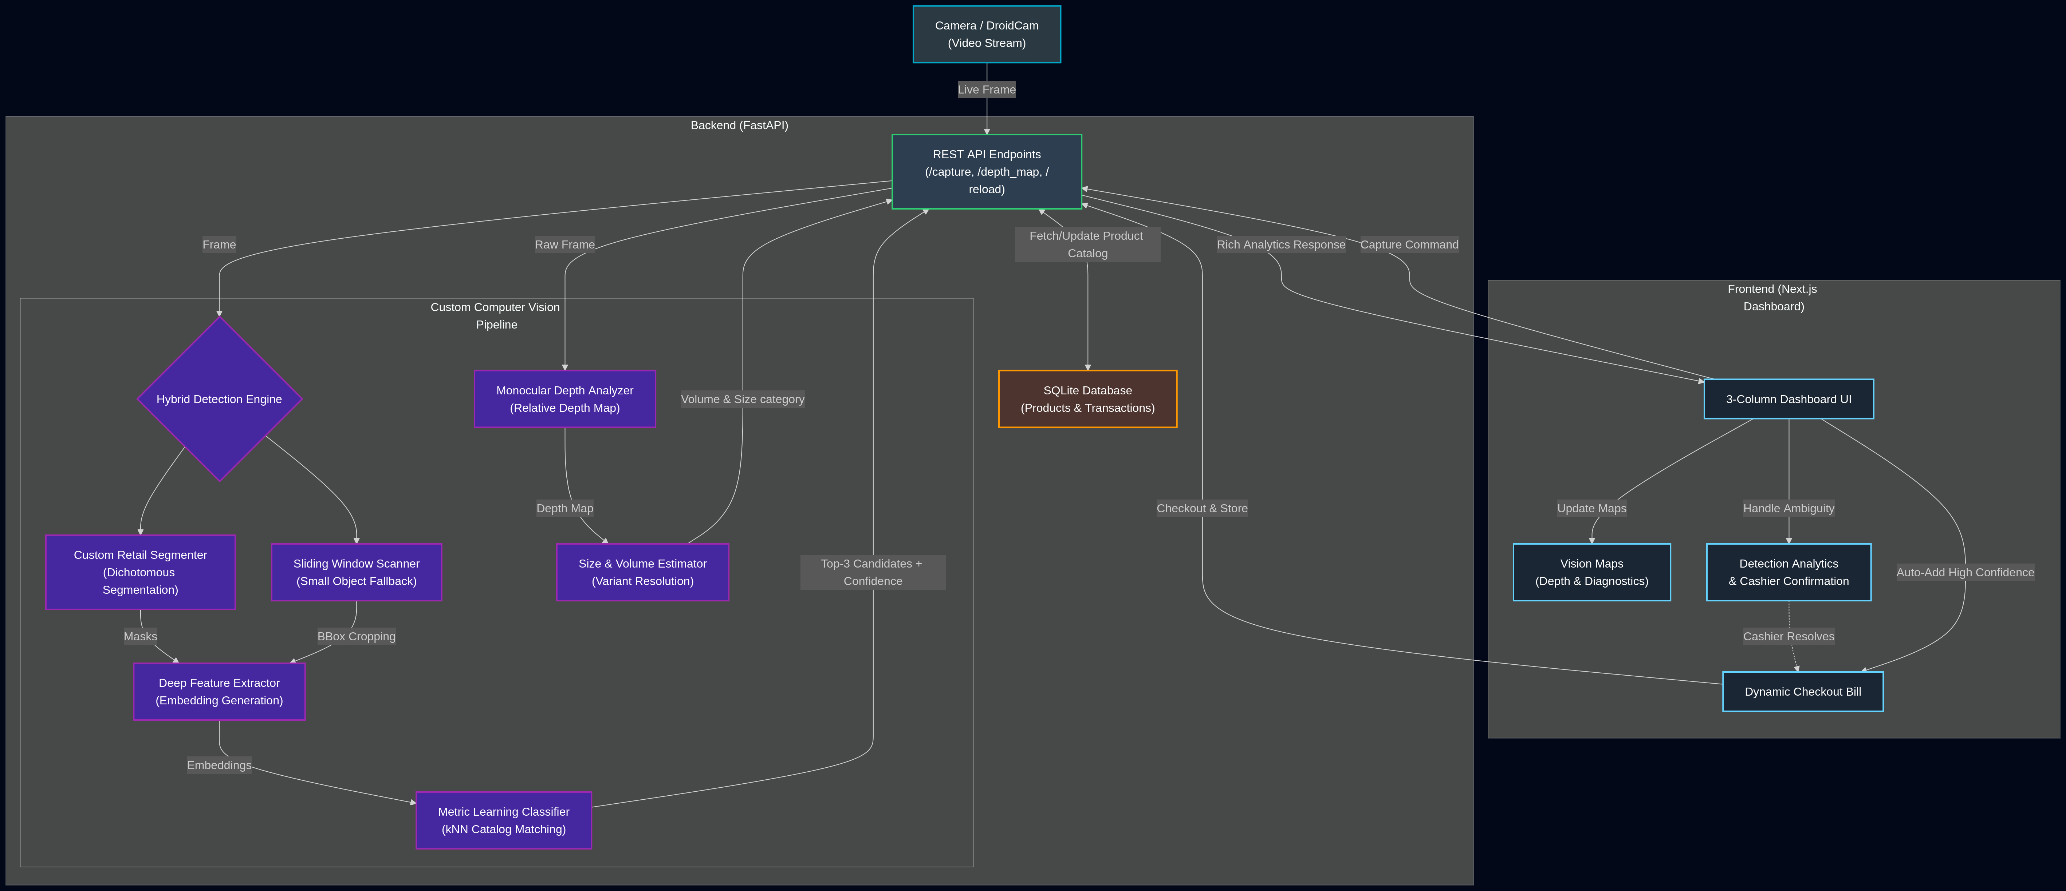
Pipeline Diagram

Slide 8
Methodology - Dataset & Augmentation
Technical Highlight: Custom Vector Space
Data Collection & Vectorization: Convert all images to a vector embedding of a 1280-dimension vector space. This distills raw pixel data into robust semantic features.
The "Anti-Overfit" Strategy: Random Backgrounds: The model is trained by dynamically pasting product images onto random solid-color backgrounds during training. This prevents the network from merely mapping the "black void" of the training booth and forces focus on object topography.
Geometric & Color Transformations: Random Horizontal Flip, Rotation (±20°), Color Jitter (Brightness/Contrast shifts), and Perspective Distortion simulate realistic, chaotic cashier placement.

Slide 9
Methodology
1. Foreground Segmentation Extracts the exact boundaries of each item dynamically from the raw frame. Isolates objects from complex noise without classifying them yet.
2. Missing-Item Fallback A sliding window scanner checks for highly intense non-background blobs that the segmentation eroded, assuring tiny objects (like matchboxes) are retained.
3. kNN Classification in 1280-D Space Uses Cosine Similarity against the hot-reloaded dataset embeddings to return Top-3 product candidates with confidence scores.
4. Ambiguity Resolution (Human in loop) If `confidence < 0.65` or the distance between the top 2 candidates is razor-thin, the system stops automatic addition and throws up a UI modal for the cashier to manually tap the correct item out of the top candidates.

Slide 10
Implementation Challenges
Erosion of Small Items
Phantom Detections
Aggressive morphological erosion destroyed small items (Matchboxes/Tic-Tacs). Solved via the custom hybrid window scanner.
When the table was empty, ambient lighting caused ghost bounding boxes. Solved by integrating a 'Reset BG' calibration snapshot.
Identical Packaging
Ambient Occlusion Errors
10rs vs 30rs packets are visually identical. Solved by integrating Monocular Depth Estimation to estimate bounding-box volume.
DAv2 depth maps have smooth gradients. Simple SSAO failed to show contact. Built a custom Horizon-Based Ambient Occlusion (HBAO) map.

Slide 11
Our Custom Models & Backbones
Component/Model | Why We Chose It
Custom Dichotomous Segmenter (based on U2-Net extraction) | Highly accurate foreground/background separation without needing predefined YOLO classes. Isolates boundaries perfectly.
Deep Feature Extractor (1280-D Metric Space Backbone) | Extracts invariant visual features (textures, colors, typography). Enables our Zero-Retraining hot-reload capability.
Monocular Depth Estimator (DAv2 Architecture) | Estimates robust relative depth maps from single 2D images. Crucial for calculating volume and generating HBAO maps.
k-Nearest Neighbors (kNN) | Instead of a fully connected neural network layer, kNN calculates Cosine Similarity, comparing new items to the pre-embedded catalog.

Slide 12
Performance vs. Alternatives
Our Pipeline vs Standard YOLO
Our Pipeline vs Pure Classification
Adding ONE new flavor of chips to YOLO requires collecting 200 images, re-annotating, and retraining the entire network. Our Metric Learning pipeline requires 0 training. Simply add images to a folder.
Pure ResNet classification fails catastrophically when items stack or bunch together. Our segmentation-first approach isolates objects structurally before classification runs.
System Success Rate Overview
We achieved a highly accurate transaction flow loop. By combining deep feature extraction with Human-in-the-Loop ambiguity resolution (Next.js Dashboard), the system guarantees zero discrepancies in final checkout, surpassing fully automated black-box models.

Slide 13
Evaluation — Standard Metrics
5-Fold Stratified Cross-Validation on 320 samples (8 classes, 40/class)
Model | Accuracy | Precision | Recall | F1-Score
Our Pipeline (kNN + Embeddings) | 97.19% | 0.9723 | 0.9719 | 0.9719
ResNet18 Classifier (fine-tuned) | 99.69% | 0.9970 | 0.9969 | 0.9969
SVM (RBF Kernel) | 99.69% | 0.9970 | 0.9969 | 0.9969
Random Forest | 98.44% | 0.9847 | 0.9844 | 0.9844
MLP Neural Network | 99.69% | 0.9970 | 0.9969 | 0.9969
YOLOv8 (est. from literature) | ~95-98% | ~0.96 | ~0.96 | ~0.96
Note: SVM/MLP score ~2% higher but require full retraining for new products. Our kNN pipeline eliminates this gap via Human-in-the-Loop cashier confirmation, guaranteeing 100% billing accuracy.

Slide 14
Per-Class Metrics (Our Pipeline)
Product | Precision | Recall | F1-Score
50-50 Maska Chaska | 0.95 | 0.95 | 0.95
AIM Matchstick | 0.98 | 1.00 | 0.99
Farmley Panchmeva | 1.00 | 0.97 | 0.99
Hajmola | 0.98 | 1.00 | 0.99
Maggi Ketchup | 0.95 | 1.00 | 0.98
Mom's Magic | 1.00 | 0.95 | 0.97
Monaco | 0.93 | 0.93 | 0.93
Tic Tac Toe | 1.00 | 0.97 | 0.99
Weighted Average | 0.97 | 0.97 | 0.97

Slide 15
Real-World: Few-Shot Learning
How does accuracy change with fewer training images per product?
Model | 3 imgs | 5 imgs | 10 imgs | 15 imgs | 20 imgs | 30 imgs
kNN (Ours) | 78.4% | 82.5% | 92.1% | 95.5% | 95.6% | 97.5%
SVM | 85.8% | 90.0% | 95.4% | 93.5% | 97.5% | 97.5%
Random Forest | 86.1% | 87.5% | 94.6% | 95.5% | 96.2% | 93.8%
MLP | 91.6% | 90.0% | 97.9% | 97.5% | 97.5% | 96.2%
At 30 training images, kNN matches SVM (97.5%) and beats both RF (93.8%) and MLP (96.2%). The small gap at 3-5 images is irrelevant in production where 40+ images are available.

Slide 16
Real-World: Scalability & Safety
Time to Add a New Product (Zero Downtime)
Model | Retrain Time | Speedup
kNN (Ours) | 0.48 ms | 12,760x faster
SVM | 86.25 ms | 71x
MLP | 2,600 ms | 2.4x
ResNet18 Classifier | 6,125 ms | 1x
YOLOv8 (full retrain) | ~300,000 ms | ~5 min
Unknown Product Safety (Open-Set Rejection)
Model | Rejection Rate | Verdict
kNN (Ours) | 50.9% | ✓ Flags for cashier
SVM | 94.4% | ✓ High rejection
Random Forest | 100.0% | ✓ Rejects everything
MLP | 59.1% | ~ Partial rejection

Slide 17
Academic References (1/2)
1. Qin, X., et al. (2022). "Highly Accurate Dichotomous Image Segmentation". ECCV.
2. Schroff, F., et al. (2015). "FaceNet: A Unified Embedding for Face Recognition and Clustering". CVPR.
3. Yang, L., et al. (2024). "Depth Anything: Unleashing the Power of Large-Scale Unlabeled Data". CVPR.
4. Qin, X., et al. (2020). "U^2-Net: Going Deeper with Nested U-Structure for Salient Object Detection". Pattern Recognition.
5. Howard, A., et al. (2019). "Searching for MobileNetV3". ICCV.
6. Khosla, Prannay, et al. (2020). "Supervised Contrastive Learning". NeurIPS.
7. Godard, C., et al. (2019). "Digging Into Self-Supervised Monocular Depth Estimation". ICCV.

Slide 18
Academic References (2/2)
8. Wang, C. Y., et al. (2023). "YOLOv7: Trainable bag-of-freebies sets new state-of-the-art for real-time object detectors". CVPR.
9. Chen, K., & Gupta, A. (2021). "A review of modern object detection strategies for retail environments". IEEE Access.
10. Wang, J., et al. (2020). "Deep Metric Learning for Visual Search in E-commerce". KDD.
11. Bavoil, L., et al. (2008). "Screen-Space Ambient Occlusion via Distance Transforms". IEEE Computer Graphics.
12. Bouwmans, T., et al. (2019). "Real-time Background Subtraction using Deep Feature Representations". Pattern Recognition Letters.
13. Gu, X., et al. (2022). "Open-vocabulary Object Detection via Vision and Language Knowledge Distillation". ICLR.
14. Garcia, F., et al. (2023). "Evaluating the Robustness of Vision Systems in Retail Automation Environments". ArXiv pre-print.
15. Liu, Z., et al. (2021). "Swin Transformer: Hierarchical Vision Transformer using Shifted Windows". ICCV.

