Slide 1
def __init__(Regression, Analysis):
Aditya Ram.B

Slide 2
Regression Analysis in Python
Introduction to ML
Why is statistics relevant to ML
What is the concept of regression
Types of Regressi0n
Linear Regression

Slide 3
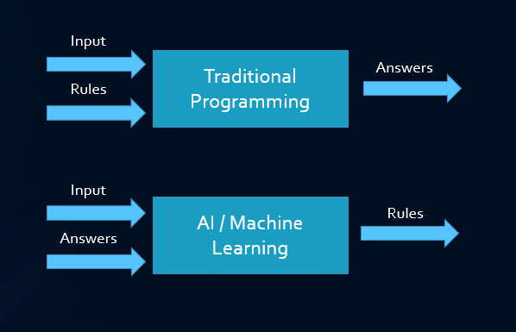
WHAT IS ML?
Machine learning is the study of computer algorithms that improve automatically through experience. It is seen as a subset of artificial intelligence.

Slide 4
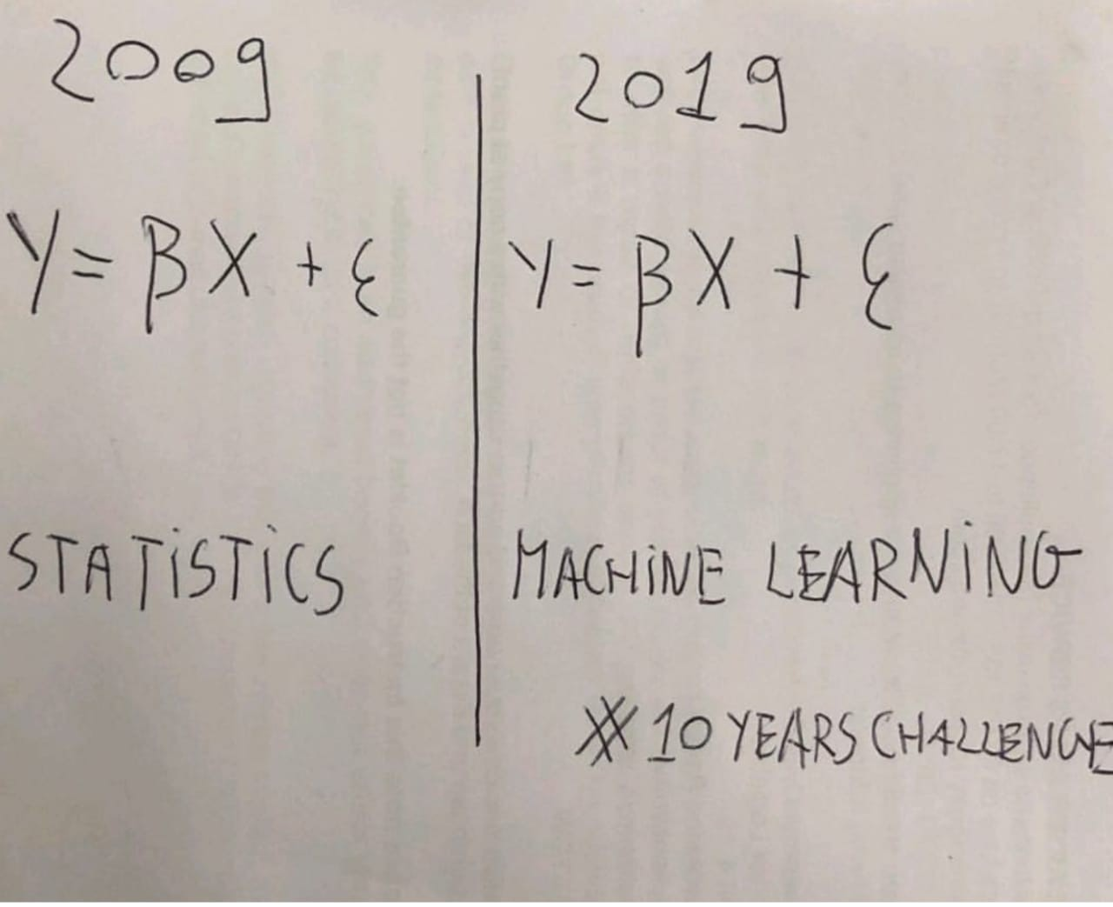
WHY IS STATISTICS RELEVANT?
First bullet point here
Second bullet point here
Third bullet point here

Slide 5
CORRELATION VS REGRESSION
CORRELATION
Correlation determines the association or dependency of two variables where there is no difference between both the variables.
REGRESSION
Regression establishes the relationship between an independent variance and a dependent variable where both the variables are different.

Slide 6
REGRESSION:
CONCEPT
Regression: helps in finding relationships between two points.
Simple linear regression is useful for finding relationship between two continuous variables. One is predictor or independent variable and other is response or dependent variable

Slide 7
TYPES OF REGRESSION
SIMPLE REGRESSION
MULTIPLE REGRESSION
INVOLVES ONLY TWO VARIABLES: A DEPENDENT VARIABLE AND ON EXPLANATORY VARIABLE
INVOLES A DEPENDENT VARIABLE AND MULTIPLE EXPLANATORY VARIABLES.

Slide 8
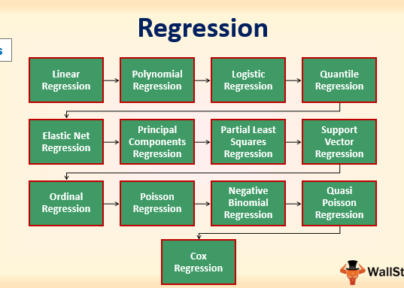
TYPES OF REGRESSION MODELS

Slide 9
A SMALL BRIEF ABOUT REGRESSION MODELS
.Linear
This can be expressed as the formula below and it measures the relationship between a dependent variable and one independent variable.
Y=mx1,x2,x…xn+e
Polynomial
In this method, the analysis is used to measure the relationship between single dependent factors and multiple independent variables.
Logistic
Here the dependent factor or variable is binary in nature. The independent variables can be continuous or binary. In multinomial logistic regression, we can afford to have more than two categories while choosing our independent variable.

Slide 10
CONTD
Quantile
This is an additive concept of linear regression and is primarily used when outliers and skewnes are present in the data.
Elastic Net
This is useful when one is handling very high correlated independent variables.
Support Vector
This can provide a solution to linear and non-linear models. It makes use of non-linear kernel functions to find the optimal solution for non-linear models.

Slide 11
LINEAR REGRESSION
.*Simple linear regression is useful for finding relationship between two continuous variables. One is predictor or independent variable and other is response or dependent variable.
*It looks for statistical relationship but not deterministic relationship. Relationship between two variables is said to be deterministic if one variable can be accurately expressed by the other, for example, using temperature in degree Celsius it is possible to accurately predict Fahrenheit.
*Statistical relationship is not accurate in determining relationship between two variables, for example, relationship between height and weight.

Slide 12
WHAT HAPPENS IN A REGRESSION?
Linear Regression establishes a relationship between dependent variable (Y) and one or more independent variables (X) using a best fit straight line (also known as regression line).
It is represented by an equation Y=a+b*X + e, where a is intercept, b is slope of the line and e is Residual( error) . This equation can be used to predict the value of target variable based on given predictor variable(s).
The difference between simple linear regression and multiple linear regression is that, multiple linear regression has (>1) independent variables, whereas simple linear regression has only 1 independent variable.

Slide 13
ASSUMPTIONS FOR LINEAR REGRESSION
Linear Relationship
Normal Distribution of error Terms for any given X.
Autocorrelation
Multicollinearity
Heteroskedasticity
Homoscedasticity

Slide 14
PREDICTED VALUES Vs EXPECTED VALUES.
Predicted, or fitted, values are values of y predicted by the least-squares regression line obtained by plugging in x1,x2,…,xn into the estimated regression line.
Expected value is a generic value that is expected throughout the distribution.

Slide 15
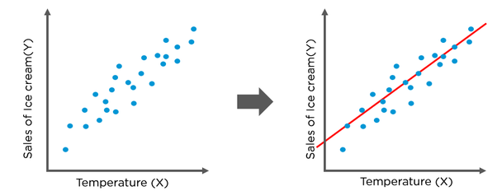
Oops…… almost forgot about that line of fit!!!!
A regression line a.k.a the line of fit is a straight line that describes how a response variable y changes as an explanatory variable x changes.
We often use a regression line to predict the value of y for a given value of x.
Okay but… what of the data points away from the line of fit???

Slide 16
Residuals.
When you perform simple linear regression (or any other type of regression analysis), you get a line of best fit.
The data points usually don’t fall exactly on this regression equation line; they are scattered around. A residual is the vertical distance between a data point and the regression line.
Each data point has one residual. They are positive if they are above the regression line and negative if they are below the regression line. If the regression line actually passes through the point, the residual at that point is zero.

Slide 17
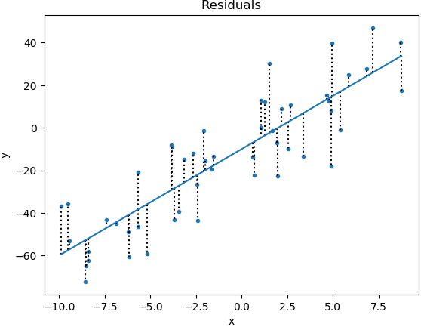
Some cool graphics for better understanding
Btw remember the “Y=a+b*X + e” the e is the residuals
As residuals are the difference between any data point and the regression line, they are sometimes called “errors.” Error in this context doesn’t mean that there’s something wrong with the analysis; it just means that there is some unexplained difference.
In other words, the residual is the error that isn’t explained by the regression line.

Slide 18
LEAST SQUARES
Least Squares regression:
Data exhibit a significant degree of scatter. The strategy is to derive a single curve that represents the general trend of the data.
The method of least squares is a standard approach to the approximate solution of overdetermined systems, i.e., sets of equations in which there are more equations than unknowns.
•"Least squares" means that the overall solution minimizes the sum of the squares of the errors made in the results of every single equation.
A least squares regression selects the line with the lowest total sum of squared prediction errors. This value is called the Sum of Squares of Error, or SSE.

Slide 19
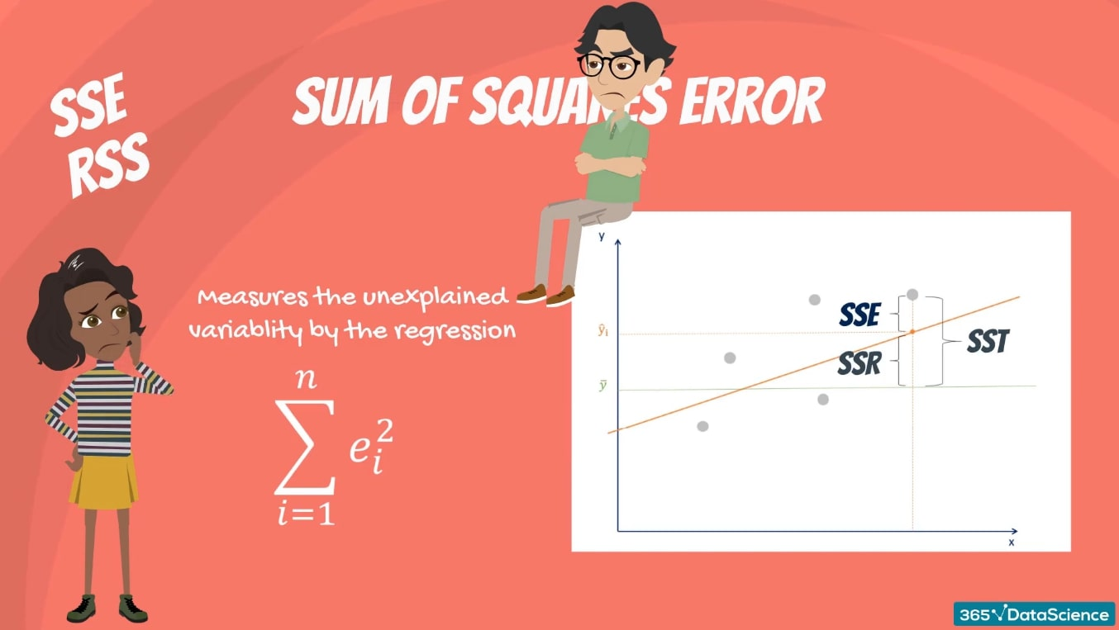
SUM OF SQUARES
The 3 Sums of Squares
There are three terms we must define. The sum of squares total(SST), the sum of squares regression(SSR), and the sum of squares error(SSE).

Slide 20
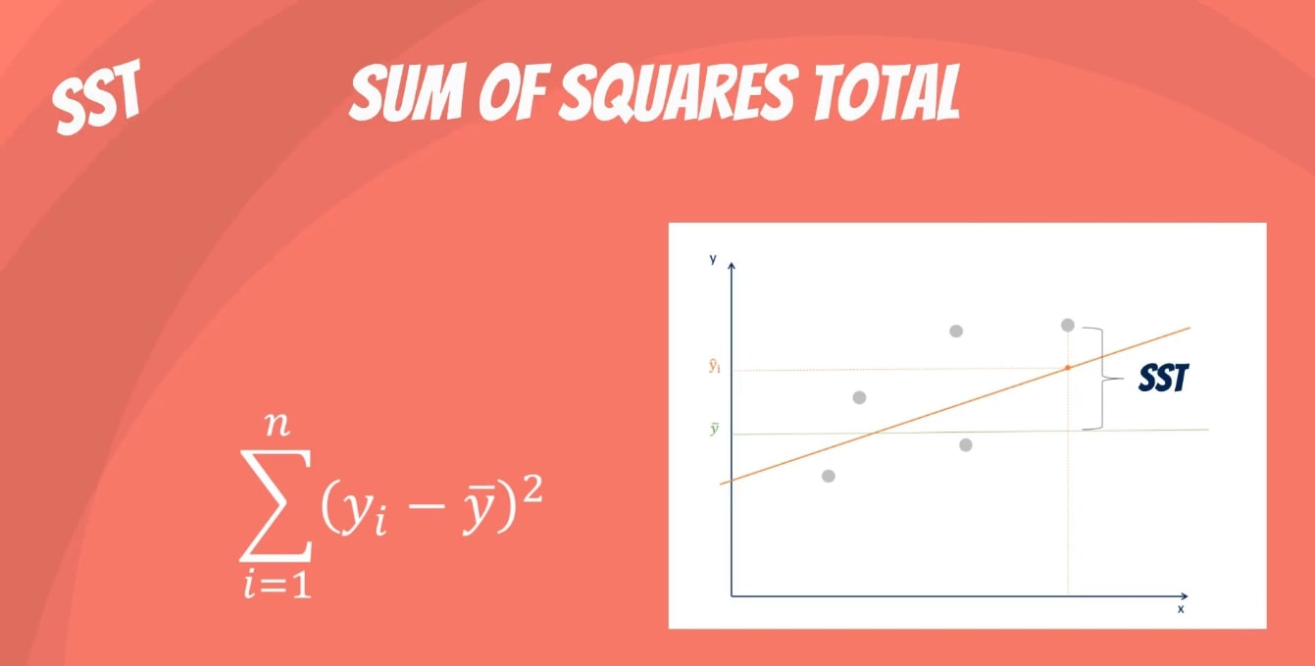
SST
.The sum of squares total, denoted SST, is the squared differences between the observed dependent variable and its mean.
.You can think of this as the dispersion of the observed variables around the mean – much like the variance in descriptive statistics
. It is a measure of the total variability of the dataset.
Side note: There is another notation for the SST. It is TSS or total sum of squares.

Slide 21
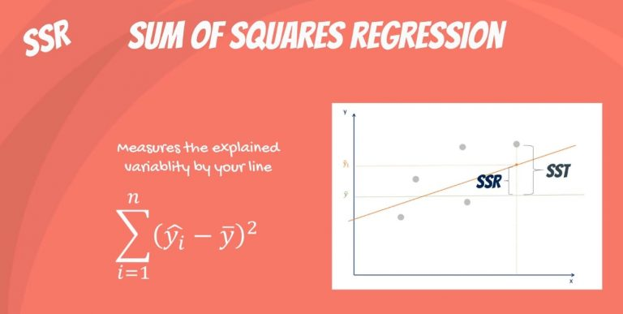
SSR
.The second term is the sum of squares due to regression, or SSR. It is the sum of the differences between the predicted value and the mean of the dependent variable. Think of it as a measure that describes how well our line fits the data.
.If this value of SSR is equal to the sum of squares total, it means our regression model captures all the observed variability and is perfect.
.Once again, we have to mention that another common notation is ESS or explained sum of squares.

Slide 22
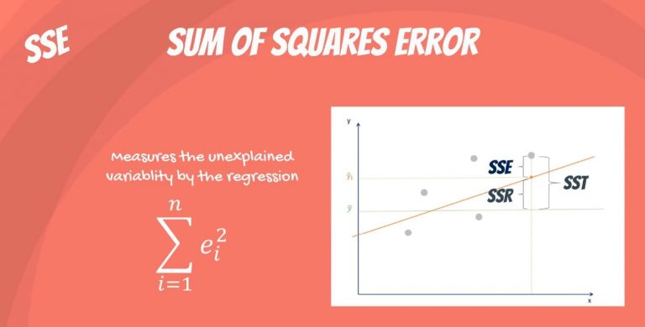
SSE
The last term is the sum of squares error, or SSE. The error is the difference between the observed value and the predicted value.
.We usually want to minimize the error. The smaller the error, the better the estimation power of the regression.
. Finally, we should add that it is also known as RSS or residual sum of squares. Residual as in: remaining or unexplained.

Slide 23
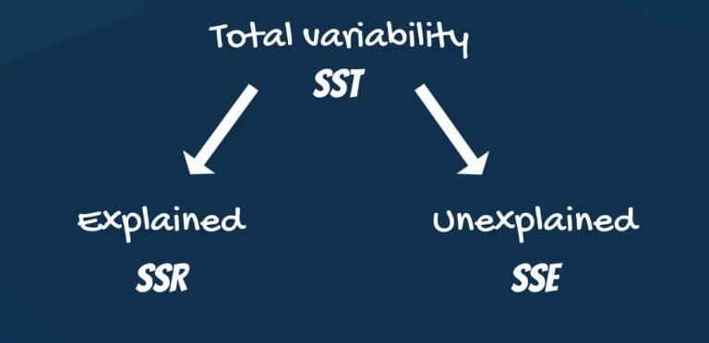
RELATION BETWEEN THE SUM OF SQUARES
Mathematically, SST = SSR + SSE.
Total Variability = Explained variability + Unexplained variability(The rationale is the following: the total variability of the data set is equal to the variability explained by the regression line plus the unexplained variability, known as error.)
.That implies =>Given a constant total variability, a lower error will cause a better regression.
Conversely, a higher error will cause a less powerful regression. And that’s what you must remember, no matter the notation

Slide 24
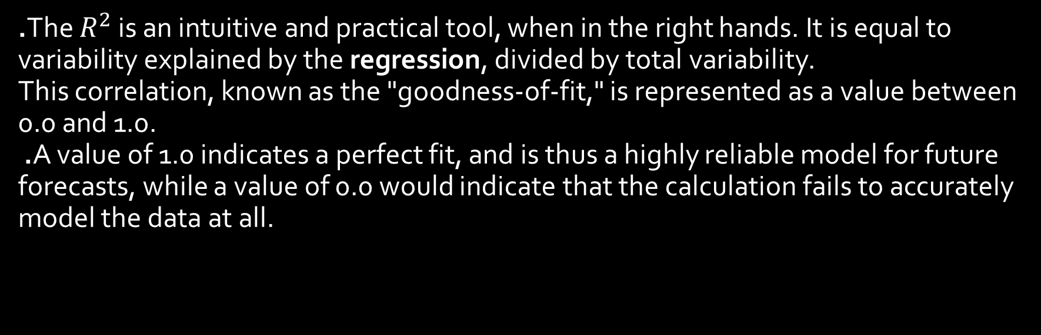
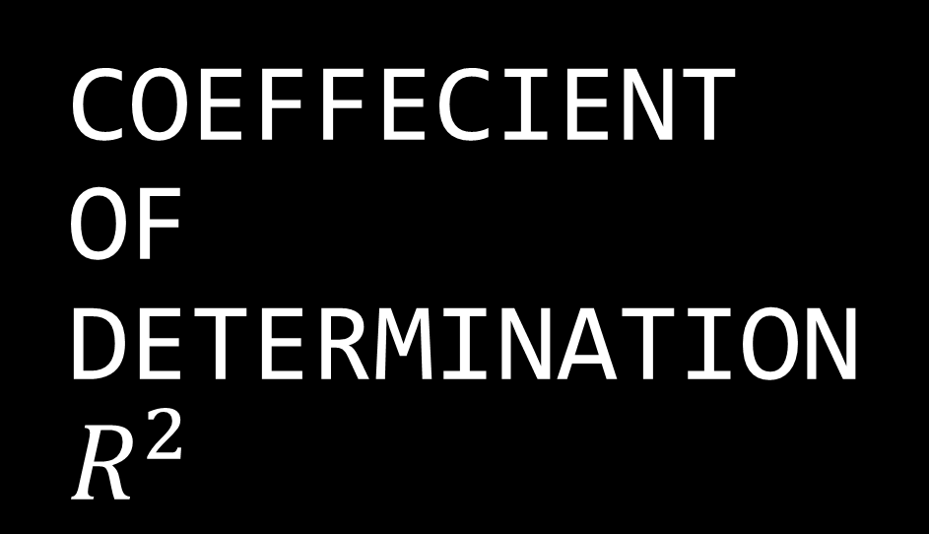
COEFFECIENT OF DETERMINATION$R^{2}$
.The $R^{2}$ is an intuitive and practical tool, when in the right hands. It is equal to variability explained by the regression, divided by total variability.
This correlation, known as the "goodness-of-fit," is represented as a value between 0.0 and 1.0.
.A value of 1.0 indicates a perfect fit, and is thus a highly reliable model for future forecasts, while a value of 0.0 would indicate that the calculation fails to accurately model the data at all.

Slide 25
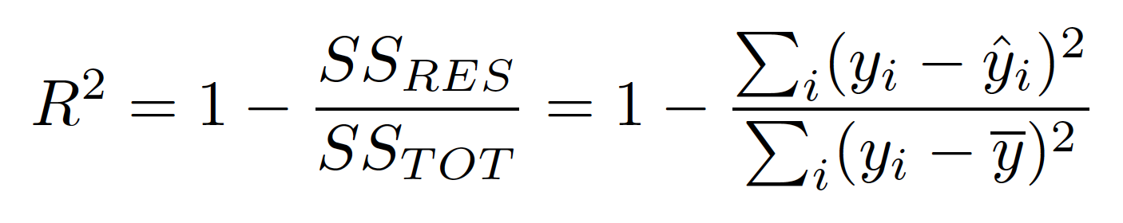
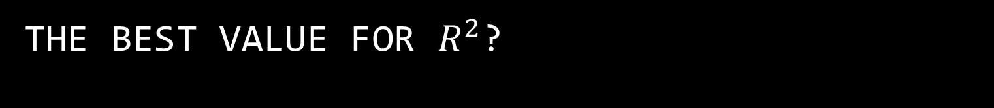
THE BEST VALUE FOR $R^{2}$?
Assume a value of 0.20, for example, suggests that 20% of the dependent variable is predicted by the independent variable, while a value of 0.50 suggests that 50% of the dependent variable is predicted by the independent variable, and so forth.
Unfortunately, regressions explaining the entire variability are rare. What we usually observe are values ranging from 0.2 to 0.9.
The R-squared measures the goodness of fit of our model. The more factors we include in our regression, the higher the R-squared.

Slide 26
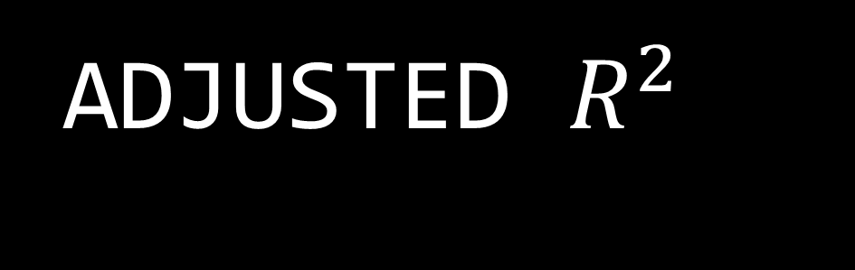
ADJUSTED $R^{2}$
.The R-squared measures how much of the total variability is explained by our model.
.Multiple regressions are always better than simple ones. This is because with each additional variable that you add, the explanatory power may only increase or stay the same.
.The adjusted R-squared considers exactly that. It measures how much of the total variability our model explains, considering the number of variables.
.The adjusted R-squared is always smaller than the R-squared, as it penalizes excessive use of variables.

Slide 27
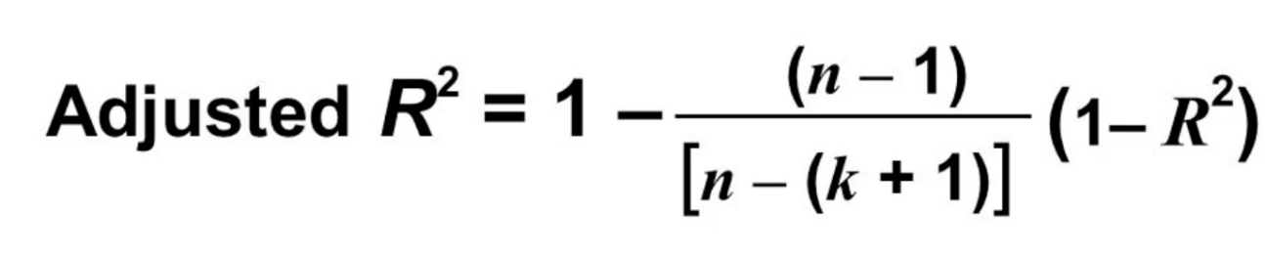
ADJUSTED R²
However, there is one main difference between R² and the adjusted R²: R² assumes that every single variable explains the variation in the dependent variable.
The adjusted R² tells you the percentage of variation explained by only the independent variables that actually affect the dependent variable.
n is the number of points in your data sample.
k is the number of independent regressors, i.e. the number of variables in your model, excluding the constant.

Slide 28
WHAT AND HOW DOES ADJUSTED R² PENALIZE?
The adjusted R² will penalize you for adding independent variables (K in the equation) that do not fit the model.
Why? In regression analysis, it can be tempting to add more variables to the data as you think of them. Some of those variables will be significant, but you can’t be sure that significance is just by chance. The adjusted R² will compensate for this by that penalizing you for those extra variables
While values are usually positive, they can be negative as well. This could happen if your R² is zero; After the adjustment, the value can dip below zero. This usually indicates that your model is a poor fit for your data. Other problems with your model can also cause sub-zero values, such as not putting a constant term in your model.

Slide 29
PERKS ADJUSTED R² HAS OVER R²
.R² increases with every predictor added to a model. As R² always increases and never decreases, it can appear to be a better fit with the more terms you add to the model. This can be completely misleading.
. Similarly, if your model has too many terms and too many high-order polynomials you can run into the problem of over-fitting the data. When you over-fit data, a misleadingly high R² value can lead to misleading projections.

Slide 30
WE TALKED ABOUT THE “FITTING A MODEL”,
BUT CAN THAT BE FATHOMED?CAN THAT AFFECT THE PERFORMANCE OF THE MODEL?
Generalization is the model’s ability to give sensible outputs to sets of input that it has never seen before
OVERFITTING:
                When we run our training algorithm on the data set, we allow the overall cost (i.e. distance from each point to the line) to become smaller with more iterations. Leaving this training algorithm run for long leads to minimal overall cost. However, this means that the line will be fit into all the points (including noise), catching secondary patterns that may not be needed for the generalizability of the model.
UNDERFITTING:
                We want the model to learn from the training data, but we don’t want it to learn too much (i.e. too many patterns). One solution could be to stop the training earlier. However, this could lead the model to not learn enough patterns from the training data, and possibly not even capture the dominant trend. This case is called underfitting.

Slide 31
OVERFITTING VS UNDERFITTING
Overfitting is the case where the overall cost is really small, but the generalization of the model is unreliable. This is due to the model learning “too much” from the training data set.
If you add a data point which is not present in the trained set of data then the model will crash
Underfitting is the case where the model has “ not learned enough” from the training data, resulting in low generalization and unreliable predictions.
The model as such wont be great to go with as the prediction would be weak.

Slide 32
THE BIAS-VARIENCE TRADEOFF
BIAS occurs when an algorithm has limited flexibility to learn the true signal from the data(overfitting).
VARIANCE refers to an algorithm’s sensitivity to specific-sets of training data(underfitting)
.If our model is too simple and has very few parameters then it may have high bias and low variance. On the other hand if our model has large number of parameters then it’s going to have high variance and low bias.
.So we need to find the right/good balance without overfitting and underfitting the data.
.This tradeoff in complexity is why there is a tradeoff between bias and variance.
An algorithm can’t be more complex and less complex at the same time.

Slide 33
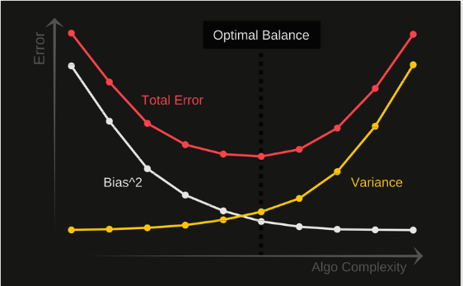
Total Error
To build a good model, we need to find a good balance between bias and variance such that it minimizes the total error.
TOTAL ERROR=BIAS² + VARIANCE+IRREDUCIBLE ERROR.
Irreducible error is a noise than can’t be reduced by algorithms, rather can be reduced by better data cleaning.

Slide 34
OPTIMIZATION
Optimization is always the ultimate goal whether you are dealing with a real life problem or building a software product.
Optimization basically means getting the optimal output for your problem.
Optimization in machine learning has a slight difference. Generally, while optimizing, we know exactly how our data looks like and what areas we want to improve. But in machine learning we have no clue how our “new data” looks like, let alone try to optimize on it.
So in machine learning, we perform optimization on the training data and check its performance on a new validation data.

Slide 35

GRADIENT DESCENT
Gradient descent is a first-order iterative optimization algorithm for finding the minimum of a function. To find a local minimum of a function using gradient descent, one takes steps proportional to the negative of the gradient (or approximate gradient) of the function at the current point. Gradient descent is also known as steepest descent.
Take an example:

Slide 36
3TYPES OF GRADIENT DESCENT
1.BATCH: computes the gradient of the cost function w.r.t. to the parameters θθ for the entire training dataset. It supports maximum vectorization, but if the data is large, it cannot fit into the memory.(θ=θ−η⋅∇θJ(θ))
2.STOCHASTIC: Stochastic gradient descent (SGD) in contrast performs a parameter update for each training example of the training dataset. It cannot exploit vectorization, since it has to iterate through all the training examples and make an update for each training example. It also shows a lot of fluctuations before converging to the solution(θ=θ−η⋅∇θJ(θ;x(i);y(i)))
3.MINI-BATCH:Mini-batch gradient descent finally takes the best of both approaches and performs an update for every mini-batch of n training examples. The size of the mini-batch is usually in the power of 2 like 64 or 256, but can vary depending on the applications. It exploits vectorization to some extent and its update is also fast. It is the most preferred way of update among these variants(θ=θ−η⋅∇θJ(θ;x(i:i+n);y(i:i+n)))

Slide 37
BTW WHAT’S A LEARNING RATE??
The size of these steps taken in gradient descent is called the learning rate.
With a high learning rate we can cover more ground each step, but we risk overshooting the lowest point since the slope of the hill is constantly changing.
With a very low learning rate, we can confidently move in the direction of the negative gradient since we are recalculating it so frequently. A low learning rate is more precise, but calculating the gradient is time-consuming, so it will take us a very long time to get to the bottom.

Slide 38
Evaluation Metrics or Loss functions for Regression
If you are working on a regression-based machine learning model like linear regression, one of the most important tasks is to select an appropriate evaluation metric. These are also called loss functions.
The top 4 used metrics are:
Mean absolute error (MAE)
Mean squared error (MSE)
Root mean square error (RMSE)
Root mean square log error (RMSLE)

Slide 39
MEAN ABSOLUTE ERROR(MAE)
In simple terms, mean absolute error is the sum of absolute/positive errors of all values. So, if there are 5 values in our data set, we find out the difference between the actual value and predicted values for all 5 values and take their positive value. So even if the difference between actual and predicted value is negative, we take positive value for calculation.
So we take the positive value of all errors, add them and find out their mean.
MAE is the sum of absolute differences between actual and predicted values. It doesn’t consider the direction, that is, positive or negative.
When we consider directions also, that is called Mean Bias Error (MBE), which is a sum of errors(difference).
The MAE is a linear score which means that all the individual differences are weighted equally in the average.

Slide 40
MEAN SQUARED ERROR(MSE)
The Mean Squared Error (MSE) is a measure of how close a fitted line is to data points. For every data point, you take the distance vertically from the point to the corresponding y value on the curve fit (the error), and square the value.
Then you add up all those values for all data points, and, in the case of a fit with two parameters such as a linear fit, divide by the number of points minus two.** The squaring is done so negative values do not cancel positive values.
The smaller the Mean Squared Error, the closer the fit is to the data. The MSE has the units squared of whatever is plotted on the vertical axis.

Slide 41
ROOT MEAN SQUARED ERROR(RMSE)
Square root of MSE yields root mean square error (RMSE). So it’s formula is quite similar to what you have seen with mean square error, it’s just that we need to add a square root sign to it;
It is the standard deviation of error (residual error).
it indicates the spread of the residual errors. It is always positive, and a lower value indicates better performance. Ideal value would be 0 but it is never achieved.
Effect of each error on RMSE is directly proportional to the squared error therefore, RMSE is sensitive to outliers and can exaggerate results if there are outliers in the data set.

Slide 42
ROOT MEAN SQUARED LOG ERROR(RMSLE)
Root mean squared log error is basically RMSE but calculated at logarithmic scale. So, if you understand the above mentioned 3 evaluation metrics, you won’t have any problem understanding RMSLE or most other evaluation metric or loss functions used in regression-based machine learning model.
While calculating RMSLE, 1 is added as constant to actual and predicted values because they can be 0 and log of 0 is undefined.

Slide 43
Regularization
This is a form of regression, that constrains/ regularizes or shrinks the coefficient estimates towards zero. In other words, this technique discourages learning a more complex or flexible model, so as to avoid the risk of overfitting.
A simple relation for linear regression looks like this. Here Y represents the learned relation and β represents the coefficient estimates for different variables or predictors(X).
Y ≈ β0 + β1X1 + β2X2 + …+ βpXp
The fitting procedure involves a loss function, known as residual sum of squares or RSS. The coefficients are chosen, such that they minimize this loss function.

Slide 44

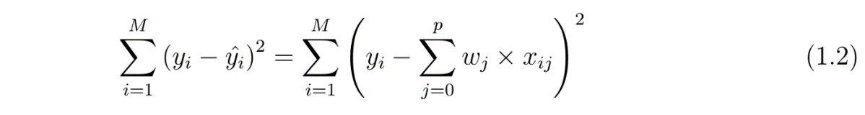
Continued…
Now, this will adjust the coefficients based on your training data. If there is noise in the training data, then the estimated coefficients won’t generalize well to the future data. This is where regularization comes in and shrinks or regularizes these learned estimates towards zero.
COST FUNCTION:

Slide 45
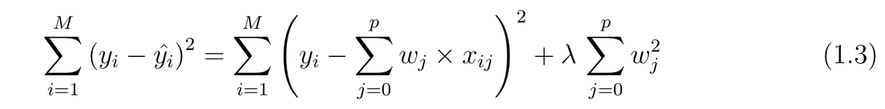
RIDGE REGRESSION
In ridge regression, the cost function is altered by adding a penalty equivalent to square of the magnitude of the coefficients.
So ridge regression puts constraint on the coefficients (w). The penalty term (lambda) regularizes the coefficients such that if the coefficients take large values the optimization function is penalized. So, ridge regression shrinks the coefficients and it helps to reduce the model complexity and multi-collinearity.

Slide 46
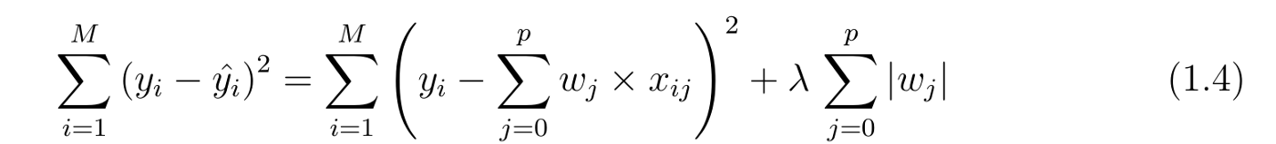
LASSO REGRESSION
The cost function for Lasso (least absolute shrinkage and selection operator) regression can be written as:
Just like Ridge regression cost function, for lambda =0, the equation above reduces to cost equation . The only difference is instead of taking the square of the coefficients, magnitudes are taken into account. This type of regularization (L1) can lead to zero coefficients i.e. some of the features are completely neglected for the evaluation of output.
So Lasso regression not only helps in reducing over-fitting but it can help us in feature selection. Just like Ridge regression the regularization parameter (lambda) can be controlled

Slide 47
DEGREES OF FREEDOM
The term degrees of freedom (df) refers to the number of independent sample points used to compute a statistic minus the number of parameters estimated from the sample points.
For simple linear regression (one independent and one dependent variable), the degrees of freedom (DF) is equal to: DF = n - 2 where n is the number of observations in the sample. Test statistic. The test statistic is a t statistic (t) defined by the following equation.
t = b1-β1 / SE
where b1 is the slope of the sample regression line, and SE is the standard error of the slope.

Slide 48
STANDARD ERROR
The Standard Error of a regression is a measure of its variability. It can be used in a similar manner to standard deviation, allowing for prediction intervals. y ± 2 standard errors will provide approximately 95% accuracy, and 3 standard errors will provide a 99% confidence interval.
Standard Error is calculated by taking the square root of the average prediction error. Standard Error= √SSE/N-k Where n is the number of observations in the sample and k is the total number of variables in the model. The output of a simple regression is the coefficient β and the constant A.
The equation is then: ∆y∆x y = A + β * x + ε
where ε is the residual error. β is the per unit change in the dependent variable for each unit change in the independent variable. Mathematically: β =∆y/∆x

Slide 49
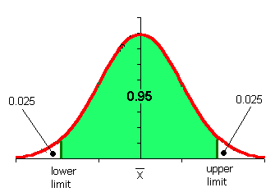
CONFIDENCE INTERVALS
A confidence interval is how much uncertainty there is with any particular statistic. Confidence intervals are often used with a margin of error. It tells you how confident you can be that the results from a poll or survey reflect what you would expect to find if it were possible to survey the entire population. Confidence intervals are intrinsically connected to confidence levels.

Slide 50
CONFIDENCEC INTERVALS VS CONFIDENCE LEVELS
Confidence levels are expressed as a percentage (for example, a 95% confidence level). It means that should you repeat an experiment or survey over and over again, 95 percent of the time your results will match the results you get from a population (in other words, your statistics would be sound!).
Confidence intervals are your results ,usually numbers.
For example, you survey a group of pet owners to see how many cans of dog food they purchase a year. You test your statistics at the 99 percent confidence level and get a confidence interval of (200,300). That means you think they buy between 200 and 300 cans a year. You’re super confident (99% is a very high level!) that your results are sound, statistically.

Slide 51

Class end:
Lets see some pseudo real time examples in python.

