Slide 1
Design and FPGA Implementation of an Efficient Partial Product Generator and Accumulation Unit
for Multipliers
Chinmay Kushwah • Aditya Raghunath Raut • MD. Hasan Usmani • Mohd. Wasim Akhtar
Under the Guidance of Dr. Laxmi Pradhan Kumre
Department of Electronics & Communication Engineering
Maulana Azad National Institute of Technology, Bhopal | April 2026
ECE-327 Project-1 | Group No. 16

Slide 2
Introduction & Motivation
Why Multipliers Matter
Digital multipliers are fundamental arithmetic components that determine critical system metrics:
Speed — Combinational delay & timing closure
Area — LUT & silicon footprint
Power — Static & dynamic consumption
Problem in conventional multipliers
Multiplication generates many Partial Products.
This leads to:
Larger Hardware area
Higher power consumption
Increased computation delay
DSP & Signal Processing
Image Processing
Cryptography
Neural Network Accelerators
Embedded & IoT

Slide 3
Objectives & Scope
1
Implement three 8-bit signed multiplier architectures — Array, Booth Radix-2, Booth Radix-4 — in Verilog HDL using a structural and modular design approach
Simulate all three designs using Vivado XSim simulator and verify functional correctness through testbench
2
Synthesize and physically implement Radix-4 on the Xilinx Artix-7 FPGA (Basys-3) under timing and area constraints
3
Compare architectures on three key metrics: area utilization (LUT count), timing performance (WHS & WNS), and power consumption
4
5
Identify the most suitable architecture for area-constrained, power-critical, and speed-balanced design scenarios

Slide 4
Methodology & Tools
Tools & Materials
Design Workflow
Verilog HDL
Verilog HDL Coding
Structural & behavioral modeling of all submodules
▼
Xilinx Vivado
Simulation (XSim)
RTL elaboration, synthesis, place & route, timing & power analysis
▼
Synthesis
Basys-3 (Artix-7)
Target FPGA platform for physical implementation & verification
▼
Place & Route
Vivado XSim
Functional simulation via manually crafted testbenches
▼
FPGA Implementation

Slide 5
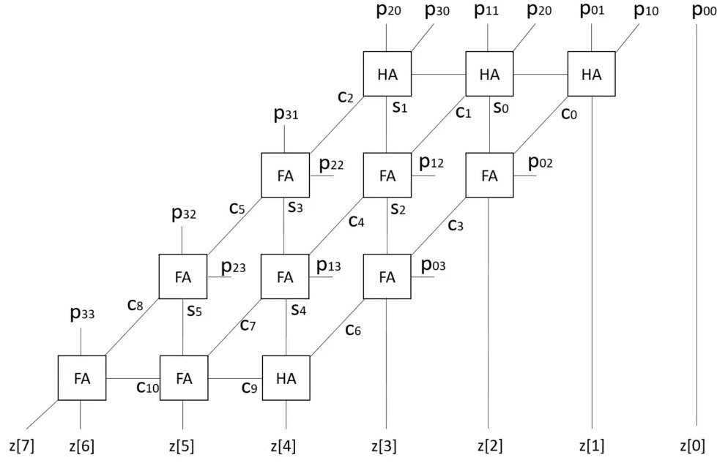
Array (Shift-and-Add) Multiplier
Operating Principle
Generates partial products by ANDing each bit of the multiplier with the full multiplicand. Partial products are then accumulated using a tree of half-adders and full-adders.
For n-bit multiplication:
Produces n partial products
Each is an AND of multiplicand with one multiplier bit Accumulation via cascaded adder rows Limited to unsigned numbers in basic form
Characteristic: Simple logic → maps efficiently to FPGA LUT primitives with minimal overhead
Result: 65 LUTs | WNS = 3.332 ns | Dynamic Power = 3 mW

Slide 6
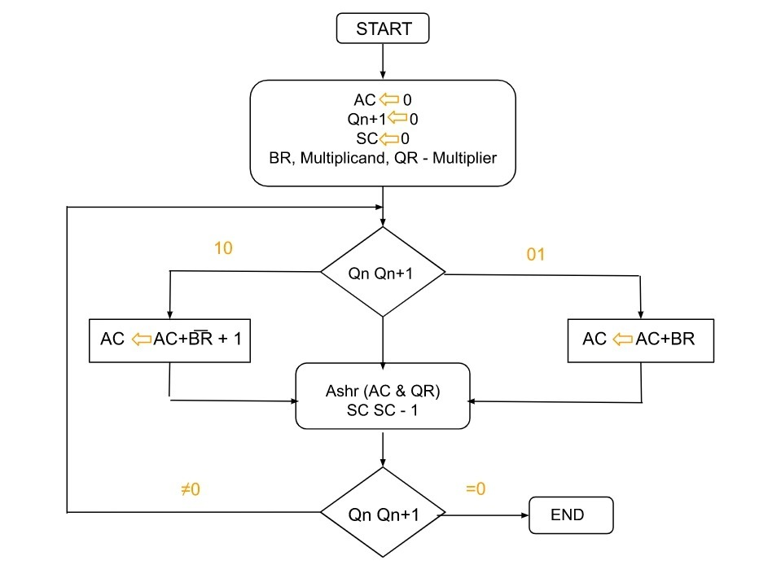
Booth Radix-2 Multiplier
Algorithm Overview
Examines overlapping pairs of multiplier bits (Qi, Qi-1), generating partial products from {0, +M, -M}. Encoding Rules:
0←0 → Right shift only
1←1 → Right shift only
0←1 → Perform A + M, then Right shift
1←0 → Perform A − M (add −M), then Right shift Example: 7 × 6 = 42 → 4 steps, result 00101010 Trade-off: Per-bit encoder logic cannot be fully absorbed into carry chain → highest LUT count (124) but lowest dynamic power (1 mW).
Result: 124 LUTs | WNS = 2.326 ns | Dynamic Power = 1 mW (Lowest)

Slide 7
Modified Booth Radix-4 Multiplier
Algorithm Overview
Examines overlapping groups of 3 multiplier bits (Q(i), Q(i-1), Q(i-2)) simultaneously, generating n/2 partial products from {0, +M, −M, +2M, −2M}.
Encoding Steps:
1. Extend sign bit by 1 position (ensure even n)
2. Append 0 at LSB of multiplier
3. Take 3-bit groups; map to {0, ±M, ±2M}
4. Negation via 2's complement; ×2 by left shift
Note: ±2M operations require extra shifting/sign-inversion logic → higher switching activity than expected.
Q | Q(i-1) | Q(i-2) | Output
0 | 0 | 0 | +0
0 | 0 | 1 | +M
0 | 1 | 0 | +M
0 | 1 | 1 | +2M
1 | 0 | 0 | −2M
1 | 0 | 1 | −M
1 | 1 | 0 | −M
1 | 1 | 1 | +0
Result: 70 LUTs | WNS = 3.009 ns | Dynamic Power = 5 mW (Highest due to encoder complexity)

Slide 8
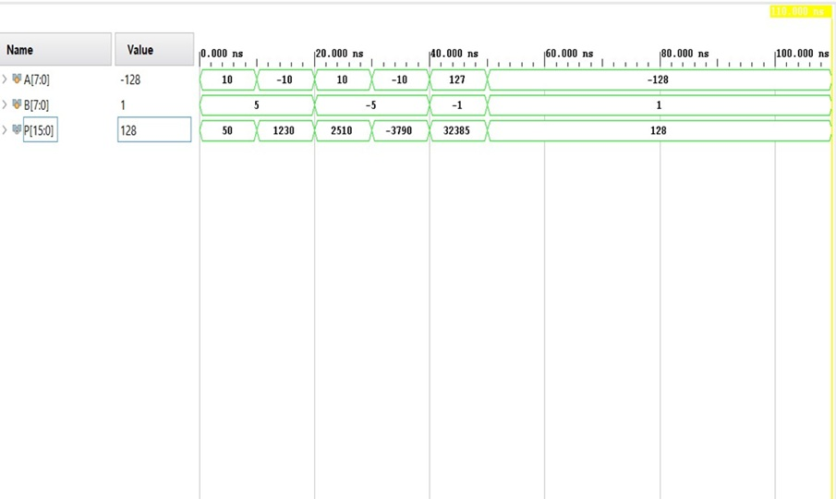
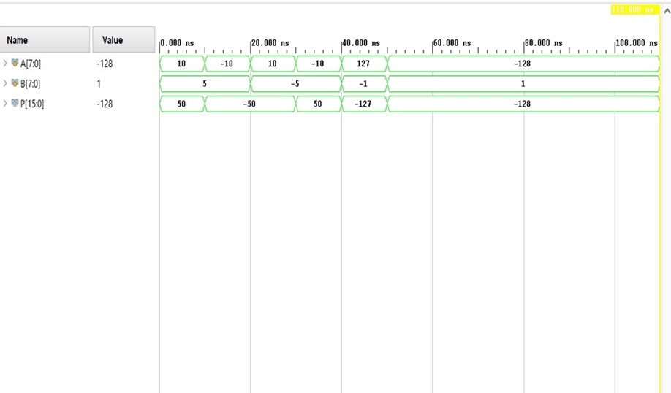
Simulation Results
All three multiplier architectures were simulated using Vivado XSim. Testbenches covered both positive and negative 8-bit signed operand combinations. All designs produced correct 16-bit signed products.
Array Multiplier
Booth Encoded Multiplier
Limitation of Array Multiplier: It gives wrong result in case of signed numbers
That’s why Booth encoding based multipliers are used for accurate signed multiplication.

Slide 9
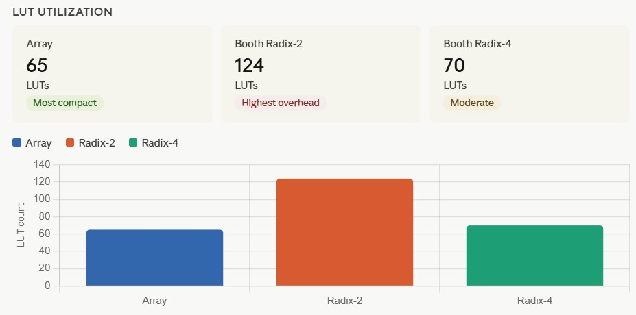
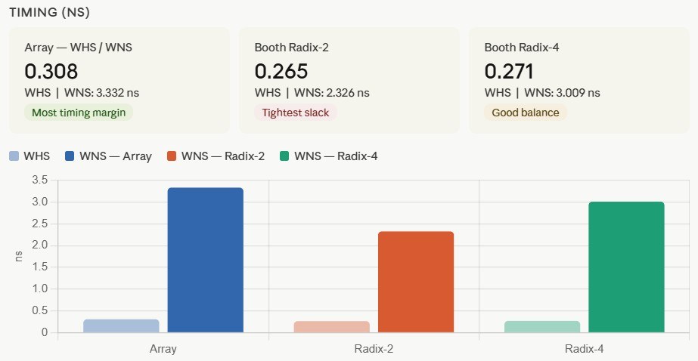
LUT Utilization & Timing Analysis
The Array multiplier is compact because adders map efficiently to dedicated carry chains (CARRY4), reducing LUT count. Radix-2 uses more LUTs due to extra Booth encoding logic that cannot be optimized into carry chains. Radix-4 balances both, reducing partial products but adding encoder complexity, so LUT count is close to Array.

Slide 10
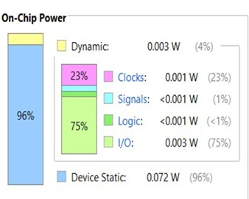
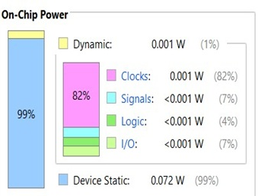
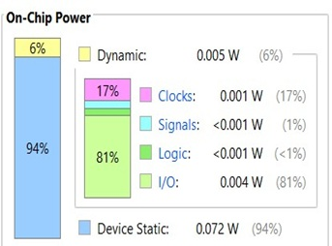
Power Analysis
Parameter | Array | Booth Radix-2 | Booth Radix-4
Total On-Chip Power | 0.075 W | 0.073 W | 0.076 W
Device Static Power | 0.072 W | 0.072 W | 0.072 W
Dynamic Power | 3 mW | 1 mW | 5 mW
Static Fraction | 96% | 99% | 94%
Array Multiplier
Booth Radix-2
Booth Radix-4

Slide 11
Comparative Summary
Metric | Array Multiplier | Booth Radix-2 | Booth Radix-4
LUTs (Area) | 65 | 124 | 70
WNS (Timing Margin) | 3.332 ns | 2.326 ns | 3.009 ns
Dynamic Power | 3 mW Moderate | 1 mW | 5 mW
Best Suited For | Area-constrained designs | Power-critical systems | Speed-area balanced designs
On FPGA, dynamic power depends on switching activity, not just number of operations.
Radix-2 shows lowest power due to sparse switching from Booth encoding (many operations become zero). Array multiplier is moderate, as switching is high but optimized carry chains reduce power. Radix-4 shows highest power due to complex encoder logic and higher internal switching, also influenced by Vivado estimation.

Slide 12
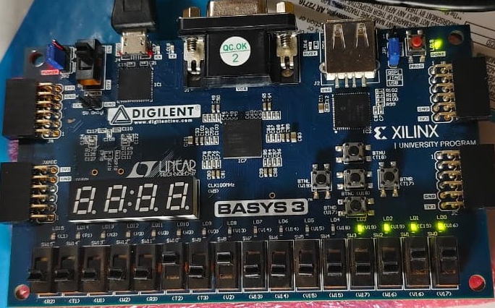
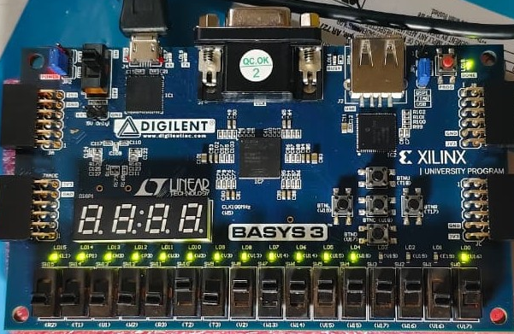
Hardware Implementation on Basys-3 FPGA
Platform: Xilinx Artix-7 (XC7A35T) — Digilent Basys-3 Board
Interface: SW0–SW7 → Operand A | SW8–SW15 → Operand B | LD0–LD15 → 16-bit Product
Test Case 1
Test Case 2
Test Case 1: A=+3 (00000011), B=+5 (00000101) → Product = +15 → 0000000000001111 Test Case 2: A=−3 (11111101), B=+5 (00000101) → Product = −15 → 1111111111110001

Slide 13
Conclusion & Future Work
Conclusions
Future Work
Array Multiplier — Best area (65 LUTs) and timing margin (WNS 3.332 ns) Ideal for area-constrained designs
Extend to 16-bit & 32-bit operands
SAIF-based accurate power estimation
Booth Radix-2 — Lowest dynamic power (1 mW) at cost of highest LUT count (124) → best for power-critical systems
ASIC implementation for gate-level comparison
Booth Radix-4 — Balanced area (70 LUTs) and timing (WNS 3.009 ns); unexpected highest dynamic power (5 mW) due to ±2M encoder complexity
Pipelined variants — evaluate throughput
FPGA technology mapping significantly influences results — theoretical gate-level advantages do not always translate to synthesis outcomes
Wallace Tree vs CSA trade-off analysis
MAC unit integration for DSP data path
Group 16 • MANIT Bhopal • April 2026 • ECE-327

