Slide 1
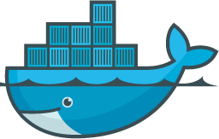

Docker
Docker
By
ADITYA PRABHAKARA

Slide 2

Docker
Introducing Myself
Aditya S P (sp.aditya@gmail.com)
Freelance trainer and technologist
Boring Stuff about me:
•14+ years of experience in development and training
•Started with Java, moved to Android and now working on Big Data Technologies
Interesting Things about me:
•Actually Nothing !

Slide 3
Docker
Getting to know you

Slide 4

Docker
Agenda
Introduction to DevOps
Docker

Slide 5

Docker
Course Objectives
A good understanding of DevOps
A good fundamental understanding of Docker
Where does docker fit in the DevOps Movement
Understanding of role of Kubernetes

Slide 6
Docker
Chapter: Introduction

Slide 7
Docker
Docker – Why Now?
Speed. Speed. Speed.
Value movement dev-> test-> prod easier and faster
Portability
Reduce complexity of developing code for distributed systems
Reduce complexity of deploying code to the cloud
For a later time - Docker's founder and CTO Solomon Hykes
https://www.youtube.com/watch?v=3N3n9FzebAA

Slide 8
Sharing: snapshots
Bang for buck
Repeated success
1 – 2min
Sharing: images
Bang for buck
Repeated success: dockerfile
ms
IP1
IP2
IP1
IP2
VM1:
Ubuntu 1GB 1C
Tomcat 1GB 1C
apps
IP2
VM2
Ubuntu 1GB 1 C
Mysql 1GB 1C
Apps
Ubuntu
Tomcat
IP2
Ubuntu
Mysql
Ubuntu
Mysql
Ubuntu
Mysql
VMM hypervisor, vmware, virtual box
docker engine
Host machine
6GB 6 core
Host machine
6GB 6 core

Slide 9
Windows system
IP2
IP1
IP2
IP2
Ubuntu
Tomcat
Ubuntu
Mysql
minikube start
Ubuntu
Mysql
Ubuntu
Mysql
docker engine
docker version
Host machine – linux VM 192.168.99.101 ( minikube )
6GB 6 core
Virtual Box

Slide 10
Docker hub
4
nginx
5
3
Local cache
Windows system
1
docker engine
docker containerun nginx
2
nothing
minikube start
Host machine – linux VM 192.168.99.101 ( minikube )
6GB 6 core
Virtual Box

Slide 11
Windows system Nw 11
80
192.168.
172.17.0.2
Host machine – linux VM 192.168.99.101 ( minikube )
6GB 6 core
docker0
8081
Virtual Box

Slide 12
UFS : Unified file system
Soft link 22B
wars
nginx
File: installed packages
tomcat
tomcat
myapp
File: FS`

Slide 13
alpine
alpine
From docker hub
openjdk
mysql
al_apache2
From Dockerfile
Tomcat
Cmd Start.sh
kafka
app
From Dockerfile
Service1
service2

Slide 14
Docker
Docker – Different Versions
https://www.docker.com/get-docker
Community Edition and Enterprise Edition
Stable and Edge
Stable vs. Edge Cont.
Edge (beta) released monthly,
Stable quarterly
Edge gets new features first, but only supported for a month
Stable rolls in three months of Edge features

Slide 15
Mysql
/var/lib/mysql
VM
1TB
1TB
/var/lib/docker/volumes/mysql_db/_data
/mnt/sda2
/mnt/sda3
/var/lib/docker/volumes/6b842b5ada8b84c14d4f13f38a894f9bae8d68e3cd1936eaab46def572d56be8/_data

Slide 16
Docker
Docker – Setup
Docker toolbox install

Slide 17
Docker
Docker – initial commands
docker version
verified it's working
docker info
most config values
docker command line structure
docker (options)

Slide 18
Docker
Chapter: Container

Slide 19
Docker
Container
Basic Building block
Let us get a container running and then we will connect the dots
Execute the command
docker container run nginx

Slide 20
Docker
Container
They are not really mini vms. They are processes
They get their own logical filepath, process space
They exit when the process stops
Some docker container command examples
docker top
docker container ls
docker container stop

Slide 21
Docker
First Container Run:What just happened?

Slide 22
Docker
Knowing more about a Container
docker container stats <container id>
docker container inspect <container id>
docker container top <container id>

Slide 23
Docker
Interactive Container
docker container run –it nginx bash
docker container exec –it <container id>
Try this out !
“alpine” is light weight linux distribution , run an alpine container interactively

Slide 24
Docker
Chapter: Images

Slide 25
Docker
What is an image
Application binaries
Application dependencies
Some meta data about what to run and how to run
Not a full fledged OS – No kernel No drivers
Where are these images stored?

Slide 26
Docker
Image vs Container
An image is an application we want to run
A container is an instance of the image running as a process
Multiple containers can run using the same image
A bad analogy but helps to get the point across : an image is like a “.exe” file
Container is application that runs when we click on that “.exe”

Slide 27
Docker
Introduction to docker hub
What is Docker Hub
How to find images
How do we say an image is good!
Versions of images
What are official images
Download images

Slide 28
Docker
docker container run
Look for image locally in image cache
If nothing exists, then look in image repository
Downloads the image related to the tag
Creates a new container based on that image
Provides a virtual ip on a private network inside docker engine
Publishes a port if specified
Starts the process in the container using the CMD in the image Dockerfile

Slide 29
Docker
Working with images
Pull an image
Pull based on a tag

Slide 30
Docker
Images and layers
Union file system concept
Layers of files and meta data
docker image history nginx
Saves space as it reuses the layers

Slide 31
Docker
Layered Visualization

Slide 32
Docker
Image and push
An image has no real name as such
It is uniquely identified through user/image:tag
I can retag an existing image and push to my repository
Only official images do not have username every other image has a user id behind it

Slide 33
Docker
Chapter: Networking

Slide 34
Docker
Container Network
An image has no real name as such
Each container connected to a private virtual network "bridge"
Each virtual network routes through NAT firewall on host IP
All containers on a virtual network can talk to each other without -p
Best practice is to create a new virtual network for each app:
network “my_weblayer" for mysql and php/apache containers
network “my_mongo_rest" for mongo and nodejs containers

Slide 35
VM on which docker is running
container1
container2
May3_network2
May3_network

Slide 36
ng3exc
Ng1
bridge
Ng2
Myhostnetwork
myhost2network
Link ng2 myhost2network ng1

Slide 37
Host only 1
NAT
Host only 2
192.169.2.1
10.1.10.1
192.168.2.1
192.168.2.2
Host only 1
Host only 2
Host only 1
192.169.2.1:8080
wifi
192.168.2.1:8080

Slide 38
Docker
Docker network commands
docker network ls
docker network inspect bridge
Check the containers running
Check the ip address
docker network create my_own_network

Slide 39
Docker
Chapter: Docker File

Slide 40
Docker
Docker Building Images
Dockerfile basics
FROM (base image)
ENV (environment variable)
RUN (any arbitrary shell command)
EXPOSE (open port from container to virtual network)
CMD (command to run when container starts)
docker image build (create image from Dockerfile)

Slide 41
Docker
Chapter: Persistent Data

Slide 42
Docker
Container lifetime and data
Containers are usually meant to be immutable and ephemeral
Immutable == unchanging
Ephemeral == temporary or throwable
Immutable infra – only redeploy containers
Currently data is present as long as the container is not destroyed
Persistent data can be achieved by two ways
1. Volume
2. Bind Mounts

Slide 43
Docker
Volume and Bind Mounts
Volumes : special location outside of container UFS
Bind Mounts :
Sharing or
Link container path to host path

Slide 44
Docker
Volume
VOLUME command in the Dockerfile
Override with docker run –v /path/in/container
Bypasses the Union File System and stores in the alt location on host
Includes its own management commands under docker volume
Connect to none, one or multiple containers at once
Not subject to commit, save or export commands
They have a unique id. But if you assign a name its then a named volume

Slide 45
Docker
Bind mounting
Mapsa host file or directory to a container file or directory
Basically just two locations pointing to the same file
Skips UFS and host files overwrite any in container
Not a Dockerfile code. It has to be mentioned during the container run

Slide 46
Docker-machine => VM
Mysql:ubuntu
Mysql:centos

Slide 47
Docker
Volume and Bind Mounts
docker container run -d --name mysql -e MYSQL_ALLOW_EMPTY_PASSWORD=True mysql
docker volume ls
docker volume inspect
docker container run -d
--name mysql -e MYSQL_ALLOW_EMPTY_PASSWORD=True
-v mysql-db:/var/lib/mysql mysql

Slide 48
Docker
Chapter: Docker Compose

Slide 49
Docker
Why?
Configure relationships between containers
Save our docker container run settings in easy to read file
Create one-liner developer environment startups
Comprised of
A YAML formatted file that describes
Containers
Networks
Volumes
A CLI took docker-compose used for local dev/test automation with YAML files

Slide 50
Docker
docker-compose.yml
Its own versions, 1,2,2.1,3,3.1
YAML file can be used with docker-compose command for local docker sutomation
docker-compose.yml is default name but can be changed

Slide 51
Docker
docker-compose CLI
CLI tool comes with docker (has to be downloaded for linux)
Not really production grade but ideal for dev and test
Two most common commands
docker-compose up
docker-compose down
Very easy for developer onboarding

Slide 52
Docker
version: '3.1'
services:
servicename: nginx
image: nginx
volumes:
- .:/usr/share/nginx/html
ports:
- '8095:80'

Slide 53
Docker
Chapter: Swarm - Introduction

Slide 54
Docker
Swarm
Automate container lifecycle
Scale out/in/up/down
Recreate containers if they fail –resilience
Blue/green deploy
Cross-node virtual networks
Run containers on trusted servers
Ability to store secrets, keys, passwords

Slide 55
Docker
Swarm Mode
Clustering solution built inside docker
Not enabled by default
New commands once enabled
Docker swarm
Docker node
Docker service
Docker stack
Docker secret
docker swarm init => to enable swarm

Slide 56
Kubernetes
Chapter: Kubernetes

Slide 57
Kubernetes
Kubernetes
Opensource orchestration system for Docker containers
Schedule containers on a cluster of machines
Run multiple containers
Run long running services
Kubernetes will manage the state of these containers
Start on specific nodes
Restart a container when it gets killed
Can manage one to 1000’s of nodes

Slide 58
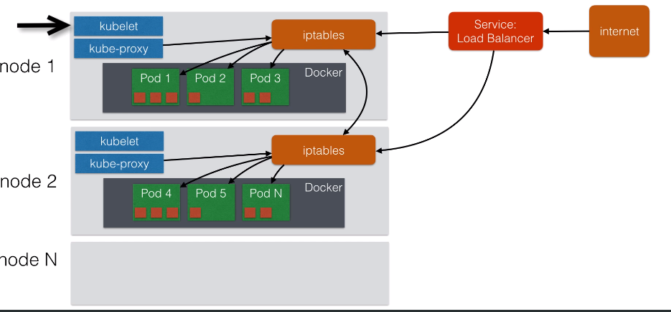
Kubernetes
Kubernetes – arch overview

Slide 59
Kubernetes
Running Kubernetes
Minikube – is a tool that makes it easy to run Kubernetes locally
Minikube runs a single node k-cluster inside a linux vm
Its aimed for dev and testing

Slide 60
Kubernetes
Kubernetes - Pod
A pod is an application running on Kubernetes
A pod can contain one or more tightly coupled containers
The app can communicate easily with each other using their local port numbers

Slide 61
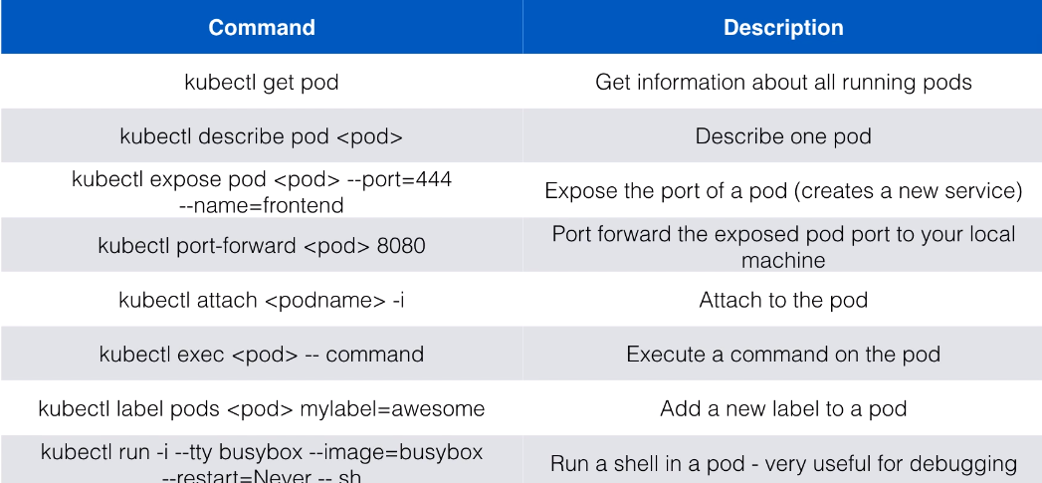
Kubernetes
Kubernetes - Pod

Slide 62
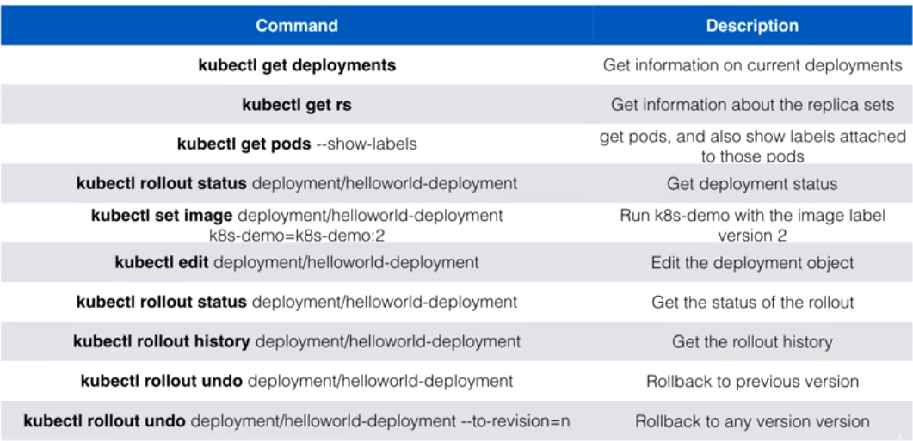
Kubernetes
Kubernetes - Deployments

Slide 63
Kubernetes
Kubernetes – Replication Controller
If application is stateless it can be easily horizontally scaled
Stateless => doesn’t write local files or keep local sessions
Databases for instance are stateful and cant be split over multiple instances
Web applications can be made stateless
Session management needs to be done outside the container
Scaling can be done using replicatin controller
Replication contrller will ensure a specified number of pod replicas will run at all times
Pods created with rc will automatically be replced if they fail
Using rc is also a way to make sure atleast one pod is running by setting the replica to 1

Slide 64
Kubernetes
Kubernetes – RS
Deployments make use of replication set
RS => next gen RC
Supports a new selector that can do selection based on filtering according
to a set of values

Slide 65
Kubernetes
Kubernetes – Deployments
A deployment declaration in k8s allows you to do app deployments and updates
Define the state of the application
K8s will make sure the cluster matches the desired state
Just using RC or RS makes the deployment cumbersome
With a Deployment you can
Create a deployment (deploy an app)
Update a deployment (deploy a new version)
Do rolling updates ( zero downtime)
Roll back to previous version
Paue or resume

Slide 66
Kubernetes
Kubernetes – Services
Pods are disposable entities. They come and go
RC and RS will create/terminate pods during scaling operations
Pods should never be accessed directly but always through a service
A service is the logical bridge between the pods and other services or end-users

Slide 67
Kubernetes
Kubernetes – Services
Creating a service will create an endpoint for the pods
A cluster ip: A vertual IP address only reachabled from within the cluster
A NodePort: a port that is the same on each node that is also reachable externally
A load balancer: created by the cloud provider that will route external traffic
to every node on the NodePort (ELB on AWS)
By default a service can run between ports 30000-32767 but this can be changed by
Adding –service-node-port-range argument to the kube-apiserver
10.99.246.20

Slide 68
Kubernetes
Kubernetes – Services Discovery
DNS is a built-in service launched automatically using the addon manager
DNS service can be used within pods to find other services running on the same cluster
Multiple containers within 1 pod don’t need this service as they can contact directly
A container in the same pod can connect using localhost:port
We require a Service definition to make the DNS work

Slide 69
Kubernetes
Kubernetes – DNS working
POD1
POD2
IP: 10.12.0.12
IP: 10.12.0.14
Container
Service:app2
Container
Service:app1
App1-service has address 10.12.0.12
App2-service has address 10.12.0.14
app2-service gets a fqdn as app2-service.default.svc.cluster.local
app1-service gets a fqdn as app1-service.default.svc.cluster.local
“default” is the namespace . Pods can be launched in different namespaces

Slide 70
Kubernetes
Kubernetes – DNS working
POD1
POD2
IP: 10.12.0.12
IP: 10.12.0.14
Container
Service:app2
Container
Service:app1
/etc/reolv.conf on pods has a way to reach services

Slide 71
Kubernetes
Kubernetes – Ingress
Ingress is a solution that allows inbound connections to the cluster
An alternative to external locadbalancer on nodeports
Ingress allows you to easily eexpose services that need to be accessible from outside
We can run our own ingress controller within the kubernetes cluster
There are default ingress controllers available or we can write out own

Slide 72
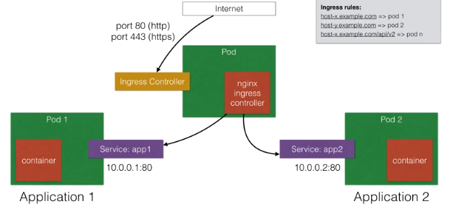
Kubernetes
Kubernetes – Ingress

Slide 73
Kubernetes
Kubernetes – Ingress
Ingress is a solution that allows inbound connections to the cluster
An alternative to external locadbalancer on nodeports
Ingress allows you to easily eexpose services that need to be accessible from outside
We can run our own ingress controller within the kubernetes cluster
There are default ingress controllers available or we can write out own

Slide 74
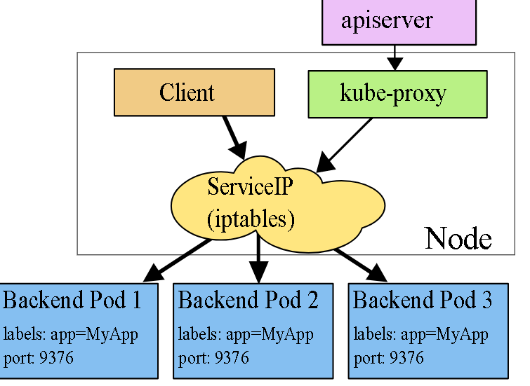

Slide 75
Kubernetes
Docker 12 factor
12factor.net

Slide 76
Kubernetes
DockerDevOps
Implementing Docker is not DevOps
Docker sits with the rest of automation and enables the DevOps Process
You will still require Cloud or VM provisioning
Use Docker with Agile’s iterative style of development

Slide 77
Accounts
Products
Comments
Users
Ecommerce
pod
container
Accounts
Products
Comments
nginx
nginx
nginx
users
nginx

Slide 78
loadbalancer
p1
volume

Slide 79
Kubernetes
Docker - downside
Docker is not a fix all
Bare metal is always faster than VM is faster than container
Patterns of development have begun and takes time to evolve and mature
Best used for REST Api’s and stateless machines
Persistent data storage is complicated

Slide 80
Kubernetes
CE VS EE
Docker open source
Docker CE
Docker EE
DIY
Stable and Edge
Unsupported
Supported by a network of companies viz Microsoft, Alibaba, IBM etc
Can get your product Docker certified
Docker datacenter
Docker security scanning – vulnerability
Container management - registry
Run certified images

Slide 81
registry
Kubernetes master
Apiserver
Control plane
Join token
Mesh network
Node1
Docker
Nfs mounts
Node2
Private registry
Docker
Nfs mounts

