Slide 1
DECEPTION DETECTION
Under the guidance of Prof. Md Shad Akhtar
Group - 23
Aditya Sahai (MT24009)
Sharad Jain (MT24138)
Shreyas Rajendra Gore (MT24087)

Slide 2
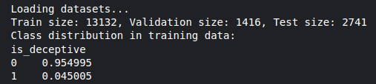
DATASET
Reference : https://aclanthology.org/2020.acl-main.353.pdf
Dataset : QANTA Diplomacy Deception Detection
Domain : Based on the board game Diplomacy, the dataset captures strategic deception in long-term player relationships
Size & Structure: Contains 17,289 annotated messages across multiple games. Each message is labeled by the sender (intended truthfulness) and receiver (perceived truthfulness).
Rich Context: Includes in-game metadata like year, season, country, and power dynamics — essential for modeling both linguistic and social aspects of deception.
Evaluation Metrics: Performance is measured using Macro F1 and accuracy, with models compared to human baselines in lie detection ability.
Highly Unbalanced Dataset !!
How we handled it ?
Data Augmentation
Oversampling
Weighted Sampling

Slide 3
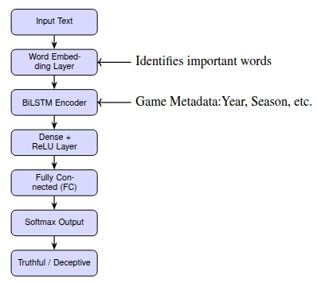
BASELINE - 1: BiLSTM with Attention
Input: Processed in-game messages + metadata
Embedding: Learned word embeddings
Sequence Modeling: BiLSTM to capture contextual information
Attention Mechanism: To highlight important parts of the message
Metadata Fusion: Metadata features projected and concatenated with attention output
Loss Function: Focal Loss (γ=2.0) to handle class imbalance.
Optimization: Adam + ReduceLROnPlateau scheduler, L2 regularization

Slide 4
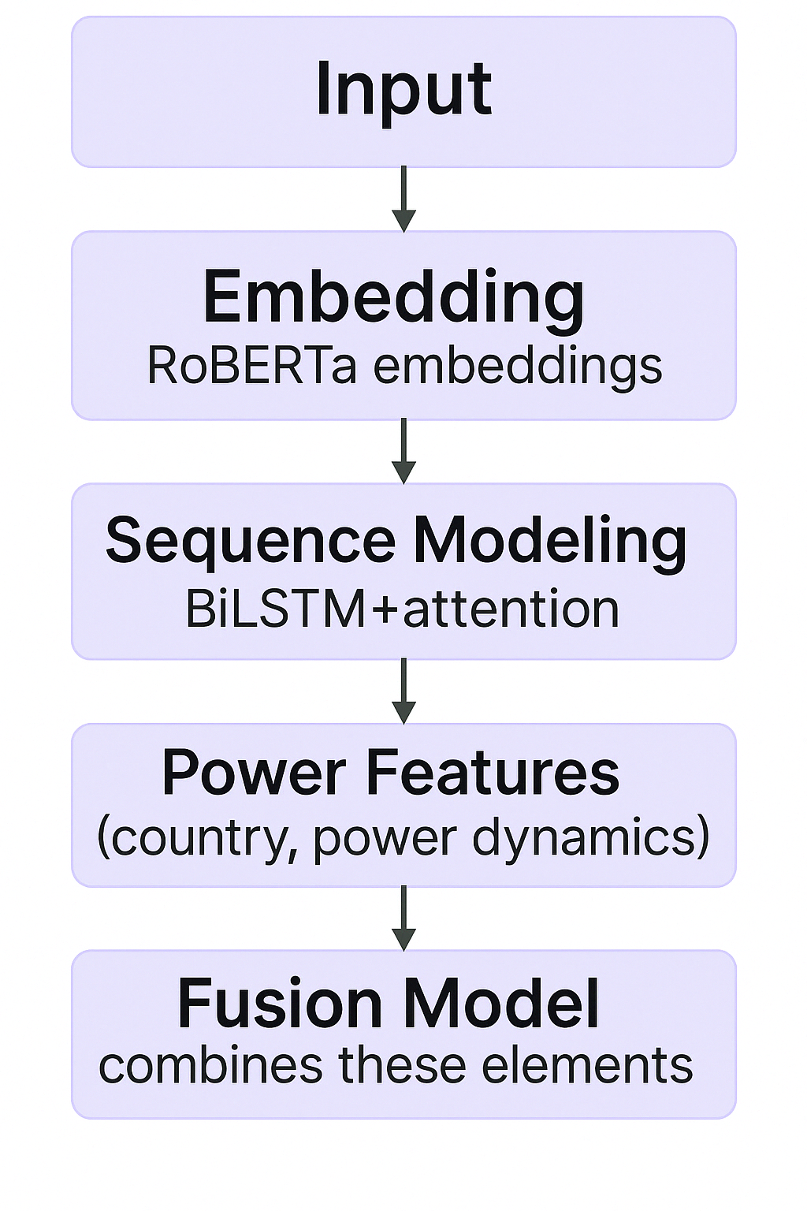
BASELINE - 2: BiLSTM with Attention + Power + RoBERTa
Input: Processed in-game messages + metadata
Embedding: RoBERTa contextual embeddings to capture rich semantic representations of each message
Sequence Modeling: BiLSTM to capture contextual information
Attention Mechanism: To highlight important parts of the message
Metadata Fusion: Power-related metadata is projected through a dense layer and concatenated with the attention output to form a unified representation
Loss Function: Focal Loss to handle class imbalance
Optimization: Adam + ReduceLROnPlateau scheduler, L2 regularization

Slide 5
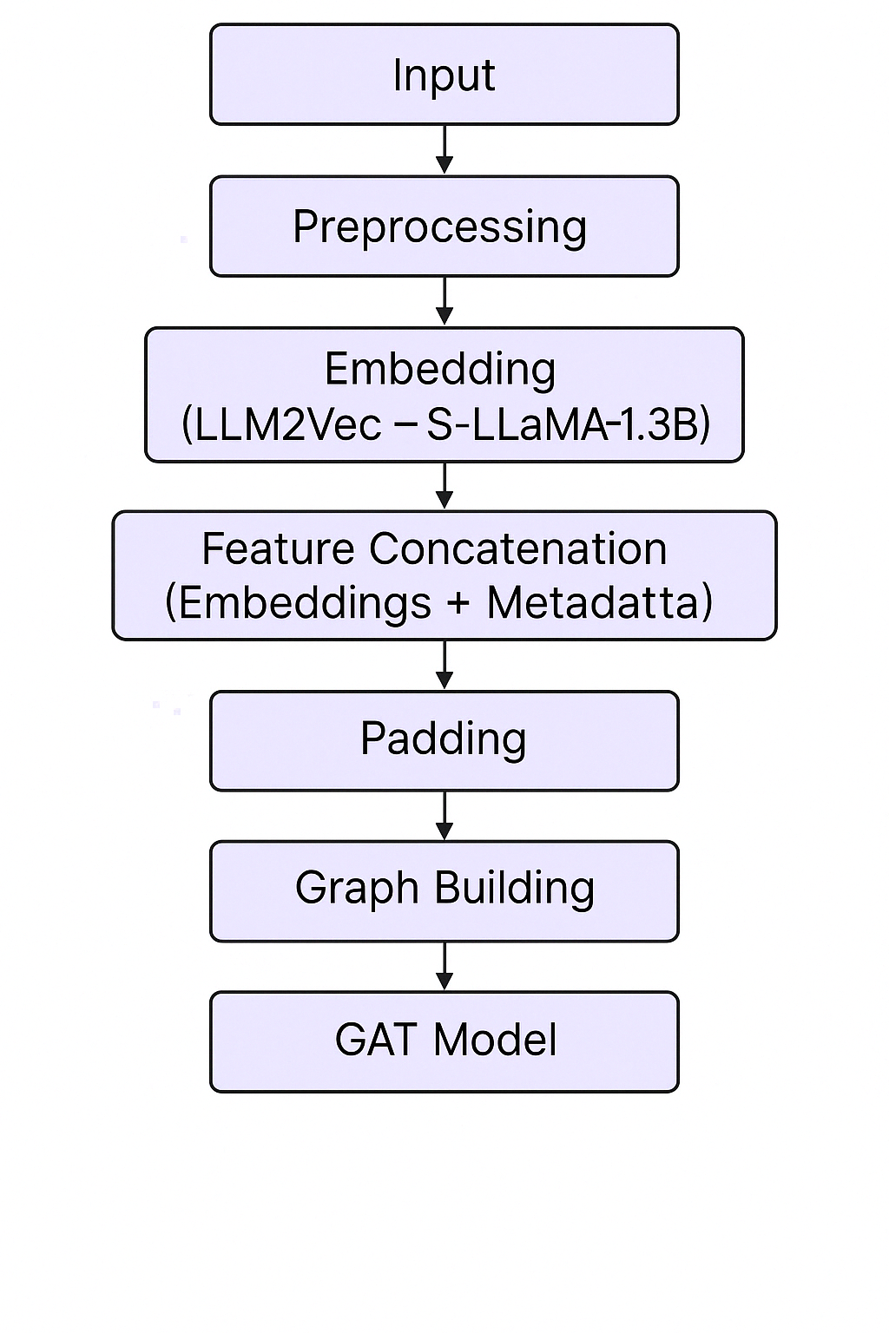
BASELINE - 3: LLM2Vec - S-LLaMA-1.3B with GNN
Architecture : Graph-based architecture using LLM2Vec embeddings from S-LLaMA-1.3B (supervised, without SimCSE).
Input: Raw message text and associated game metadata.
Preprocessing: Basic text normalization and metadata extraction.
Embedding: Sentences are converted into dense vectors using LLM2Vec (S-LLaMA-1.3B).
Feature Concatenation: Embeddings are fused with game metadata (year, season, power delta, etc.).
Padding: Ensures uniform tensor shapes across all samples.
Graph Building: Constructs graphs with nodes (messages) and edges (temporal & speaker-based).
GAT Model: Applies Graph Attention Network to model message dependencies.
Inference: Final deception prediction for each message using softmax classification.

Slide 6
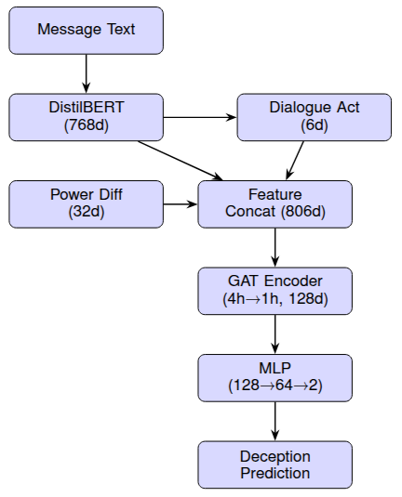
Proposed Approach: DistilBERT + Power + GNN
Architecture : MLDRM (Multilevel Deception Reasoning Model )DistilBERT + Power + GNN
Key Idea : Combine DistilBERT + Dialogue Act Classification + Pragmatic & Power Features + Speaker History in a graph-enhanced attention framework to detect deception in Diplomacy game messages.
BERT-based Utterance Encoder: Captures contextual message embeddings.
Dialogue Act Classifier: Identifies intent (e.g., promise, excuse, proposal) to reveal deceptive strategies.
Power Dynamics Embedding: Represents supply center differences between sender and receiver.
Graph Attention Layer
Nodes: Players, messages
Edges: Message flow, trust/distrust relations (via sender/receiver labels)
Lie Likelihood Predictor: Uses graph-enhanced embeddings for final deception classification.

Slide 7
COMPARISON OF RESULTS
Components | BaseLine-1 (BiLSTM) | BaseLine-2 (BiLSTM +RoBERTa) | BaseLine-3 (LLM2Vec with GNN) | MLDM (DistilBERT+GNN)
Base Text Encoder | BiLSTM with Attention | RoBERTa + BiLSTM with Attention | LLM2Vec - S-LLaMA-1.3B | DistilBERT
Attention | BiLSTM | BiLSTM | Graph Attention | Dialogue Act Head
Graph Model | - | - | GATConv | GATConv
Feature Fusion | BiLSTM + Metadata | 4 way concatenation | Embedding + Metadata | CLS + Dialogue Act
Player Interaction | - | Speaker/Receiver Encoded | - | Speaker History
Augmentation | - | - | Yes | Yes
Class Imbalance Handling | Focal Loss + Sampling | Focal Loss + Sampling | Weighted Sampling | Weighted CE
Metadata Used | Full | Full | Full | Full
Macro F1 | 0.48 | 0.49 | 0.53 | 0.54
Accuracy | 67.02 % | 68.59 % | 81.12 % | 83.25 %

Slide 8


