Slide 1

APPLIED DATA SCIENCE
CS22B2012 : ADITYA S
CS22B2015: HARSHITH B
CS22B2020: SRIRAM
CS22B2031 : SAATVIK PRABHU
GITHUB LINK'

Slide 2
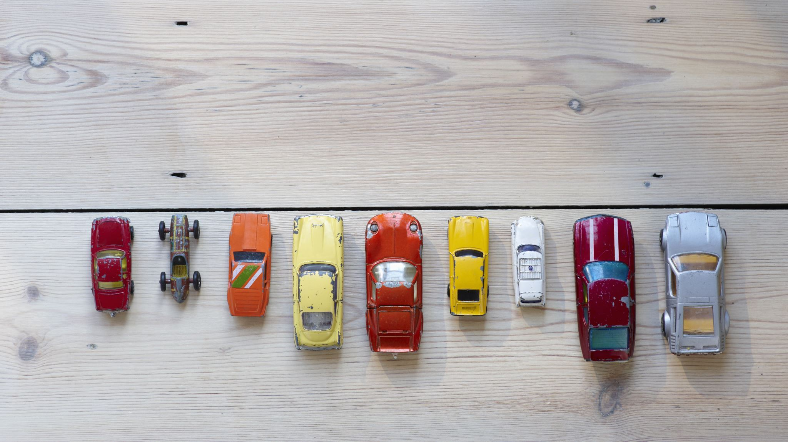
Image classification

Slide 3

TYPES OF IMAGE CLASSIFICATION
BINARY CLASSIFICATION
MULTI CLASSIFICATION

Slide 4
PROJECT STAGES
DATA COLLECTION
1
DATA PREPROCESSING
2
DATA SPLITTING AND NORMALIZATION
3
IMPLEMENTING 2 MODELS ANN AND CNN
4
COMPARISON
5
TESTING
6

Slide 5

DATA COLLECTION
The data was selected manually through camera or google images, hence a small dataset.
The data was selected based on 4 classes
ANIMALS
HUMANS
PLANTS
NON-LIVING THINGS(MAN MADE AND NATURAL)
A total of 1278 images (320+ from each class ) have been selected.

Slide 6

2.DATA PREPROCESSING
1.Data Cleaning : The images which are duplicate or not of the necessary format are removed.
2. All the images are then converted to jpg, renamed in an order and then reduced to same size 32x32 pixels to help improve the accuracy.
3. Libraries like os, imghdr, cv2, and PIL are employed to facilitate data processing task.

Slide 7
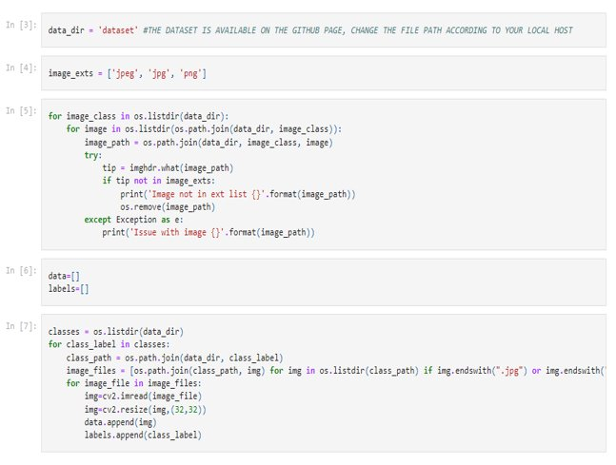

Slide 8
3.1 DATA SPLITTING
To effectively train and evaluate our models, the dataset was partitioned into two subsets: Training and Testing .
The training dataset, comprising 80% of the total data, and the testing dataset, which held the remaining 20%. This segregation was accomplished using the ‘train_test_split’ function with a fixed random state of 42 to ensure consistent results.
The labels were appropriately reshaped to ensure consistency and accuracy.

Slide 9
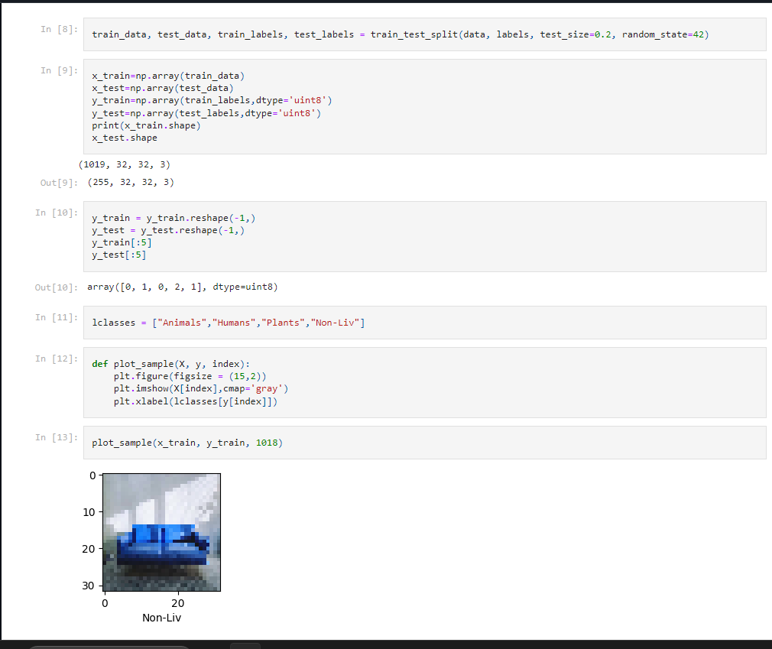

Slide 10
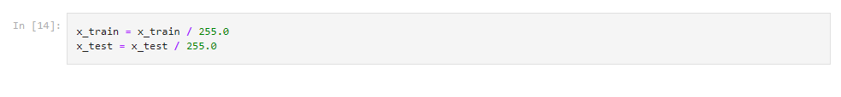
3.2 DATA NORMALIZATION
This step rescales numerical features to a range of 0 to 1, ensuring fair contribution to the analysis. It's crucial for algorithms sensitive to input scale, like gradient-based optimization in deep learning.

Slide 11
4. IMPLEMENTING OUR MODEL
Two different type of models :
ANN (Artificial Neural Networks)
CNN (Convolutional Neural Networks)

Slide 12

4.1 ARTIFICIAL NEURAL NETWORKS
WHAT?
Artificial Neural Networks (ANNs) are machine learning models inspired by the human brain. They consist of layers of interconnected nodes. Input data flows through these layers, and weights on connections are adjusted to make predictions or classifications. ANNs excel at tasks like image recognition and natural language processing
MODEL ARCHITECTURE
An ANN with one or more hidden layers is created. Each neuron in the input layer represents a pixel in the image, and the output layer has neurons corresponding to the categories (e.g., "cat" and "dog").
You can use fully connected layers where each neuron in one layer is connected to every neuron in the subsequent layer.

Slide 13
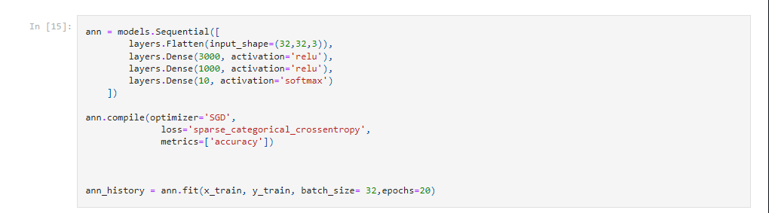

Slide 14
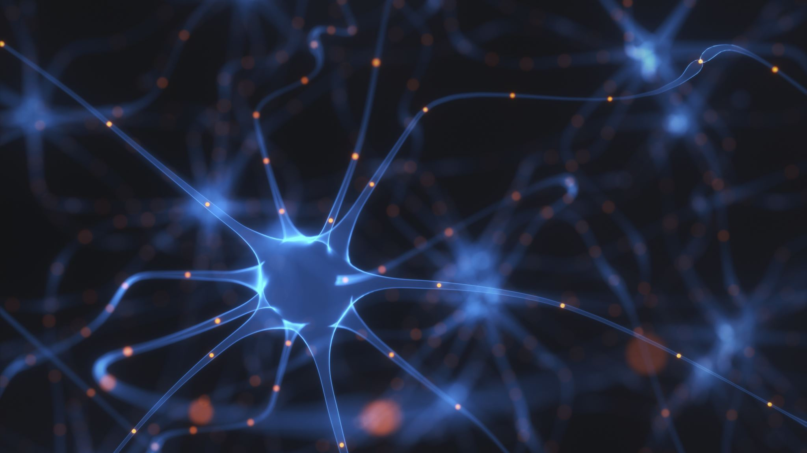
4.2 CONVOLUTIONAL NEURAL NETWORK
WHAT?
A Convolutional Neural Network (CNN) is a type of deep learning model specialized for processing and analyzing visual data, such as images and videos. It uses convolutional layers to automatically detect patterns and features in the data, making it highly effective in tasks like image classification, object detection, and image segmentation. A Convolutional Layer is a fundamental component of Convolutional Neural Networks (CNNs), specifically designed for processing and analyzing visual data like images
MODEL ARCHITECTURE
The CNN architecture is defined. This includes specifying the number of convolutional layers, pooling layers, and fully connected layers.
Configure the number of filters, their sizes, and activation functions for the convolutional layers.
Choose appropriate hyperparameters such as the learning rate and batch size.

Slide 15
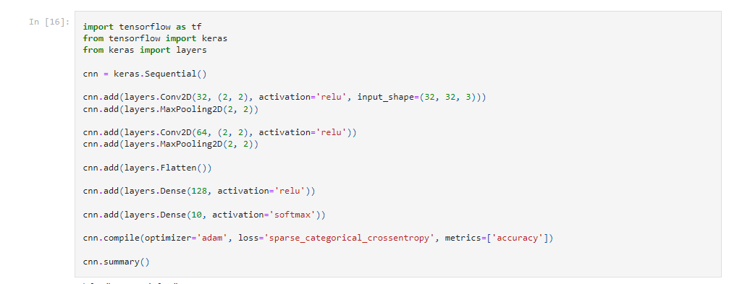

Slide 16
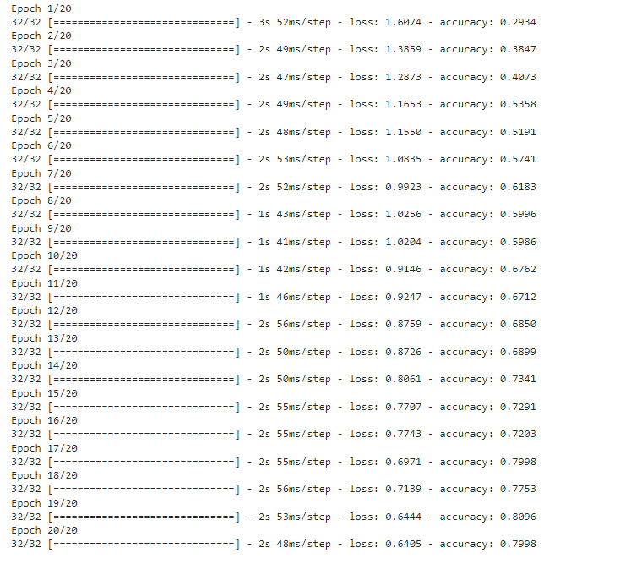
EPOCH :
It refers to one complete pass through the entire training dataset during the training process.

Slide 17
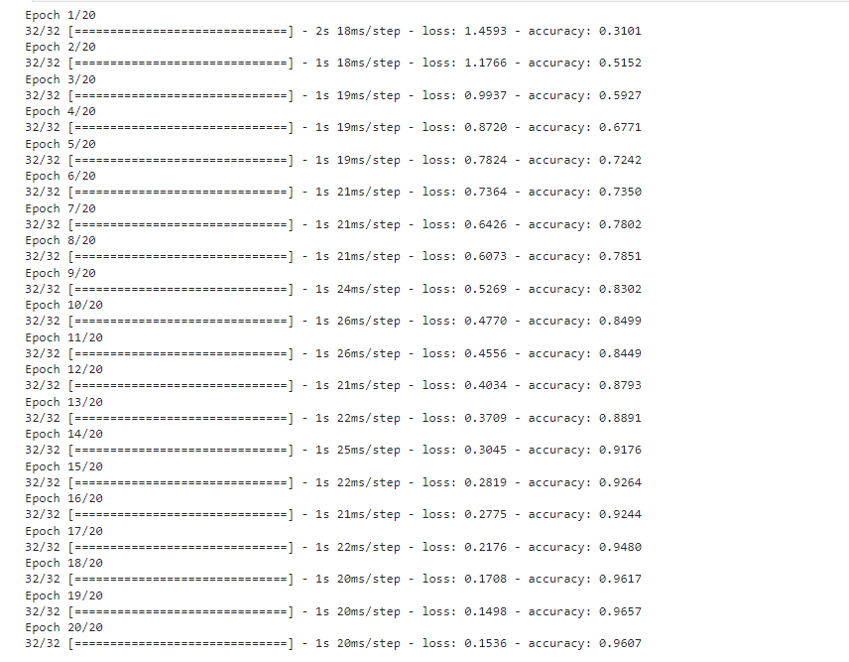

Slide 18

5. COMPARISON
Since two models have been implemented. Let's see which is better for image classification.

Slide 19
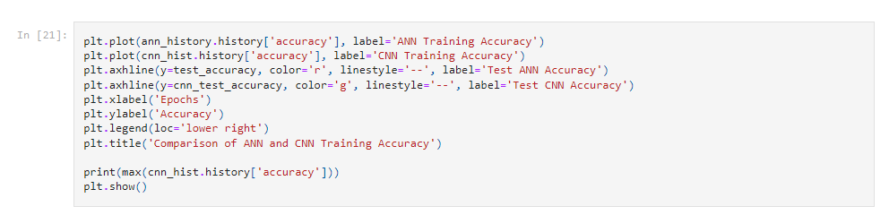

Slide 20
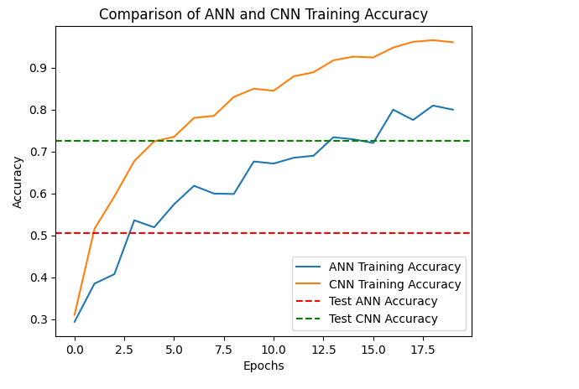

Slide 21
Hierarchical Feature Extraction: CNNs are designed to automatically learn and extract hierarchical features from images. They use convolutional layers to capture spatial patterns, textures, and features at different scales. ANNs, which are fully connected, do not have this built-in capability for feature extraction.
2. Translation Invariance: CNNs are inherently translation-invariant. This means they can recognize patterns and features regardless of their location in the image. ANNs struggle with this and require a fixed-size input.
3. Parameter Efficiency: CNNs have far fewer parameters compared to ANNs for the same level of performance, making them more efficient and less prone to overfitting.
4. Reduced Dimensionality: Pooling layers in CNNs downsample feature maps, reducing the spatial dimensions and computational complexity. ANNs do not have this inherent feature.
5 . Specialized Architecture: CNNs are specifically designed for image data, while ANNs are more general-purpose. CNN architecture is tailored to the two-dimensional structure of images, whereas ANNs operate on flat vectors.
6. Transfer Learning: Pre-trained CNN models can be used as a starting point for new image classification tasks. This transfer learning allows you to leverage the knowledge gained from one image dataset to improve performance on another dataset, with minimal additional training.
7. State-of-the-Art Performance: CNNs have consistently achieved state-of-the-art results in image classification competitions and tasks. Their ability to capture intricate image features has been demonstrated in numerous real-world applications.
While ANNs can be used for image classification, CNNs are optimized for this specific task, and their architectural features make them a superior choice for extracting meaningful information from images, resulting in better classification accuracy and efficiency.
While ANNs can be used for image classification, CNNs are optimized for this specific task, and their architectural features make them a superior choice for extracting meaningful information from images, resulting in better classification accuracy and efficiency.

Slide 22
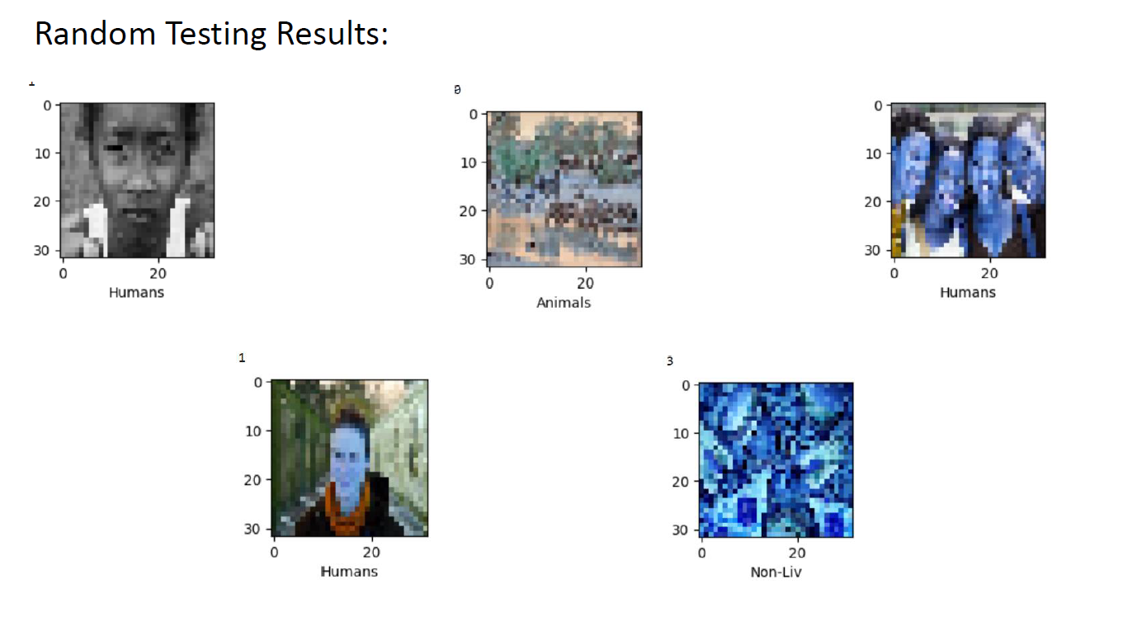
6. TESTING

