Slide 1
A Git/GitHub Workflow
Grant Braught
Dickinson College
COMP491
Fall 2018
Licensed under a Creative Commons Attribution-NonCommercial-ShareAlike 4.0 International License.
Notes:
Complicated
- No one overview or activity is going to be sufficient.
- Goal here is to walk through the fundamentals once.
Process:
- Web-page with checkpoints
- Work entirely in VM
- Can copy and paste easily
- Ctrl-C / Ctrl-V (browser)
- Shift-Ctrl-C / Shift-Ctrl-V (terminal)
- Be disciplined
- stop at checkpoints
- Don’t work ahead, just wait patiently
- let me know you have finished
- I’ll come around and verify or ask you to verify state

Slide 2
Fork / Clone
Origin
Upstream
Fork repo on GitHub
cd Documents
git clone <URL>
git remote –v
cd github-issues-activity
ls
fork
clone
Remotes
On GitHub
Local
On Your Machine
Master Branch
Files
Stage
Notes:
Upstream: Project repository (typically read-only to you)
- Circles represent commits, time left-to-right.
- Fork: Copies repo from project to your GitHub account.
- Your GitHub repo retains information about where the fork came from (thin arrows)
Origin: Your fork of the Upstream repository
Remotes: Out in the cloud (on GitHub)
Local: On your machine
- Clone: Copies your remote repo (origin) to your local machine.
- Your local repo keeps track of the remote from which it was cloned (thin arrows)
Files:
- Copy of the files from the commit that you are currently working from.
- This is what you see when you do “ls”
- This is where you will do your edits.

Slide 3
Branch / Checkout
Origin
Upstream
cd github-issues-activity
git branch –a
git branch feature
git checkout feature
Remotes
On GitHub
Local
On Your Machine
Master Branch
Feature Branch
Files
checkout
Stage
Notes:
Branch: A copy of the last commit in the repo
- Not really a full copy but it behaves like it.
- So don’t worry about the space being used.
branch:
- lists all of the branches in your repo
- creates a new branch
Feature Branch:
- Make one of these each time you want to make changes
- Do not make edits in the master branch.
- This way you retain a clean copy
- So can go back to if you mess something up or the plan doesn’t work out.
checkout:
- Switches your files to those in a different branch.
- checkout feature
- checkout master

Slide 4
Status / Add / Commit
Origin
Upstream
Make changes to files
git status
git add filename
git commit –m “message”
Remotes
On GitHub
Local
On Your Machine
Master Branch
Feature Branch
Files
Commit
add
Stage
Notes:
status:
- displays information about what has been changed since last commit
add:
- places modified files onto the “Stage”
- a list of things to be included in the next commit
commit:
- copies changes on the stage into the current branch.
- do this each time you have completed a “nameable piece of work”
- include a descriptive comment that explains what this set of changes accomplished.

Slide 5
Push / Pull Request
Origin
pull request
Upstream
git push origin feature
Check feature on GitHub
Pull Request to Upstream
Upstream does merge(s)
push
Remotes
On GitHub
Local
On Your Machine
Master Branch
Feature Branch
Files
Stage
Notes:
push:
- Copies the changes to the branch to the remote (e.g. origin)
Pull Request:
- Issued through GitHub web interface in browser.
- Asks upstream project manager to “pull” your changes into the project.

Slide 6
Remote Add / Fetch
Origin
Upstream
git checkout master
git remote add upstream <URL>
git remote –v
git fetch upstream
fetch
Remotes
On GitHub
Local
On Your Machine
Master Branch
Feature Branch
Files
upstream/master
Stage
Notes:
To bring your local and remote repos into synch with changes to the upstream master…
A little counter intuitive
Bring changes to your machine, merge them with what you have, then push to your origin.
checkout master:
- switch files to those from the master
- so when we pull in changes from upstream the go into these files not our feature.
remote add upstream:
- tells your local repo about the upstream (thin arrows)
fetch upstream:
- pulls a copy of the upstream master branch into your local repo
Note: - fetch just gets a copy of the upstream master.
- pull would do a fetch followed by a merge.
- we do them separately here so we understand the process.

Slide 7
Merge / Push
Origin
Upstream
git merge upstream/master
git push origin master
push
Remotes
On GitHub
Local
On Your Machine
Master Branch
Feature Branch
Files
upstream/master
merge
Stage
Notes:
merge upstream/master:
- merges the changes to the upstream master into your local master
- makes them look alike.
- should be automatic if you have not edited your master branch
- another good reason to use feature branches!!!
push origin master:
- pushes your local master to your remote.
- all masters now match.

Slide 8
Delete
Origin
Upstream
git branch –d feature
git push origin :feature
push
Remotes
On GitHub
Local
On Your Machine
Master Branch
Feature Branch
Files
upstream/master
Stage
Notes:
branch –d:
- deletes the branch from your local repo.
- don’t need it anymore because all of the changes are in masters.
- along with the commit messages, etc.
push origin :feature:
- causes the branch delete operation to be pushed to your remote
- deletes the branch from your GitHub.

Slide 9
Concurrent Changes
Origin
Pull Request
Upstream
Synch with upstream
git branch feature
git checkout feature
Modify feature
Upstream modified too
Commit changes to feature
git push origin feature
Issue Pull Request
Push
fetch
Remotes
On GitHub
Local
On Your Machine
Master Branch
Feature Branch
Files
upstream/master
merge
Stage
Notes:
It may be the case that others are making changes to the same sections of code that you are.
This can lead to situations where the code you issue a pull request for conflicts with changes that have been made to the upstream.
Synch with upstream:
- process we used before (fetch, merge)
- good idea before you start a new feature branch.
Make your edits
- same process as before
- push
- issue pull request
But now:
- upstream master has been changed in a way that is incompatible with your changes.
- thus there is a conflict that must be resolved
- use your changes?
- keep the upstream changes?
- some combination?

Slide 10
Synch Upstream Changes
Origin
Pull Request
Upstream
git checkout master
git fetch upstream
git merge upstream/master
git push origin master
Push
fetch
Remotes
On GitHub
Local
On Your Machine
Master Branch
Feature Branch
Files
upstream/master
merge
Stage
Notes:
Might imagine project manager taking care of the conflict.
They are busy people… Might ask you…
Synch with upstream again…
- switch to master branch
- fetch upstream/master
- merge into your master
- push to your remote
Now you have the up to date changes to master.
Next you’ll do the merge.

Slide 11
Rebase
Origin
Pull Request
Upstream
git checkout feature
git rebase master
Remotes
On GitHub
Local
On Your Machine
Master Branch
Feature Branch
Files
upstream/master
rebase
Stage
Notes:
checkout feature:
- switch to your feature branch
- incompatible with changes to the master…
rebase master:
- need your changes to lead from current master (blue dot) rather than old one (green).
- will require you to resolve the conflicts.

Slide 12
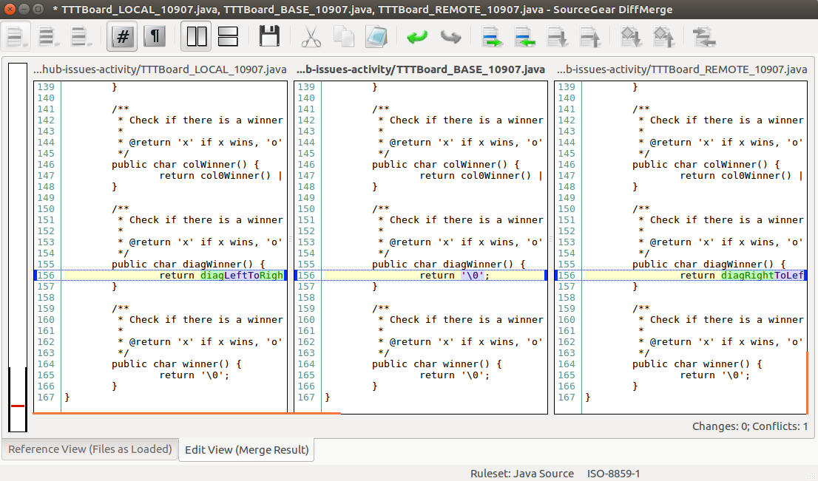
Merge Tool (diffmerge)
git mergetool
Original File / Merged Result
Feature Branch
Master Branch
Notes:
git mergetool:
- launches a graphical Merge Tool
- diffmerge – because we configured it.
Left - Feature Branch:
- shows the changes that you made locally.
Right - Master Branch
- shows your local master branch
- includes changes to the upstream master from synch.
Center – resolution
- shows original file before your changes or the upstream changes
- Resolve the conflict…
- move code in from left or right
- edit directly
- Save!

Slide 13
Rebase Continue
Origin
Updated
Pull Request
Upstream
git rebase --continue
git push --force origin feature
Push --force
Remotes
On GitHub
Local
On Your Machine
Master Branch
Feature Branch
Files
upstream/master
Stage
Notes:
rebase --continue:
- completes the merge of your files into the feature branch
- these are now built from (rebased on) the upstream master.
push --force:
- pushes the changes to your feature branch to your remote
Update pull request:
- comment on pull request letting project manager know you’ve rebased.

Slide 14
Credits
http://foss2serve.org/index.php/Git:_GitHub_Issues_and_Pull_Request
A similar activity produced by Chris Murphy.
http://foss2serve.org/index.php/Git:_GitHub_Workflow_Activity
A similar activity produced by Darci Burdge and Stoney Jackson.
https://github.com/StoneyJackson/github-workflow-activity/blob/master/presentation.pptx
Slides used by Darci Burdge and Stony Jackson with the above activity.
Basic GitHub elements (cloud/arrows/filesystems) were copied from this slide set.
http://foss2serve.org/index.php/Git:_Working_Locally_from_the_Command_Line
Activity introducing some of the basic git commands produced by Stoney Jackson, Nick Yeates.

