Slide 1
Procedure
Took images made by CheKiPEUQ
Edited in powerpoint for 65% Saturation
Manually covered old axes labels and put new ones.
Along the way was some grouping etc., then copied and pasted as image.

Slide 2
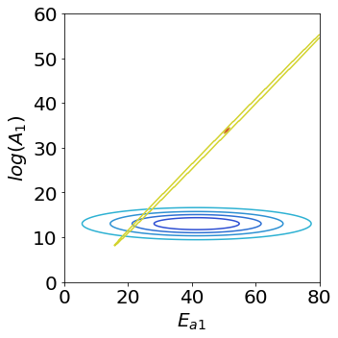
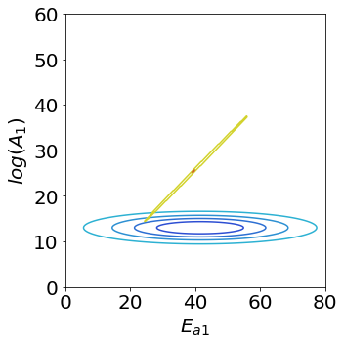
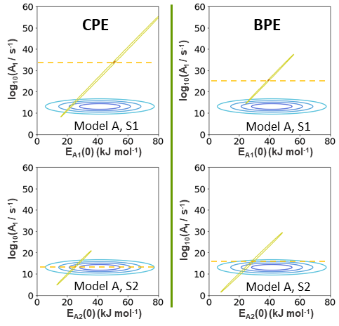
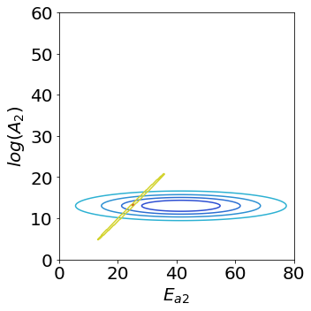

CPE
BPE
log₁₀(A₁ / s⁻¹)
log₁₀(A₁ / s⁻¹)
Model A, S1
Model A, S1
E_{A1}(0) (kJ mol⁻¹)
E_{A1}(0) (kJ mol⁻¹)
log₁₀(A₁ / s⁻¹)
log₁₀(A₁ / s⁻¹)
Model A, S2
Model A, S2
E_{A2}(0) (kJ mol⁻¹)
E_{A2}(0) (kJ mol⁻¹)
CPE & BPE with Model A & 0.0050
Aka Example 19

Slide 3


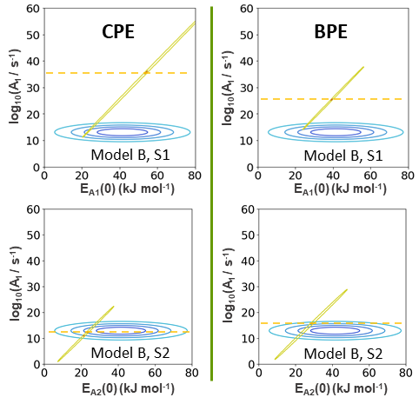
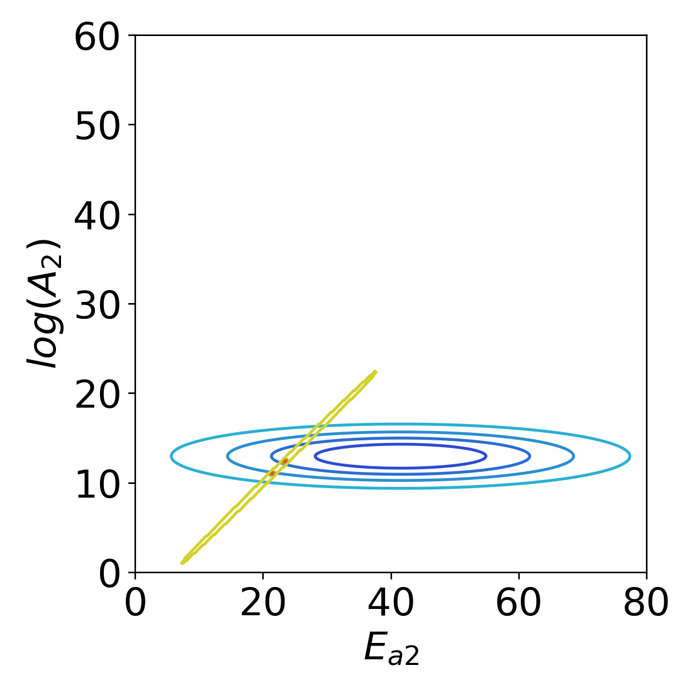

CPE
BPE
log₁₀(A₁ / s⁻¹)
log₁₀(A₁ / s⁻¹)
Model B, S1
Model B, S1
E_{A1}(0) (kJ mol⁻¹)
E_{A1}(0) (kJ mol⁻¹)
log₁₀(A₁ / s⁻¹)
log₁₀(A₁ / s⁻¹)
Model B, S2
Model B, S2
E_{A2}(0) (kJ mol⁻¹)
E_{A2}(0) (kJ mol⁻¹)
CPE & BPE with Model B & 0.0050
Aka Example 20

Slide 4
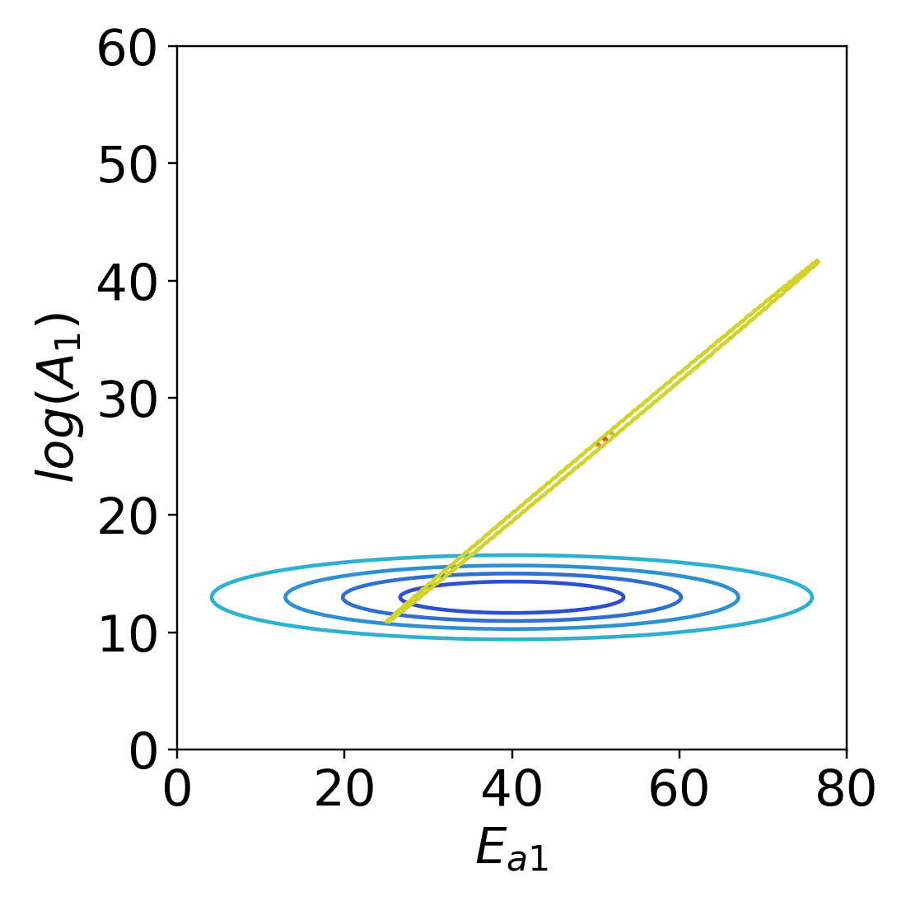
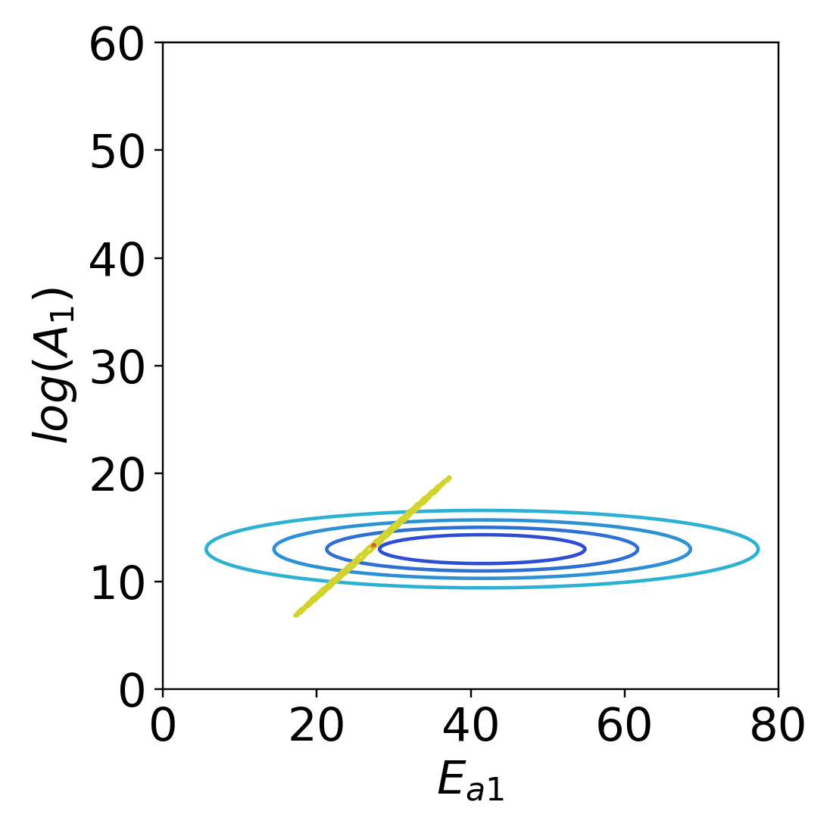
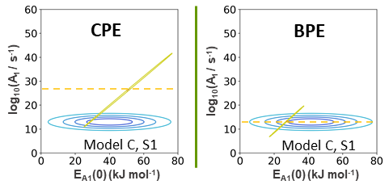
CPE
BPE
log₁₀(A₁ / s⁻¹)
log₁₀(A₁ / s⁻¹)
Model C, S1
Model C, S1
E_{A1}(0) (kJ mol⁻¹)
E_{A1}(0) (kJ mol⁻¹)
log₁₀(A₁ / s⁻¹)
log₁₀(A₁ / s⁻¹)
Placeholder
Placeholder
E_{A1} (kJ mol⁻¹)
E_{A1} (kJ mol⁻¹)
CPE & BPE with Model C & 0.0050
Aka Example 21

Slide 5
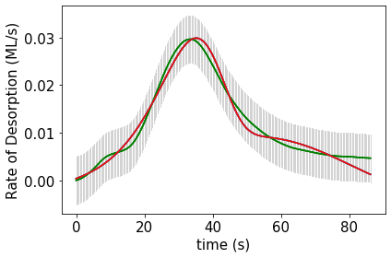
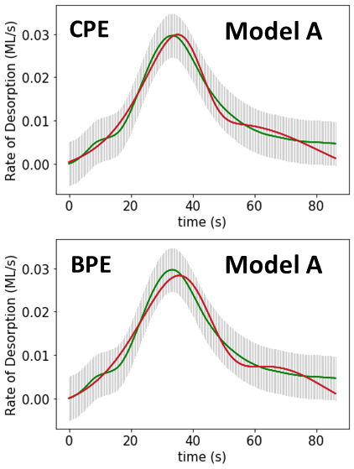
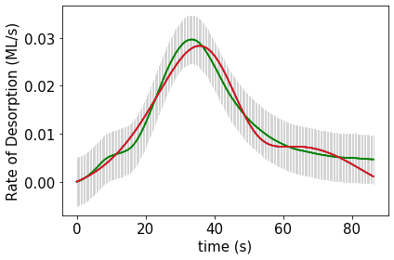
CPE
Model A
BPE
Model A
CPE & BPE with Model A & 0.0050
Aka Example 19

Slide 6

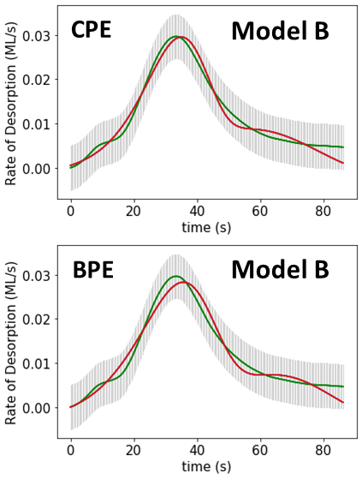

CPE
Model B
BPE
Model B
CPE & BPE with Model B & 0.0050
Aka Example 20

Slide 7
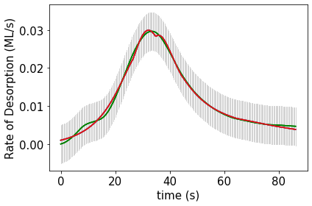
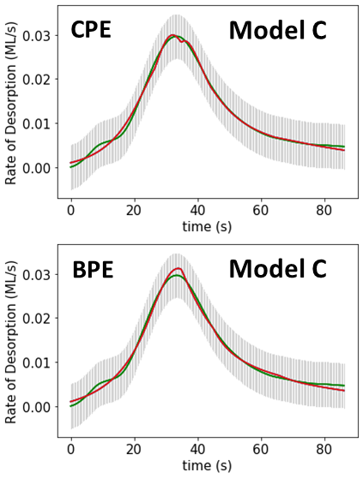
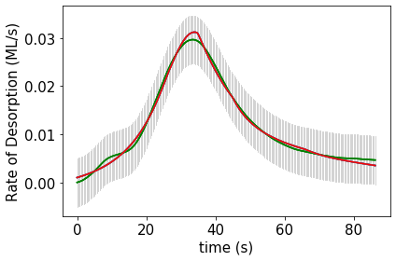
CPE
Model C
BPE
Model C
CPE & BPE with Model C & 0.0050
Aka Example 21

