Slide 1
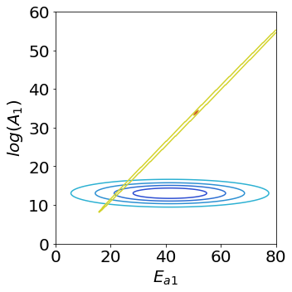
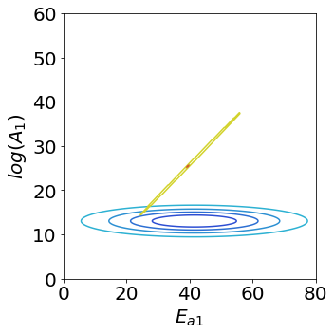
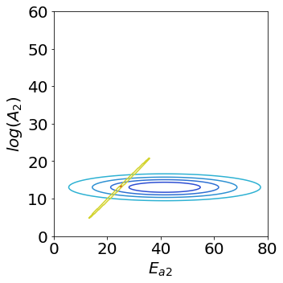

CPE & BPE with Model A & 0.0025
Aka Example 19

Slide 2
CPE & BPE with Model A & 0.0025
Aka Example 19

