Slide 1




Software Combines and Displays
Compared by Researcher
Data From Different Studies, Even with Different Units

Slide 2
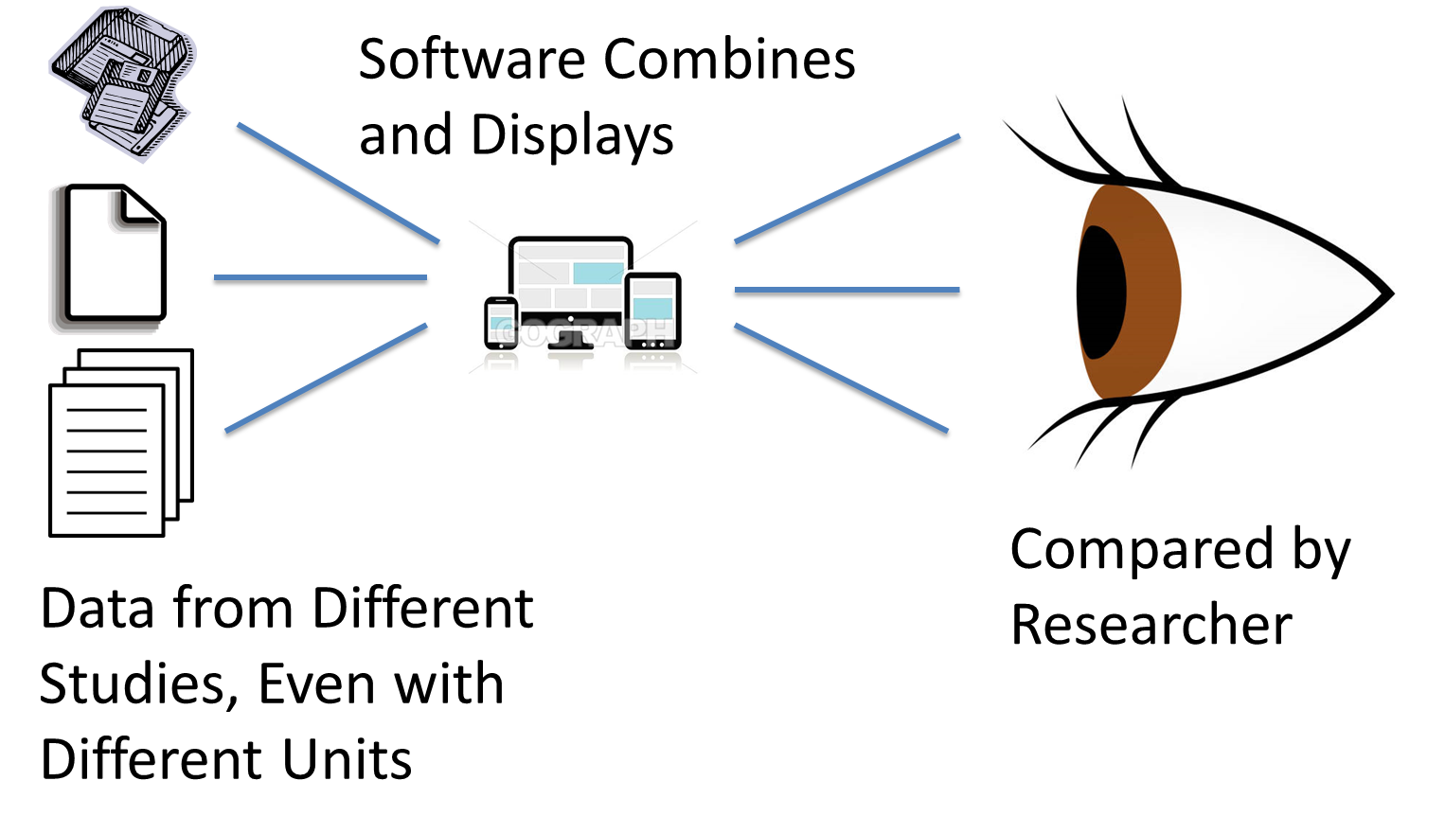
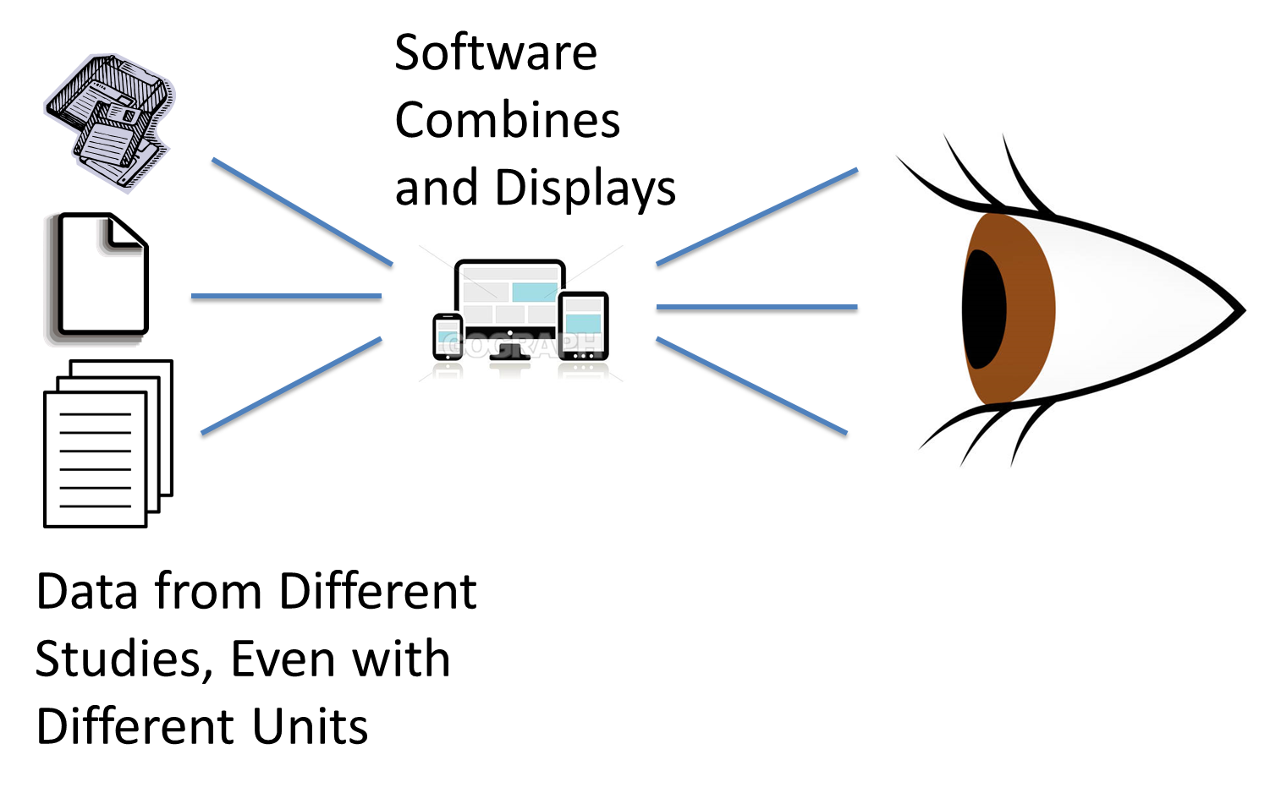
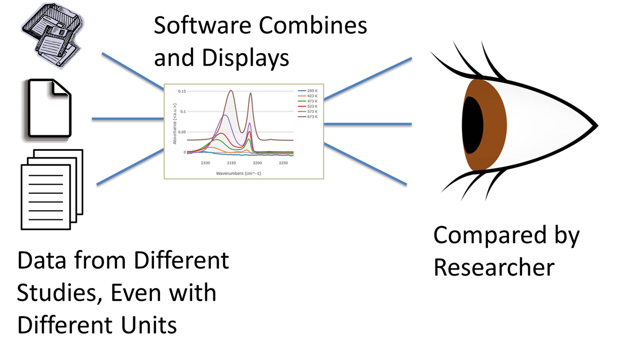

Slide 3
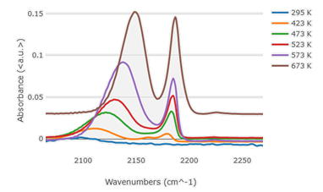

Slide 4
Software Combines and Displays
Compared by Researcher
Data from Different Studies, Even with Different Units

Slide 5
Software Combines and Displays
Compared by Researcher
Data from Different Studies, Even with Different Units

Slide 6
Image sources
Paid for license, from:
https://www.istockphoto.com/vector/eye-gm1153181078-313105864
https://media.istockphoto.com/illustrations/eye-illustration-id1153181078?k=6&m=1153181078&s=612x612&w=0&h=N2-EjNP_URGSRPm9L1yedvGNms0PYfQsqjcHDi391uQ=
Paid for regular license.
https://www.gograph.com/clipart/responsive-design-for-web-computer-gg63318880.html
Free clipart
https://www.istockphoto.com/illustrations/human-eye-side-view

