Slide 1
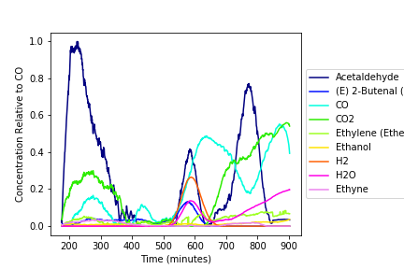
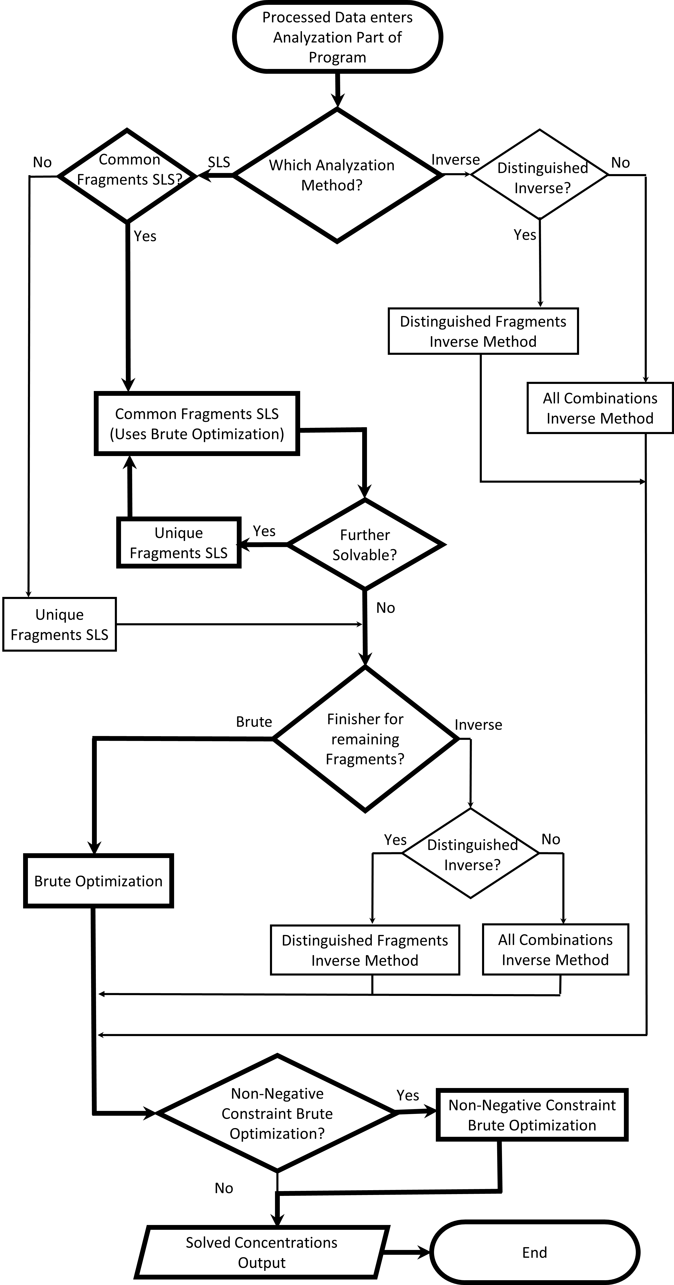
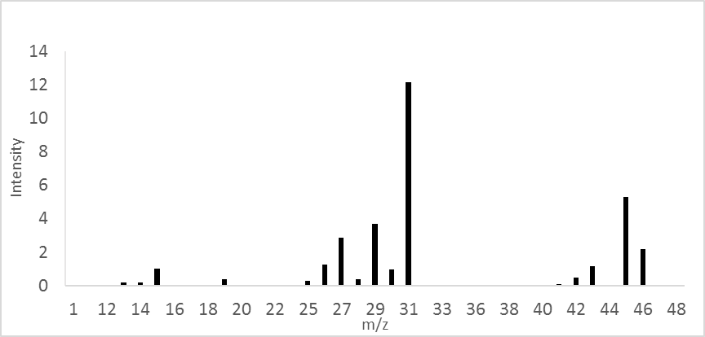
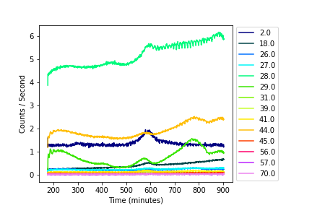
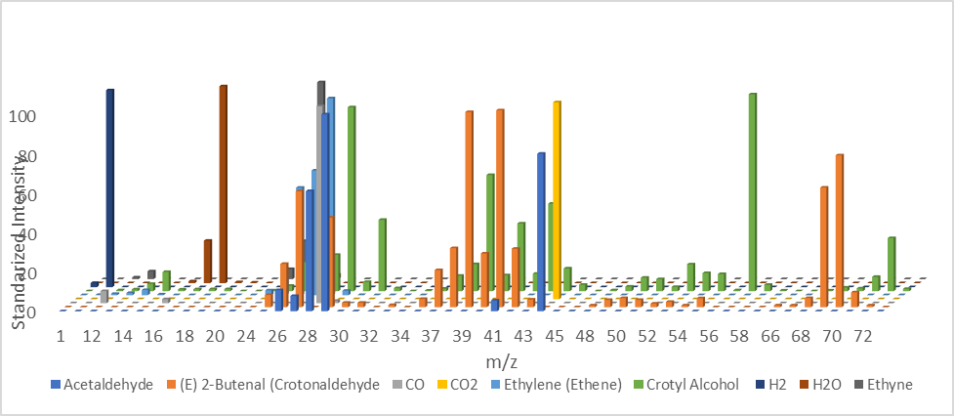
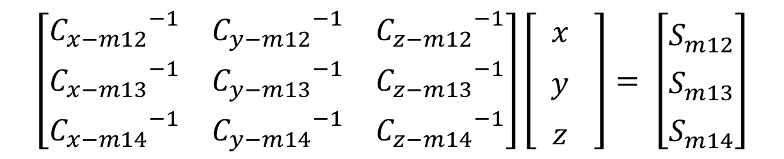
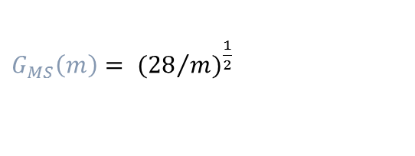
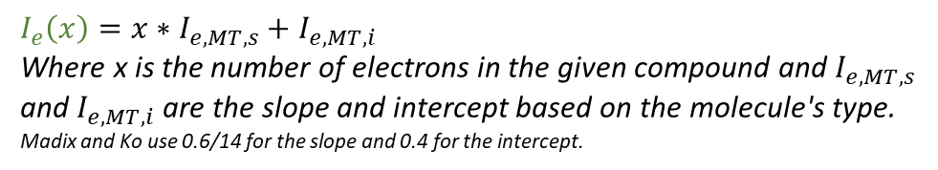
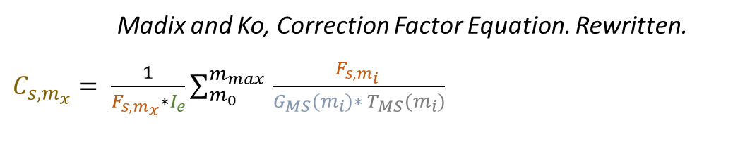
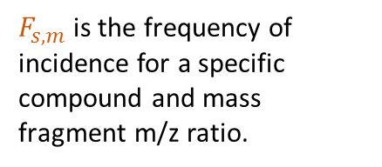
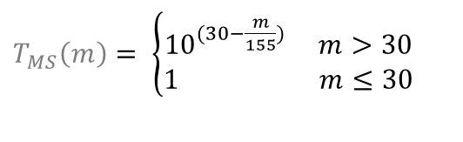
. Mass Spectrometry Signal Resolving (MS-RESOLVE)
Aditya “Ashi” Savara, Chemical Sciences Division, Oak Ridge National Laboratory, savaraa@ornl.gov
1
MS
C = Correction Value
Concentration Relative to CO
Raw Signal
Concentrations
$$\left[\begin{matrix}{C_{x−m12}}^{−1} & {C_{y−m12}}^{−1} & {C_{z−m12}}^{−1} \\ {C_{x−m13}}^{−1} & {C_{y−m13}}^{−1} & {C_{z−m13}}^{−1} \\ {C_{x−m14}}^{−1} & {C_{y−m14}}^{−1} & {C_{z−m14}}^{−1}\end{matrix}\right]\left[\begin{matrix} { x}_{}^{} \\ { y}_{}^{} \\ { z}_{}^{}\end{matrix}\right]= \left[\begin{matrix}S_{m12}^{} \\ S_{m13}^{} \\ S_{m14}^{}\end{matrix}\right]$$
Mass Spectrometry can be used to determine relative concentrations of molecular species using fragmentation patterns (right). There is a need for software that can resolve signals that overlap when multiple molecules are present (below).
MSRESOLVE-SG uses matrix solving techniques, including Sequential Linear
Subtraction (SLS).
Raw Data
MS-SESOLVE is able to successfully resolve molecules with multiple overlapping fragments. The program enables both pre-processing and analysis of time dependent mass spectrometry signals. A GUI and a feature which enables analytical predictions of which masses are best to monitor are also included. The most notable feature of MS-RESOLVE is the Sequential Linear Subtraction analysis method, which operates by iteratively solving molecules either individual molecules or small subsets of molecules based on when unique masses present. When there are no individual masses present, SLS common can be used which solves subsets of molecules via either the inverse method or brute force method, enabling iterative solutions even in the absence of unique signals. MS-RESOLVE will enable more quantitative analysis of mass spectrometry data.
Additional developers (chronological): Christopher Elliott, Wilson Jeter, Charles Watt, Clinton Dunn, Andrea Kraetz, Alexander Rogers.
Mass Spectrometry Reference Spectrum of Ethanol
Madix and Ko, Correction Factor Equation. Rewritten.
$C_{s,m_{x}}= \frac{1}{F_{s,m_{x}}∗I_{e}}\sum_{m_{0}}^{m_{max} }{\frac{F_{s,m_{i} }}{G_{MS}(m_{i})∗ T_{MS}(m_{i})}}$
$F_{s,m}$ is the frequency of incidence for a specific compound and mass fragment m/z ratio.
$G_{MS}\left(m\right)= {({28}/m)}^{\frac{1}{2}}$
Acknowledgements
$T_{MS}\left(m\right)= \left\{\begin{aligned}{10}^{(30−\frac{m}{155})} m>30 \\ 1 m≤30\end{aligned}\right.$
Research sponsored by the U.S. Department of Energy, Office of Science, Basic Energy Sciences, Chemical Sciences, Geosciences, and Biosciences Division.
Mass Spectrometry Reference Patterns of Molecules With Overlapping Fragments
$I_{e}\left(x\right)=x∗I_{e,MT,s}+$ $I_{e,MT,i}$
Where x is the number of electrons in the given compound and $I_{e,MT,s}$ and $I_{e,MT,i}$ are the slope and intercept based on the molecule's type. Madix and Ko use 0.6/14 for the slope and 0.4 for the intercept.
This slide is intended to be “presented”, but the basic ideas are as follows:
In mass spectrometry with multiple molecules present, overlapping signals can occur at discrete masses.
The intensities have different proportionality constants to concentration (both across masses and across molecules). Thus, one needs to use an equation or separate constants for each peak of each molecule.
These should ideally be calibrated separately, but this is not always feasible. For cases where that is not feasible, the separate factors can be approximated by equations.
The constants (called ‘correction factors’) and the raw signals can then be put into a matrix that represents a series of algebraic equations to solve for concentrations.
For cases with overlapping fragments, this is not always solvable, and even when it is solvable the effects of error can be significant.
MSRESOLVE has capabilities to solve such cases, in particular using Sequential Linear Subtraction (SLS) with implicit error correction, and MSRESOLVE can also consider input uncertainties to report the final concentrations with their uncertainties.
In practice, one also has to do pre-processing of the data, and as can be seen in the flow chart, and MSRESOLVE has these features, also: baseline correction, smoothing, etc.
MSRESOLVE enables repeat analyses of time series with different choices. This is very useful since if one wants to change which mass is used or to add another molecule into the analysis etc., attempting to make such changes is quick with MSRESOLVE, and saves the use hours of work.
Notes:
In mass spectrometry with multiple molecules present, overlapping signals can occur at discrete masses.
The intensities have different proportionality constants to concentration (both across masses and across molecules). Thus, one needs to use an equation or separate constants for each peak of each molecule.
These should ideally be calibrated separately, but this is not always feasible. For cases where that is not feasible, the separate factors can be approximated by equations.
The constants (called ‘correction factors’) and the raw signals can then be put into a matrix that represents a series of algebraic equations to solve for concentrations.
For cases with overlapping fragments, this is not always solvable, and even when it is solvable the effects of error can be significant.
MSRESOLVE has capabilities to solve such cases, in particular using Sequential Linear Subtraction (SLS) with implicit error correction, and MSRESOLVE can also consider input uncertainties to report the final concentrations with their uncertainties.
In practice, one also has to do pre-processing of the data, and as can be seen in the flow chart, and MSRESOLVE has these features, also: baseline correction, smoothing, etc.
MSRESOLVE enables repeat analyses of time series with different choices. This is very useful since if one wants to change which mass is used or to add another molecule into the analysis etc., attempting to make such changes is quick with MSRESOLVE, and saves the use hours of work.

