Slide 1




Name of Project
Solar Power preduction using
Linear Regration Model

Slide 2

Learning Objectives
Renewable Energy Forecasting:
Understand how ML predicts solar power output using historical and weather data.
Data-Driven Insights:
Learn data collection, cleaning, and feature engineering techniques.
Model Development:
Build, evaluate, and optimize regression models (e.g., Linear Regression, Random Forest).
Real-World Application:
Develop a full ML pipeline for practical solar energy forecasting.
GOAL
Source :
www.freepik.com/

Slide 3
Tools and Technology used
Programming:
Python (Jupyter Notebook).
Data Libraries:
Pandas, NumPy, Matplotlib, Seaborn.
ML Libraries:
Scikit-learn; TensorFlow/Keras (if
applicable).
Data Sources:
Historical solar and weather datasets.

Slide 4
Methodology
Data Processing:
Collect data, handle missing values, and normalize features.
Feature Engineering:
Create time-based and weather indicators.
Model Training:
Compare regression models with cross-validation and
hyperparameter tuning.
Evaluation & Deployment:
Use MAE, RMSE for evaluation and integrate the model for
real-time predictions.

Slide 5
Problem Statement:
Output Variability:
Solar power fluctuates due to weather changes.
Grid Management:
Uncertain forecasts impact energy distribution.
Data Challenges:
Missing data, noise, and non-linear relationships
Complicate predictions.
Need:
Accurate forecasting to optimize resource allocation
and grid efficiency.

Slide 6
Solution:
Comprehensive Pipeline:
From data collection to deployment for solar power
prediction.
Algorithm Comparison:
Use advanced regression models to capture complex
relationships.
Optimization:
Hyperparameter tuning and cross-validation improve
accuracy.
Impact:
Reduced forecasting errors and enhanced grid
management.

Slide 7
Solution:
Comprehensive Pipeline:
From data collection to deployment for solar power
prediction.
Algorithm Comparison:
Use advanced regression models to capture complex
relationships.
Optimization:
Hyperparameter tuning and cross-validation improve
accuracy.
Impact:
Reduced forecasting errors and enhanced grid
management.

Slide 8
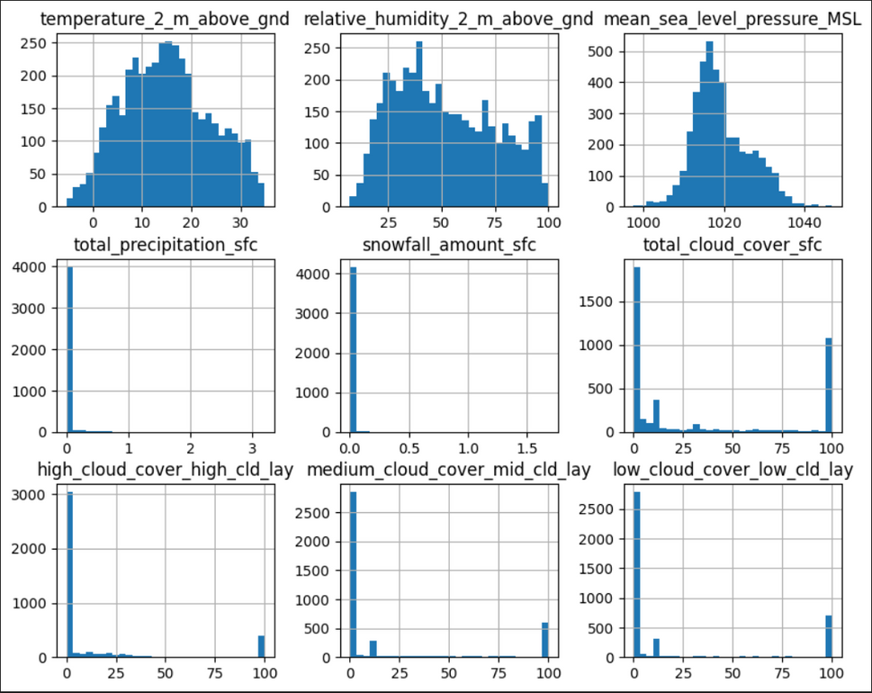
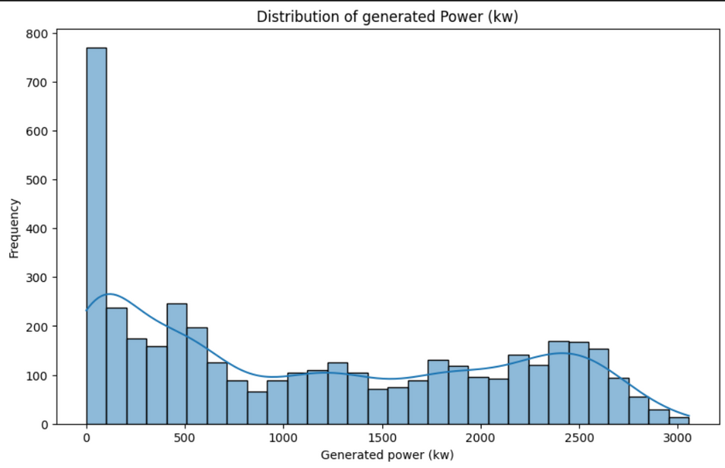
Screenshot of Output:

Slide 9
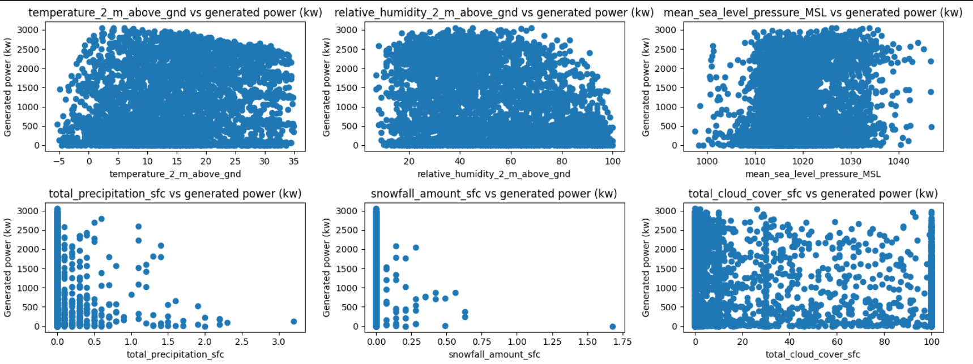
Screenshot of Output:
Bivariate analysis

Slide 10
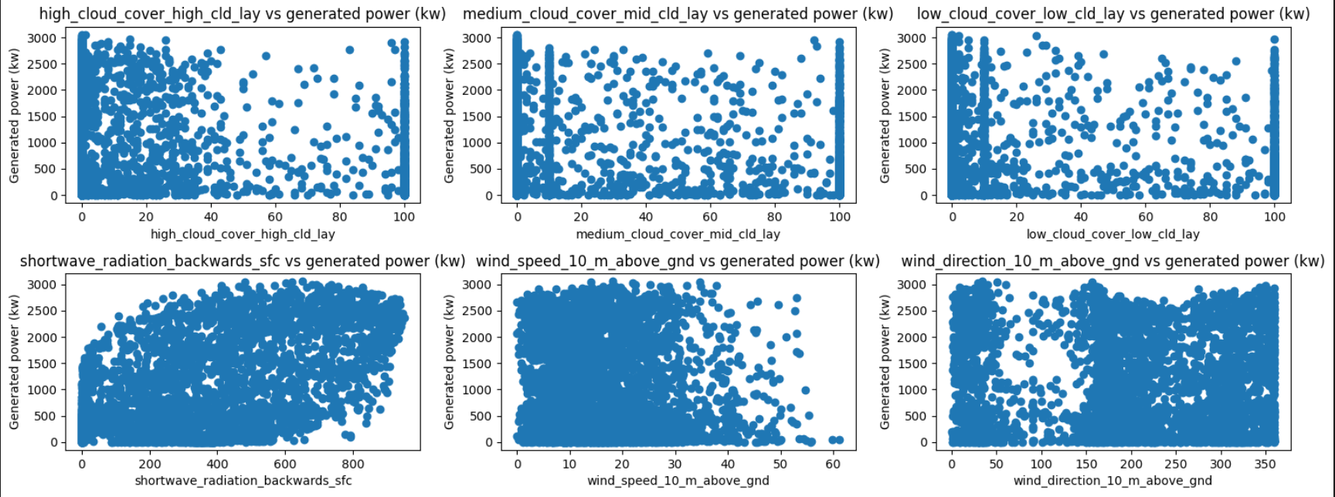
Screenshot of Output:

Slide 11
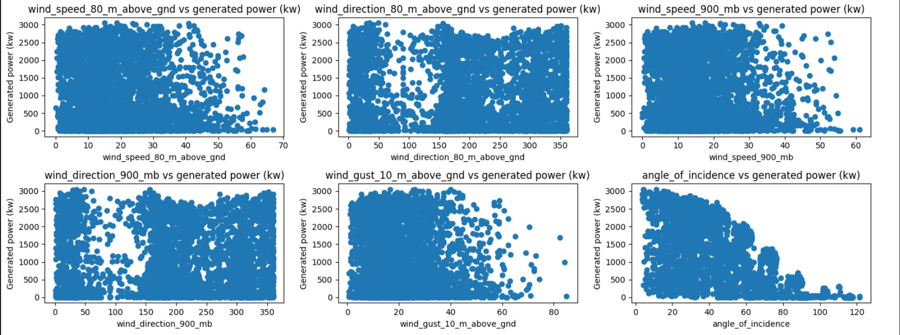
Screenshot of Output:

Slide 12
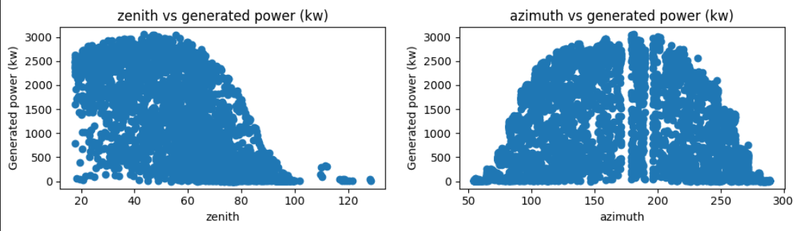
Screenshot of Output:

Slide 13
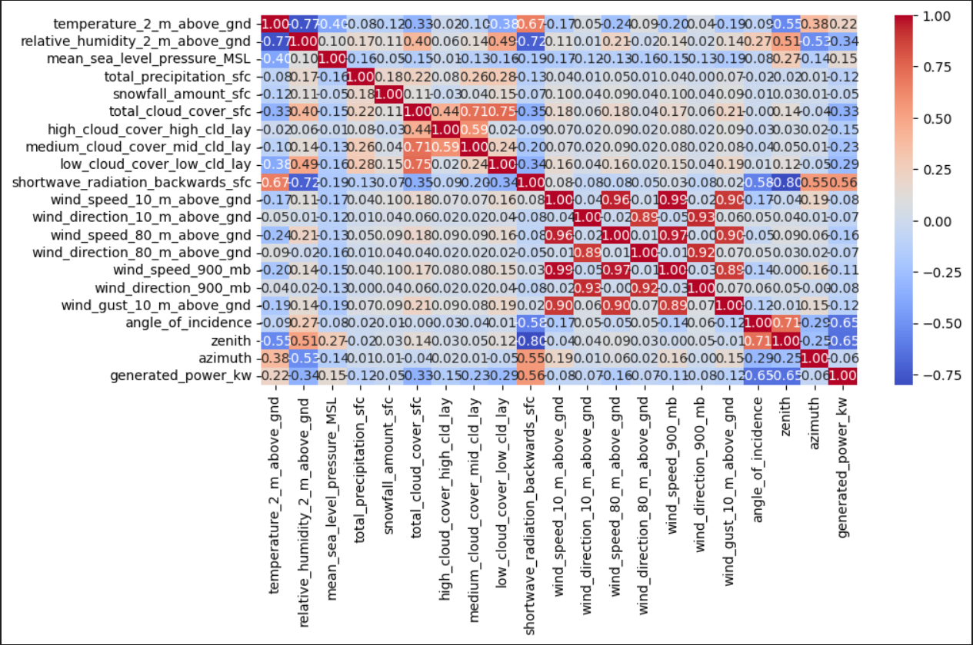
Screenshot of Output:
Heatmap

Slide 14
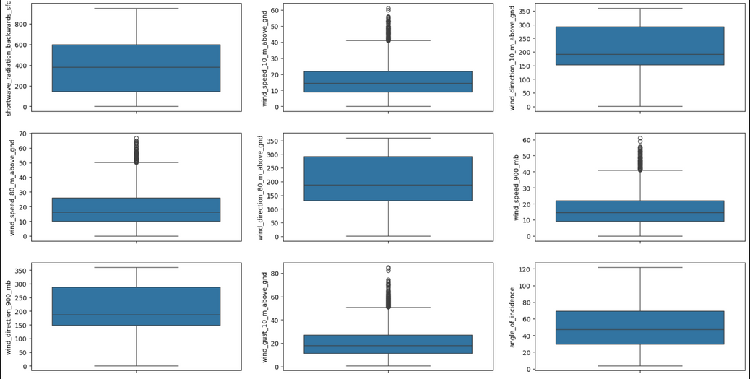
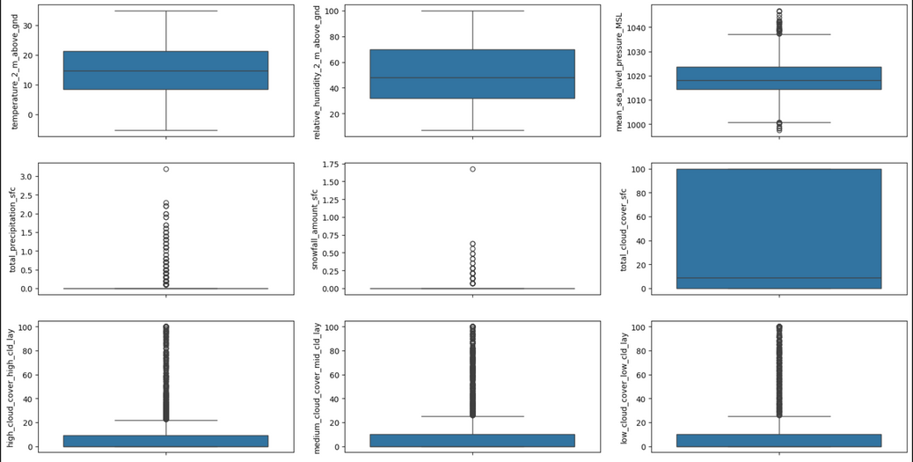
Screenshot of Output:
Outlier

Slide 15
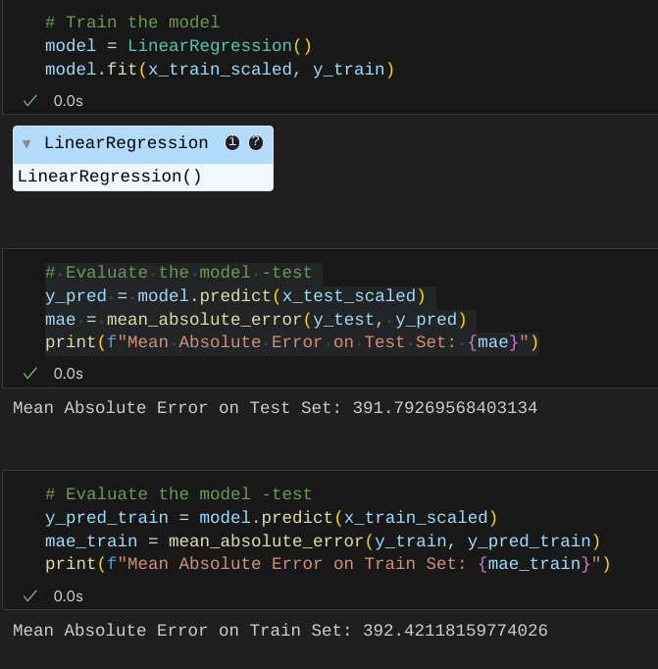
Screenshot of Output:

Slide 16
Conclusion:
Effective Forecasting:
ML accurately predicts solar power, even with variable data.
Energy Management:
Improved forecasts optimize energy distribution.
Future Work:
Real-time integration and deeper learning methods could further improve predictions.
Sustainability:
Demonstrates AI's role in enhancing renewable energy systems.

