Slide 1
COLLEGE ADMISSION AGENT
IBM AICTE INTERSHIP AI PROJECT
Student name : Aditya Sharma
College Name & Department : Maulana Azad National Institute of Technology & Computer Science

Slide 2
OUTLINE
Problem Statement
Technology used
Wow factor
End users
Result
Conclusion
Git-hub Link
Future scope
IBM Certifications

Slide 3
Problem Statement
The college admission process is often overwhelming and confusing for prospective students due to scattered information, unclear eligibility criteria, and delayed responses from institutions. Admission offices are burdened with repetitive queries related to course offerings, fees, application deadlines, and documentation, which slows down the overall process and negatively impacts the student experience. There is a lack of a centralized, real-time, and reliable system that can provide accurate and personalized admission guidance to applicants.
Proposed Solution: To address this, we developed a College Admission Agent powered by RAG (Retrieval-Augmented Generation) using IBM Granite and IBM Cloud Lite services. The system retrieves relevant information from institutional documents, FAQs, and policy manuals, and then uses a powerful language model to generate accurate, real-time answers to natural language queries from students. The assistant provides guidance on course selection, eligibility, fee structure, important dates, and application procedures. This AI-driven solution enhances transparency, reduces manual workload, and significantly improves the admission experience for students and institutions alike.

Slide 4
Technology used
IBM cloud lite services
Natural Language Processing (NLP)
Retrieval Augmented Generation (RAG)
IBM Granite model

Slide 5
IBM cloud services used
IBM Cloud Watsonx AI Studio
IBM Cloud Watsonx AI runtime
IBM Cloud Agent Lab
IBM Granite foundation model

Slide 6
Wow factors
Gives user-specific information based on course, category, and exam score — almost like a personal admission counselor.
The agent uses Retrieval-Augmented Generation (RAG) to give real-time responses based strictly on verified admission documents — no guesswork.Unique features:
Uses IBM’s powerful enterprise-grade LLM for generating high-quality, factual, and context-aware answers
Gives user-specific information based on course, category, and exam score — almost like a personal admission counselor
Can be deployed as a chatbot on college websites or messaging platforms like WhatsApp and Telegram.
Recommendation of research papers based on a user’s current topic
Trend analysis over time for specific keywords or domains.
With minor tweaks, the system can be scaled to serve multiple colleges or even a centralized education portal.

Slide 7
End users
Academic Researchers
Prospective Students
Research Institutions and Universities
School Counselors and Career Advisors
Parents and Guardians
Education Consultants and Agencies

Slide 8
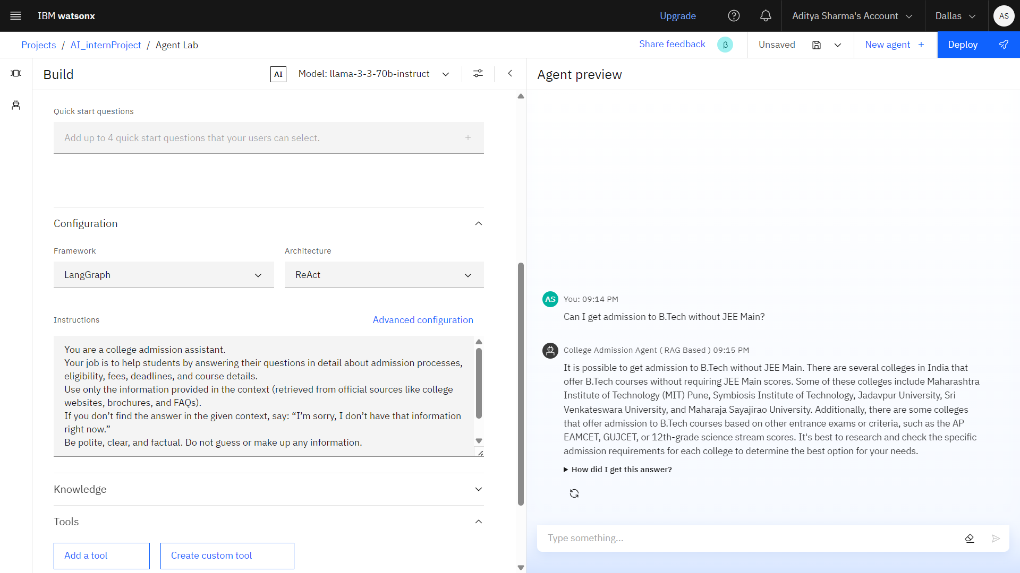
Results

Slide 9
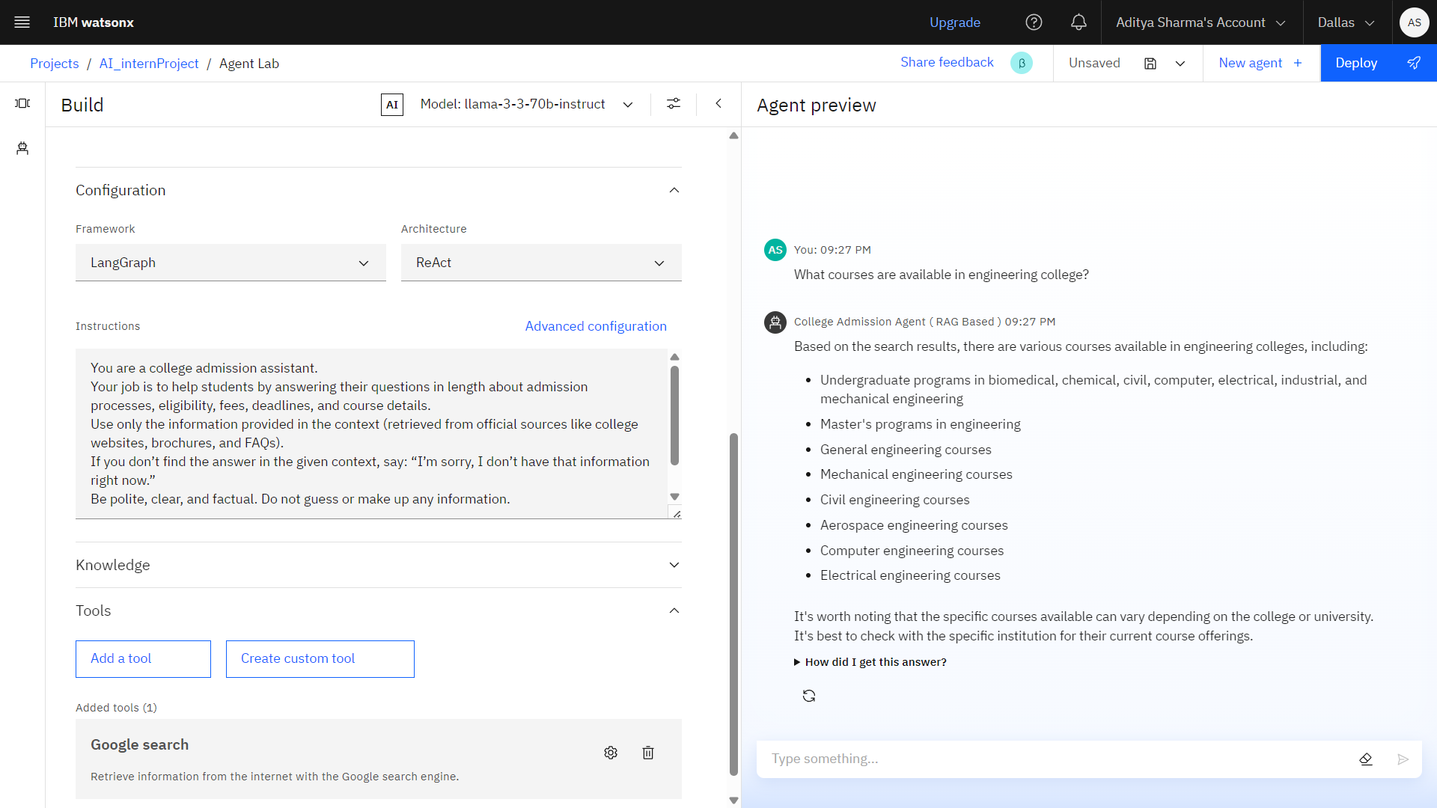

Slide 10
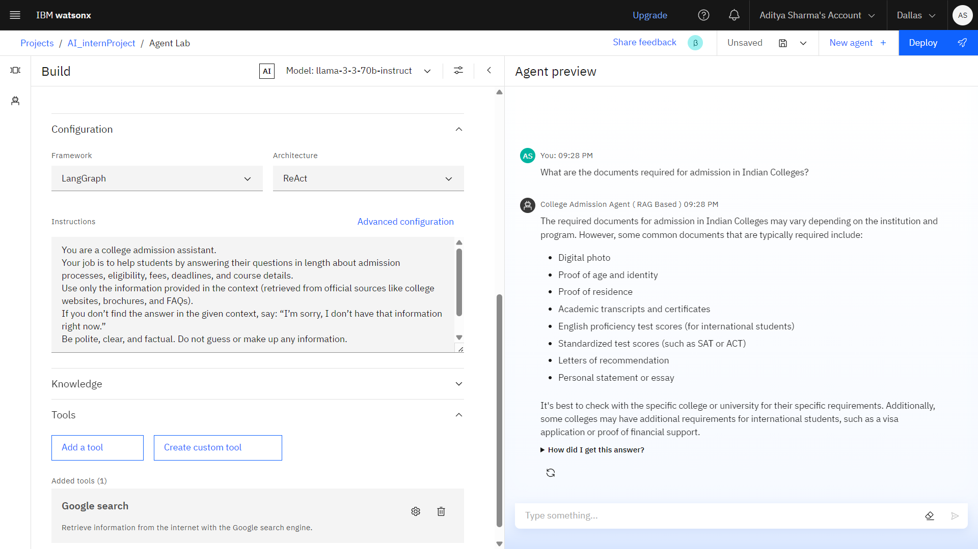

Slide 11
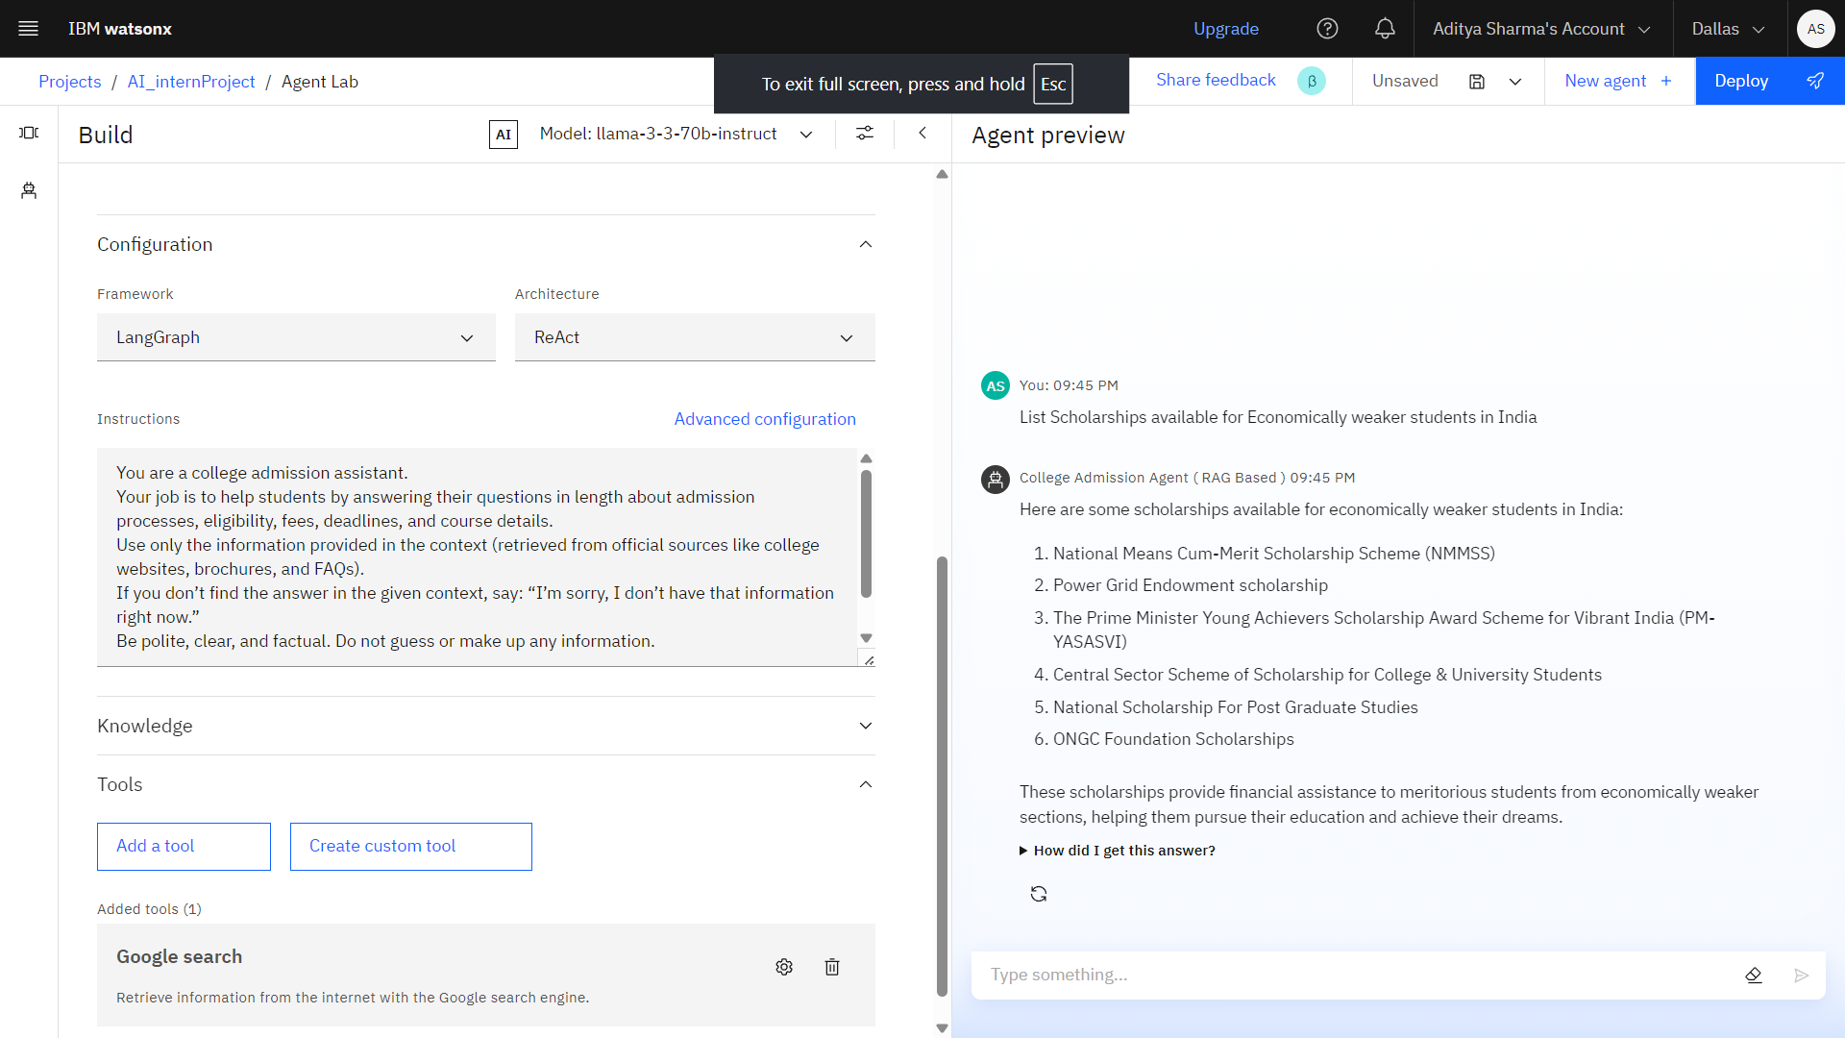

Slide 12
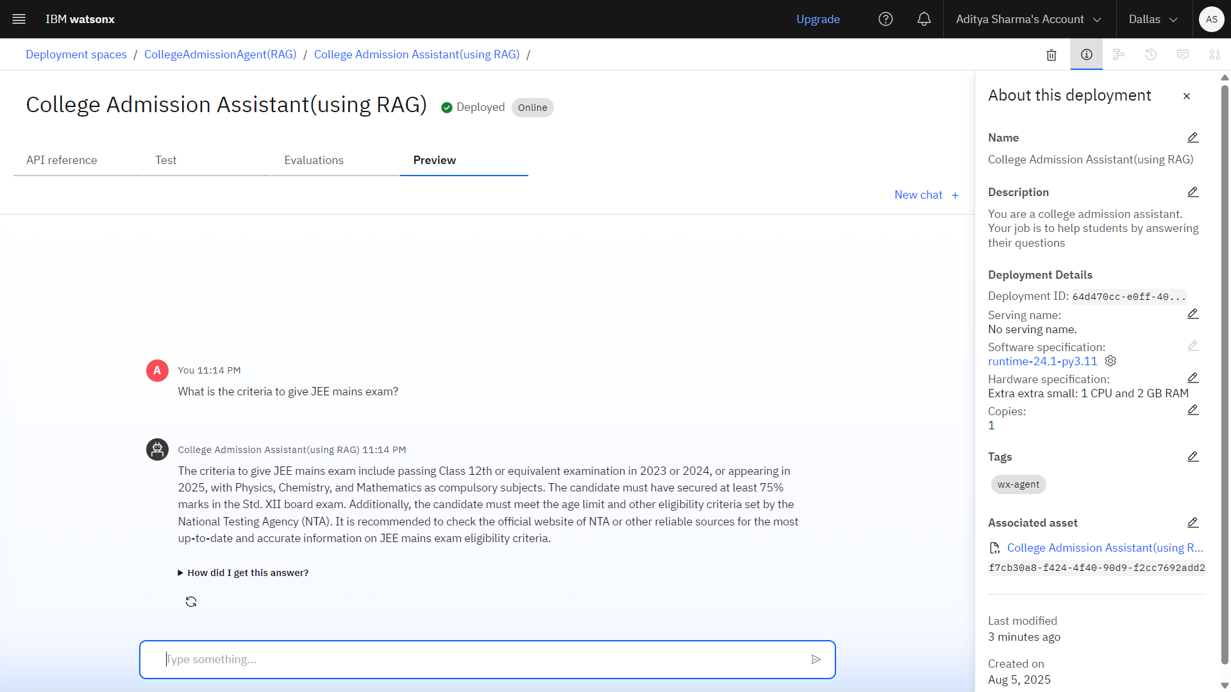
Results
(Deployed AI Agent)

Slide 13
Conclusion
The project successfully streamlines the college admission process by providing instant, accurate, and contextual responses to student queries.
By combining document retrieval with generative AI, the system delivers trustworthy, real-time information from official sources.
The agent reduces the burden on administrative staff by handling frequently asked questions automatically.
The system is scalable and can be easily integrated with college websites, chat platforms, or mobile apps.

Slide 14
Future scope
Multilingual Support
Voice-Activated Research Assistant
Real-Time Notification Feature
Integration with Whatsapp and telegram
Scholar Finder
Document Upload & Verification
Parent and Counselor Modes

Slide 15
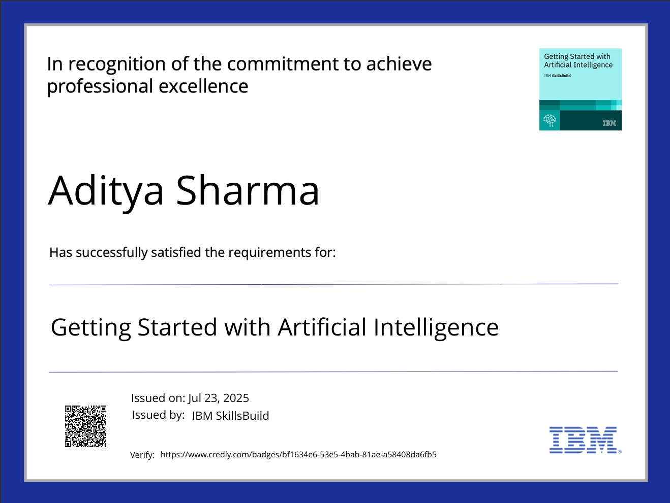
IBM Certifications

Slide 16
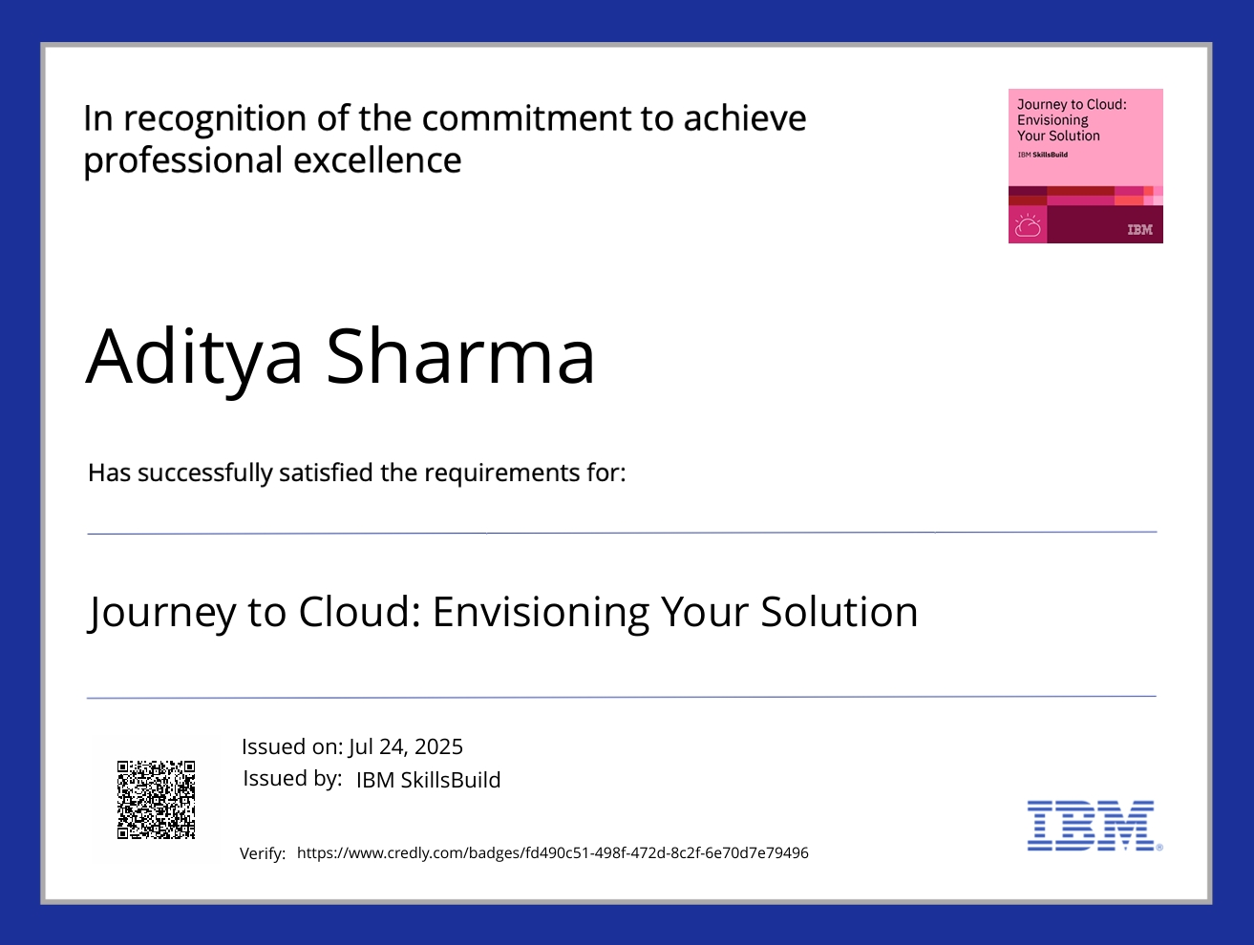

Slide 17
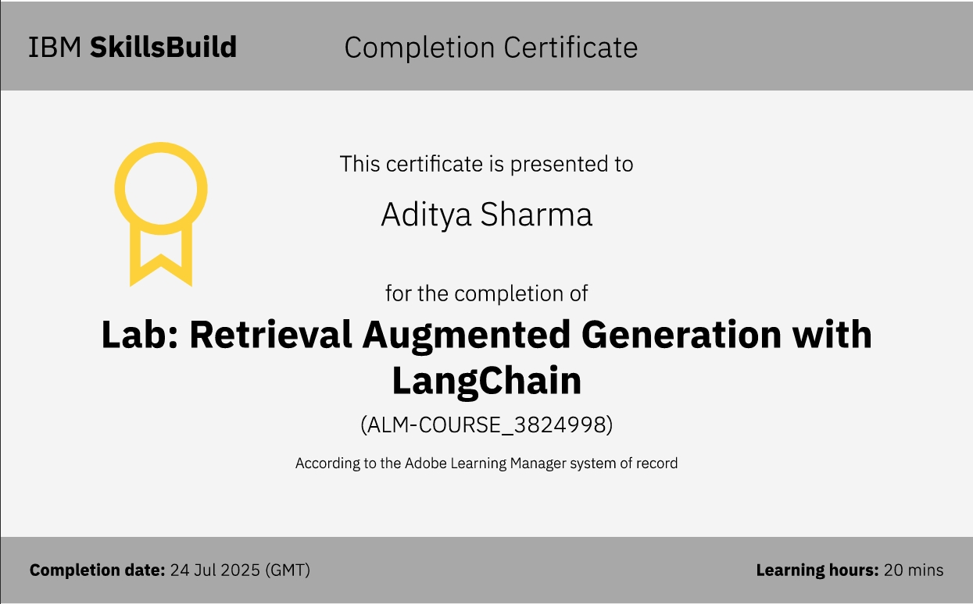

Slide 18
Github link : https://github.com/AdityaSh42/CollegeAdmissionAgent

Slide 19
THANK YOU

