Slide 1
Input/output systems, I/O module-need & functions and Types of data transfer techniques: Programmed I/O, Interrupt driven I/O and DMA
MODULE-6
I/O Organization

Slide 2
INTRODUCTION –I/O SYSTEM
In addition to the processor and a set of memory modules, the third key element of a computer system is a set of I/O modules.
Each module interfaces to the system bus or central switch and controls one or more peripheral devices.
An I/O module is not simply a set of mechanical connectors that wire a device into the system bus.
Rather, the I/O module contains logic for performing a communication function between the peripheral and the bus.

Slide 3
INTRODUCTION –I/O SYSTEM
We may wonder why one does not connect peripherals directly to the system bus.
The reasons are as follows:
• There are a wide variety of peripherals with various methods of operation. It would be impractical to incorporate the necessary logic within the processor to control a range of devices.
• The data transfer rate of peripherals is often much slower than that of the memory or processor. Thus, it is impractical to use the high-speed system bus to communicate directly with a peripheral.
• On the other hand, the data transfer rate of some peripherals is faster than that of the memory or processor. Again, the mismatch would lead to inefficiencies if not managed properly.
• Peripherals often use different data formats and word lengths than the computer to which they are attached. Thus, an I/O module is required.
This module has two major functions :
• Interface to the processor and memory via the system bus or central switch
• Interface to one or more peripheral devices by tailored data link

Slide 4
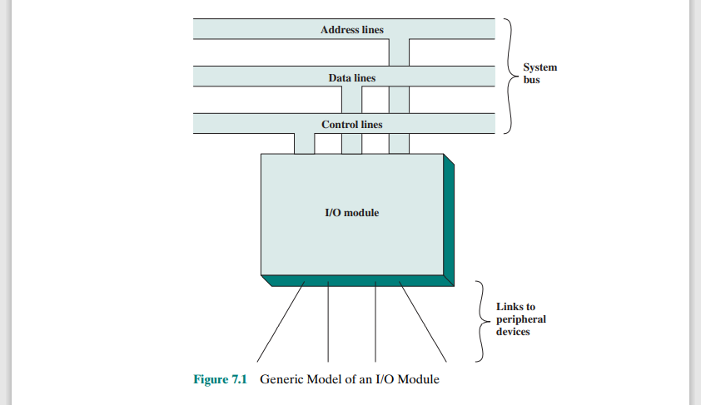
I/O MODULE

Slide 5
I/O MODULE
I/O operations are accomplished through a wide assortment of external devices that provide a means of exchanging data between the external environment and the computer. An external device attaches to the computer by a link to an I/O module.
The link is used to exchange control, status, and data between the I/O module and the external device.
An external device connected to an I/O module is often referred to as a peripheral device or, simply, a peripheral.

Slide 6
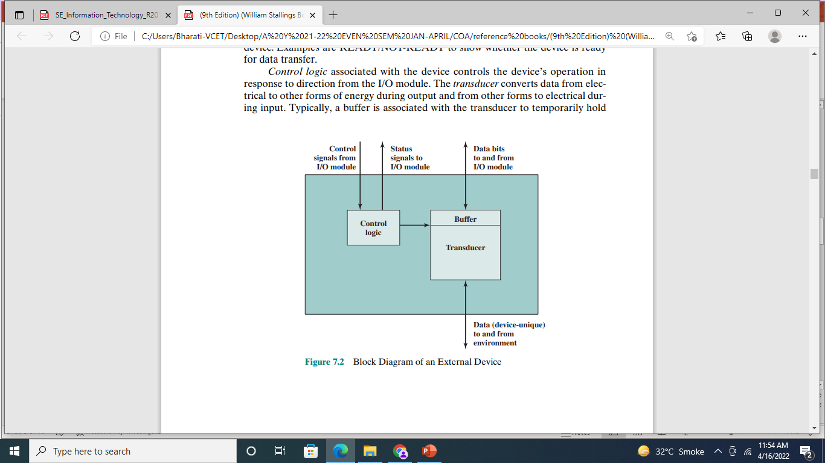
I/O DEVICES
We can broadly classify external devices into three categories:
•Human readable: Suitable for communicating with the computer user
• Machine readable: Suitable for communicating with equipment
• Communication: Suitable for communicating with remote devices

Slide 7
I/O DEVICES
Examples of human-readable devices are video display terminals (VDTs) and printers.
Examples of machine-readable devices are magnetic disk and tape systems, and sensors and actuators, such as are used in a robotics application
Communication devices allow a computer to exchange data with a remote device, which may be a human-readable device, such as a terminal, a machine-readable device, or even another compute

Slide 8
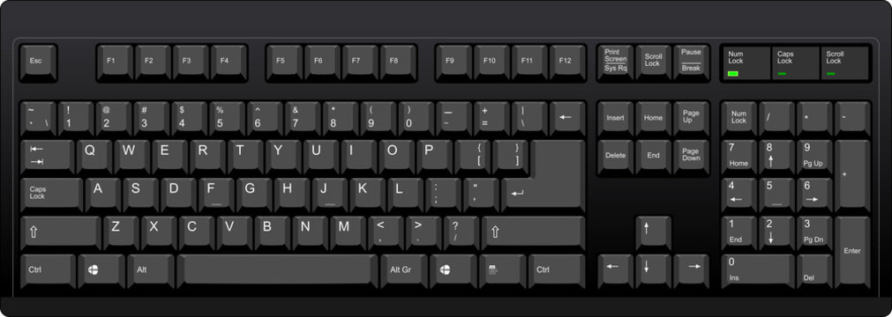
Keyboard/Monitor
The most common means of computer/user interaction is a keyboard/monitor arrangement.
The user provides input through the keyboard. This input is then transmitted to the computer and may also be displayed on the monitor.
The basic unit of exchange is the character. Associated with each character is a code, typically 7 or 8 bits in length.
The most commonly used text code is the International Reference Alphabet (IRA).
Each character in this code is represented by a unique 7-bit binary code; thus, 128 different characters can be represented.
Characters are of two types: printable and control.
Printable characters are the alphabetic, numeric, and special characters that can be printed on paper or displayed on a screen.
Some of the control characters have to do with controlling the printing or displaying of characters; an example is carriage return.
Other control characters are concerned with communications .

Slide 9
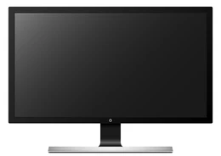
Keyboard/Monitor
For keyboard input, when the user depresses a key, this generates an electronic signal that is interpreted by the transducer in the keyboard and translated into the bit pattern of the corresponding IRA code.
This bit pattern is then transmitted to the I/O module in the computer.
On output, IRA code characters are transmitted to an external device from the I/O module.
The transducer at the device interprets this code and sends the required electronic signals to the output device either to display the indicated character or perform the requested control function

Slide 10
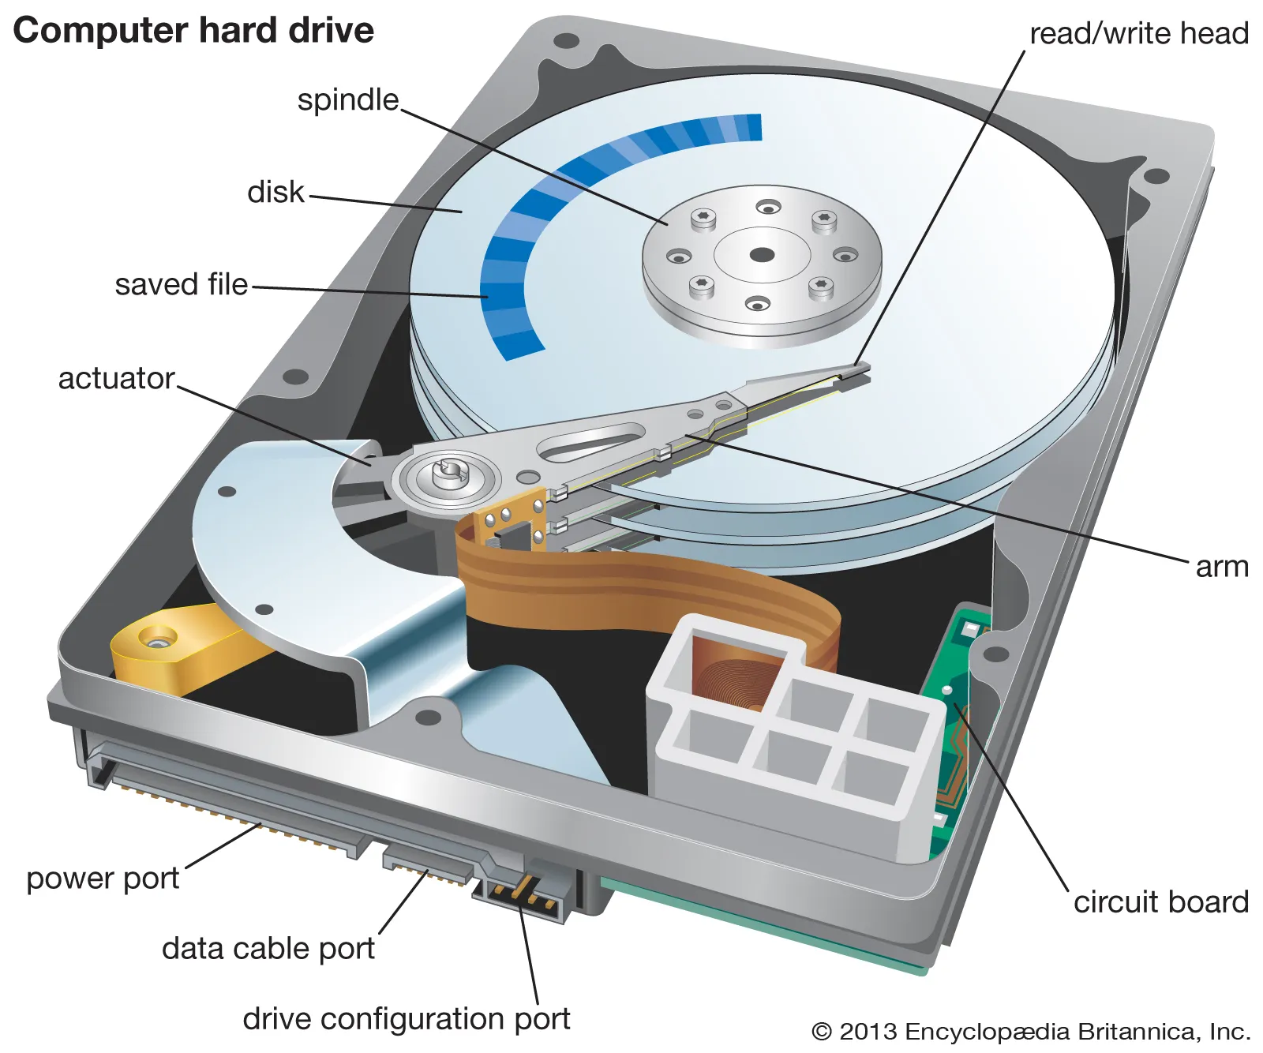
Disk Drive
A disk drive contains electronics for exchanging data, control, and status signals with an I/O module plus the electronics for controlling the disk read/write mechanism.
In a fixed-head disk, the transducer can convert between the magnetic patterns on the moving disk surface and bits in the device’s buffer .
A moving-head disk must also be able to cause the disk arm to move radially in and out across the disk’s surface.

Slide 11
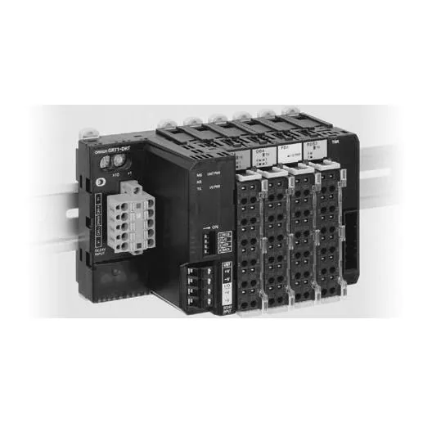
I/O Module Function
The major functions or requirements for an I/O module fall into the following categories:
• Control and timing
• Processor communication
• Device communication
• Data buffering
• Error detection
During any period of time, the processor may communicate with one or more external devices in unpredictable patterns, depending on the program’s need for I/O.
The internal resources, such as main memory and the system bus, must be shared among a number of activities, including data I/O.
Thus, the I/O function includes a control and timing requirement, to coordinate the flow of traffic between internal resources and external devices.

Slide 12
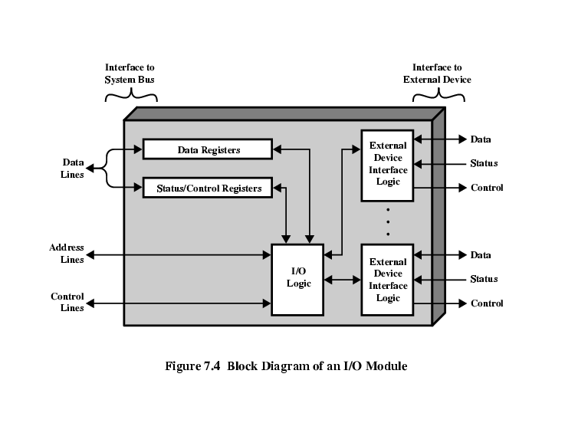
contd

Slide 13
contd
For example, the control of the transfer of data from an external device to the processor might involve the following sequence of steps:
1. The processor interrogates the I/O module to check the status of the attached device.
2. The I/O module returns the device status.
3. If the device is operational and ready to transmit, the processor requests the transfer of data, by means of a command to the I/O module.
4. The I/O module obtains a unit of data (e.g., 8 or 16 bits) from the external device.
5. The data are transferred from the I/O module to the processor

Slide 14
CONTD
If the system employs a bus, then each of the interactions between the processor and the I/O module involves one or more bus arbitrations.
Processor communication involves the following:
• Command decoding: The I/O module accepts commands from the processor, typically sent as signals on the control bus. For example, an I/O module for a disk drive might accept the following commands: READ SECTOR, WRITE SECTOR, SEEK track number, and SCAN record ID.
• Data: Data are exchanged between the processor and the I/O module over the data bus.
• Status reporting: Because peripherals are so slow, it is important to know the status of the I/O module. For example, if an I/O module is asked to send data to the processor (read), it may not be ready to do so because it is still working on the previous I/O command. This fact can be reported with a status signal. Common status signals are BUSY and READY.
• Address recognition: Just as each word of memory has an address, so does each I/O device. Thus, an I/O module must recognize one unique address for each peripheral it controls.

Slide 15
contd
On the other side, the I/O module must be able to perform device communication. This communication involves commands, status information, and data .
An essential task of an I/O module is data buffering, function is apparent whereas the transfer rate into and out of main memory or the processor is quite high, the rate is orders of magnitude lower for many peripheral devices and covers a wide range. Data coming from main memory are sent to an I/O module in a rapid burst. The data are buffered in the I/O module and then sent to the peripheral device at its data rate.
In the opposite direction, data are buffered so as not to tie up the memory in a slow transfer operation. Thus, the I/O module must be able to operate at both device and memory speeds.
Similarly, if the I/O device operates at a rate higher than the memory access rate, then the I/O module performs the needed buffering operation.

Slide 16
CONTD
Finally, an I/O module is often responsible for error detection and for subsequently reporting errors to the processor. One class of errors includes mechanical and electrical malfunctions reported by the device (e.g., paper jam, bad disk track).
Another class consists of unintentional changes to the bit pattern as it is transmitted from device to I/O module. Some form of error-detecting code is often used to detect transmission errors.
A simple example is the use of a parity bit on each character of data. For example, the IRA character code occupies 7 bits of a byte. The eighth bit is set so that the total number of 1s in the byte is even (even parity) or odd (odd parity). When a byte is received, the I/O module checks the parity to determine whether an error has occurred.

Slide 17
Three techniques are possible for I/O operations
With programmed I/O, data are exchanged between the processor and the I/O module. The processor executes a program that gives it direct control of the I/O operation, including sensing device status, sending a read or write command, and transferring the data.
When the processor issues a command to the I/O module, it must wait until the I/O operation is complete. If the processor is faster than the I/O module, this is wasteful of processor time.
With interrupt-driven I/O, the processor issues an I/O command, continues to execute other instructions, and is interrupted by the I/O module when the latter has completed its work.
With both programmed and interrupt I/O, the processor is responsible for extracting data from main memory for output and storing data in main memory for input.
The alternative is known as direct memory access (DMA). In this mode, the I/O module and main memory exchange data directly, without processor involvement.
.

Slide 18
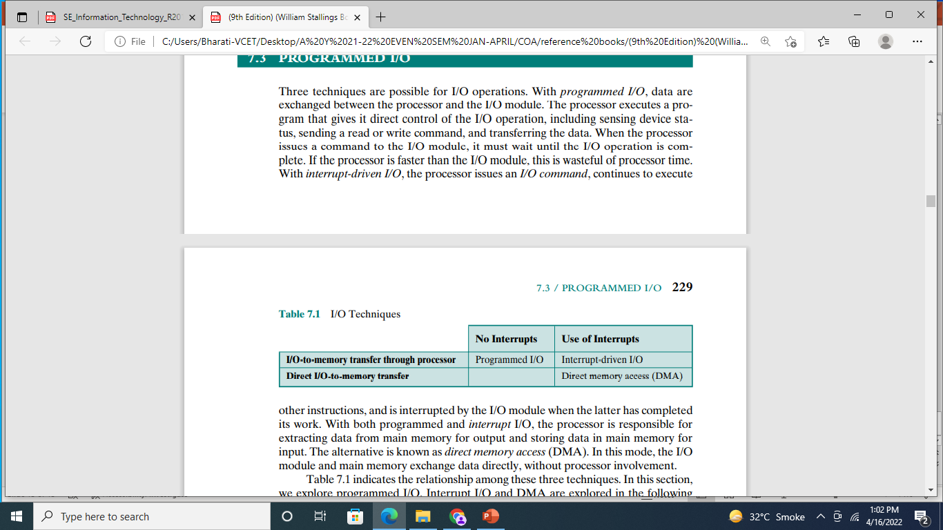
Table indicates the relationship among these three techniques.

Slide 19
Programmed I/O
When the processor is executing a program and encounters an instruction relating to I/O, it executes that instruction by issuing a command to the appropriate I/O module.
With programmed I/O, the I/O module will perform the requested action and then set the appropriate bits in the I/O status register .
The I/O module takes no further action to alert the processor. In particular, it does not interrupt the processor. Thus, it is the responsibility of the processor periodically to check the status of the I/O module until it finds that the operation is complete.
To explain the programmed I/O technique, we view it first from the point of view of the I/O commands issued by the processor to the I/O module, and then from the point of view of the I/O instructions executed by the processor

Slide 20
Interrupt driven I/O
The problem with programmed I/O is that the processor must wait a long time for the I/O module of concern to be ready for either reception or transmission of data.
The processor, while waiting, must repeatedly interrogate the status of the I/O module. As a result, the level of the performance of the entire system is severely degraded.
An alternative is for the processor to issue an I/O command to a module and then go on to do some other useful work.
The I/O module will then interrupt the processor to request service when it is ready to exchange data with the processor.
The processor then executes the data transfer, as before, and then resumes its former processing.

Slide 21
Interrupt driven I/O
Let us consider how this works, first from the point of view of the I/O module. For input, the I/O module receives a READ command from the processor.
The I/O module then proceeds to read data in from an associated peripheral. Once the data are in the module’s data register, the module signals an interrupt to the processor over a control line.
The module then waits until its data are requested by the processor. When the request is made, the module places its data on the data bus and is then ready for another I/O operation

Slide 22
Drawbacks of Programmed and Interrupt-Driven I/O
Interrupt-driven I/O, though more efficient than simple programmed I/O, still requires the active intervention of the processor to transfer data between memory and an I/O module, and any data transfer must traverse a path through the processor. Thus, both these forms of I/O suffer from two inherent drawbacks:
1. The I/O transfer rate is limited by the speed with which the processor can test and service a device.
2. The processor is tied up in managing an I/O transfer; several instructions must be executed for each I/O transfer
Using simple programmed I/O, the processor is dedicated to the task of I/O and can move data at a rather high rate, at the cost of doing nothing else.
Interrupt I/O frees up the processor to some extent at the expense of the I/O transfer rate. Nevertheless, both methods have an adverse impact on both processor activity and I/O transfer rate.
When large volumes of data are to be moved, a more efficient technique is required: direct memory access (DMA)

Slide 23
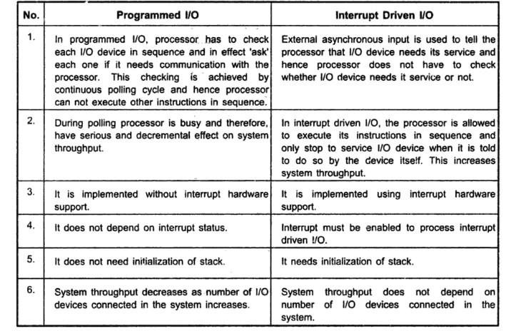
Difference between

Slide 24
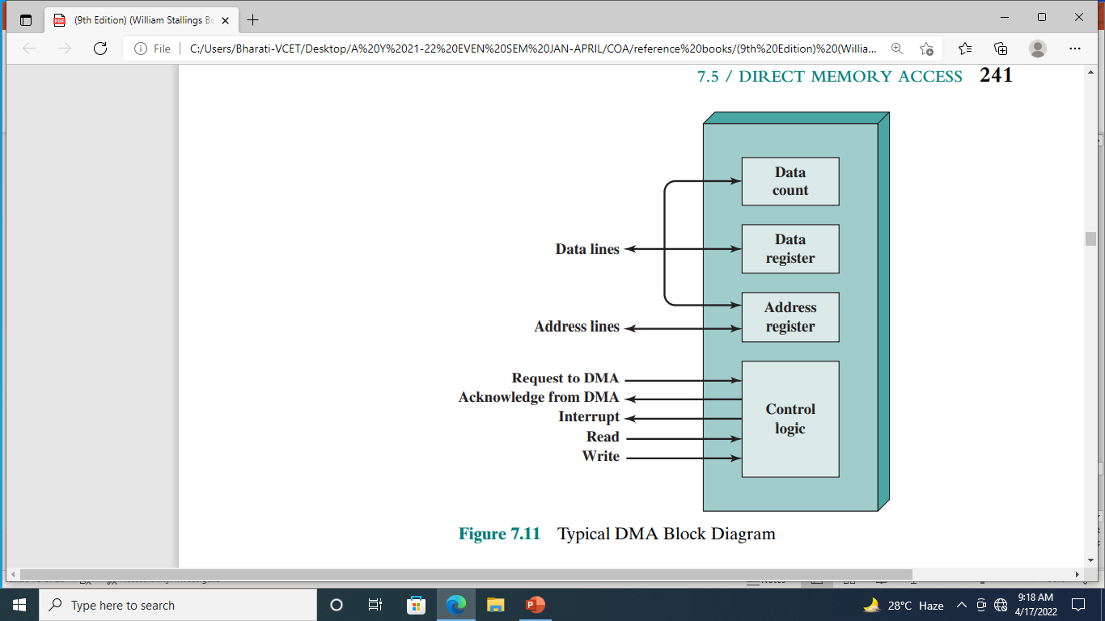
DMA Function

Slide 25
DMA Function
DMA involves an additional module on the system bus. The DMA module (Figure 7.11) is capable of mimicking the processor and, indeed, of taking over control of the system from the processor.
It needs to do this to transfer data to and from memory over the system bus.
For this purpose, the DMA module must use the bus only when the processor does not need it, or it must force the processor to suspend operation temporarily.
The latter technique is more common and is referred to as cycle stealing, because the DMA module in effect steals a bus cycle.

Slide 26
DMA Function
When the processor wishes to read or write a block of data, it issues a command to the DMA module, by sending to the DMA module the following information:
Whether a read or write is requested, using the read or write control line between the processor and the DMA module
The address of the I/O device involved, communicated on the data lines
The starting location in memory to read from or write to, communicated on the data lines and stored by the DMA module in its address register
The number of words to be read or written, again communicated via the data lines and stored in the data count register

Slide 27
DMA Function
The processor then continues with other work.
It has delegated this I/O operation to the DMA module.
The DMA module transfers the entire block of data, one word at a time, directly to or from memory, without going through the processor.
When the transfer is complete, the DMA module sends an interrupt signal to the processor.
Thus, the processor is involved only at the beginning and end of the transfer

Slide 28
