Slide 1
Paging

Slide 2
Storage
Disk
1TB
Main Memory
(RAM)
16GB

Slide 3
Storage
Disk
1TB
Virtual
Memory
Main Memory
(RAM)
16GB

Slide 4
Virtual Memory
Physical Memory
Page 7
Page 6
Page 5
Page 4
Page 3
Page 2
Page 1
Page 0
Page frame 3
Page frame 2
Page frame 1
Page frame 0

Slide 5
Virtual Memory (64KB)
Page 15 (4KB)
Page 14 (4KB)
Page 13 (4KB)
Page 12 (4KB)
Page 11 (4KB)
Page 10 (4KB)
Page 9 (4KB)
Page 8 (4KB)
Page 7 (4KB)
Page 6 (4KB)
Page 5 (4KB)
Page 4 (4KB)
Page 3 (4KB)
Page 2 (4KB)
Page 1 (4KB)
Page 0 (4KB)
Physical Memory (32KB)
Page frame 7 (4KB)
Page frame 6 (4KB)
Page frame 5 (4KB)
Page frame 4 (4KB)
Page frame 3 (4KB)
Page frame 2 (4KB)
Page frame 1 (4KB)
Page frame 0 (4KB)

Slide 6
Page / Page frame (4KB)
4095
4094
4093
4092
4091
. . .
4
3
2
1
0
4096

Slide 7
Program generates virtual address which points in Virtual Memory.
MMU maps this Virtual address into physical address.
Let’s see how MMU works?

Slide 8
Page Table
15 |  | 0
14 |  | 0
13 |  | 0
12 |  | 0
11 | 111 | 1
10 |  | 0
9 | 101 | 1
8 |  | 0
7 |  | 0
6 |  | 0
5 | 011 | 1
4 | 100 | 1
3 | 000 | 1
2 | 110 | 1
1 | 001 | 1
0 | 010 | 1
Page No.
Present / Absent bit
Page frame No.

Slide 9
MMU splits Virtual address into 2 part;
High order bits as page no.
Low order bits as an offset
Here we consider Virtual Memory of 64KB
ie 16 bits virtual address (2¹⁶ = 65536 Bytes).
We have 16 pages of 4KB each.
Upper 4-bits of VA used for page no ( as 2⁴ = 16) and
Lower 12-bits as an offset ie location of data byte in page frame.
2¹² = 4096 (4KB)
This virtual address split depends on number of pages and
page size.

Slide 10
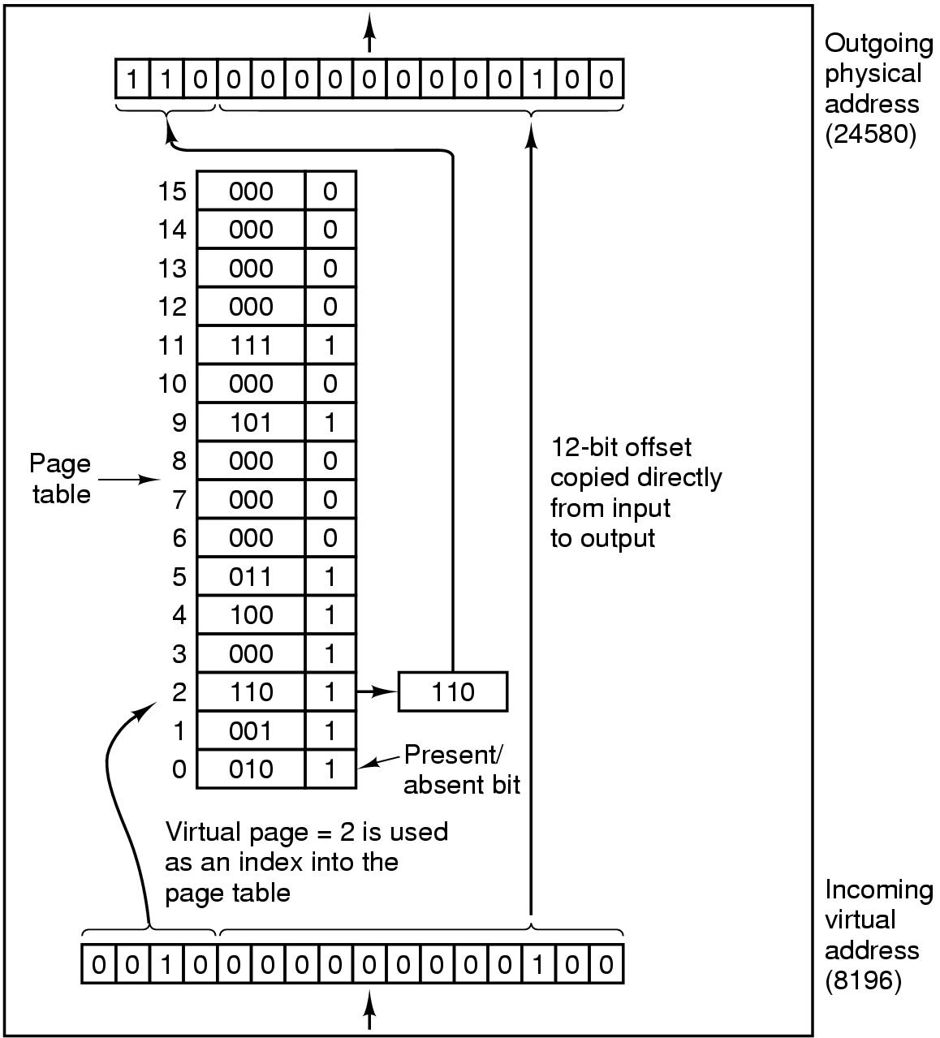
MMU operation

Slide 11
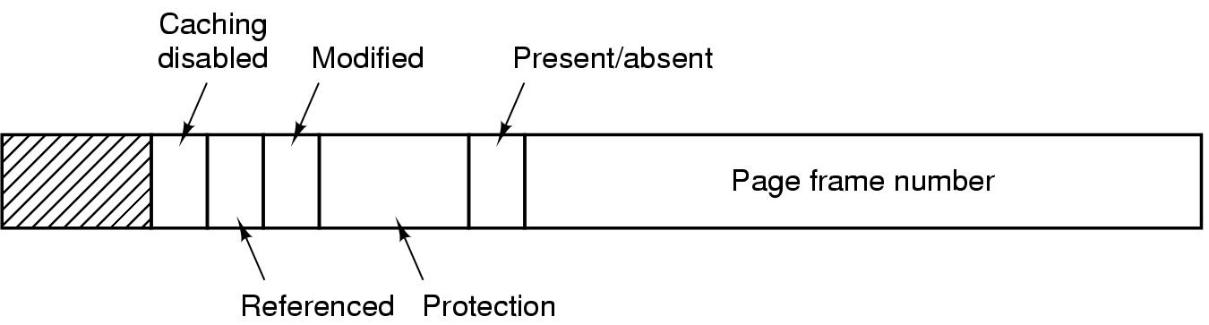
Structure of Page Table Entry

Slide 12
Structure of Page Table Entry
Most important field that gives which frame is mapped into the page.

Slide 13
Structure of Page Table Entry
If this bit is 1 that means page frame is in memory. Otherwise page fault occurs.

Slide 14
Structure of Page Table Entry
Tells what kind of access are permitted ie read/ write.

Slide 15
Structure of Page Table Entry
When write operation takes place on page then H/W set this bit.
1- mean page has been modified ie dirty, it must be written back to disk. Otherwise clean, not necessary to write. Also called as dirty bit.

Slide 16
Structure of Page Table Entry
This bit set whenever a page is referenced for reading /writing. This bit used by OS for page replacement.

Slide 17
Structure of Page Table Entry
This bit allows caching to be disabled.

Slide 18
Structure of the Page Table
Some most common techniques for structuring the page table.
Hierarchical Paging
Hashed Page Tables
Inverted Page Tables

Slide 19
Structure of the Page Table
Hierarchical Paging:
If logical address space is large, then the page table itself becomes excessively large.
One simple solution to this problem is to divide the page table into smaller pieces.
One way is to use a two-level paging algorithm, in which the page table itself is also paged.

Slide 20
Structure of the Page Table
Hierarchical Paging:

Slide 21
Structure of the Page Table
Hierarchical Paging:

Slide 22
Structure of the Page Table
Hashed Page Tables:
A common approach for handling address spaces larger than 32 bits is to use a hashed page table. with the hash value being the virtual page number.
Each entry in the hash table contains a linked list of elements that hash to the same location.
Each element consists of three fields:
the virtual page number,
the value of the mapped page frame, and
a pointer to the next element in the linked list.

Slide 23
Structure of the Page Table
Hashed Page Tables:
The algorithm works as follows:
The virtual page number in the virtual address is hashed into the hash table.
The virtual page number is compared with field 1 in the first element in the linked list.
If there is a match, the corresponding page frame is used to form the desired physical address.
If there is no match, subsequent entries in the linked list are searched for a matching virtual page number.

Slide 24
Structure of the Page Table
Hashed Page Tables:

Slide 25
Structure of the Page Table
Inverted Page Tables:

Slide 26
Thank You

