Slide 1
Introduction to Memory and Memory parameters. Classifications of primary and secondary memories. Types of RAM and ROM, Allocation policies, Memory hierarchy and characteristics. Cache memory: Concept, architecture (L1, L2, L3), mapping techniques. Cache Coherency, Interleaved and Associative memory
MODULE 5- Memory Organization

Slide 2
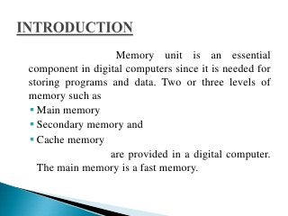

Slide 3
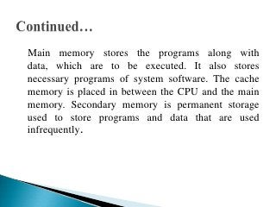

Slide 4
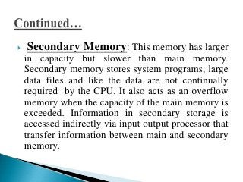

Slide 5
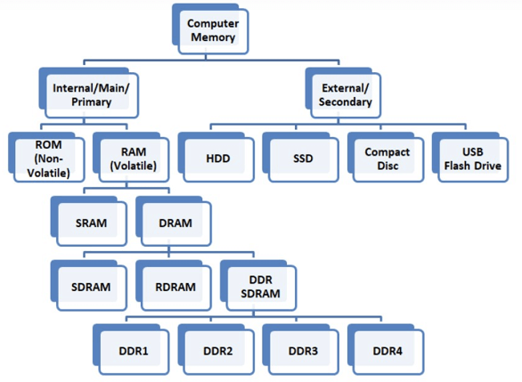

Slide 6
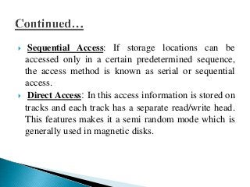

Slide 7
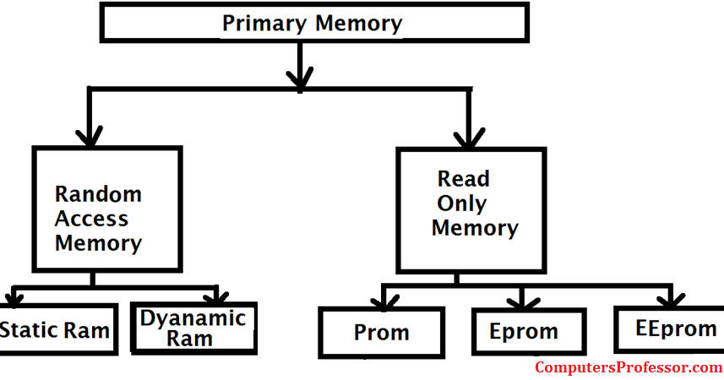

Slide 8
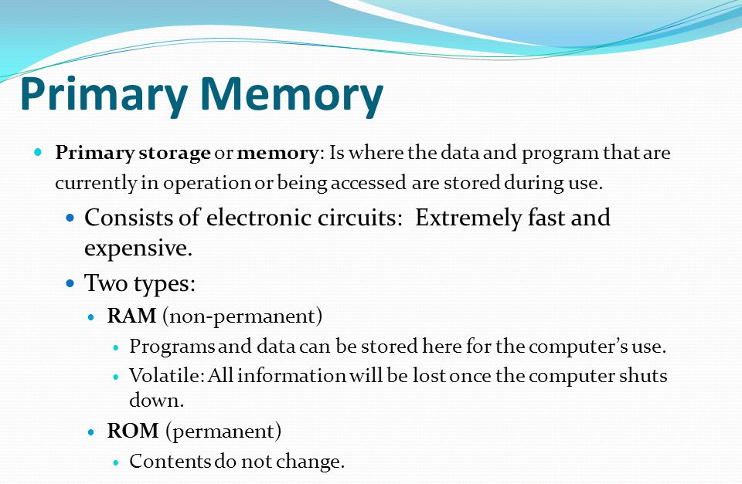

Slide 9
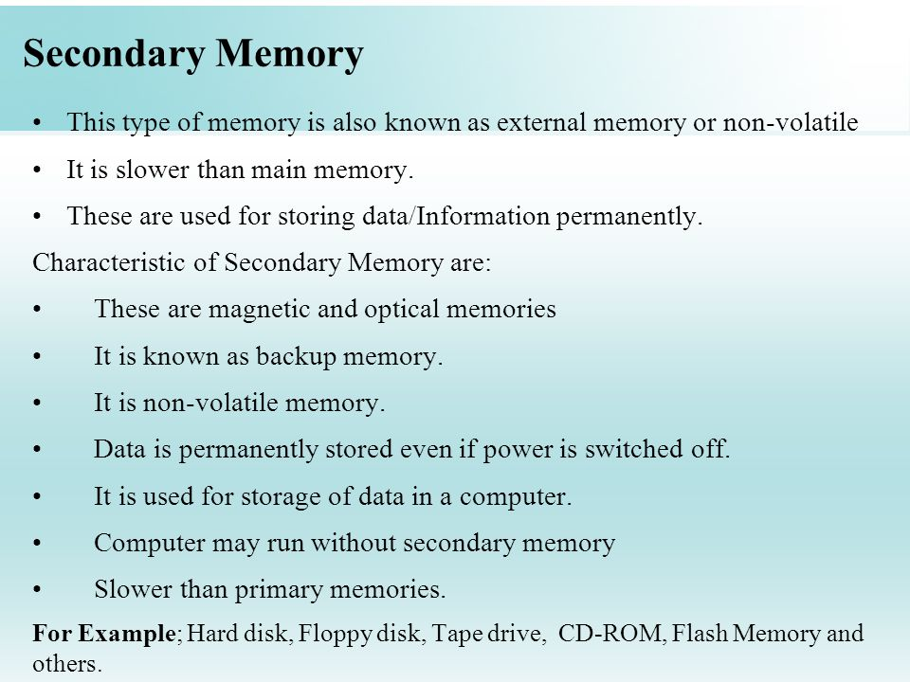

Slide 10
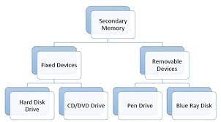

Slide 11
Types of main memory
There are two types of main memory, Random Access Memory (RAM) and Read Only Memory (ROM)
Random Access Memory (RAM) holds its data as long as the computer is switched on
All data in RAM is lost when the computer is switched off
Described as being volatile
It is direct access as it can be both written to or read from in any order
Its purpose is to temporarily hold programs and data for processing. In modern computers it also holds the operating system

Slide 12
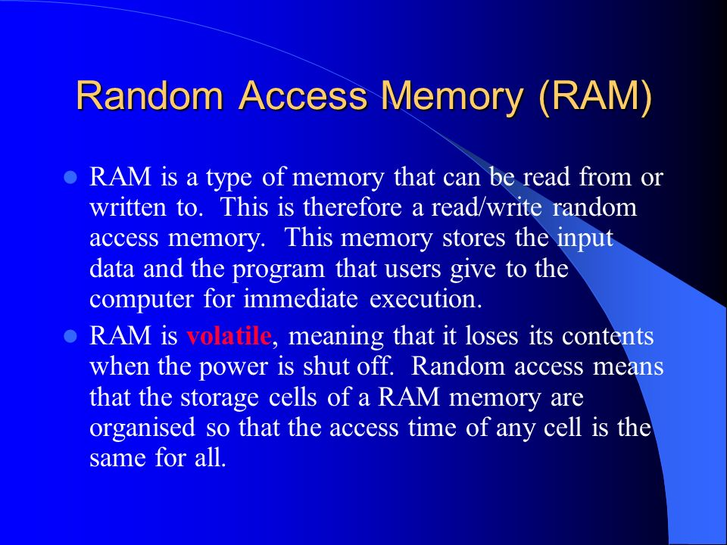
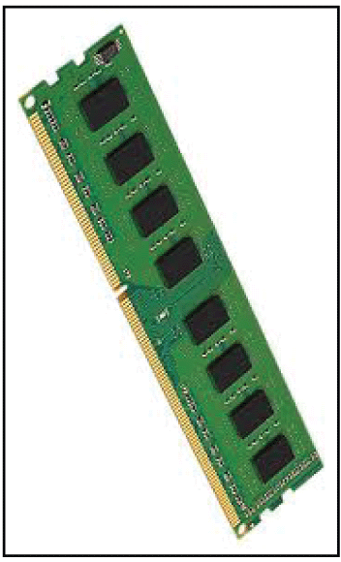

Slide 13
Types of RAM 1. Dynamic Random Access Memory (DRAM)
Contents are constantly refreshed 1000 times per second
Access time 60 – 70 nanoseconds
Note: a nanosecond is one billionth of a second!
Synchronous Dynamic Random Access Memory (SDRAM)Quicker than DRAM
Access time less than 60 nanoseconds
Direct Rambus Dynamic Random Access Memory (DRDRAM)New type of RAM architecture
Access time 20 times faster than DRAM
More expensive

Slide 14
Types of RAM 2. Static Random Access Memory (SRAM)
Doesn’t need refreshing
Retains contents as long as power applied to the chip
Access time around 10 nanoseconds
Used for cache memory
Also, for date and time settings as powered by small battery
Cache memory
Small amount of memory typically 256 or 512 kilobytes
Temporary store for often used instructions
Level 1 cache is built within the CPU (internal)
Level 2 cache may be on chip or nearby (external)
Faster for CPU to access than main memory

Slide 15
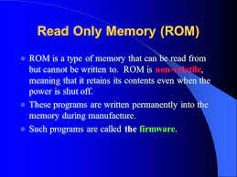

Slide 16
Types of ROM
1. Programmable Read Only Memory (PROM)
Empty of data when manufactured
May be permanently programmed by the user
2. Erasable Programmable Read Only Memory (EPROM)
Can be programmed, erased and reprogrammed
The EPROM chip has a small window on top allowing it to be erased by shining ultra-violet light on it
After reprogramming the window is covered to prevent new contents being erased
Access time is around 45 – 90 nanoseconds

Slide 17
Types of ROM
3. Electrically Erasable Programmable Read Only Memory (EEPROM)
Reprogrammed electrically without using ultraviolet light
Must be removed from the computer and placed in a special machine to do this
Access times between 45 and 200 nanoseconds
4. Flash ROM
Similar to EEPROM
However, can be reprogrammed while still in the computer
Easier to upgrade programs stored in Flash ROM
Used to store programs in devices e.g. modems
Access time is around 45 – 90 nanoseconds
5. ROM cartridges
Commonly used in games machines
Prevents software from being easily copied

Slide 18
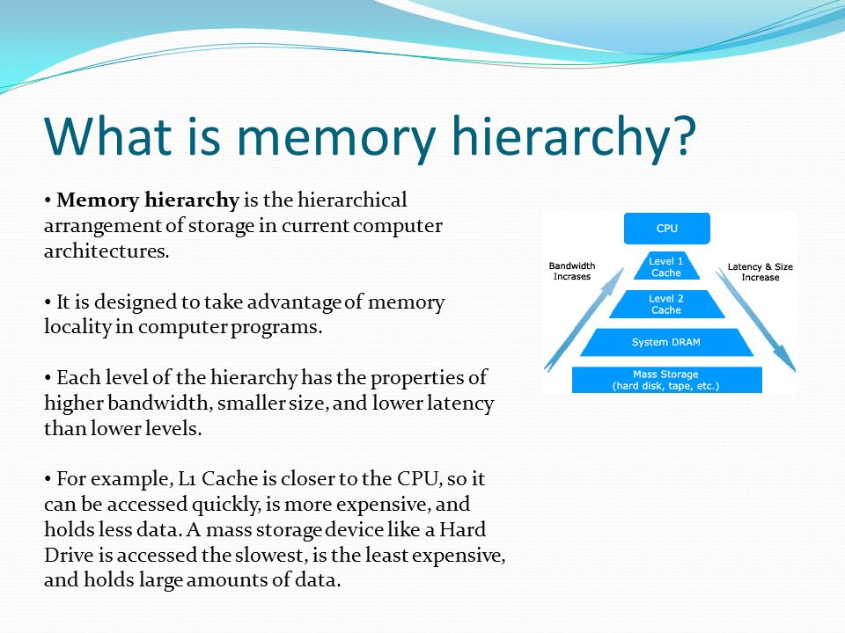

Slide 19
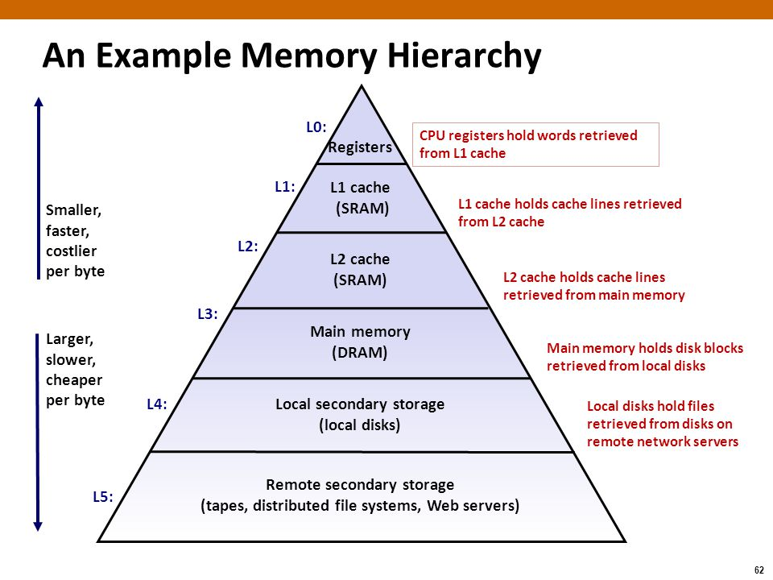

Slide 20
