Slide 1
Monte Carlo Integration using OpenMP
Name: Aditya Shankar
Course: Heterogeneous Parallelism (HP)

Slide 2
Index
Project Idea
Novelty
Approach
Code & Output Screenshots
Demo & Output
Learnings
References

Slide 3
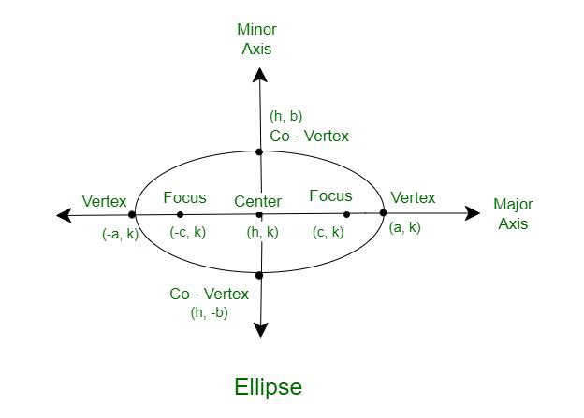
Project Idea
Estimate the area of an ellipse using Monte Carlo Integration.
Generate random points in the bounding box of the ellipse.
Calculate ratio of points that fall inside the ellipse.
Use OpenMP to parallelize the computation for faster performance.

Slide 4
Novelty
Demonstrates Monte Carlo method on a non-trivial shape (ellipse).
Adds parallelism using OpenMP for significant speed-up.
Dynamic thread tuning possible to observe scalability.
Accurate area estimation using probabilistic modeling.

Slide 5
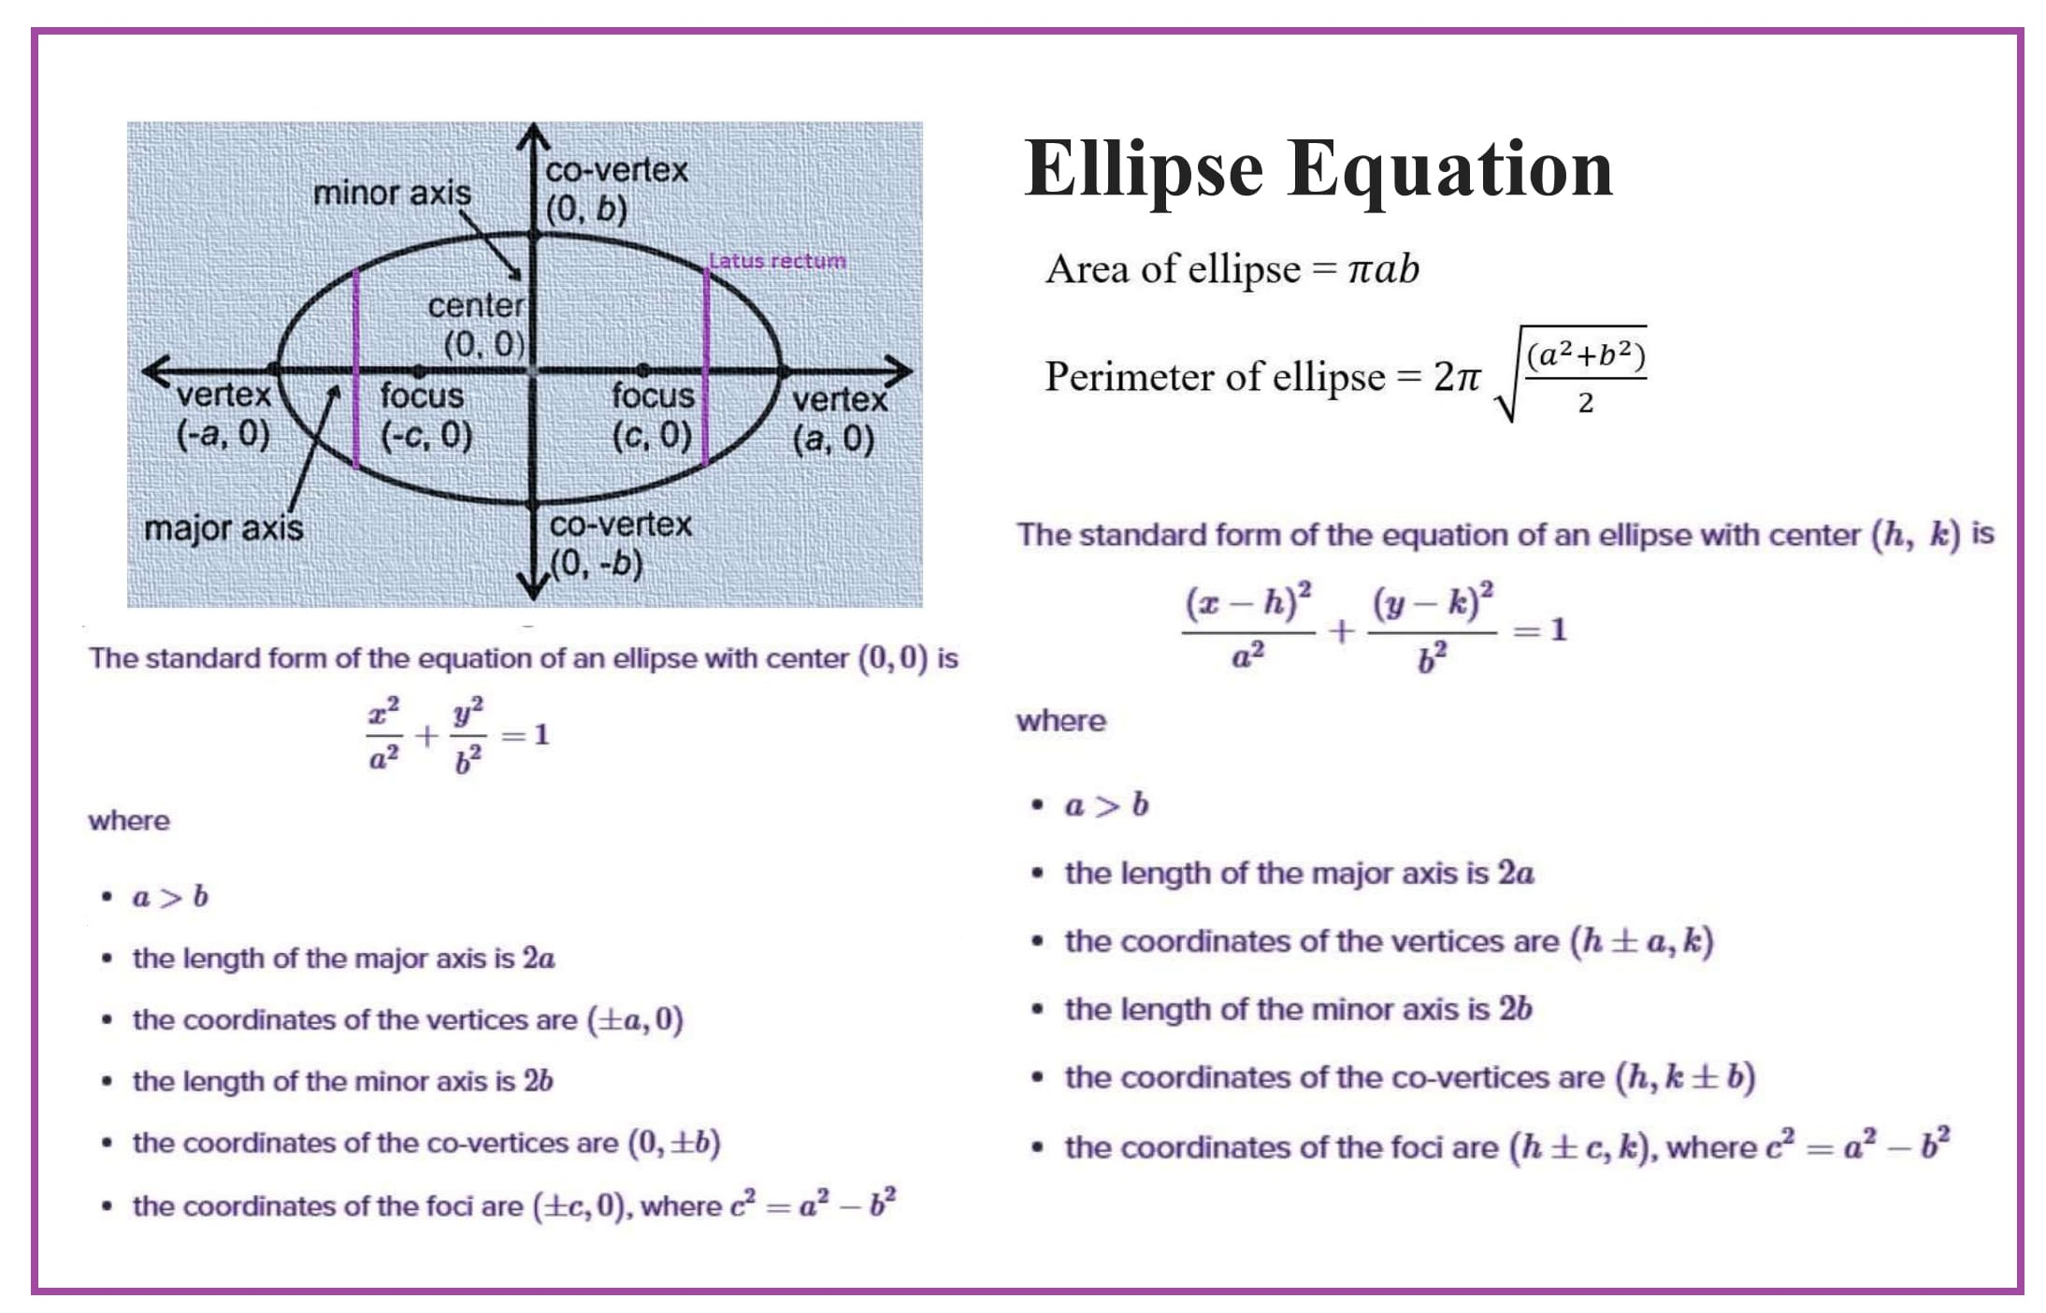
Approach
Generate random (x, y) within bounding rectangle of ellipse.
Condition for being inside ellipse: (x²/a² + y²/b² ≤ 1).
Parallel loop with OpenMP:
#pragma omp parallel for reduction(+:pointsInside)
Area = (Points Inside / Total Points) × (4ab)

Slide 6
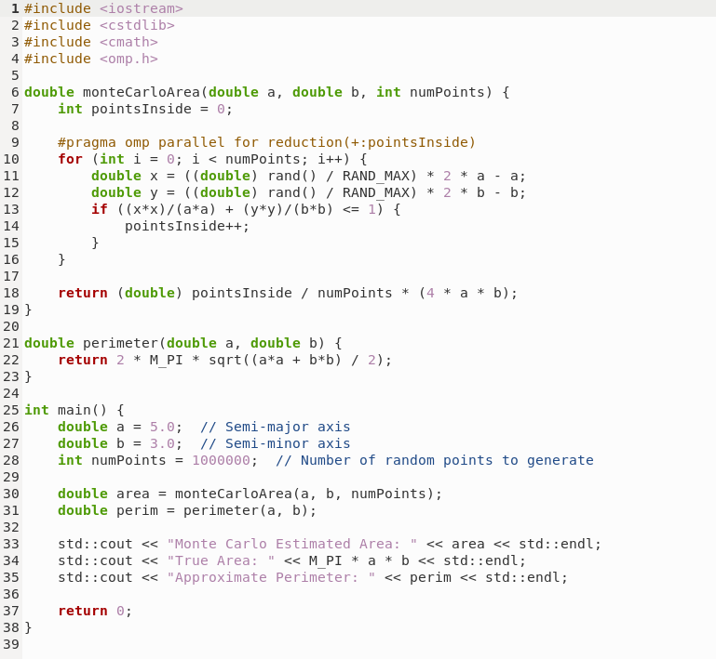
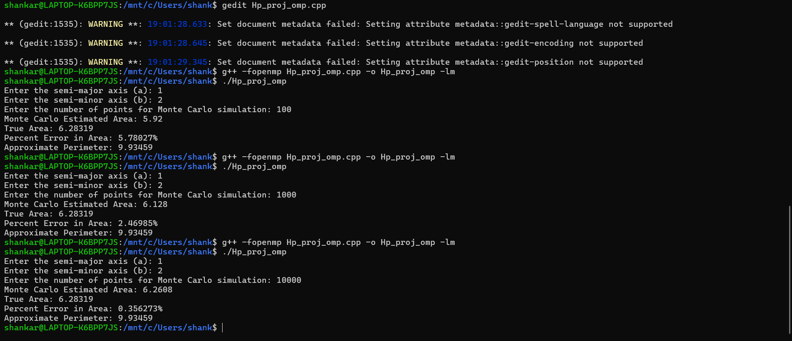
Code & Output Screenshots:
Language Used: C++

Slide 7

Demo & Output
Code outputs:
Monte Carlo Estimated Area: 47.1
True Area: 47.1239
Approximate Perimeter: 25.5276
Inference: The model performs increasingly better as the number of points are increased (error decreases significantly)

Slide 8
Learnings
Practical experience with OpenMP and parallelism.
Understood reduction clause and thread safety.
Learned how randomness and probability can solve real-world geometry.
Observed real speed improvements from multithreading.

Slide 9
References
• OpenMP Official Documentation
• Numerical Recipes in C - Monte Carlo Integration
• Wikipedia: Ellipse Area and Perimeter
• C++ rand() function and usage for point generation

Slide 10


