Slide 1



Garbage Classification with EfficientNetV2B2
Presented by: Aditya Sharma

Slide 2

Learning Objectives :
Understand image classification in waste management
Apply EfficientNetV2B2 for classification tasks
Preprocess and augment datasets
Evaluate model performance
Deploy trained models in real-world scenarios
GOAL

Slide 3
Tools and Technology used :
Python
TensorFlow / Keras
EfficientNetV2B2
Garbage Classification Dataset (Kaggle)
Jupyter Notebook / Google Colab
NumPy, Pandas, Matplotlib, OpenCV

Slide 4
Problem Statement:
To develop an accurate and efficient garbage classification model using EfficientNetV2B2 and transfer learning for automated waste sorting.

Slide 5
Solution:
1. Leveraging Pre-trained EfficientNetV2B2
Utilize EfficientNetV2B2, a state-of-the-art CNN architecture pre-trained on ImageNet.
Benefits :
High accuracy with fewer parameters.
Faster training and inference.
Scales well for various datasets.
2. Transfer Learning Approach
Freeze initial layers of EfficientNetV2B2 to retain learned features.
Customize final classification layers (Dense + Softmax) for garbage categories (e.g., Plastic, Metal, Organic, etc.).
Fine-tune on a garbage image dataset for higher accuracy.
3. Garbage Image Dataset
Train on a labeled dataset of waste images:
Categories: Cardboard , Glass , Metal , Paper , Plastic , Trash.
Data Augmentation: Rotation, Zoom, Flip to handle variability.
4. Model Training and Evaluation
Use Adam optimizer, categorical crossentropy loss, and early stopping for stable training.
Evaluate using accuracy, precision, recall, and F1-score.
Achieved accuracy
5. Deployment Readiness
Export trained model to TensorFlow Lite or ONNX format for edge deployment (e.g., on mobile or smart bins).
Integrate with a camera-based detection system for real-time classification and sorting.

Slide 6
Methodology :
1. Dataset Collection
2. Data Preprocessing (resize, normalize, augment)
3. Model Building (EfficientNetV2B2 + custom layers)
4. Training (Adam optimizer, categorical loss)
5. Evaluation (accuracy, confusion matrix)

Slide 7
Model Architecture (Diagram) :
EfficientNetV2B2 (base)
Global Average Pooling
Dense (ReLU)
Dropout
Dense Softmax (Output Classes)

Slide 8
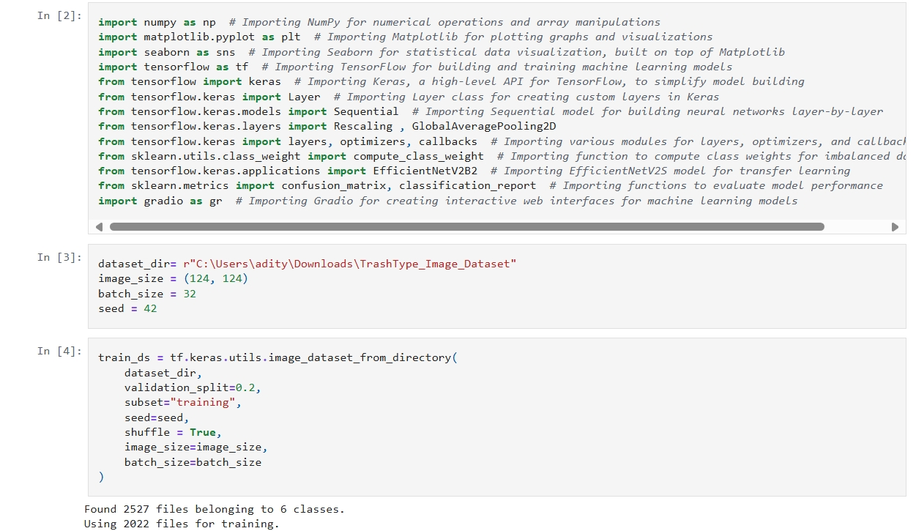
CODE SCREENSHOT:

Slide 9
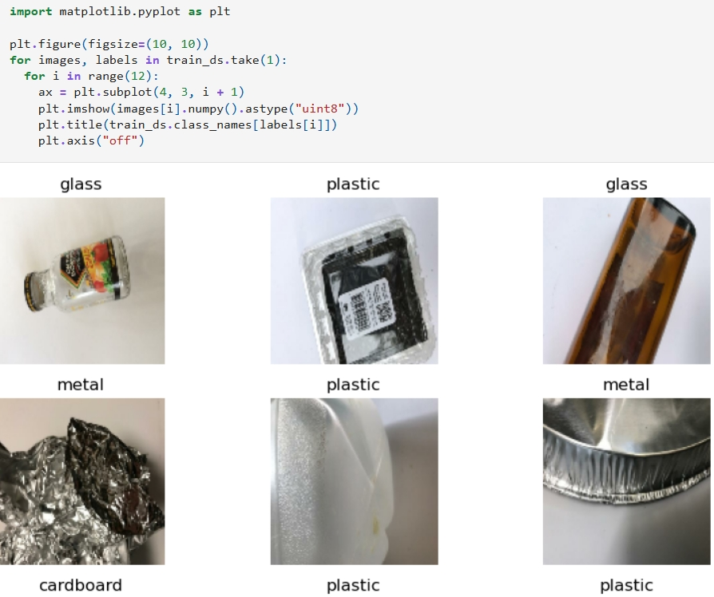
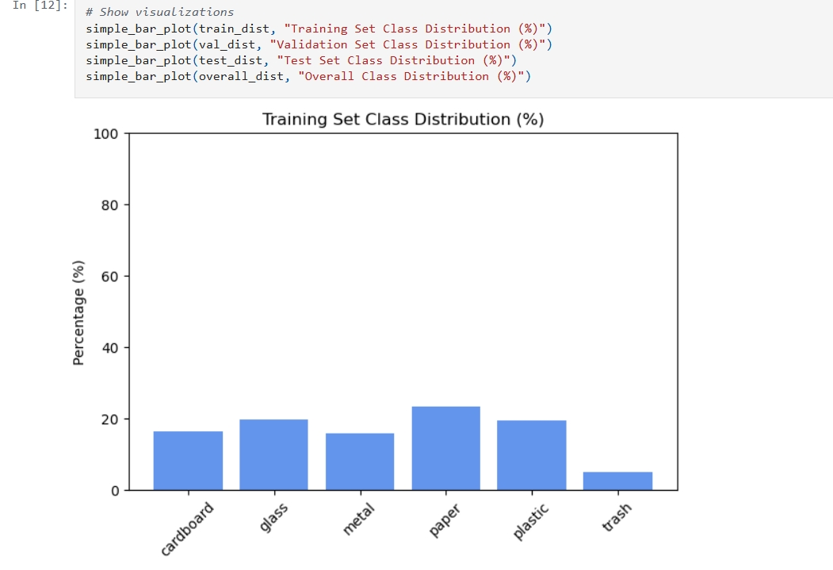
CODE SCREENSHOT:

Slide 10
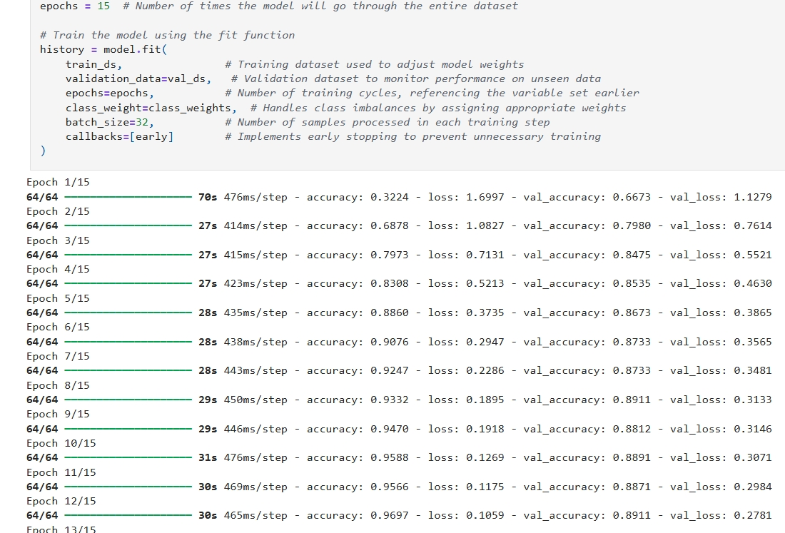
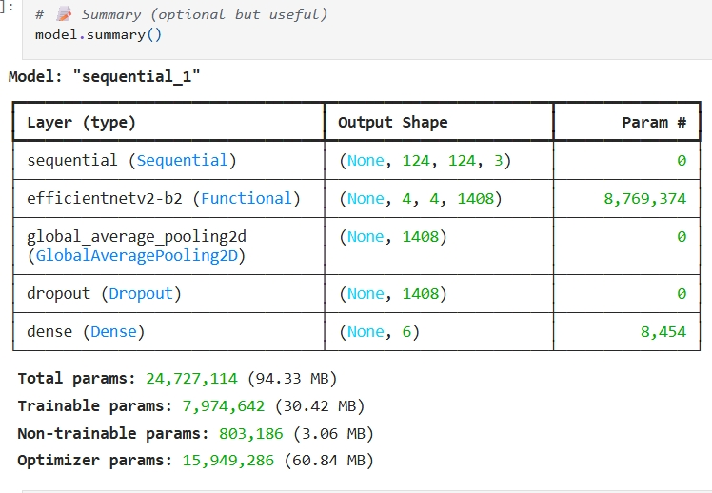
CODE SCREENSHOT:
FOR FULL CODE VISIT MY GITHUB LINK : https://github.com/AdityaSharma-12/garbage-classification.git

Slide 11
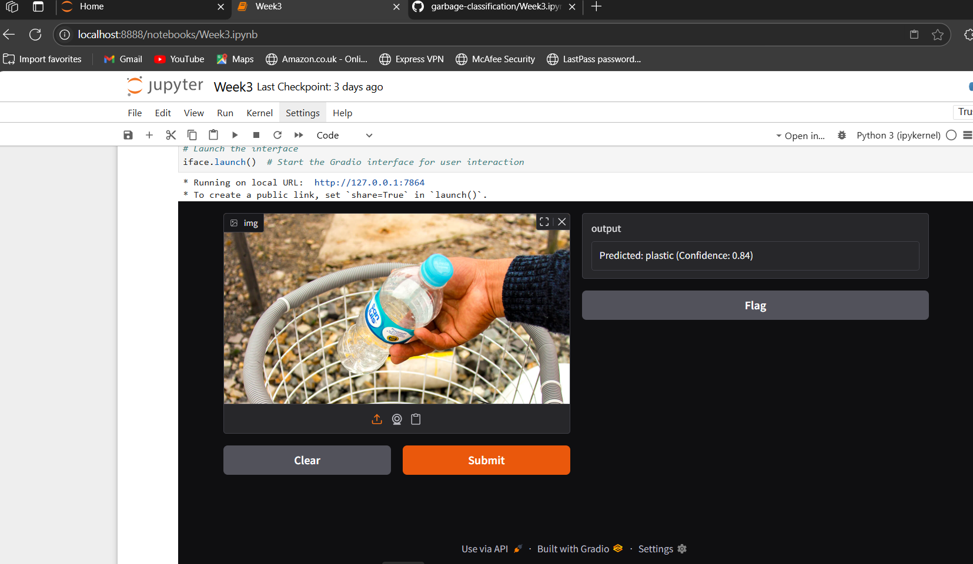
Screenshot of Output:

Slide 12
Conclusion:
Waste classification can be automated
EfficientNetV2B2 is accurate and scalable
Integrates into smart waste management systems

Slide 13
Future Scope :
Real-time detection on edge/mobile devices
Classify sub-types of recyclables
Field testing with local authorities

