Slide 1
THE GREAT INDIA HACKATHON (2022)
Driver-Drowsiness-Detection

Slide 2
ABOUT DRIVER – DROWSINESS – DETECTION - PROJECT
Driver Drowsiness Detector detects if a driver or a person is drowsy or not by using augumented reality algorithm
In current years, drowsy driver detection is the most necessary procedure to prevent any road accidents, probably worldwide. The aim of our project is to construct a smart alert technique for building intelligent vehicles that can automatically avoid drowsy driver impairment.

Slide 3
HOW IT WORK
This project focuses on a driver drowsiness detection system in automotive vehicles. The driver behaviour is noticed in many conditions such as wearing spectacles and also in the dark condition inside the vehicle. The proposed system will be continuously monitoring the retina of the driver and all the monitored signals are sent to the microcontroller.
The system is capable of detecting the drowsiness condition with every eye movement. After the detection of abnormal behaviour it is alerted to the driver through alarms and the parking lights will be on that will stop the vehicle which reduces the accidents due to drowsiness of the driver.

Slide 4
Augumented reality
Augmented reality is used to enhance natural environments or situations and offer perceptually enriched experiences. With the help of advanced AR technologies (e.g. adding computer vision, incorporating AR cameras into smartphone applications and object recognition) the information about the surrounding real world of the user becomes interactive and digitally manipulated.
Augmentation techniques are typically performed in real time and in semantic contexts with environmental elements.
We use Augumentation technology in our system to get the information about the surrounding real world of the user and detect their eye movement.

Slide 5
Library Used In Our Project
DLIB :-
For Image Processing (Face Detectation or Landmark Detection )
Imutils(Faceutils):-
For basic operations(translation, rotation and resize)
OpenCv :-
OpenCV is a Python open-source library, which is used for computer vision,face recognition,etc.
Numpy:-
We use Numpy to perform mathematical operation

Slide 6
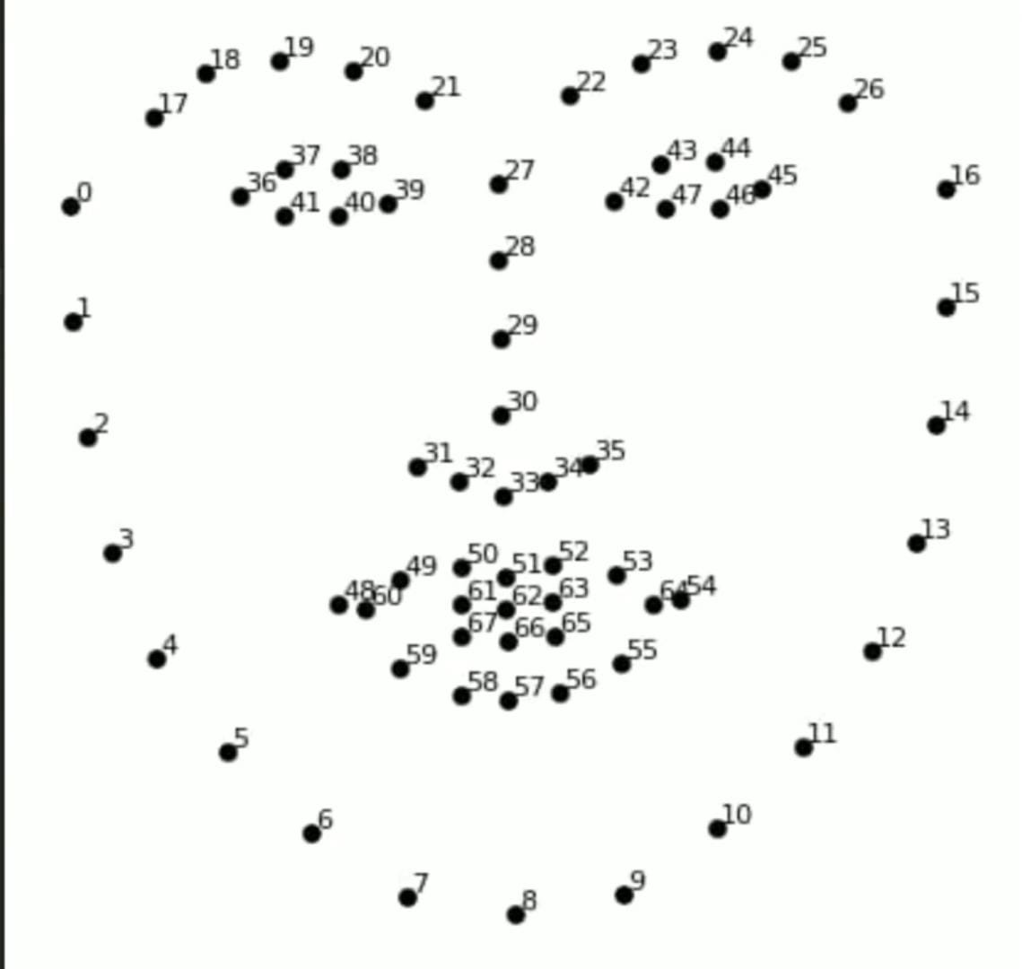
We use landmark for face detection

Slide 7
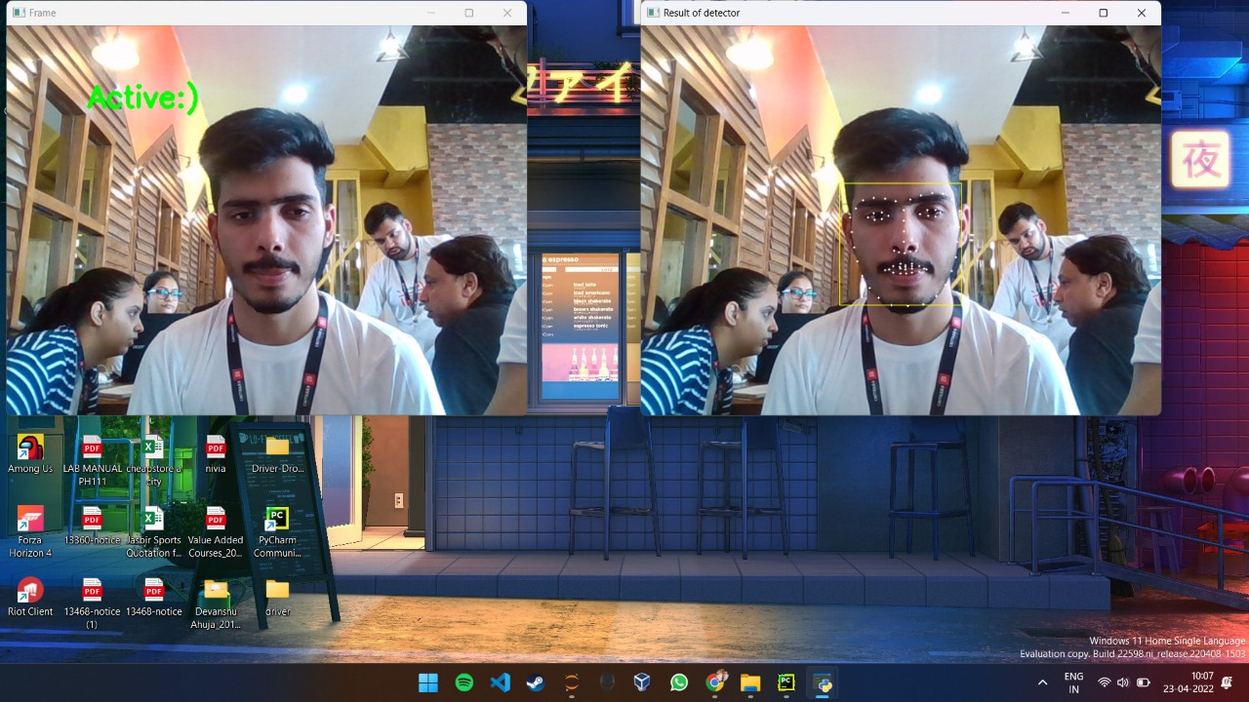
3 STAGES :-
1. ACTIVE :- (MORE THAN 0.25)

Slide 8
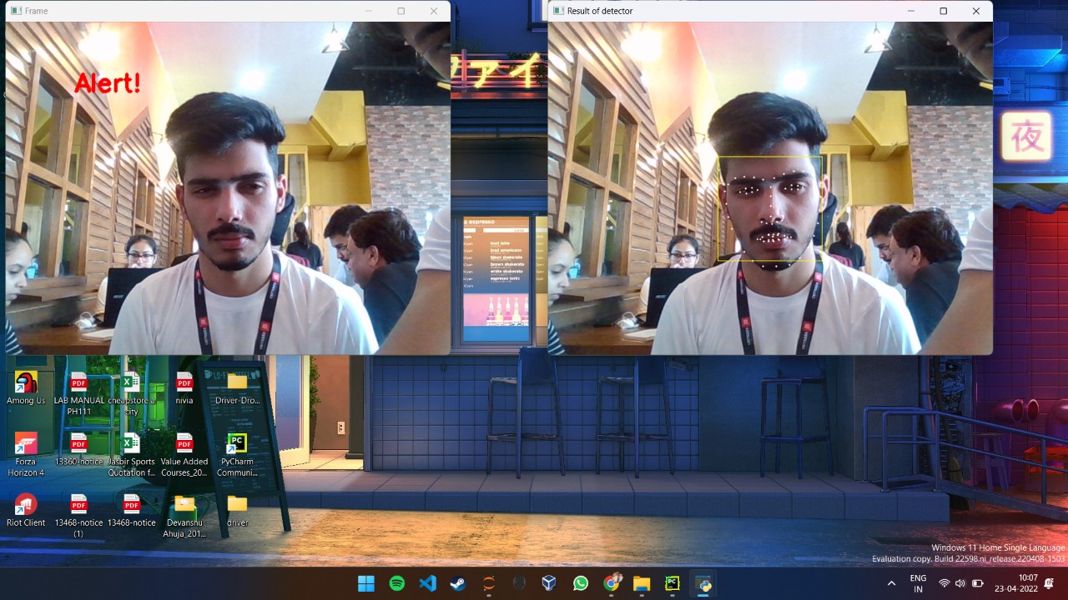
2. DROWSY :-

Slide 9
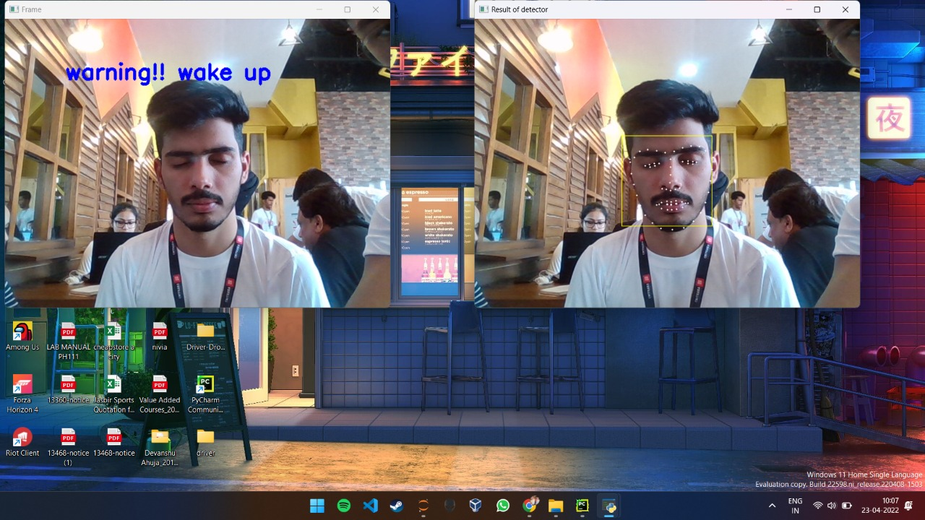
3. SLEEPY:-

Slide 10
GRIFFENDOOR
Aditya Sharma
Devanshu Ahuja
Kartikey Sharma
Abhishweta Gupta
THANKS !!

