Slide 1
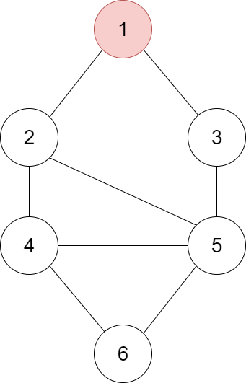
Key = 6 , Queue = [1]
Print:
node = queue.pop()
print(node.value, end=' ')
if node.value == key:
print('\nKey found')
return
for neighbor in node.neighbors:
if not visited[neighbor]:
queue.append(neighbor)
visited[neighbor] = True

Slide 2
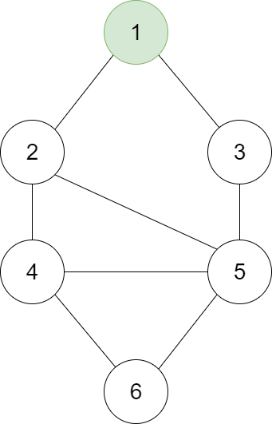
Key = 6 , Queue = []
Print:
→ node = queue.pop(0)
print(node.value, end=' ')
if node.value == key:
print('\nKey found')
return
for neighbor in node.neighbors:
if not visited[neighbor]:
queue.append(neighbor)
visited[neighbor] = True

Slide 3
Key = 6 , Queue = []
Print: 1
node = queue.pop(0)
→ print(node.value, end=' ')
if node.value == key:
print('\nKey found')
return
for neighbor in node.neighbors:
if not visited[neighbor]:
queue.append(neighbor)
visited[neighbor] = True

Slide 4
Key = 6 , Queue = []
Print: 1
node = queue.pop(0)
print(node.value, end=' ')
→ if node.value == key: # False
print('\nKey found')
return
for neighbor in node.neighbors:
if not visited[neighbor]:
queue.append(neighbor)
visited[neighbor] = True

Slide 5
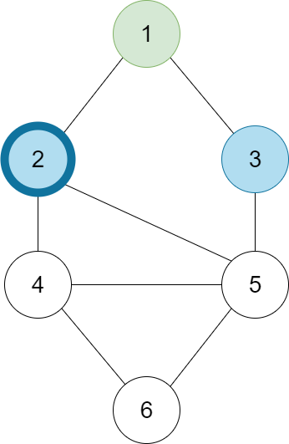
Key = 6 , Queue = []
Print: 1
node = queue.pop(0)
print(node.value, end=' ')
if node.value == key:
print('\nKey found')
return
→ for neighbor in node.neighbors:
if not visited[neighbor]:
queue.append(neighbor)
visited[neighbor] = True

Slide 6
Key = 6 , Queue = []
Print: 1
node = queue.pop(0)
print(node.value, end=' ')
if node.value == key:
print('\nKey found')
return
for neighbor in node.neighbors:
→ if not visited[neighbor]: # True
queue.append(neighbor)
visited[neighbor] = True

Slide 7
Key = 6 , Queue = [2]
Print: 1
node = queue.pop(0)
print(node.value, end=' ')
if node.value == key:
print('\nKey found')
return
for neighbor in node.neighbors:
if not visited[neighbor]:
→ queue.append(neighbor)
visited[neighbor] = True

Slide 8
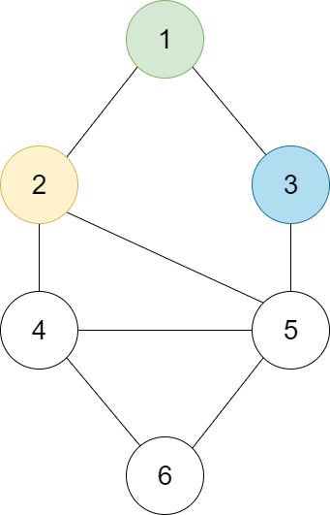
Key = 6 , Queue = [2]
Print: 1
node = queue.pop(0)
print(node.value, end=' ')
if node.value == key:
print('\nKey found')
return
for neighbor in node.neighbors:
if not visited[neighbor]:
queue.append(neighbor)
→ visited[neighbor] = True

Slide 9
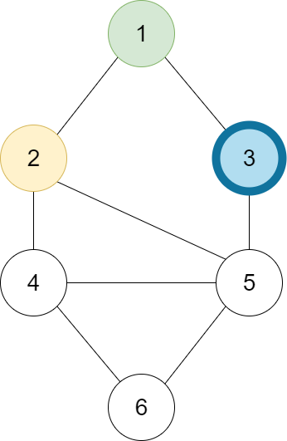
Key = 6 , Queue = [2]
Print: 1
node = queue.pop(0)
print(node.value, end=' ')
if node.value == key:
print('\nKey found')
return
→ for neighbor in node.neighbors:
if not visited[neighbor]:
queue.append(neighbor)
visited[neighbor] = True

Slide 10
Key = 6 , Queue = [2]
Print: 1
node = queue.pop(0)
print(node.value, end=' ')
if node.value == key:
print('\nKey found')
return
for neighbor in node.neighbors:
→ if not visited[neighbor]: # True
queue.append(neighbor)
visited[neighbor] = True

Slide 11
Key = 6 , Queue = [2, 3]
Print: 1
node = queue.pop(0)
print(node.value, end=' ')
if node.value == key:
print('\nKey found')
return
for neighbor in node.neighbors:
if not visited[neighbor]:
→ queue.append(neighbor)
visited[neighbor] = True

Slide 12
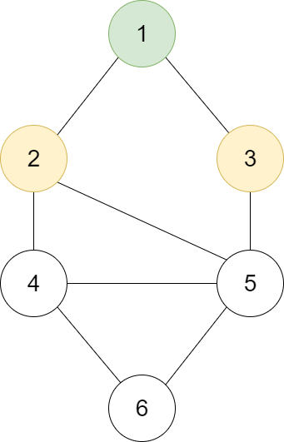
Key = 6 , Queue = [2, 3]
Print: 1
node = queue.pop(0)
print(node.value, end=' ')
if node.value == key:
print('\nKey found')
return
for neighbor in node.neighbors:
if not visited[neighbor]:
queue.append(neighbor)
→ visited[neighbor] = True

Slide 13
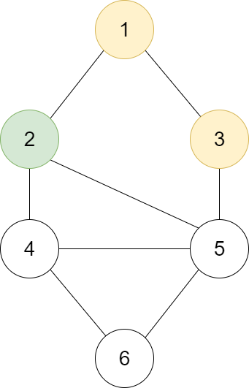
Key = 6 , Queue = [3]
Print: 1
→ node = queue.pop(0)
print(node.value, end=' ')
if node.value == key:
print('\nKey found')
return
for neighbor in node.neighbors:
if not visited[neighbor]:
queue.append(neighbor)
visited[neighbor] = True

Slide 14
Key = 6 , Queue = [3]
Print: 1 2
node = queue.pop(0)
→ print(node.value, end=' ')
if node.value == key:
print('\nKey found')
return
for neighbor in node.neighbors:
if not visited[neighbor]:
queue.append(neighbor)
visited[neighbor] = True

Slide 15
Key = 6 , Queue = [3]
Print: 1 2
node = queue.pop(0)
print(node.value, end=' ')
→ if node.value == key: # False
print('\nKey found')
return
for neighbor in node.neighbors:
if not visited[neighbor]:
queue.append(neighbor)
visited[neighbor] = True

Slide 16
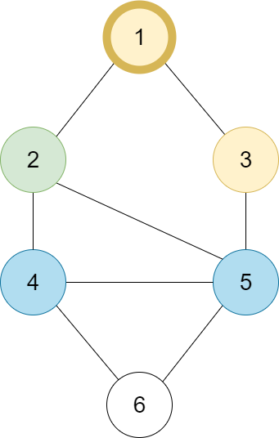
Key = 6 , Queue = [3]
Print: 1 2
node = queue.pop(0)
print(node.value, end=' ')
if node.value == key:
print('\nKey found')
return
→ for neighbor in node.neighbors:
if not visited[neighbor]:
queue.append(neighbor)
visited[neighbor] = True

Slide 17
Key = 6 , Queue = [3]
Print: 1 2
node = queue.pop(0)
print(node.value, end=' ')
if node.value == key:
print('\nKey found')
return
for neighbor in node.neighbors:
→ if not visited[neighbor]: # False
queue.append(neighbor)
visited[neighbor] = True

Slide 18
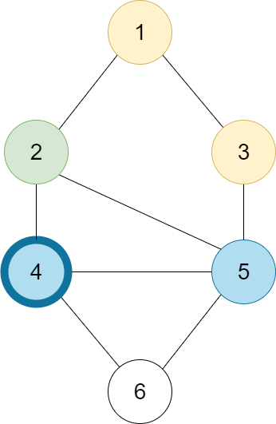
Key = 6 , Queue = [3]
Print: 1 2
node = queue.pop(0)
print(node.value, end=' ')
if node.value == key:
print('\nKey found')
return
→ for neighbor in node.neighbors:
if not visited[neighbor]:
queue.append(neighbor)
visited[neighbor] = True

Slide 19
Key = 6 , Queue = [3]
Print: 1 2
node = queue.pop(0)
print(node.value, end=' ')
if node.value == key:
print('\nKey found')
return
for neighbor in node.neighbors:
→ if not visited[neighbor]: # True
queue.append(neighbor)
visited[neighbor] = True

Slide 20
Key = 6 , Queue = [3, 4]
Print: 1 2
node = queue.pop(0)
print(node.value, end=' ')
if node.value == key:
print('\nKey found')
return
for neighbor in node.neighbors:
if not visited[neighbor]:
→ queue.append(neighbor)
visited[neighbor] = True

Slide 21
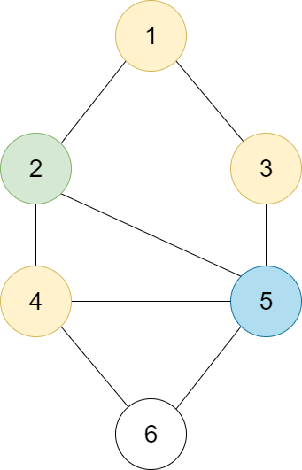
Key = 6 , Queue = [3, 4]
Print: 1 2
node = queue.pop(0)
print(node.value, end=' ')
if node.value == key:
print('\nKey found')
return
for neighbor in node.neighbors:
if not visited[neighbor]:
queue.append(neighbor)
→ visited[neighbor] = True

Slide 22
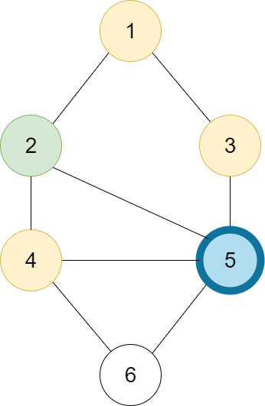
Key = 6 , Queue = [3, 4]
Print: 1 2
node = queue.pop(0)
print(node.value, end=' ')
if node.value == key:
print('\nKey found')
return
→ for neighbor in node.neighbors:
if not visited[neighbor]:
queue.append(neighbor)
visited[neighbor] = True

Slide 23
Key = 6 , Queue = [3, 4]
Print: 1 2
node = queue.pop(0)
print(node.value, end=' ')
if node.value == key:
print('\nKey found')
return
for neighbor in node.neighbors:
→ if not visited[neighbor]: # True
queue.append(neighbor)
visited[neighbor] = True

Slide 24
Key = 6 , Queue = [3, 4, 5]
Print: 1 2
node = queue.pop(0)
print(node.value, end=' ')
if node.value == key:
print('\nKey found')
return
for neighbor in node.neighbors:
if not visited[neighbor]:
→ queue.append(neighbor)
visited[neighbor] = True

