Slide 1
Welcome to DaimlerChrysler
www.daimlerchrsyler.com

Slide 2
Today’s Agenda
About Us
History
DaimlerChrysler India. Pvt. Ltd.
Business Principle
Members of Board
Organisation Chart
Quarterly Report
Questions and Suggestions
Contact Us
www.daimlerchrsyler.com

Slide 3
About Us
Daimler AG with its businesses Mercedes-Benz Cars, Daimler Trucks, Daimler Financial Services, Mercedes-Benz Vans and Daimler Buses, is a globally leading producer of premium passenger cars and the largest manufacturer of commercial vehicles in the world. The Daimler Financial Services division has a broad offering of financial services, including vehicle financing, leasing, insurance and fleet management.
Daimler sells its products in nearly all the countries of the world and has production facilities on five continents. The company’s founders, Gottlieb Daimler and Carl Benz, continued to make automotive history following their invention of the automobile in 1886. As an automotive pioneer, Daimler and its employees willingly accept an obligation to act responsibly towards society and the environment and to shape the future of safe and sustainable mobility with groundbreaking technologies and high-quality products.
www.daimlerchrsyler.com

Slide 4
History
Daimler Motoren Gesellschaft-(DMG) was founded by Gottlieb Daimler and his partner Wilhelm Maybach in 1890. Daimler died in 1900 and Maybach left DMG in 1907. By then, Benz & Cie. and DMG were rivals. In 1924, owing to economic necessity after World War I, they entered into an "Agreement of Mutual Interest" valid until the year 2000. This initial agreement still allowed each company to manufacture and sell their products under their original brand names. After the official merger in June 28, 1926, the firm became known as Daimler-Benz.
In 1998, Daimler-Benz and Chrysler agreed to combine their businesses — promoted as the "merger of equals" — and the new entity was named DaimlerChrysler AG. However, this was actually when Daimler-Benz bought out Chrysler.
On May 14, 2007, the separation of Daimler AG and Chrysler LLC was announced. Selling Chrysler has been seen as a positive move for Daimler by its shareholders, who hope that the separation will allow Daimler's car brand Mercedes-Benz to be free to do what it does best without having the distractions of its heavily unprofitable U.S. partner Chrysler. However, Daimler retains a 20 per cent minority stake in Chrysler.
www.daimlerchrsyler.com

Slide 5
DaimlerChrysler India Pvt. Ltd (DCIPL)
Since its entry into India in 1994, DaimlerChrysler has strived to serve its customers with excellent and technologically advanced products from the Mercedes Benz stable. In tune with the company’s worldwide corporate philosophy, Mercedes Benz India Pvt. Ltd. was rechristened DaimlerChrysler India Pvt. Ltd. in 2001.
DaimlerChrysler India is an important part of DaimlerChrysler AG’s Asia strategy, to help it generate 25% of its total turnover from Asia. By announcing the setting up of a brand new manufacturing facility in Chakan near Pune, DaimlerChrysler AG has visibly demonstrated its commitment to the Indian Market
DaimlerChrysler Research and Technology India (DCRTI) was incorporated in November, 1996. DCRTI is a 100% subsidiary of DaimlerChrysler AG, located in Bangalore. Since inception. DCRTI has been making local talent available globally to DaimlerChrysler and its core suppliers.
DCRTI is partner to DaimlerChrysler business units and assists them in meeting their research and development challenges. Our global teams are spread across Germany, USA, Japan and India. Our technical teams (Engineering Services, Electrical & Electronics , IT and Business Services) ably assisted by support functions carry out pioneering work for our business units and partners.
www.daimlerchrsyler.com

Slide 6
Quality throughout
Protect the environment
and life
Business Principle
Promote safety
www.daimlerchrsyler.com
Notes:
Aspire to be the best
• Develop a world-class franchise in every business we operate
• Be field- and client-driven, consistently delivering the best products and services in a cost-effective way
• Innovate, test and learn
• Create powerful brands that carry a commitment of quality and integrity
Execute superbly
• Demand and maintain strong financial discipline, building for good times and bad
• Create and maintain a fortress balance sheet
• Design and maintain the best systems and operations
• Eliminate waste and bureaucracy
• Maintain a strong system of internal governance and controls
• Measure performance through a complete and balanced scorecard
Build a great team and a winning culture
• Operate with the highest standards of integrity
• Train and retain great managers
• Be open and honest with ourselves, our colleagues, our shareholders and our communities
• Get incentives right
• Foster an environment of respect and inclusiveness
• Give back to our communities

Slide 7
Board Members
Günther Fleig Human Resources & Labor Relations Director Appointed until: 2009; first appointed: 1999 | Dr. Rüdiger Grube Corporate Development Appointed until: 2010; first appointed: 2001 | Andreas Renschler Daimler Trucks Appointed until: 2010; first appointed: 2004
Bodo Uebber Finance & Controlling / Daimler Financial Services Appointed until: 2011; first appointed: 2003 | Dr. Thomas Weber Group Research & Mercedes-Benz Cars Development Appointed until: 2010; first appointed: 2003
www.daimlerchrsyler.com

Slide 8
DaimlerChrysler Organisation Chart
CEO
VP
AVP
AVP
AVP
Process Manager
Process Manager
Process Manager
Team Leader
Team Leader
Team Leader
Team Member
Team Member
Team Member
www.daimlerchrsyler.com

Slide 9
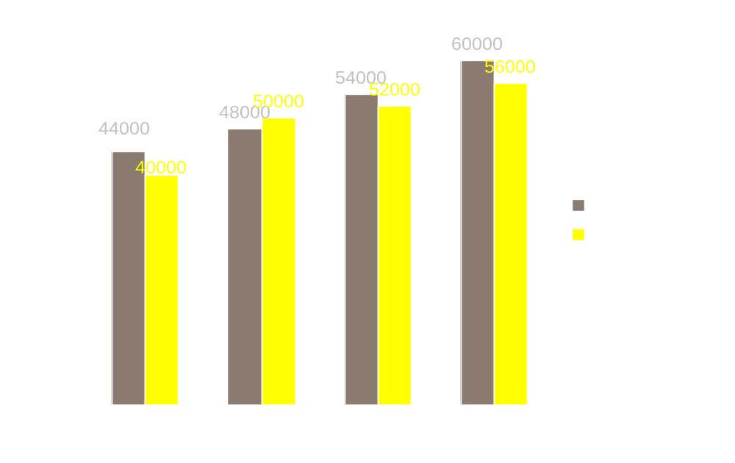
Quarterly Report
AMOUNT
QUARTER
www.daimlerchrsyler.com

Slide 10
DaimlerChrysler Products
Mercedes-Benz
Smart cars
Freightliner trucks
Setra buses and coaches
www.daimlerchrsyler.com

Slide 11
Contact Us
DaimlerChrysler India Pvt. Ltd.
Sector 15-A Chikhali
Pimpri
Pune - 411 018
Phone : (+91) 20 2750 5000
Fax : (+91) 20 2750 5953
E-mail: careers_pune@DaimlerChrysler.com
DaimlerChrysler Research & Technology India Pvt. Ltd.
Pine Valley, 3rd Floor,
Embassy Golf Links Business Park,
Off Intermediate Ring Road,
Bangalore - 560 071(India)
Phone : (+91) 80 6660 3400
Fax : (+91) 80 6660 3660
E-mail: hr_bangalore@DaimlerChrysler.com
www.daimlerchrsyler.com

Slide 12
Smart Cars
Discover a car that has been perfectly designed for your everyday life. A car that offers maximum comfort, agility, safety, ecology and driving fun. A pioneering vehicle concept that is one of the best with its low CO2 emission figures.
Discover the smart fortwo – as a coupé and a cabrio in the pure, pulse, passion and BRABUS equipment lines.
www.daimlerchrsyler.com

Slide 13
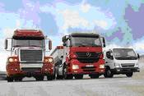
FreightLiner Trucks
As the world’s leading truck manufacturer, the Daimler Trucks division develops and produces vehicles within a global network under the brands Mercedes-Benz, Freightliner, Sterling, Western Star and Mitsubishi Fuso. The division’s 35 production facilities are in the NAFTA region (17), Europe (7), South America (2) and Asia (8). Its product range covers light, medium and heavy trucks for local and long-distance deliveries and construction sites, as well as special vehicles for municipal applications. Due to close links in terms of production technology, Daimler Trucks’ product range also includes the buses of the Thomas Built Buses and Mitsubishi Fuso brands. The division’s most important sales markets in 2007 were Asia (with 31% of unit sales), the NAFTA region (24%), Western Europe (19%) and Latin America excluding Mexico (11%).
www.daimlerchrsyler.com

Slide 14
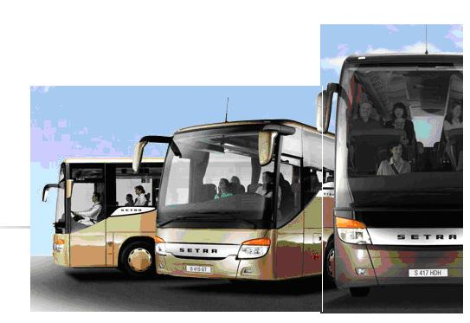
Setra Buses
Setra Buses are available in three categories
Multi-Class
Comfort-Class
Top-Class
Address:
Daimler AG
70546 Stuttgart
Germany
Phone: +49 711 17 0
Fax: +49 711 17 22244
www.daimlerchrsyler.com

Slide 15
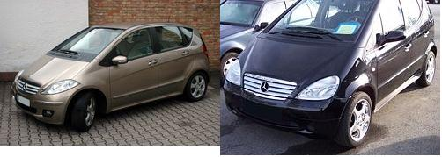
Mercedes-Benz
Welcome to Mercedes-Benz Cars
The products supplied by the Mercedes-Benz Cars division range from the high-quality small cars of the smart brand to the premium automobiles of
the Mercedes-Benz, Mercedes AMG and Mercedes-Benz McLaren brands
and to the Maybach luxury sedans. Most of these vehicles are produced in Germany, but the division also has production facilities in the United States, France, South Africa, Brazil, India, Vietnam and Indonesia, and since the
year 2005 also in China. Worldwide, Mercedes-Benz Cars has 17 production sites. Its most important markets in 2007 were Germany with 27% of unit sales, the other markets of Western Europe (34%), the United States (19%) and Japan (4%).
www.daimlerchrsyler.com

