Slide 1
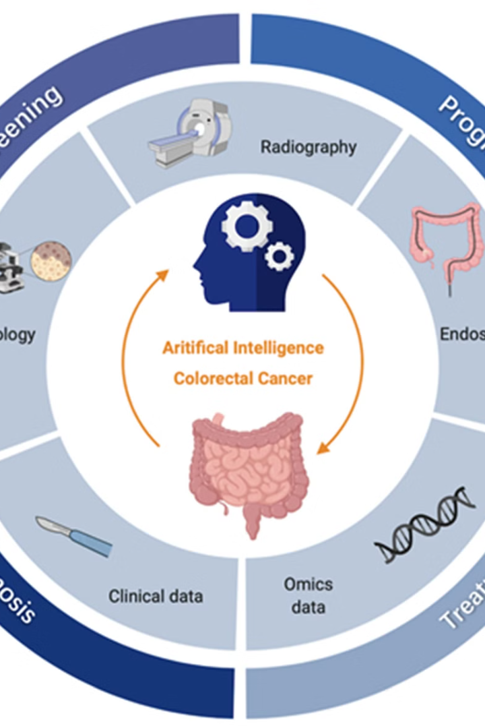

AI-Driven Precision Oncology: Revolutionizing Cancer Treatment
This presentation explores how AI is transforming cancer therapy. We'll focus on personalized treatment strategies. The goal is to combine chemotherapy and targeted radiation therapy. This innovative approach promises to enhance cancer care.
by Aditya Shukla

Slide 2
Enhanced Targeting in Radiation Therapy with AI
Current Limitations
AI-Driven Precision
Traditional radiation targets all cells in a tumor volume. This often affects healthy tissue. It can cause unwanted side effects.
AI predicts dead cell locations with enhanced accuracy. It refines radiation delivery. This maximizes impact on viable tumor cells. The goal is to minimize exposure to healthy tissue.

Slide 3
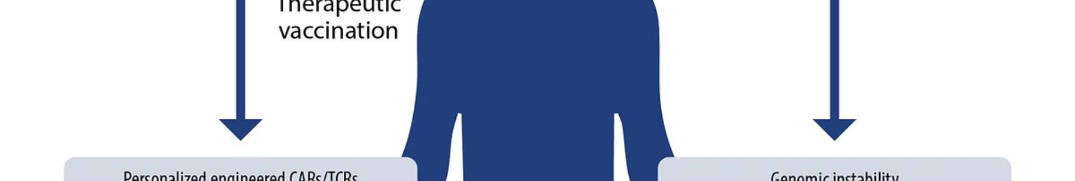
Personalized Chemotherapy and Side Effect Reduction via AI
Challenge
AI Solution
Chemotherapy drugs affect both cancerous and healthy cells. This results in significant side effects.
AI predicts individual patient response to chemotherapy regimens. This enables personalized treatment plans.
Data Inputs
Outcome
Data used: genomic profiles, tumor biomarkers, patient history, lifestyle factors.
Tailored chemotherapy combinations and dosages. Reduced side effects and improved efficacy are the goals.

Slide 4

Radiation Therapy: A Targeted Approach to Cancer Treatment
1
Principle
High-energy radiation damages and kills cancer cells.
2
Modalities
External beam (EBRT), brachytherapy (internal).
3
Mechanism
Radiation damages DNA, preventing cell division.
4
Side Effects
Fatigue, skin changes, hair loss, organ effects.

Slide 5
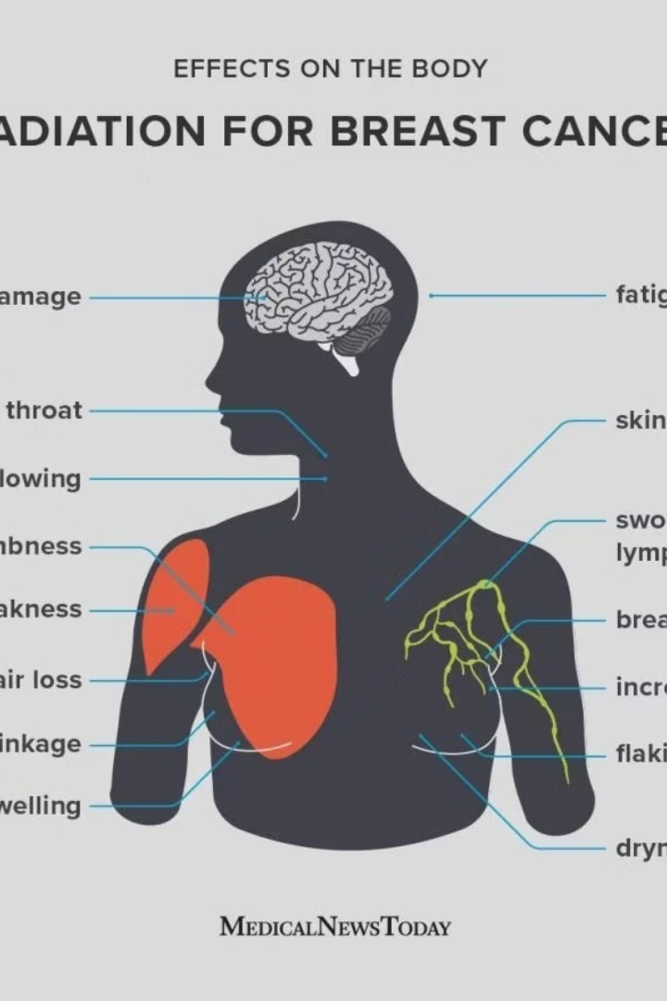
Limitations of Radiation Therapy
Lack of Precision
Affects surrounding healthy tissue, causing side effects.
Variable Response
Not all tumors respond equally to radiation.
Imaging Challenges
Difficult to assess tumor response in real-time.
Individual Variability
Genetic factors influence sensitivity to radiation.

Slide 6



Precision Medicine: Tailoring Treatment for Best Results
Individual Characteristics
1
Treatment strategies based on genetics and lifestyle.
Chemotherapy Context
2
Selecting drugs based on tumor genomic profile.
Biomarkers
3
Predict treatment response and toxicity.

Slide 7





Chemotherapy: Systemic Cancer Treatment Explained
Mechanism
Administration
Combination
Side Effects
Drugs kill rapidly dividing cells (cancer cells).
Intravenously or orally.
Multiple drugs target different cancer growth aspects.
Nausea, hair loss, fatigue, infection risk, organ damage.

Slide 8
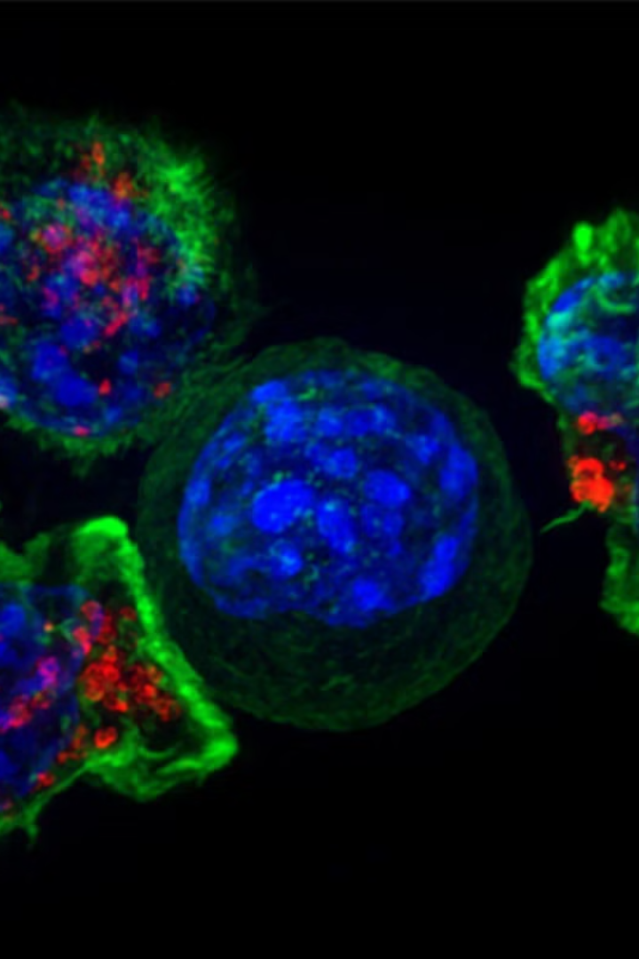
Conclusion
AI-driven precision oncology holds immense promise for cancer care. It optimizes chemotherapy and radiation therapy. This leads to improved treatment efficacy, reduced toxicity, and enhanced patient outcomes. Further research and validation are essential. This technology will translate into widespread clinical practice, offering new hope to patients.

