Slide 1

PJM Grid Data Analysis
CSE – 234
Subject – Predictive Analysis
Name – Aditya Shukla
Registration Number - 12312951

Slide 2


About Dataset
A Realtime dataset which tells about the power outage in a particular region.
Data Source: https://www.gridstatus.io/datasets/pjm_outages_daily
Second Data ( Synthetic ) generated to predict the difference in prices of resource by total outage.

Slide 3
Overview of Project
A predictive analysis project which predict 5 day forecast for outage in a particular region.
Dependency fields are Planned outage, Forced outage and Maintenance outage.
Used five models for comparing best accuracy: Linear Regression, KNN, Decision Tree, Random Forest and SVR.
Used Synthetic dataset for further analysis of prices fluctuation on different total outages.

Slide 4
Data Pre-Processing
Added three more fields: Day of week, month, and isWeekend for better accuracy.
Added a previous field as what happened yesterday for better results.

Slide 5
Train Test Split
Split the fields as planned outage + forced outage with other fields to predict maintenance outage.
Split the field as planned outage + maintenance outage with other fields to predict forced outage.
For individual price compared with total outage.

Slide 6
Prediction Result
Best winner was Random Forest with less Errors.
Got five day forecast for total outage and prices of resource.
Analysis and Use Cases
Best use for stock marketing to predict and invest in prices.
Good for analysis for upcoming outages and to be prepared.
Good for data analysis and understanding its concept.
Results may help government to focus on weak regions.

Slide 7
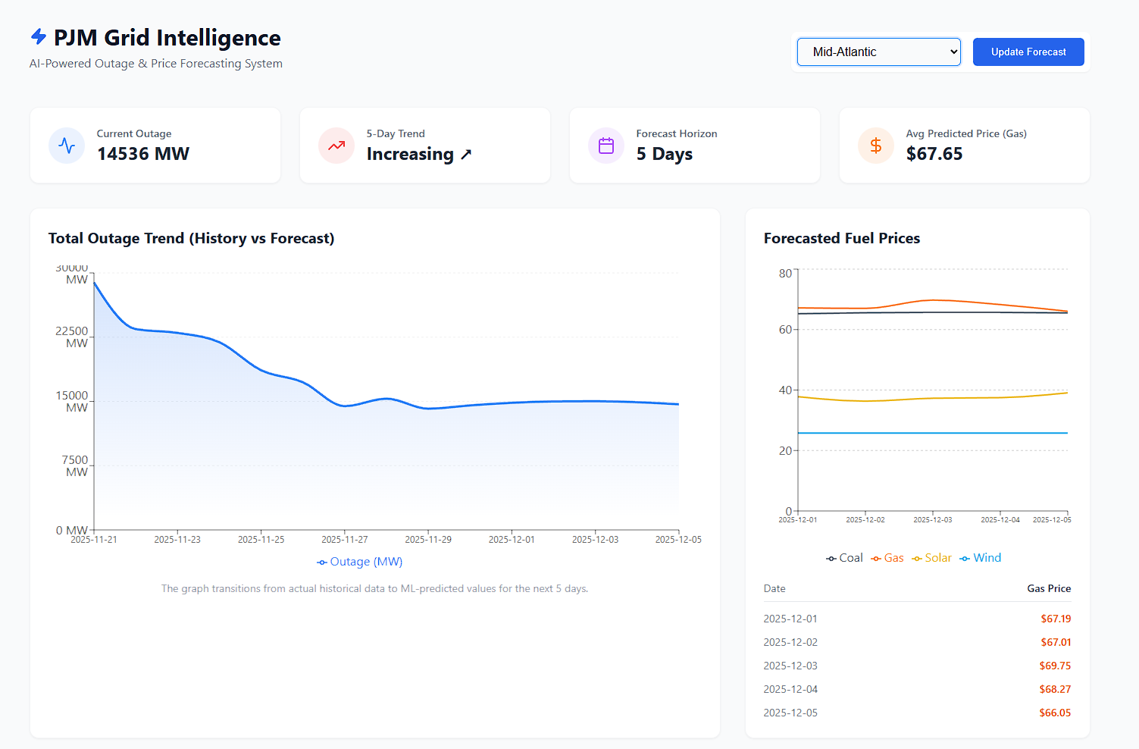
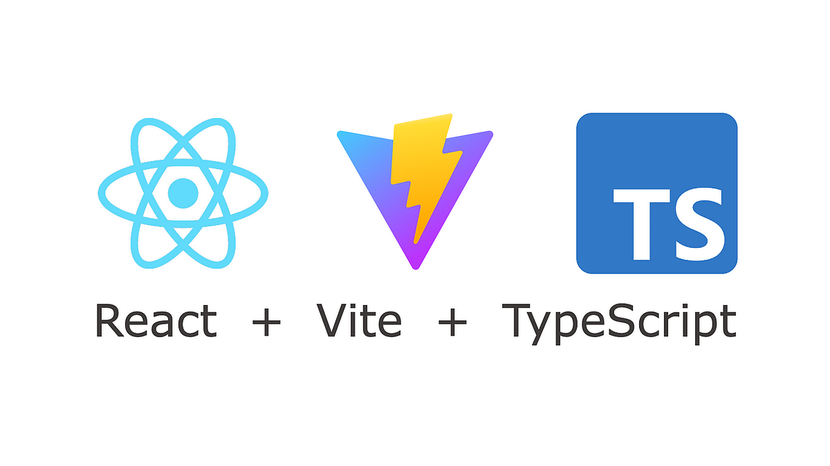
Display and Use
Created a Dashboard with help of:
Vite, React, recharts, lucid-react icons and JavaScript.
Backend with help of flask framework.

Slide 8
Conclusion
A good forecasting project for outage analysis.
May help in power sector of country for good maintenance.
Analysis for better prediction in stock markets.
Examine the trend in prices hike and down.

Slide 9
Thank You
Special thanks to Dr. Tanima Thakur for guidance.

