Slide 1
Predictive Maintenance of Industrial Machinery
CAPSTONE PROJECT
Presented By: Aditya Singh Mandrawal - Graphic Era Hill University

Slide 2
OUTLINE
Problem Statement
Proposed System/Solution
System Development Approach
Algorithm & Deployment
Result
Conclusion
Future Scope
References

Slide 3
Problem Statement-39
In today’s fast-paced industrial environment, unexpected machinery breakdowns can lead to costly downtime, delayed production schedules, and increased operational expenses. Traditional maintenance strategies such as reactive (fix after failure) or scheduled (fix at regular intervals) often prove inefficient, as they either respond too late or waste resources on unnecessary maintenance. These approaches fail to detect early signs of wear, overheating, or power issues. To address this gap, industries require a predictive maintenance system that continuously monitors real-time sensor data to detect subtle anomalies and patterns. By forecasting potential failures before they occur, such a system can ensure timely interventions, enhance equipment lifespan, and significantly reduce both downtime and maintenance costs.

Slide 4
Proposed Solution
The aim is to build a predictive maintenance system that identifies potential machine failures before they occur. This will allow industries to shift from reactive to proactive maintenance, reducing downtime and improving overall equipment efficiency. The solution will be built and deployed using IBM Cloud Lite services and includes the following components:
Data Collection:
Gather sensor data from industrial machines, including parameters such as rotational speed, torque, tool wear, air temperature, and machine load.
Use existing datasets like the one from Kaggle to simulate real-time data input for model training and testing.
Data Preprocessing:
Clean the raw sensor data by handling missing values, filtering noise, and correcting outliers.
Perform feature engineering to derive useful features such as rolling averages, temperature fluctuations, and tool usage over time.
Machine Learning Algorithm:
Use classification algorithms like Snap Random Forest, XGBoost, or SVM to predict the type of machine failure (e.g., tool wear, heat dissipation failure, or power failure).
Split the data into training and test sets; apply cross-validation and hyperparameter tuning to enhance model performance.

Slide 5
Deployment:
Deploy the trained model using IBM Watson Studio on IBM Cloud Lite.
Set up a simple interface or monitoring tool that ingests live sensor data and flags machines at risk of failure.
Evaluation:
Evaluate model accuracy using metrics like Confusion Matrix, Accuracy, Precision, and Recall.
Continuously monitor prediction outcomes and fine-tune the model based on real-time feedback and new data.
Result :
The model is expected to predict machine failures with over 99.5% accuracy, enabling maintenance teams to take timely action and prevent unexpected breakdowns.
Early intervention reduces repair costs and extends machine lifespan.

Slide 6
System Approach
System Requirements:
Python, Pandas, Scikit-learn, Matplotlib
IBM Watson Studio (IBM Cloud Lite)
Libraries:
pandas, numpy, matplotlib, seaborn
scikit-learn for ML classification
Process:
Data loading and preprocessing
Feature engineering
Train/test split
Model training and evaluation

Slide 7
Algorithm & Deployment
Algorithm Selection:
Snap Random Forest Classifier A robust algorithm that handles multiple failure types and performs well even with noisy sensor data.
Data Input:
Torque, Rotational Speed, Tool Wear, Air Temperature, and other operational parameters collected from machines.
Training Process:
The model is trained using labeled historical failure data. Techniques like cross-validation and hyperparameter tuning are applied to boost accuracy and avoid overfitting.
Prediction Process:
Once trained, the model classifies incoming sensor readings to predict whether a machine is at risk of: Tool wear failure, Heat dissipation failure, Power failure, or No failure (normal operation)
In a live setting, the model continuously receives data via IBM Cloud services and generates alerts when a machine is likely to fail, allowing for proactive maintenance actions.

Slide 8
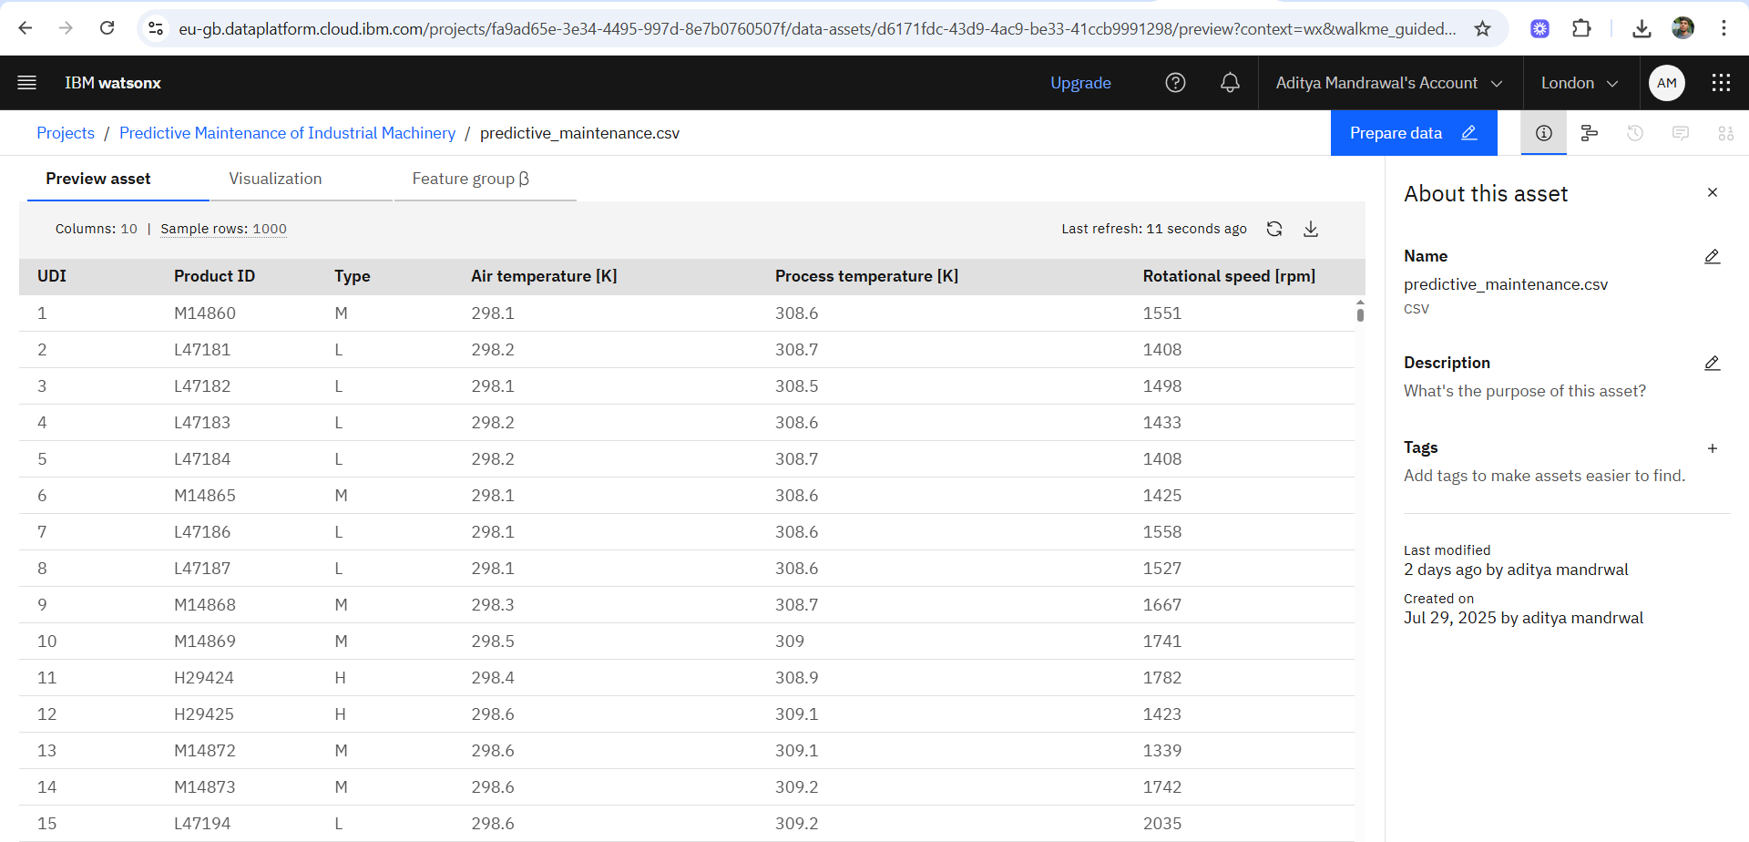
Result: DATA SET

Slide 9
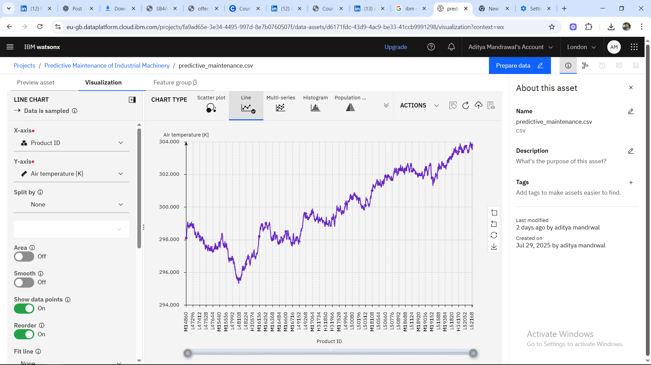
Result: DATA SET

Slide 10
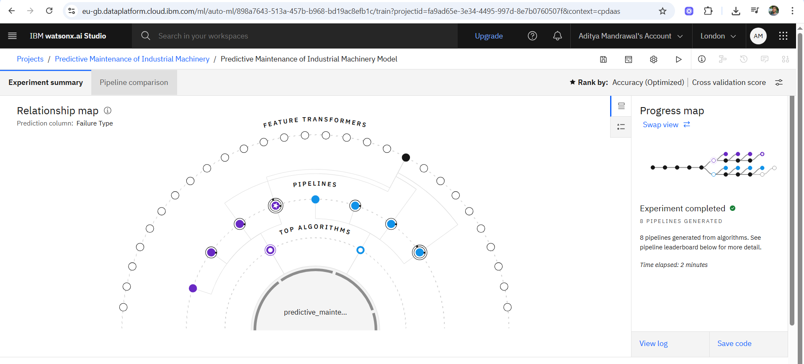
Result: ML Model selection

Slide 11
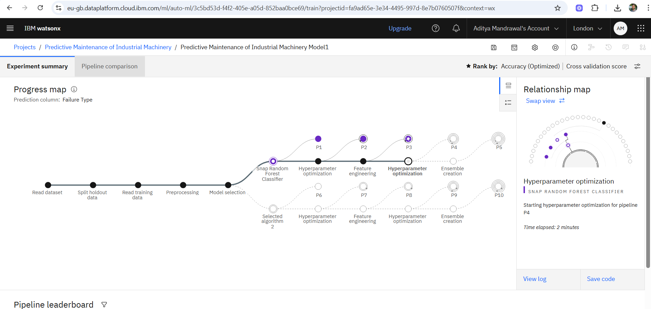
Result: ML Model selection

Slide 12
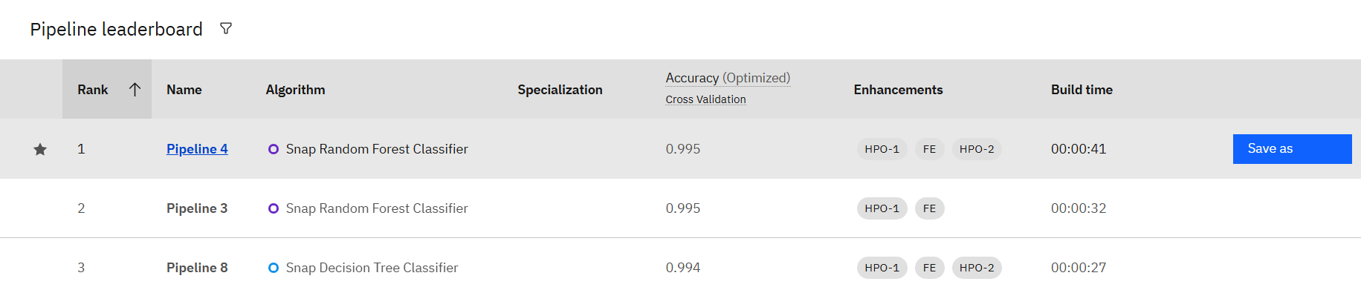
Result: Snap random forest classifier with 99.5% accuracy

Slide 13
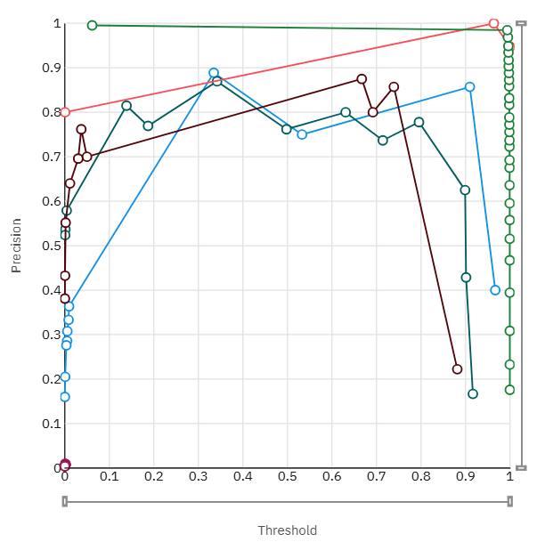
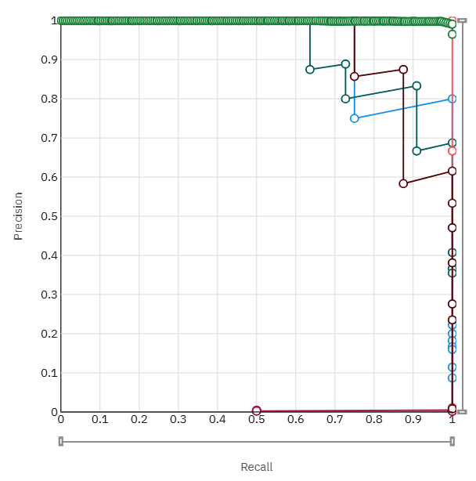
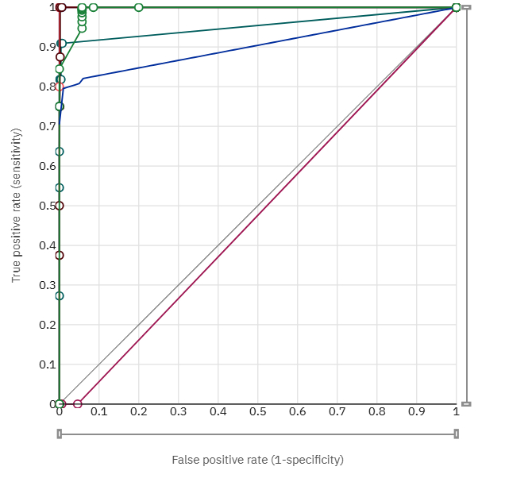
Result: Evaluation, Threshold, Recall graph

Slide 14
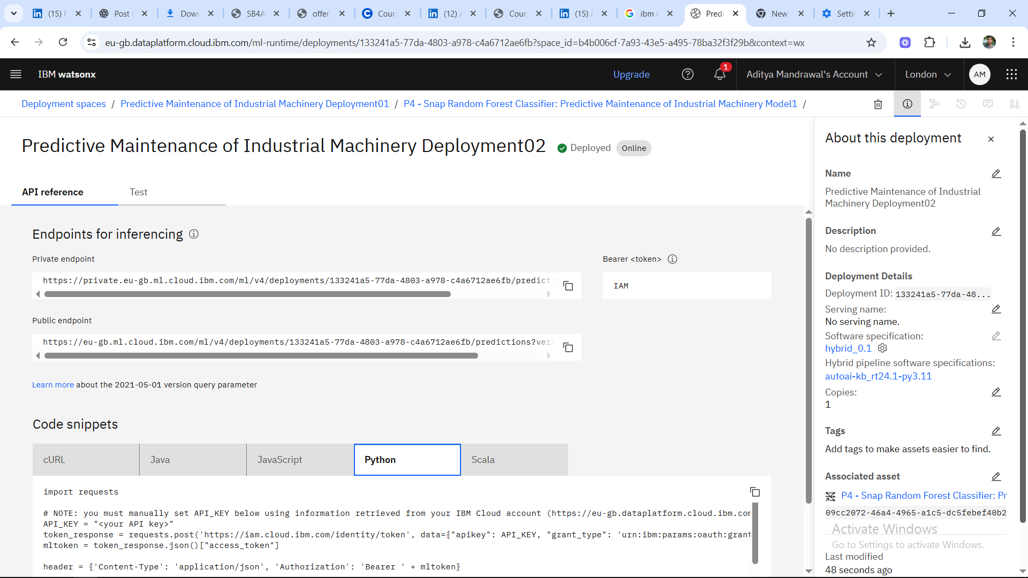
Result: Model Deployemnt

Slide 15
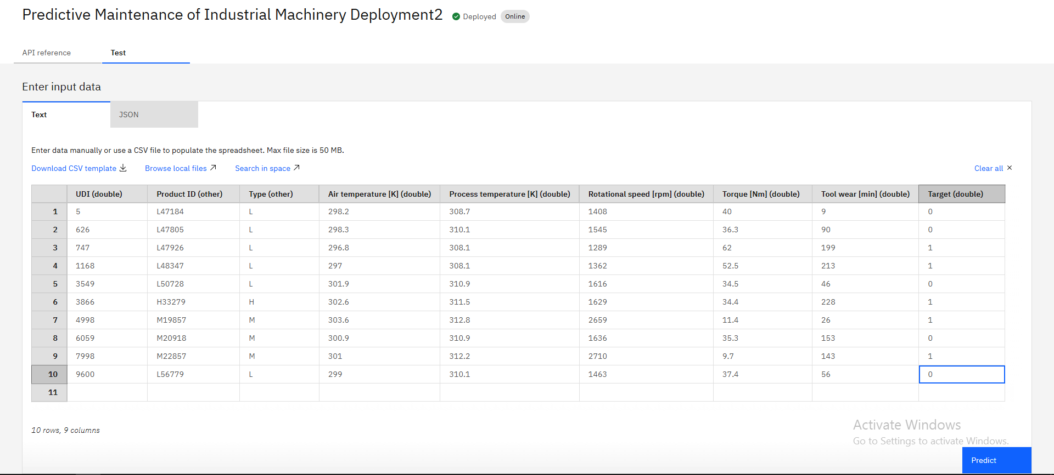
Result: Input for testing

Slide 16
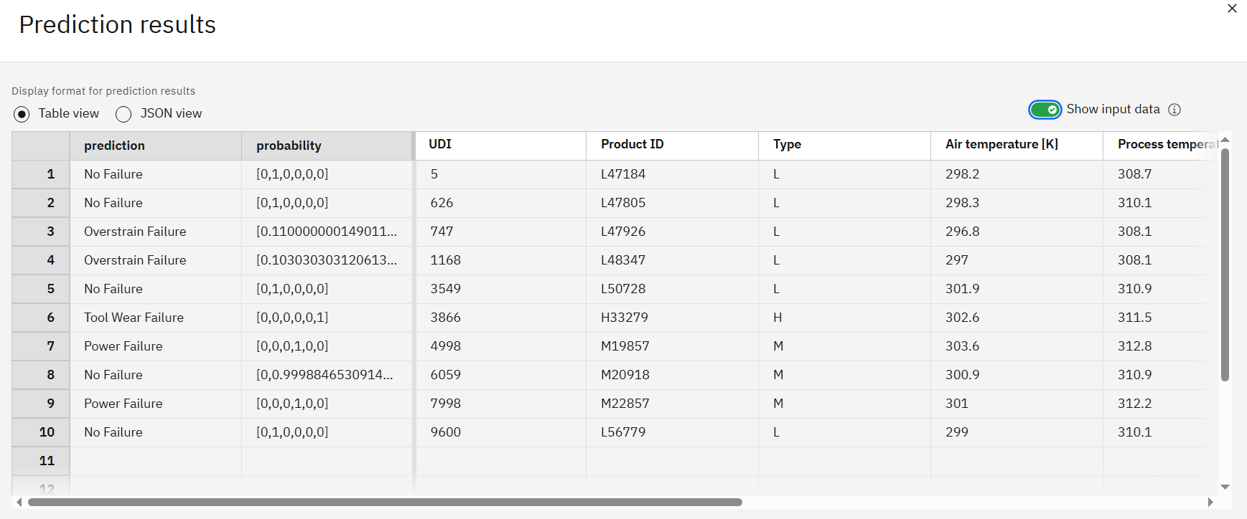
Result: Predicted output

Slide 17
Conclusion
The predictive maintenance model successfully demonstrated its ability to identify potential machinery failures in advance, using real-time sensor data and machine learning techniques. With over 99.5% accuracy, the model effectively predicted different types of failures such as tool wear, heat dissipation issues, and power failures enabling proactive actions that minimize downtime and optimize maintenance schedules.
During implementation, one of the main challenges was handling imbalanced class data, as most machines operate normally. However, this was addressed through appropriate preprocessing and model tuning techniques.
Overall, the project proved that data-driven maintenance systems can significantly improve operational efficiency, reduce unexpected breakdowns, and save on repair costs. It highlights the growing importance of intelligent monitoring in modern manufacturing environments.

Slide 18
Future scope
Wider Machine Coverage: Extend the model to monitor different types of industrial equipment across varied sectors like automotive, textiles, and food processing.
Enhanced Data Sources: Integrate additional data types such as vibration analysis, acoustic signals, and oil particle counts for richer insights and improved predictions.
Real-Time Edge Computing: Implement edge computing solutions to allow real-time, on-device failure prediction in remote or bandwidth-limited environments.
Advanced Algorithms: Explore the use of deep learning models like LSTM and CNN to capture more complex patterns and time-series behavior for better accuracy.
Automated Maintenance Scheduling: Connect the predictive model with maintenance management systems to automatically schedule service and notify technicians when issues are detected.
Scalability on IBM Cloud: Enhance the deployment for large-scale industrial use with improved model retraining pipelines and containerized deployment on IBM Kubernetes Service (IKS).

Slide 19
References
Kaggle Dataset – Predictive Maintenance Classification: https://www.kaggle.com/datasets/shivamb/machine-predictive-maintenance-classification
IBM Cloud & Watson Studio Documentation – Building and deploying ML models: https://www.ibm.com/cloud/watson-studio
Scikit-learn Documentation – Machine Learning in Python: https://scikit-learn.org/stable/
Bousdekis, A., Magoutas, B., Apostolou, D., & Mentzas, G. (2019). A proactive decision-making framework for condition-based maintenance. Computers in Industry, 105, 191–199.
Lee, J., Bagheri, B., & Kao, H. A. (2015). A Cyber-Physical Systems architecture for Industry 4.0-based manufacturing systems. Manufacturing Letters, 3, 18–23.

Slide 20
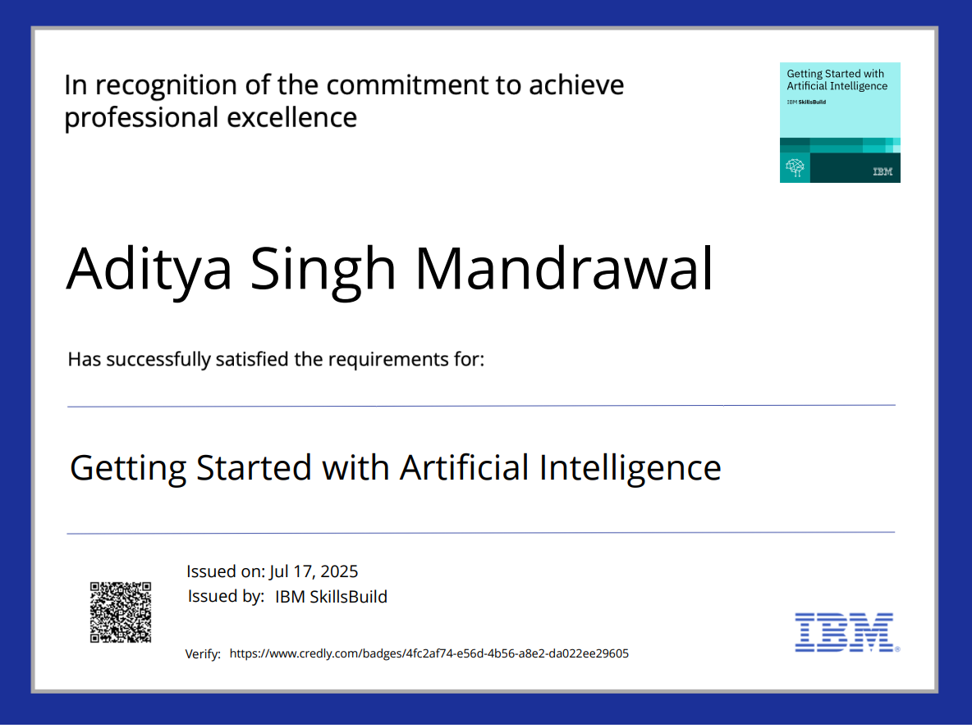
IBM Certifications

Slide 21
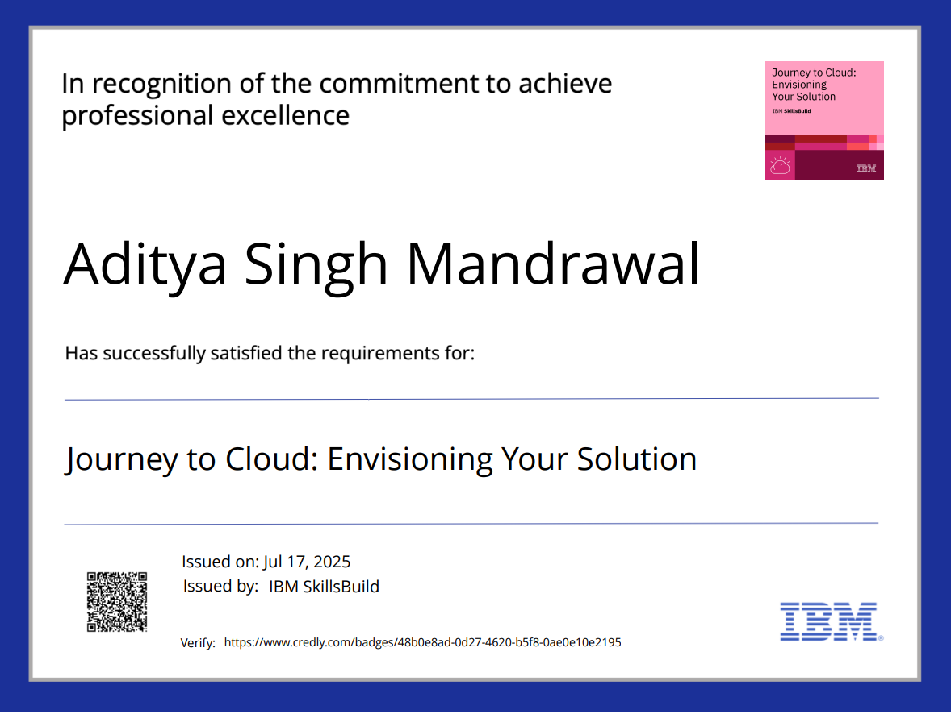
IBM Certifications

Slide 22
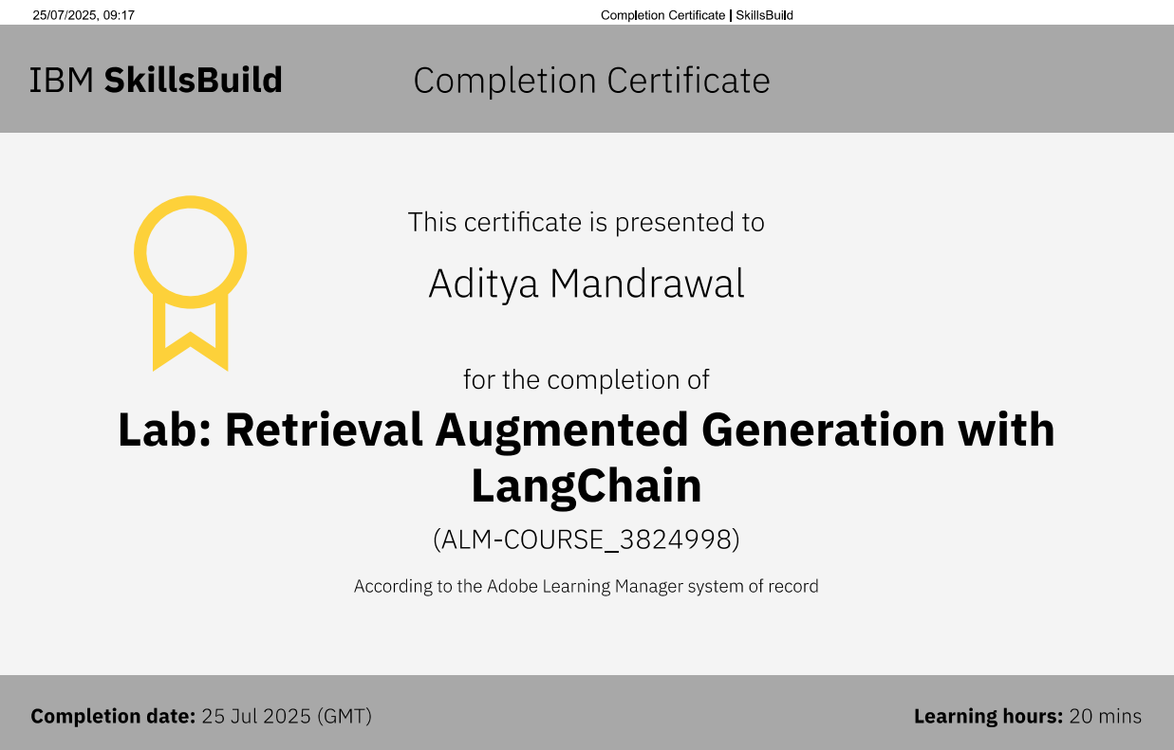
IBM Certifications

Slide 23
THANK YOU

