Slide 1
Formal Languages
A Universal Turing Machine

Slide 2
A limitation of Turing Machines:
Turing Machines are “hardwired”
they execute
only one program
Real Computers are re-programmable

Slide 3
Solution:
Universal Turing Machine
Attributes:
Reprogrammable machine
Simulates any other Turing Machine

Slide 4

Universal Turing Machine
simulates any other Turing Machine
Input of Universal Turing Machine:
Description of transitions of
Initial tape contents of

Slide 5
Tape 1
Three tapes
Description of
Universal
Turing
Machine
Tape 2
Tape Contents of
Tape 3
State of

Slide 6
Tape 1
Description of
We describe Turing machine
as a string of symbols:
We encode as a string of symbols

Slide 7








Alphabet Encoding
Symbols:
Encoding:

Slide 8






State Encoding
States:
Encoding:
Head Move Encoding
Move:
Encoding:

Slide 9
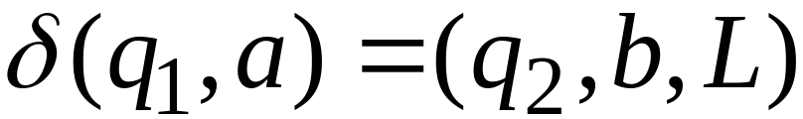
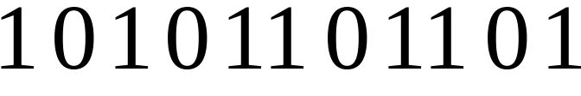
Transition Encoding
Transition:
Encoding:
separator

Slide 10
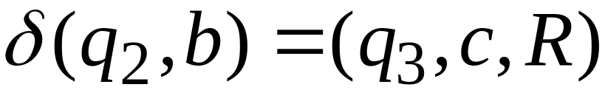

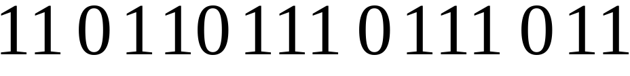
Machine Encoding
Transitions:
Encoding:
separator

Slide 11
Tape 1 contents of Universal Turing Machine:
encoding of the simulated machine
as a binary string of 0’s and 1’s

Slide 12
A Turing Machine is described
with a binary string of 0’s and 1’s
Therefore:
The set of Turing machines forms a language:
each string of the language is
the binary encoding of a Turing Machine

Slide 13
Language of Turing Machines
L = { 010100101,
00100100101111,
111010011110010101,
…… }
(Turing Machine 1)
(Turing Machine 2)
……

Slide 14
Countable Sets

Slide 15
Infinite sets are either:
Countable
or
Uncountable

Slide 16
Countable set:
Any finite set
or
Any Countably infinite set:
There is a one to one correspondence
between
elements of the set
and
Natural numbers

Slide 17
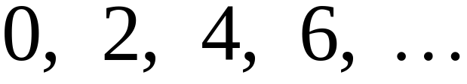
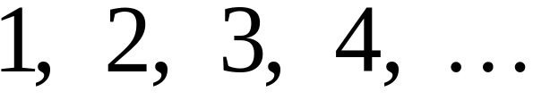


Example:
The set of even integers
is countable
Even integers:
Correspondence:
Positive integers:
corresponds to

Slide 18
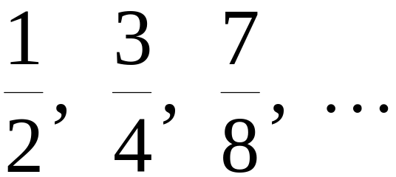
Example:
The set of rational numbers
is countable
Rational numbers:

Slide 19
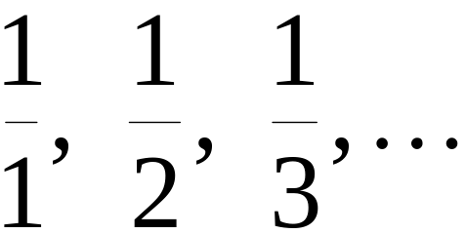
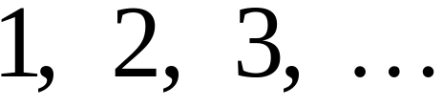
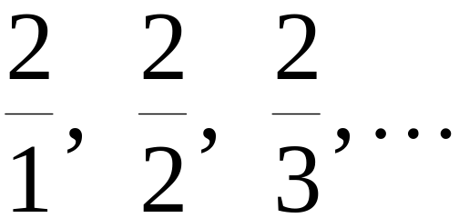
Naïve Proof
Rational numbers:
Correspondence:
Positive integers:
Doesn’t work:
we will never count
numbers with nominator 2:

Slide 20










Better Approach

Slide 26
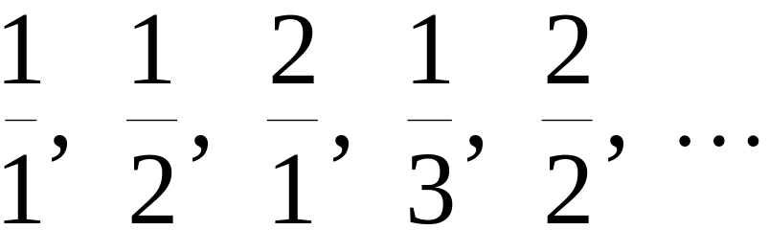
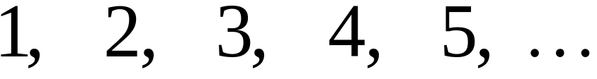
Rational Numbers:
Correspondence:
Positive Integers:

Slide 27
We proved:
the set of rational numbers is countable
by describing an enumeration procedure

Slide 28

Definition
Let be a set of strings
An enumeration procedure for is a
Turing Machine that generates
all strings of one by one
and
Each string is generated in finite time

Slide 29
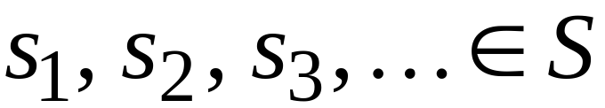
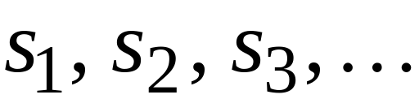

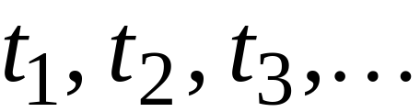
strings
Enumeration
Machine for
output
(on tape)
Finite time:

Slide 30







Enumeration Machine
Configuration
Time 0
Time

Slide 31






Time
Time

Slide 32
Observation:
If for a set there is an
enumeration procedure,
then the set is countable

Slide 33
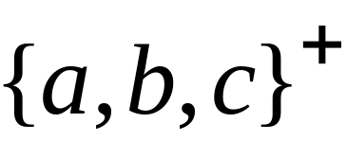
Example:
The set of all strings
is countable
Proof:
We will describe an enumeration procedure

Slide 34



Naive procedure:
Produce the strings in lexicographic order:
Doesn’t work:
strings starting with
will never be produced

Slide 35
Better procedure:
Proper Order
1. Produce all strings of length 1
2. Produce all strings of length 2
3. Produce all strings of length 3
4. Produce all strings of length 4
..........

Slide 36












length 1
Produce strings in
Proper Order:
length 2
length 3

Slide 37
Theorem:
The set of all Turing Machines
is countable
Proof:
Any Turing Machine can be encoded
with a binary string of 0’s and 1’s
Find an enumeration procedure
for the set of Turing Machine strings

Slide 38
Enumeration Procedure:
Repeat
1. Generate the next binary string
of 0’s and 1’s in proper order
2. Check if the string describes a
Turing Machine
if YES: print string on output tape
if NO: ignore string

Slide 39
Uncountable Sets

Slide 40
Definition:
A set is uncountable
if it is not countable

Slide 41
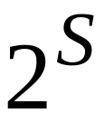
Theorem:
Let be an infinite countable set
The powerset of is uncountable

Slide 42
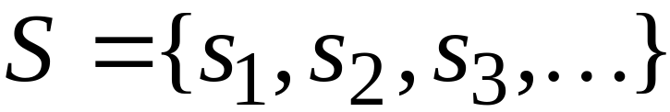
Proof:
Since is countable, we can write
Elements of

Slide 43
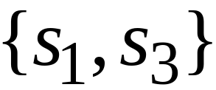
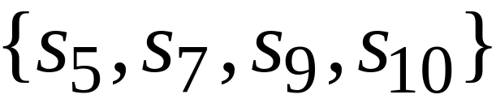
Elements of the powerset have the form:
……

Slide 44




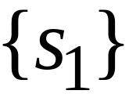

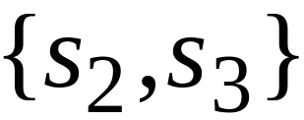
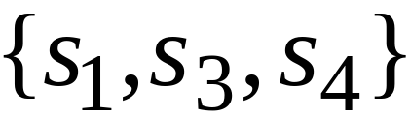
We encode each element of the power set
with a binary string of 0’s and 1’s
Encoding
Powerset
element

Slide 45
Let’s assume (for contradiction)
that the powerset is countable.
Then: we can enumerate
the elements of the powerset

Slide 46




Powerset
element
Encoding

Slide 47
Take the powerset element
whose bits are the complements
of the bits in the diagonal

Slide 48

New element:
(binary complement of diagonal)

Slide 49

The new element must be some
of the powerset
However, that’s impossible:
from definition of
the i-th bit of must be
the complement of itself
Contradiction!!!

Slide 50
Since we have a contradiction:
The powerset of is uncountable

Slide 51
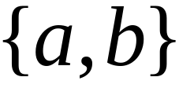
An Application: Languages
Example Alphabet :
The set of all Strings:
infinite and countable

Slide 52
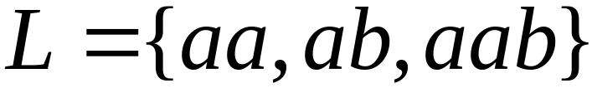
Example Alphabet :
The set of all Strings:
infinite and countable
A language is a subset of :

Slide 53




Example Alphabet :
The set of all Strings:
infinite and countable
The powerset of contains all languages:
uncountable

Slide 54



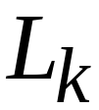
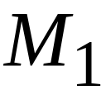
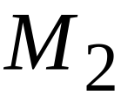
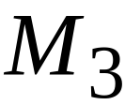

Languages: uncountable
Turing machines: countable
There are more languages
than Turing Machines

Slide 55
Conclusion:
There are some languages not accepted
by Turing Machines
(These languages cannot be described
by algorithms)

Slide 56
Languages not accepted by Turing Machines
Languages
Accepted by
Turing Machines

