Slide 1
FORMAL LANGUAGES AND AUTOMATA THEORY
Giridhar N S

Slide 2
Peter Linz, An Introduction to Formal
Languages and Automat, (6e), Jones & Bartlett
Learning, 2016
INTRODUCTION TO THE THEORY OF COMPUTATION AND FINITE AUTOMATA
REGULAR LANGUAGES, REGULAR GRAMMARS AND PROPERTIES OF REGULAR LANGUAGES:
CONTEXT-FREE LANGUAGES AND SIMPLIFICATION OF CONTEXT-FREE GRAMMARS AND NORMAL FORMS
CONTEXT-FREE LANGUAGES AND SIMPLIFICATION OF CONTEXT-FREE GRAMMARS AND NORMAL FORMS
TURING MACHINES AND OTHER MODELS OF TURING MACHINES &
A HIERARCHY OF FORMAL LANGUAGES & AUTOMATA

Slide 3
Computation
CPU
memory

Slide 4
temporary memory
input memory
CPU
output memory
Program memory

Slide 5



Example:
temporary memory
input memory
CPU
output memory
Program memory
compute
compute

Slide 6

temporary memory
input memory
CPU
output memory
Program memory
compute
compute

Slide 7


temporary memory
input memory
CPU
output memory
Program memory
compute
compute

Slide 8
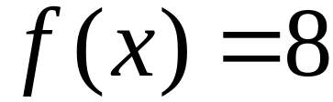
temporary memory
input memory
CPU
Program memory
output memory
compute
compute

Slide 9
Automaton
temporary memory
Automaton
input memory
CPU
output memory
Program memory

Slide 10
Different Kinds of Automata
Automata are distinguished by the temporary memory
  Finite Automata: no temporary memory
  Pushdown Automata: stack
  Turing Machines: random access memory

Slide 11
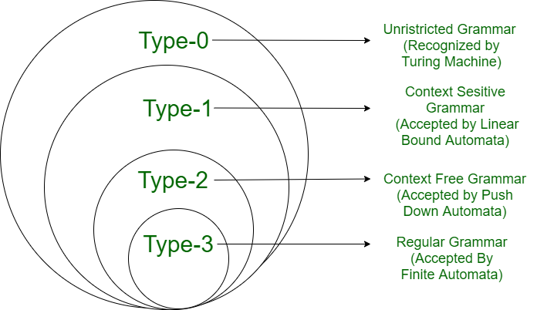

Slide 12
Finite Automaton
temporary memory
input memory
Finite
Automaton
output memory
Example: Vending Machines
(small computing power)

Slide 13
Pushdown Automaton
Stack
Push, Pop
input memory
Pushdown
Automaton
output memory
Example: Compilers for Programming Languages
(medium computing power)

Slide 14
Turing Machine
Random Access Memory
input memory
Turing
Machine
output memory
Examples: Any Algorithm
(highest computing power)

Slide 15
Power of Automata
Finite
Automata
Pushdown
Automata
Turing
Machine
Less power
More power
Solve more
computational problems

Slide 16
Languages, Grammars & Automata
Three Basic concepts

Slide 17
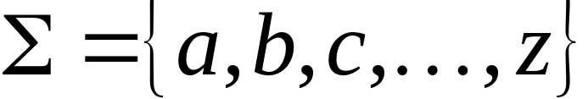
A language is a set of strings
String: A sequence of letters
  Examples: “cat”, “dog”, “house”, …
  Defined over an alphabet:

Slide 18

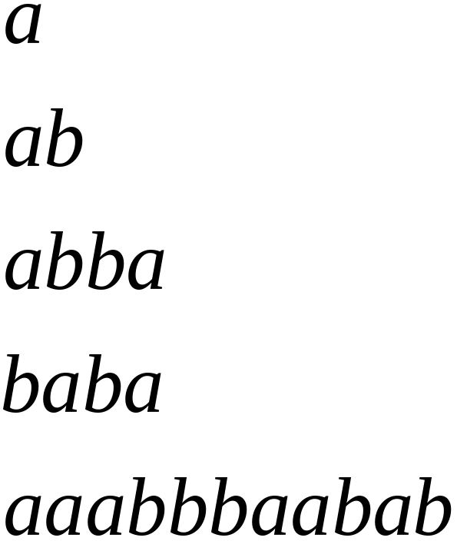
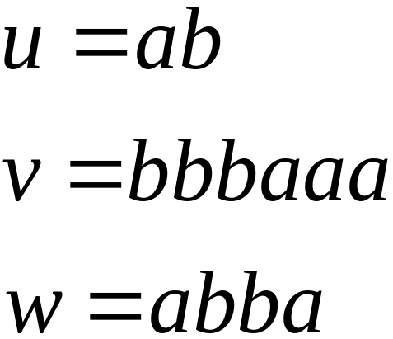
Alphabets and Strings
Alphabet: Finite nonempty set Σof symbols, called the alphabet
Strings: Finite sequence of symbols from the alphabet
Strings
For example, if the alphabet is , then abab & aaabbba are strings on Σ . We use lowercase letters a, b,c,… for elements of Σ & u,v,w… for string names

Slide 19
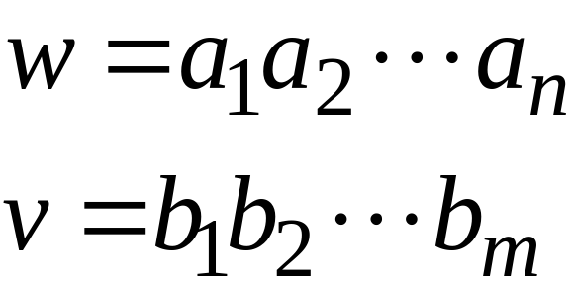
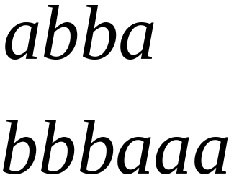
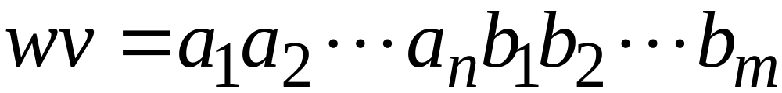

String Operations
Concatenation

Slide 20




Reverse

Slide 21


String Length
Length:
Examples:

Slide 22
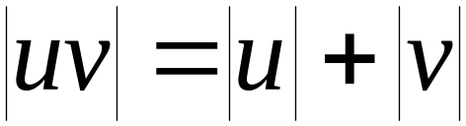

Length of Concatenation
Example:

Slide 23

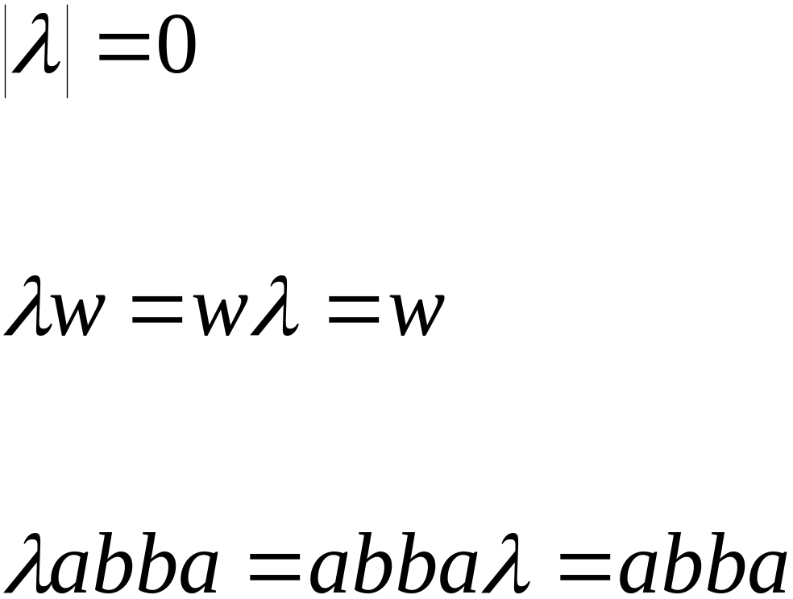
Empty String
Empty string: A string with no symbols and it is denoted by
Observations:

Slide 24


Substring
Substring of string:
  a subsequence of consecutive characters
String Substring

Slide 25




Prefix and Suffix
Prefixes Suffixes
prefix
suffix

Slide 26




Another Operation
Example:
Definition:

Slide 27



The * Operation
: the set of all possible strings from
alphabet

Slide 28

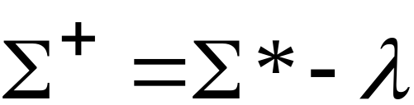
The + Operation
: the set of all possible strings from
alphabet except

Slide 29


Languages
A language is any subset of
Example:
Languages:
The set L = {a^{n}b^{n} : n ≥ 0} is also a language on Σ. The strings aabb and aaaabbbb are in L, but strings abb is not in L. This language is infinite

Slide 30
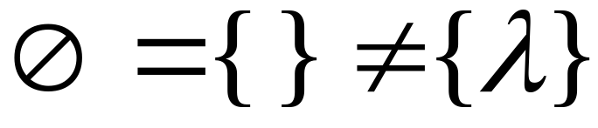



Note that:
Sets
Set size
Set size
String length

Slide 31




Another Example
An infinite language

Slide 32


Operations on Languages
The usual set operations
Complement:

Slide 33



Reverse
Definition:
Examples:

Slide 34


Concatenation
Definition:
Example:

Slide 35



Another Operation
Definition:
Special case:

Slide 36



More Examples

Slide 37


Star-Closure (Kleene *)
Definition:
Example:

Slide 38
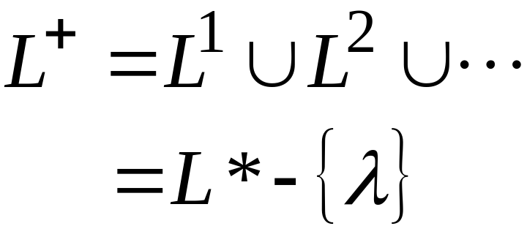

Positive Closure
Definition:

