Slide 1
Formal Languages
Decidability

Slide 2


Consider problems with answer YES or NO
Examples:
Does Machine have three states ?
Is string a binary number?
Does DFA accept any input?

Slide 3
A problem is decidable if some Turing machine
decides (solves) the problem
Decidable problems:
Does Machine have three states ?
Is string a binary number?
Does DFA accept any input?

Slide 4
The Turing machine that decides (solves)
a problem answers YES or NO
for each instance of the problem
Input
problem
instance
YES
Turing Machine
NO

Slide 5
The machine that decides (solves) a problem:
If the answer is YES
then halts in a yes state
If the answer is NO
then halts in a no state
These states do not have to be final states

Slide 6
Turing Machine that decides a problem
YES states
NO states
YES and NO states are halting states

Slide 7
Difference between
Recursive Languages and Decidable problems
For decidable problems:
The YES states do not have to be
final states

Slide 8
Some problems are undecidable:
which means:
there is no Turing Machine that
solves all instances of the problem
A simple undecidable problem:
The membership problem

Slide 9


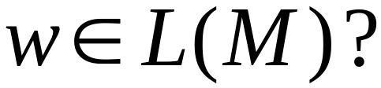
The Membership Problem
Input:
Turing Machine
String
Question:
Does accept ?

Slide 10
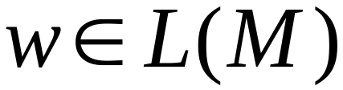
Theorem:
The membership problem is undecidable
(there are and for which we cannot
decide whether )
Proof?

Slide 11
Theorem:
The membership problem is undecidable
(there are and for which we cannot
decide whether )
Proof:
Assume for contradiction that
the membership problem is decidable

Slide 12

Thus, there exists a Turing Machine
that solves the membership problem
YES
accepts
NO
rejects

Slide 13

Let be a recursively enumerable language
Let be the Turing Machine that accepts
We will prove that is also recursive:
we will describe a Turing machine that
accepts and halts on any input

Slide 14
Turing Machine that accepts
and halts on any input
YES
accept
accepts ?
NO
reject

Slide 15
Therefore,
is recursive
Since is chosen arbitrarily, every recursively enumerable language is also recursive
But there are recursively enumerable
languages which are not recursive
Contradiction!!!!

Slide 16
Therefore, the membership problem
is undecidable
END OF PROOF

Slide 17
Another famous undecidable problem:
The halting problem

Slide 18
The Halting Problem
Input:
Turing Machine
String
Question:
Does halt on input ?

Slide 19
Theorem:
The halting problem is undecidable
(there are and for which we cannot
decide whether halts on input )
Proof?

Slide 20
Theorem:
The halting problem is undecidable
(there are and for which we cannot
decide whether halts on input )
Proof:
Assume for contradiction that
the halting problem is decidable

Slide 21
Thus, there exists Turing Machine
that solves the halting problem
YES
halts on
NO
doesn’t
halt on

Slide 22
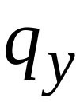
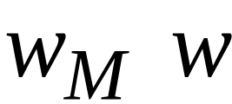


Construction of
Input:
initial tape contents
YES
NO
Encoding
of
String

Slide 23


Construct machine :
If returns YES then loop forever
If returns NO then halt

Slide 24


Loop forever
YES
NO

Slide 25

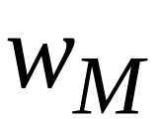
Construct machine :
Input:
(machine )
If
halts on input
Then loop forever
Else halt

Slide 26
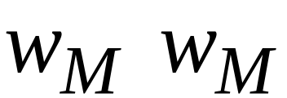
copy

Slide 27
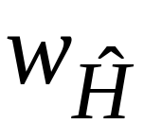
Run machine on itself:
Input:
(machine )
If
halts on input
Then it will loop forever
Else it will halt

Slide 28
on input
:
If halts then it loops forever
If doesn’t halt then it halts
Contradiction !!!!!

Slide 29
Therefore, we have a contradiction
The halting problem is undecidable
END OF PROOF

Slide 30
Another proof of the same theorem:
If the halting problem were decidable then
every recursively enumerable language
would be recursive

Slide 31
Theorem:
The halting problem is undecidable
Proof:
Assume for contradiction that
the halting problem is decidable

Slide 32
There exists Turing Machine
that solves the halting problem
YES
halts on
NO
doesn’t
halt on

Slide 33
Let be a recursively enumerable language
Let be the Turing Machine that accepts
We will prove that is also recursive:
we will describe a Turing machine that
accepts and halts on any input

Slide 34
Turing Machine that accepts
and halts on any input
NO
reject
halts on ?
YES
accept
Halts on final state
Run
with input
reject
Halts on non-final
state

Slide 35
Therefore
is recursive
Since is chosen arbitrarily, every
recursively enumerable language
is also recursive
But there are recursively enumerable
languages which are not recursive
Contradiction!!!!

Slide 36
Therefore, the halting problem is undecidable
END OF PROOF

