Slide 1
Formal Languages
Regular Expressions

Slide 2
Regular Expressions (RE)
The regular language (RL) can be easily described by simple expressions called regular expressions
Each RE r denotes a RL L(r)
Note: We use + to denote denotes union,
We use . for concatenation and
* for star closure
Examples:
1. RE for the language L = {a} is a.
2. RE for the language L = {a, b, c} is a+b+c
3. RE for the language L = {λ, a, bc, aa, abc, bca, bcbc, aaa, aabc,… } is (a + bc)*

Slide 3
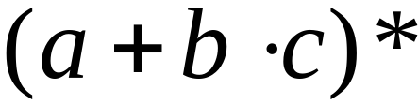
Regular Expressions
Regular expressions
describe regular languages
Example:
describes the language

Slide 4
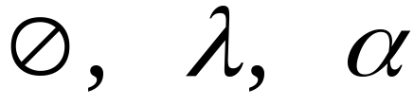



Recursive Definition
Primitive regular expressions:
Given regular expressions and
Are regular expressions

Slide 5
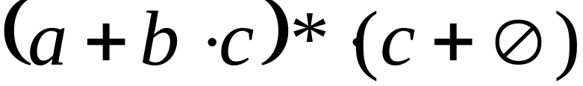
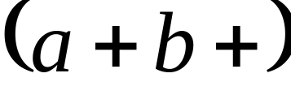
Examples
A regular expression:
Not a regular expression:

Slide 6
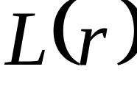

Languages of Regular Expressions
: language of regular expression
Example

Slide 7
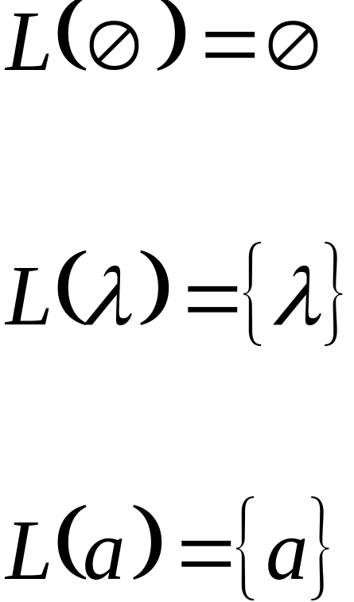
Definition
For primitive regular expressions:

Slide 8


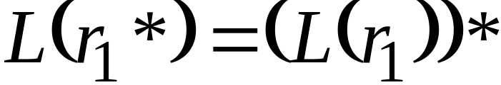

Definition (continued)
For regular expressions and

Slide 9
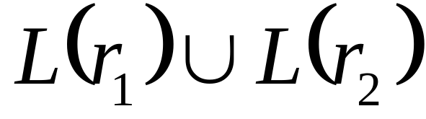
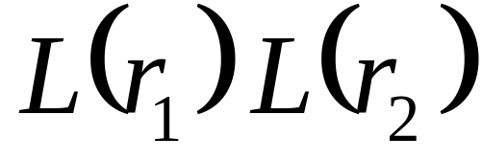
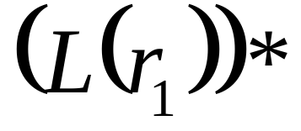
Definitions?

Slide 10

L(r)?
Regular expression:

Slide 11
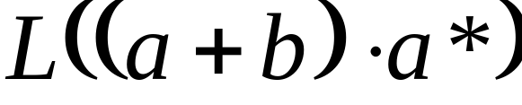


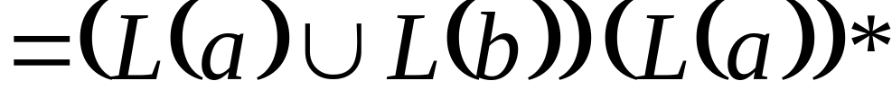
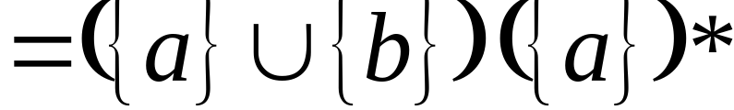
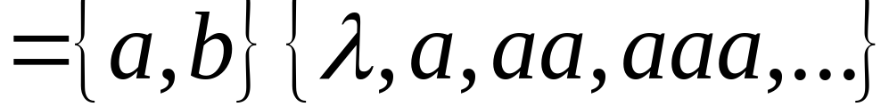
Example
Regular expression:

Slide 12

L(r)?
Regular expression

Slide 13
Example
Regular expression

Slide 14

L(r)?
Regular expression

Slide 15

Example
Regular expression

Slide 16
L(r)?

Slide 17

Regular expression?
= { all strings without
two consecutive 0 }

Slide 18

Example
Regular expression
= { all strings with at least
two consecutive 0 }

Slide 19
Regular expression?
= { all strings without
two consecutive 0 }

Slide 20
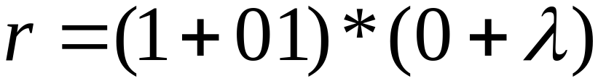
Example
Regular expression
= { all strings without
two consecutive 0 }

Slide 21

Equivalent Regular Expressions
Definition:
Regular expressions and
are equivalent if

Slide 22

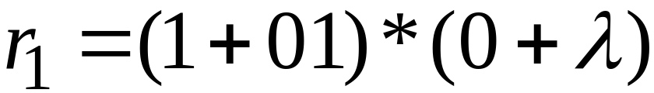

Example
= { all strings without
two consecutive 0 }
and
are equivalent
regular expr.

Slide 23
Regular Expressions and
Regular Languages

Slide 24

Theorem
Languages
Generated by
Regular Expressions
Regular
Languages

Slide 25


We will show:
Languages
Generated by
Regular Expressions
Regular
Languages
Languages
Generated by
Regular Expressions
Regular
Languages

Slide 26
Proof - Part 1
Languages
Generated by
Regular Expressions
Regular
Languages
For any regular expression
the language is regular
Proof by induction on the size of

Slide 27
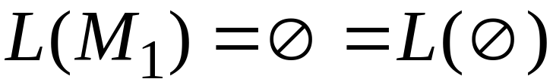
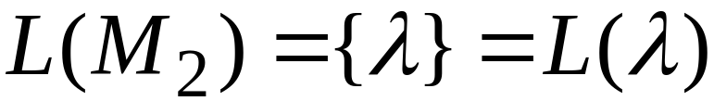

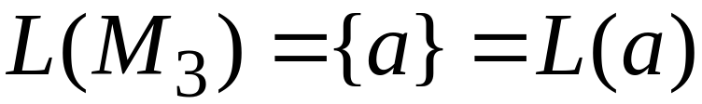
Induction Basis
Primitive Regular Expressions:
NFAs
regular
languages

Slide 28
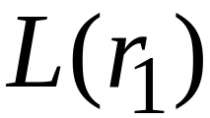
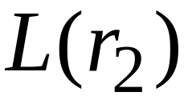
Inductive Hypothesis
Assume
for regular expressions and
that
and are regular languages

Slide 29
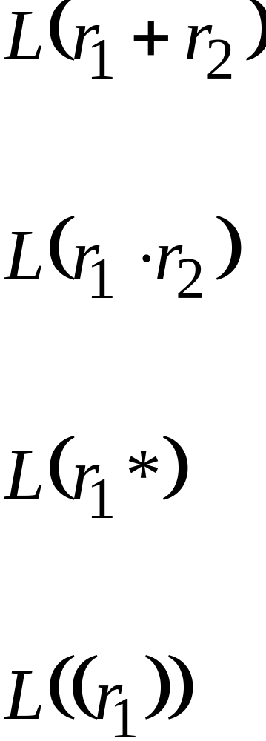
Inductive Step
We will prove:
Are regular
Languages

Slide 30
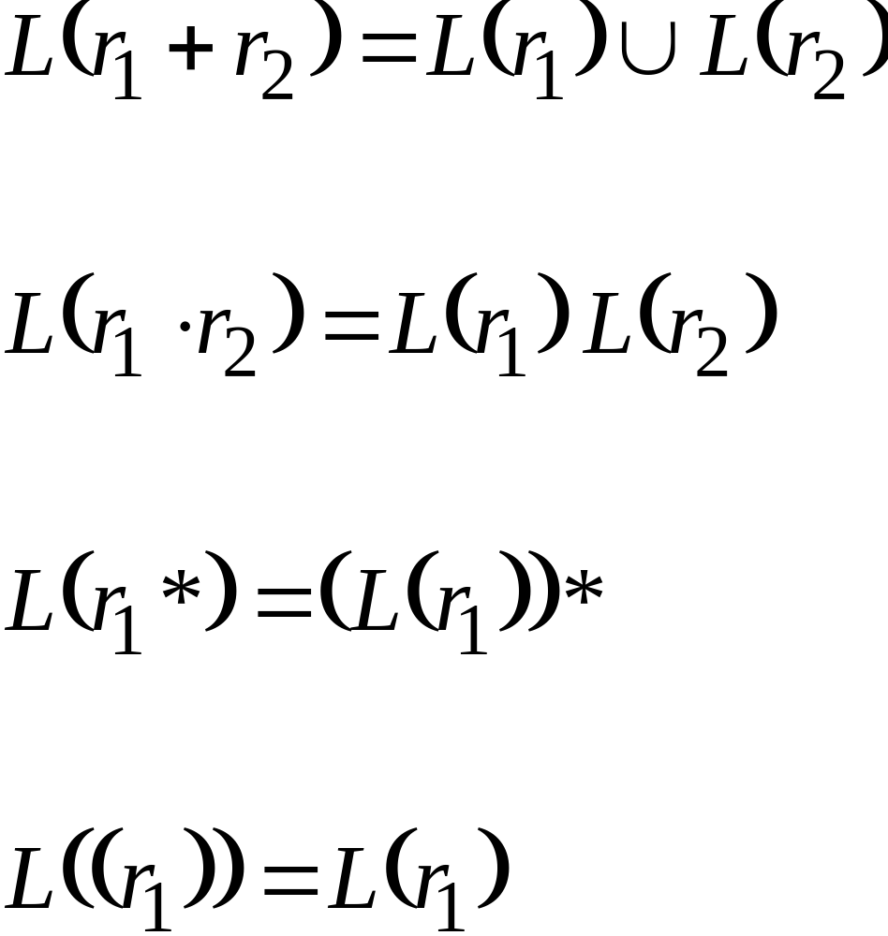
By definition of regular expressions:

Slide 31
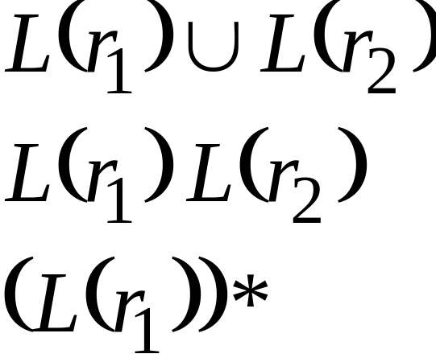
By inductive hypothesis we know:
and are regular languages
We also know:
Regular languages are closed under:
Union
Concatenation
Star

Slide 32
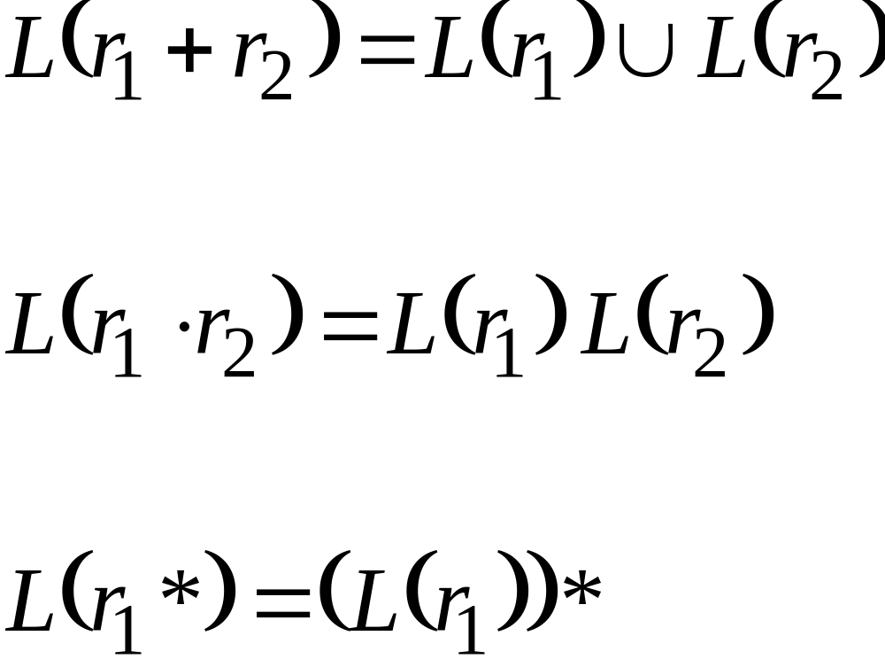
Therefore:
Are regular
languages

Slide 33
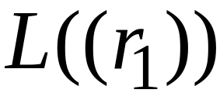
And trivially:
is a regular language

Slide 34
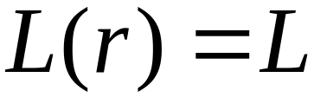
Proof - Part 2
Languages
Generated by
Regular Expressions
Regular
Languages
For any regular language there is
a regular expression with
Proof by construction of regular expression

Slide 35

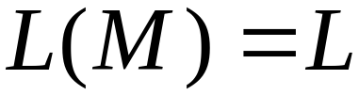
Since is regular take the
NFA that accepts it
Single final state

Slide 36




From construct the equivalent
Generalized Transition Graph
in which transition labels are regular expressions
Example:

Slide 37
Procedure nfa-rex
Start with an nfa with states q0,q1, ...qn and a single final state , distinct from its initial state

Slide 38
Procedure nfa-rex
Start with an nfa with states q0,q1, ...qn and a single final state , distinct from its initial state
Convert the nfa into a complete generalized transition graph.
Let r_{ij} stand for the label of the edge from qi to qj

Slide 39
Procedure nfa-rex
.
3.If the generalized transition graph(GTG) has only 2 states with qi as initial and qj as final, as its associated regular expression is
r_{ii}* r_{ij} (r_{jj} + r_{ji} r_{ii} * r_{ij} )*
^{<number>}

Slide 40
4. If GTG has 3 states with the initial state qi and final state qj and the third state qk, introduce new edge labelled
r_{pq} +r_{pk} r_{kk} * r_{kq} for p =i, j and q=i, j. When this is done the remove the vertex q_{k} and its associated edges.

Slide 41
5 . If GTG has 4 or more edges , pick a state q_{k} to be removed. Apply rule 4 for all pairs of states (q_{i} ,q_{j).} i≠k , j ≠k . At each step apply the simplifying rules
r+Ф =r
r Ф= Ф
Ф*=λ
Wherever possible. When this is done , remove q_{k}

Slide 42
6. Repeat step 3 to 5 until the correct regular expression is obtained.

Slide 43




Another Example:

Slide 44

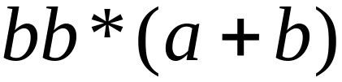
Reducing the states:

Slide 45
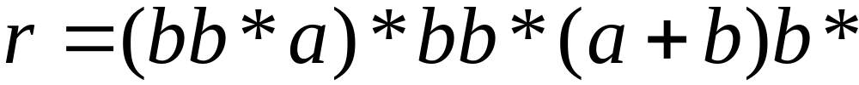
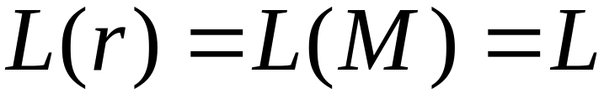
Resulting Regular Expression:

Slide 46









In General
Removing states:

Slide 47





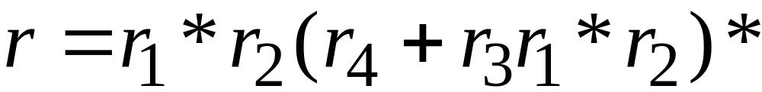
The final transition graph:
The resulting regular expression:

Slide 48
Standard Representations of Regular Languages
Regular Languages
FAs
Regular
Expressions
NFAs

Slide 49
When we say:
We are given
a Regular Language
We mean:
Language is in a standard
representation

Slide 50
Elementary Questions about
Regular Languages

Slide 51


Membership Question
Question:
Given regular language
and string
how can we check if ?

Slide 52
Membership Question
Question:
Given regular language
and string
how can we check if ?
Answer:
Take the DFA that accepts
and check if is accepted

Slide 53


DFA
DFA

Slide 54
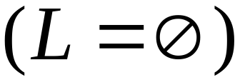
Question:
Given regular language
how can we check
if is empty: ?

Slide 55
Question:
Given regular language
how can we check
if is empty: ?
Answer:
Take the DFA that accepts
Check if there is any path from
the initial state to a final state

Slide 56


DFA
DFA

Slide 57
Question:
Given regular language
how can we check
if is finite?

Slide 58
Question:
Given regular language
how can we check
if is finite?
Answer:
Take the DFA that accepts
Check if there is a walk with cycle
from the initial state to a final state

Slide 59
DFA
is infinite
DFA
is finite

Slide 60


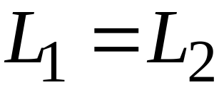
Question:
Given regular languages and
how can we check if ?

Slide 61
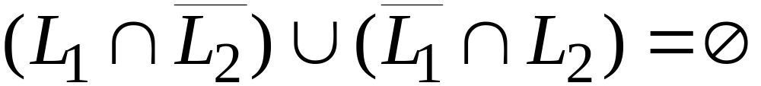
Question:
Given regular languages and
how can we check if ?
Answer:
Find if

Slide 62
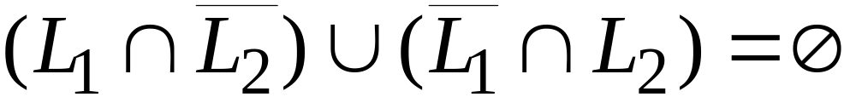
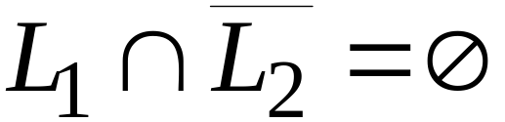
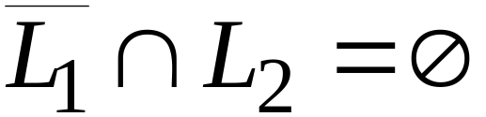


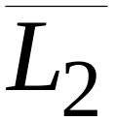
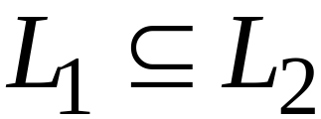
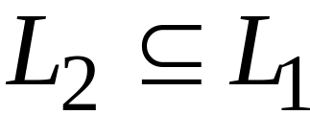
and

Slide 63
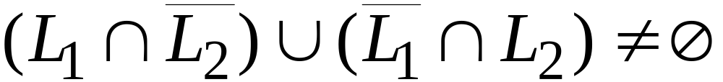
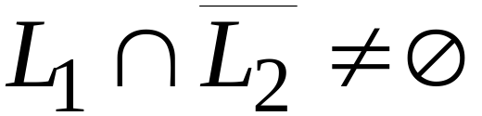
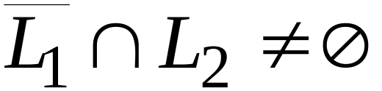
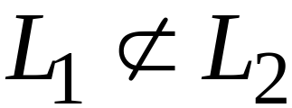
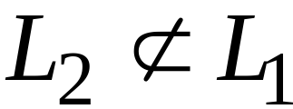
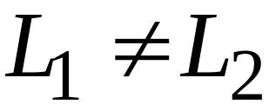
or

