Slide 1
Formal Languages
Context-Free Languages

Slide 2




Regular Languages

Slide 3
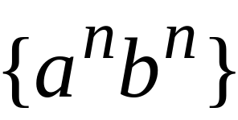
Context-Free Languages
Context-Free Languages
Regular Languages

Slide 4
Context-free Grammars
Definition: A grammar G = (V, T, S, P) is said to be context-free if all production rules in P have the form
A → x
where A ∈ V and x ∈ (V ∪ T)*
A language is said to be context-free iff there is a context free grammar G such that L = L(G).

Slide 5
Context-Free Languages
Context-Free
Grammars
Pushdown
Automata
stack
automaton

Slide 6
Context-Free Grammars

Slide 7

Grammars
Grammars express languages
Example: the English language

Slide 8
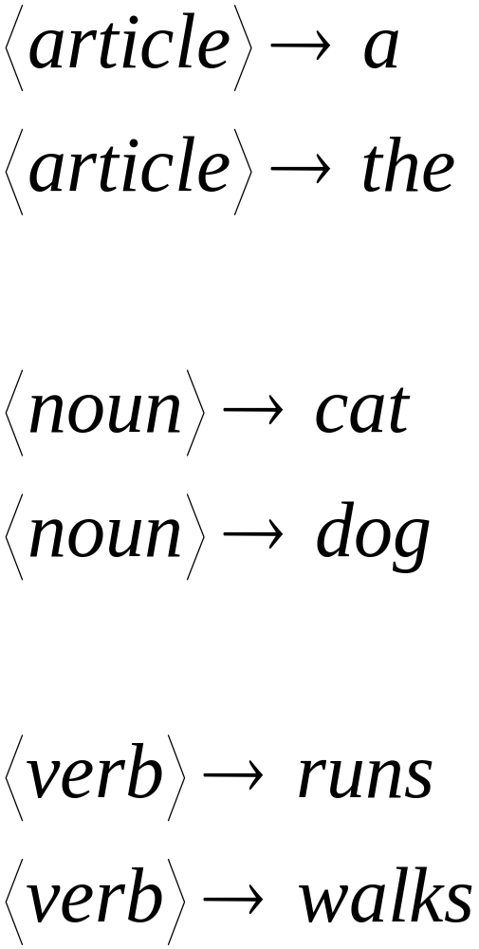

Slide 9
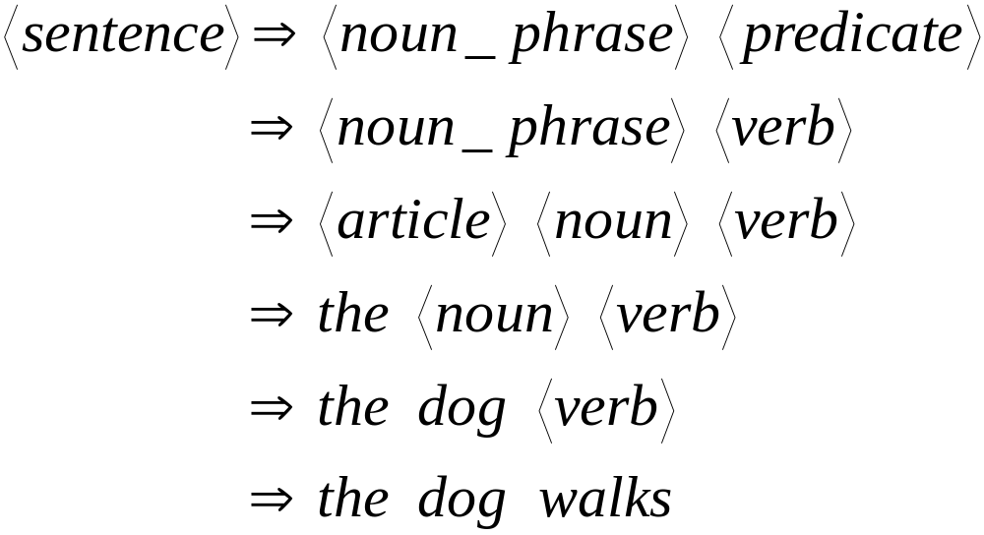
A derivation of “the dog walks”:

Slide 10
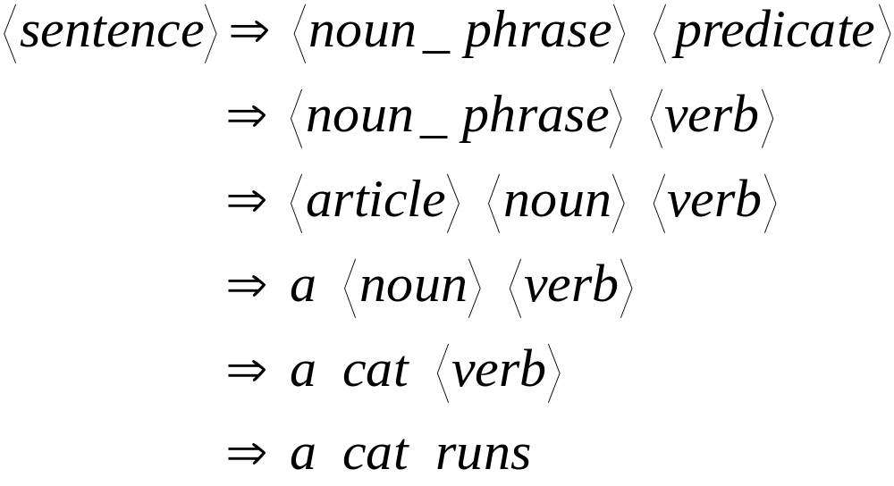
A derivation of “a cat runs”:

Slide 11
Language of the grammar:
L = { “a cat runs”,
“a cat walks”,
“the cat runs”,
“the cat walks”,
“a dog runs”,
“a dog walks”,
“the dog runs”,
“the dog walks” }

Slide 12
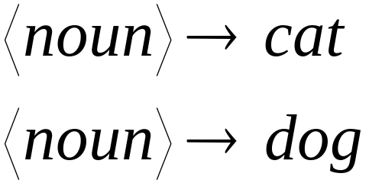
Notation
Production Rules
Variable
Terminal

Slide 13





Another Example
Grammar:
Derivation of sentence :

Slide 14
Language?

Slide 15



Grammar:
Derivation of sentence :

Slide 16

Other derivations:

Slide 17

Language of the grammar

Slide 18





More Notation
Grammar
Set of variables
Set of terminal symbols
Start variable
Set of Production rules

Slide 19




Example
Grammar :

Slide 20
More Notation
Sentential Form:
A sentence that contains
variables and terminals
Example:
Sentential Forms
sentence

Slide 21

We write:
Instead of:

Slide 22

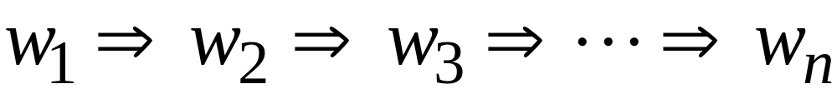
In general we write:
If:

Slide 23
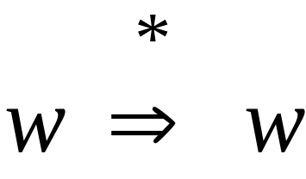
By default:

Slide 24
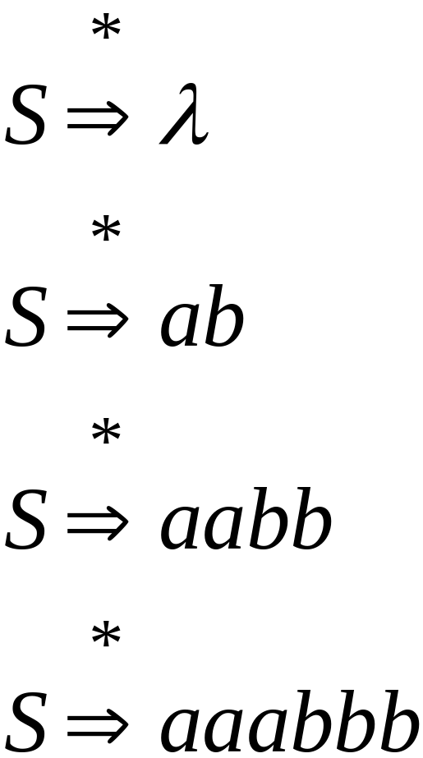
Example
Grammar
Derivations

Slide 25
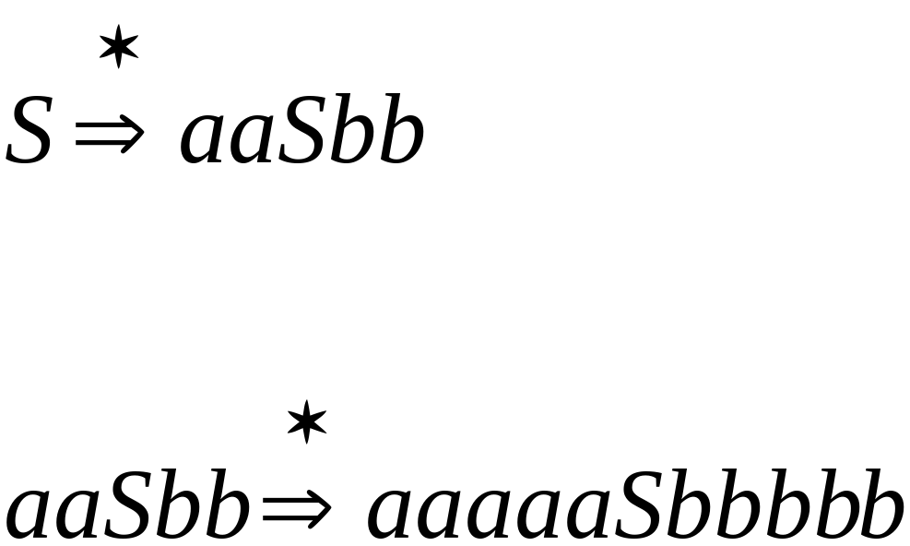
Example
Grammar
Derivations

Slide 26
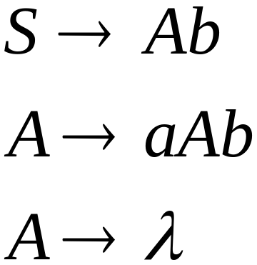
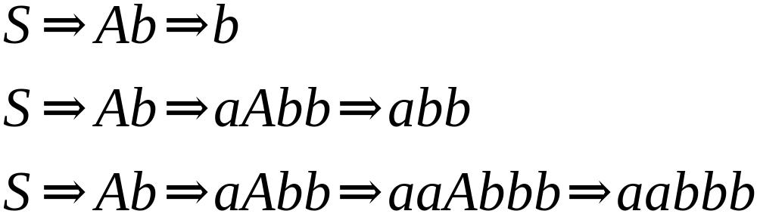
Another Grammar Example
Grammar :
Derivations:

Slide 27
Language?

Slide 28
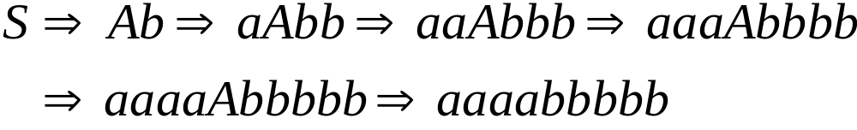
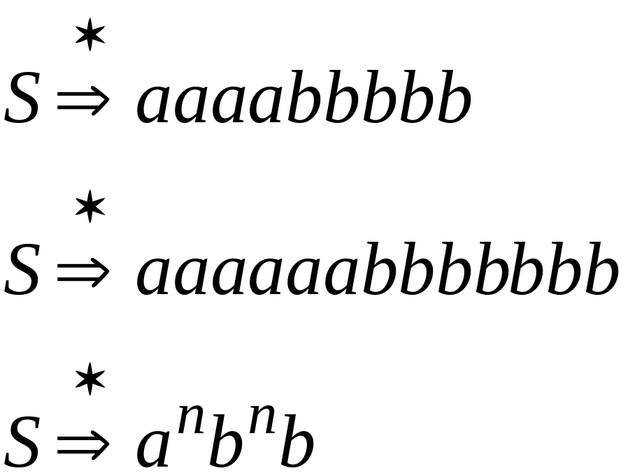
More Derivations

Slide 29

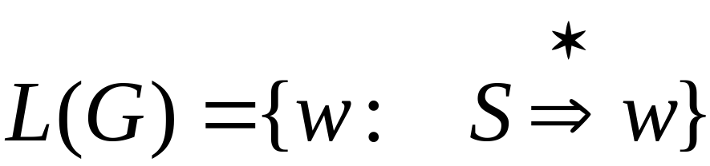
Language of a Grammar
For a grammar
with start variable :
String of terminals

Slide 30

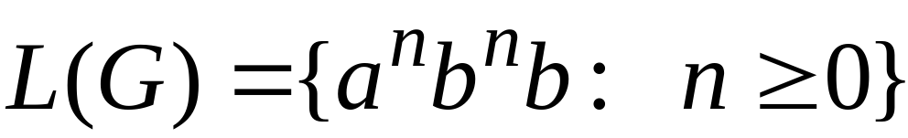
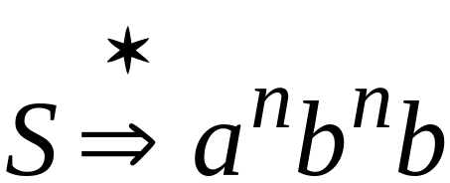
Example
For grammar :
Since:

Slide 31
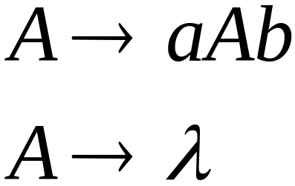
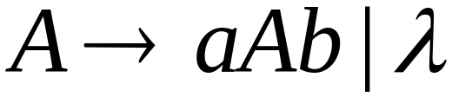
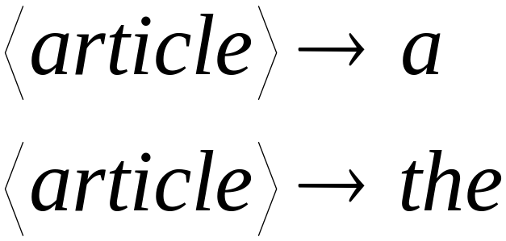
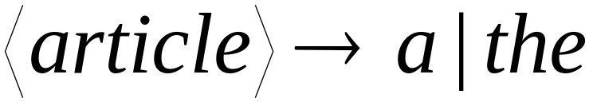
A Convenient Notation

Slide 32
Example
A context-free grammar :
A derivation:

Slide 33
A context-free grammar :
Another derivation:

Slide 34


Describes parentheses:
(((( ))))

Slide 35
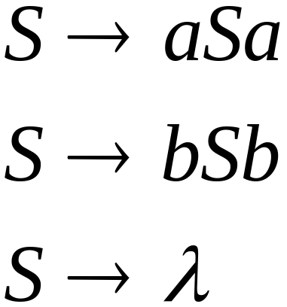
Example
A context-free grammar :
A derivation:

Slide 36
Language?

Slide 37
A context-free grammar :
Another derivation:

Slide 38


Slide 39
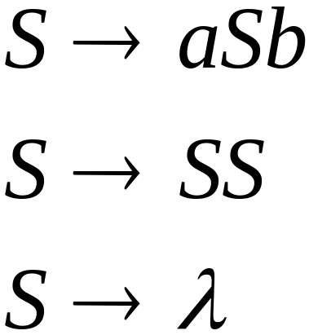
Example
A context-free grammar :
A derivation:

Slide 40
Language?

Slide 41
A context-free grammar :
A derivation:

Slide 42
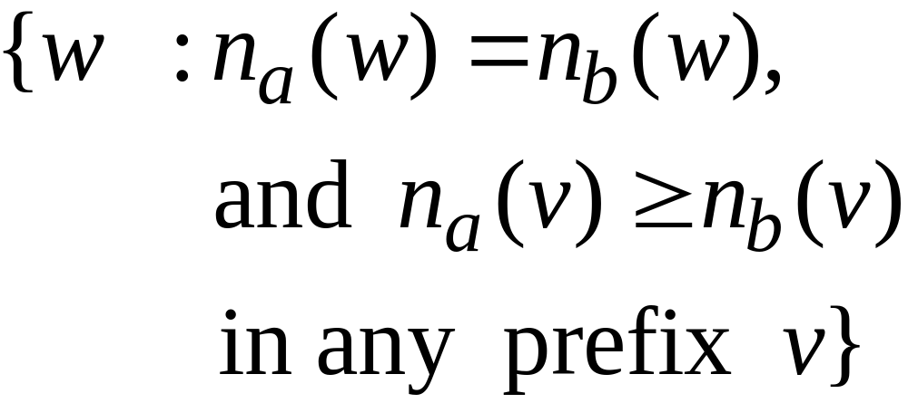
Interpretation?

Slide 43
Describes
matched
parentheses:
() ((( ))) (( ))

Slide 44


Definition: Context-Free Grammars
Grammar
Variables
Terminal
symbols
Start
variable
Productions of the form:
Variable
String of variables
and terminals

Slide 45


Slide 46

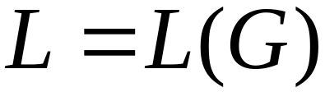
Definition: Context-Free Languages
A language is context-free
if and only if
there is a context-free grammar
with

Slide 47
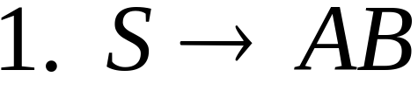
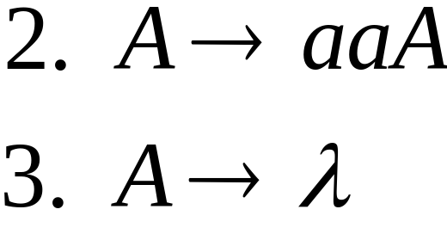
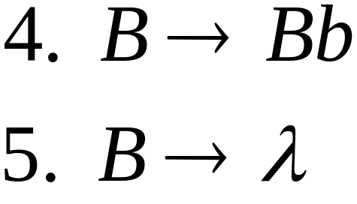


Derivation Order
Leftmost derivation:
Rightmost derivation:

Slide 48
Language?

Slide 49
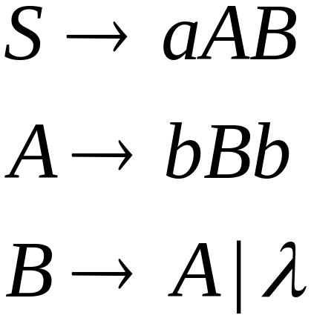
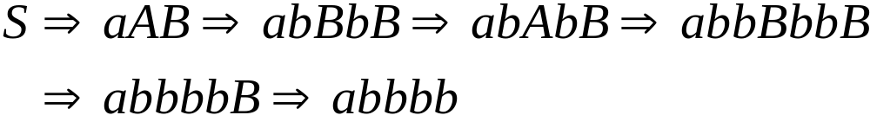
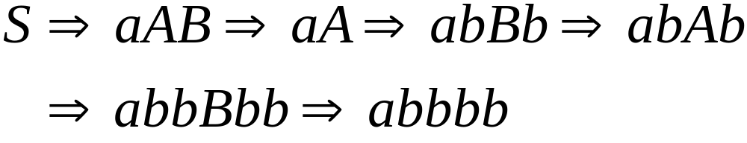
Leftmost derivation:
Rightmost derivation:

Slide 50
Language?

Slide 51
Derivation Trees

Slide 52

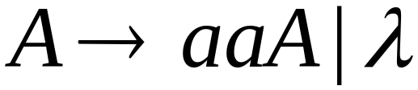
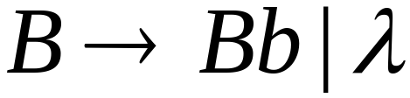





Slide 53



Slide 54


Slide 55


Slide 56
Derivation Tree

Slide 57
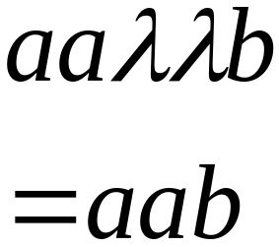
Derivation Tree
yield

Slide 58
Partial Derivation Trees
Partial derivation tree

Slide 59
Partial derivation tree

Slide 60

sentential
form
Partial derivation tree
yield

Slide 61
Sometimes, derivation order doesn’t matter
Leftmost:
Rightmost:
Same derivation tree

Slide 62
Ambiguity

Slide 63





leftmost derivation

Slide 64

leftmost derivation

Slide 65
Two derivation trees

Slide 66
The grammar
is ambiguous:
string
has two derivation trees

Slide 67
The grammar
is ambiguous:
string
has two leftmost derivations

Slide 68

Definition:
A context-free grammar is ambiguous
if some string has:
two or more derivation trees

Slide 69
In other words:
A context-free grammar is ambiguous
if some string has:
two or more leftmost derivations
(or rightmost)

Slide 70

Why do we care about ambiguity?
take

Slide 71



Slide 72






Slide 73
Correct result:

Slide 74
Ambiguity is bad for programming languages
We want to remove ambiguity

Slide 75
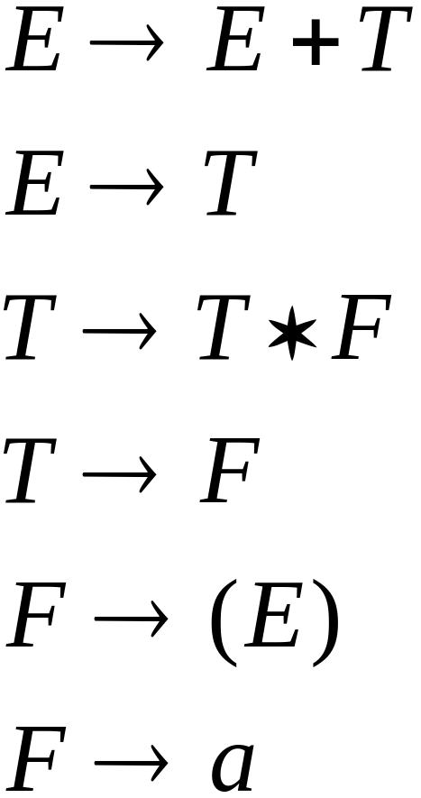
We fix the ambiguous grammar:
New non-ambiguous grammar:

Slide 76




Slide 77
Unique derivation tree

Slide 78
The grammar :
is non-ambiguous:
Every string has
a unique derivation tree

Slide 79

Another Ambiguous Grammar
IF_STMT
if EXPR then STMT
if EXPR then STMT else STMT

Slide 80
If expr1 then if expr2 then stmt1 else stmt2
IF_STMT
if
expr1
then
STMT
if
expr2
then
stmt1
else
stmt2
IF_STMT
if
expr1
then
STMT
else
stmt2
if
expr2
then
stmt1

Slide 81
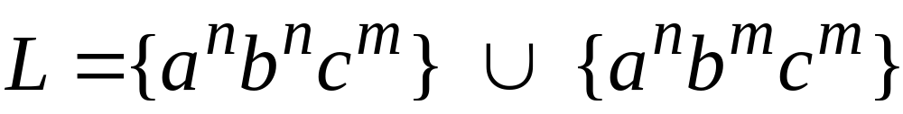

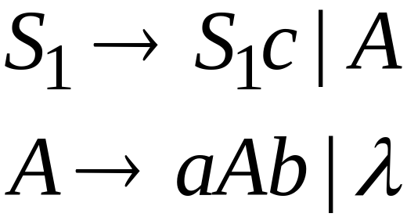
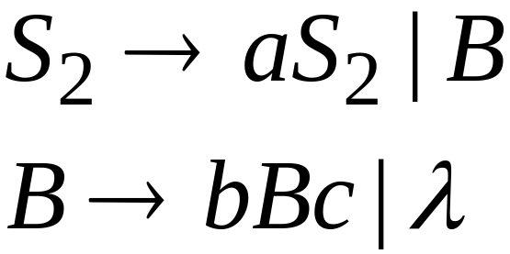
Inherent Ambiguity
Some context free languages
have only ambiguous grammars
Example:

Slide 82
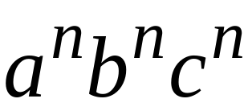



The string
has two derivation trees

Slide 83
Ambiguity in natural language?

