Slide 1
Chapter 12
Coping with the Limitations of
Algorithm Power

Slide 2
Tackling Difficult Combinatorial Problems
There are two principal approaches to tackling difficult combinatorial problems (NP-hard problems):
Use a strategy that guarantees solving the problem exactly but doesn’t guarantee to find a solution in polynomial time
Use an approximation algorithm that can find an approximate (sub-optimal) solution in polynomial time

Slide 3
Exact Solution Strategies
exhaustive search (brute force)
  useful only for small instances
dynamic programming
  applicable to some problems (e.g., the knapsack problem)
backtracking
  eliminates some unnecessary cases from consideration
  yields solutions in reasonable time for many instances but worst case is still exponential
branch-and-bound
  further refines the backtracking idea for optimization problems

Slide 4
Backtracking
Construct the state-space tree
  nodes: partial solutions
  edges: choices in extending partial solutions
Explore the state space tree using depth-first search
“Prune” nonpromising nodes
  dfs stops exploring subtrees rooted at nodes that cannot lead to a solution and backtracks to such a node’s parent to continue the search

Slide 5
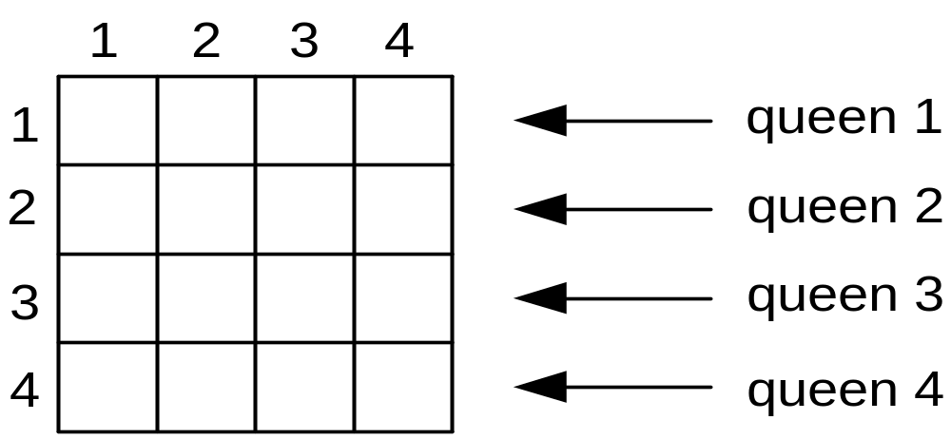
Example: n-Queens Problem
Place n queens on an n-by-n chess board so that no two of them are in the same row, column, or diagonal

Slide 6
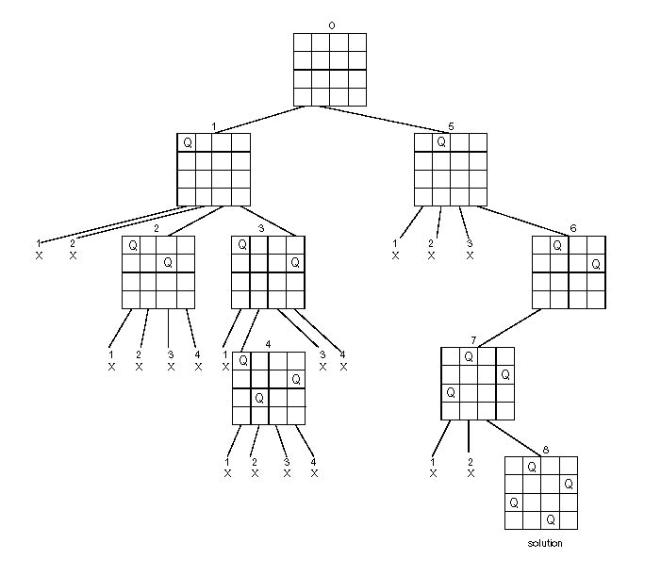
State-Space Tree of the 4-Queens Problem

Slide 7
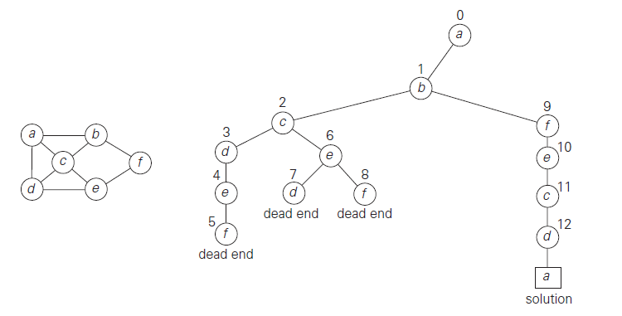
Examples: Hamiltonian Circuit and Subset-Sum Problems

Slide 8
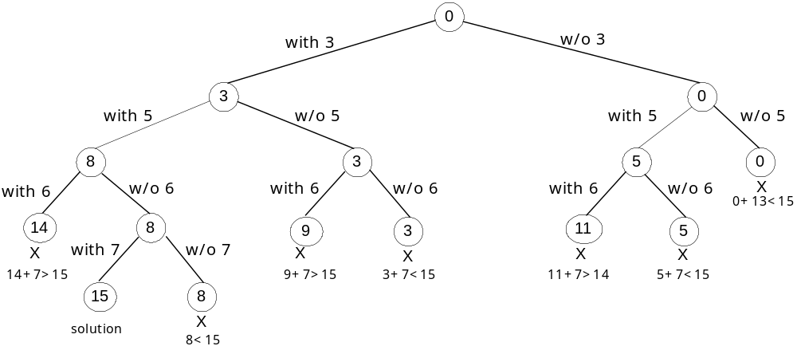
Examples: Hamiltonian Circuit and Subset-Sum Problems

Slide 9
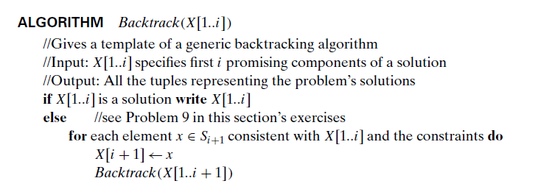


Slide 10
Branch-and-Bound
An enhancement of backtracking
Applicable to optimization problems
For each node (partial solution) of a state-space tree, computes a bound on the value of the objective function for all descendants of the node (extensions of the partial solution)
Uses the bound for:
  ruling out certain nodes as “nonpromising” to prune the tree – if a node’s bound is not better than the best solution seen so far
  guiding the search through state-space

Slide 11
Example: Assignment Problem
Select one element in each row of the cost matrix C so that:
no two selected elements are in the same column
the sum is minimized
Example
Job 1 Job 2 Job 3 Job 4
Person a 9 2 7 8
Person b 6 4 3 7
Person c 5 8 1 8
Person d 7 6 9 4
Lower bound: Any solution to this problem will have total cost
at least: 2 + 3 + 1 + 4 (or 5 + 2 + 1 + 4)

Slide 12
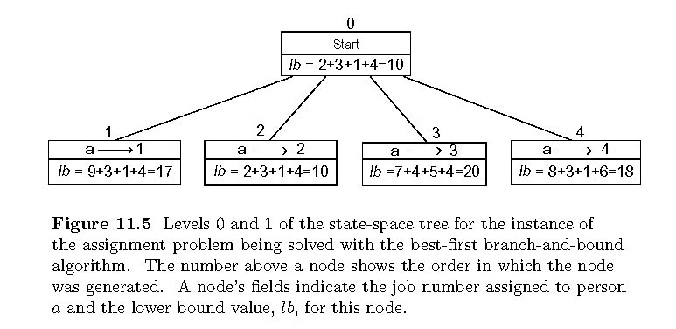
Example: First two levels of the state-space tree

Slide 13
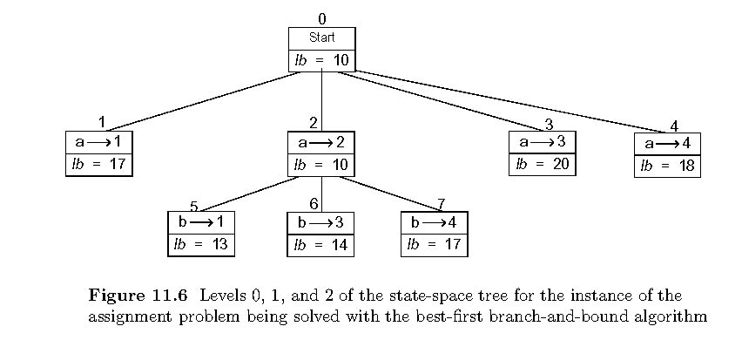
Example (cont.)

Slide 14
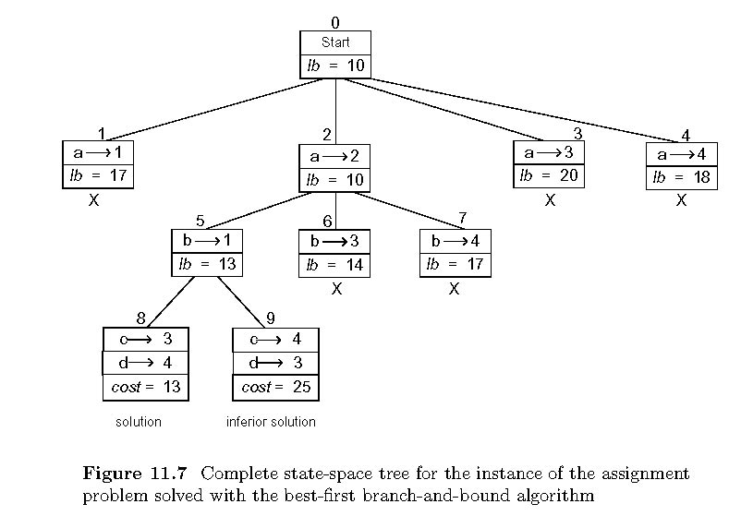
Example: Complete state-space tree

Slide 15
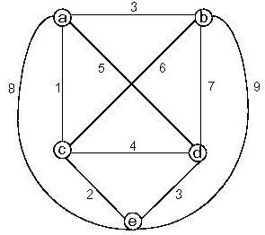
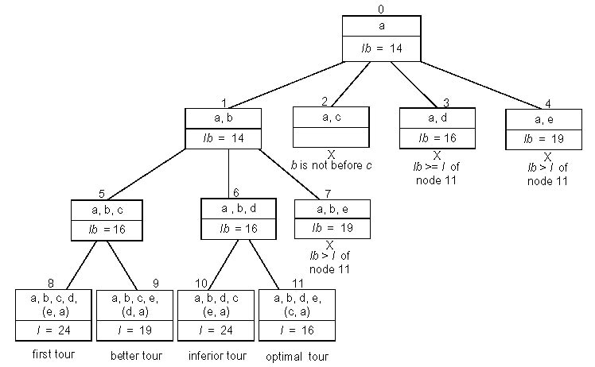
Example: Traveling Salesman Problem

Slide 16



