Slide 1
Formal Languages
Deterministic PDAs

Slide 2
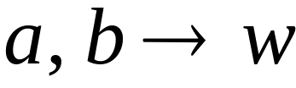


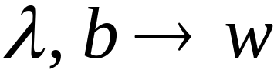


Deterministic PDA: DPDA
Allowed transitions:
(deterministic choices)

Slide 3
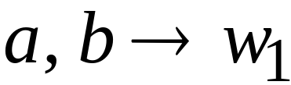
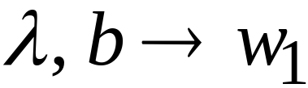
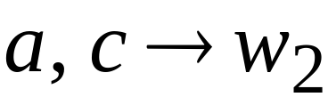
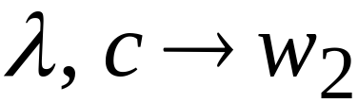

Allowed transitions:
(deterministic choices)

Slide 4
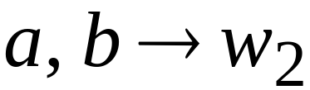
Not allowed:
(non deterministic choices)

Slide 5
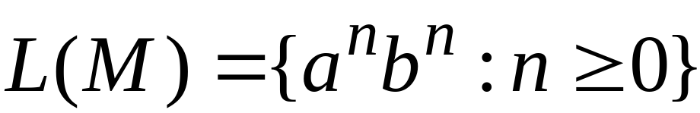




DPDA example

Slide 6

Definition:
A language is deterministic context-free
if there exists some DPDA that accepts it
Example:
The language
is deterministic context-free

Slide 7
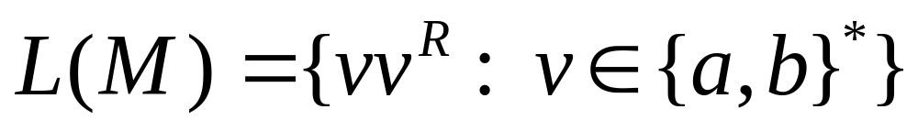
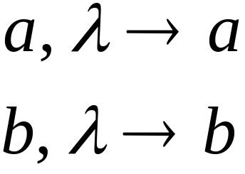
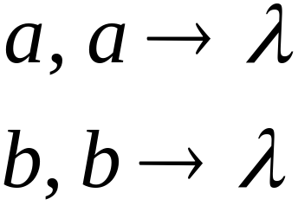

Example of Non-DPDA (PDA)

Slide 8
Not allowed in DPDAs

Slide 9
PDAs
Have More Power than
DPDAs

Slide 10

It holds that:
Deterministic
Context-Free
Languages
(DPDA)
Context-Free
Languages
PDAs
Since every DPDA is also a PDA

Slide 11


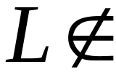
We will actually show:
Deterministic
Context-Free
Languages
(DPDA)
Context-Free
Languages
(PDA)
We will show that there exists
a context-free language which is not
accepted by any DPDA

Slide 12
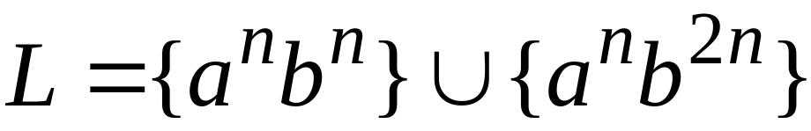

The language is:
We will show:
is context-free
is not deterministic context-free

Slide 13
Proof?

Slide 14


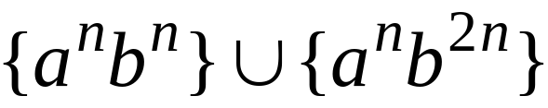
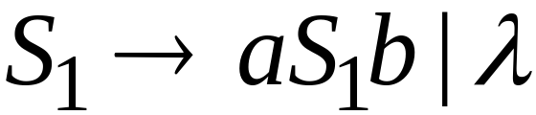
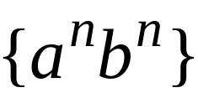
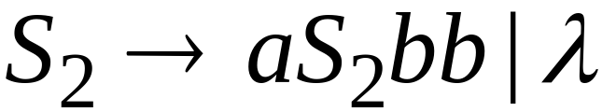
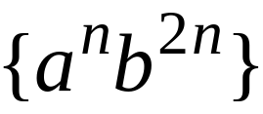
Language is context-free
Context-free grammar for :

Slide 15
Theorem:
The language
is not deterministic context-free
(there is no DPDA that accepts )

Slide 16

Proof:
Assume for contradiction that
is deterministic context free
Therefore:
there is a DPDA that accepts

Slide 17
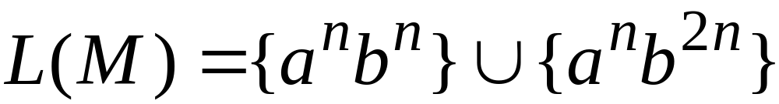
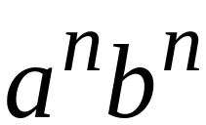
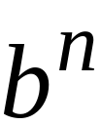
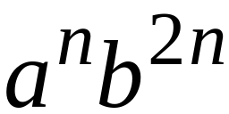
DPDA with
accepts
accepts

Slide 18
DPDA with
Such a path exists due to determinism

Slide 19
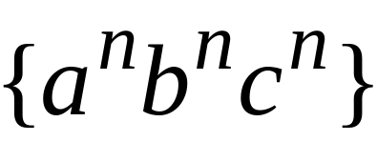

Fact 1:
The language
is not context-free
Context-free languages
Regular languages
(we will prove this at a later class using
pumping lemma for context-free languages)

Slide 20
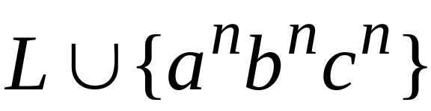
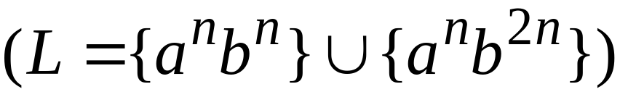
Fact 2:
The language
is not context-free
(we can prove this using pumping lemma
for context-free languages)

Slide 21
We will construct a PDA that accepts:
which is a contradiction!

Slide 22
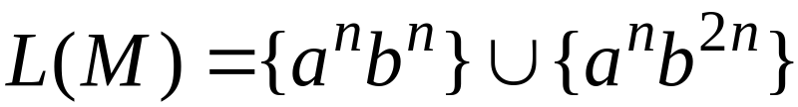



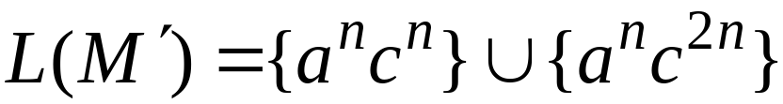
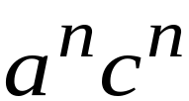

DPDA
Modify
Replace
with
DPDA

Slide 23






A PDA that accepts
Connect the final states of
with the final states of

Slide 24
Since is accepted by a PDA
it is context-free
Contradiction!
(since is not context-free)

Slide 25
Therefore:
Is not deterministic context free
There is no DPDA that accepts it
End of Proof

Slide 26
Positive Properties of
Context-Free languages

Slide 27



Union
Context-free languages
are closed under:
Union
is context free
is context free
is context-free

Slide 28
Proof?

Slide 29
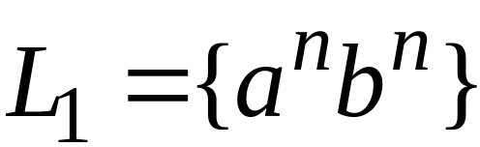
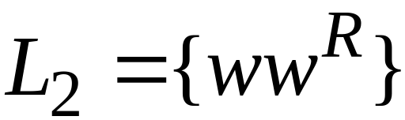
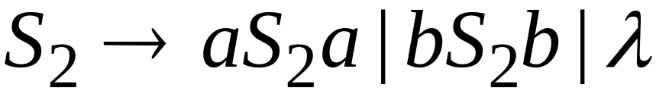
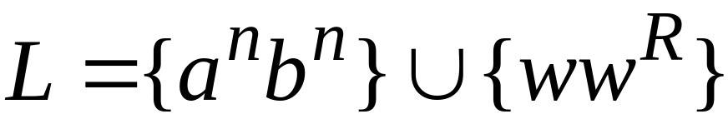
Example
Language
Grammar
Union

Slide 30
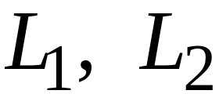
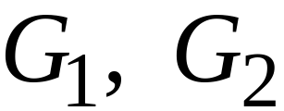
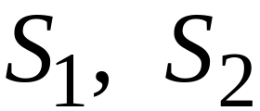

In general:
For context-free languages
with context-free grammars
and start variables
The grammar of the union
has new start variable
and additional production

Slide 31

Concatenation
Context-free languages
are closed under:
Concatenation
is context free
is context free
is context-free

Slide 32
Proof?

Slide 33
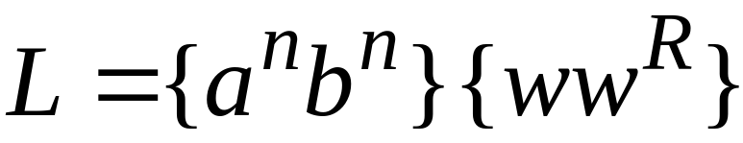
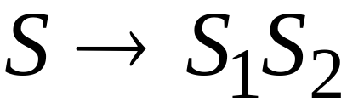
Example
Language
Grammar
Concatenation

Slide 34
In general:
For context-free languages
with context-free grammars
and start variables
The grammar of the concatenation
has new start variable
and additional production

Slide 35

Star Operation
Context-free languages
are closed under:
Star-operation
is context free
is context-free

Slide 36
Proof?

Slide 37
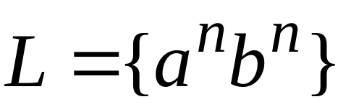
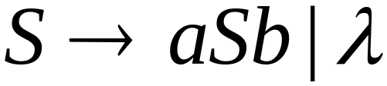
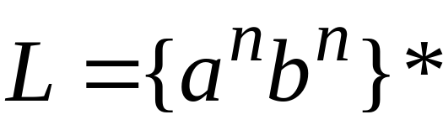
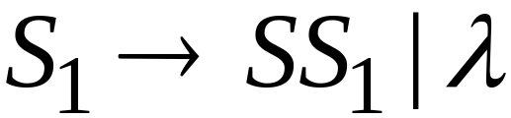
Example
Language
Grammar
Star Operation

Slide 38



In general:
For context-free language
with context-free grammar
and start variable
The grammar of the star operation
has new start variable
and additional production

Slide 39
Negative Properties of
Context-Free Languages

Slide 40

Intersection
Context-free languages
are not closed under:
intersection
is context free
is context free
not necessarily
context-free

Slide 41
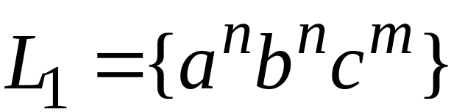
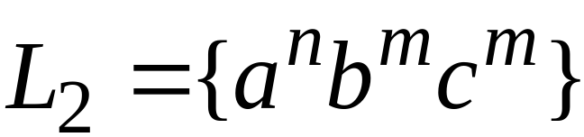
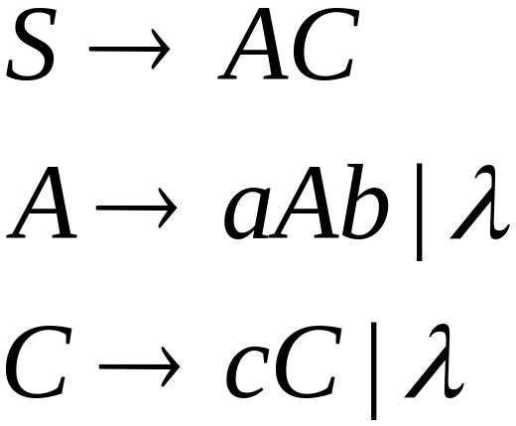
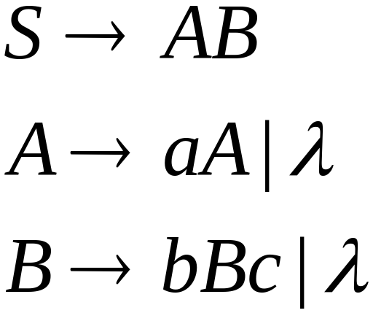
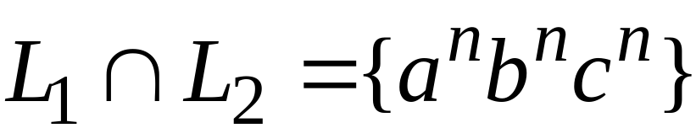
Example
Context-free:
Context-free:
Intersection
NOT context-free

Slide 42

Complement
Context-free languages
are not closed under:
complement
is context free
not necessarily
context-free

Slide 43
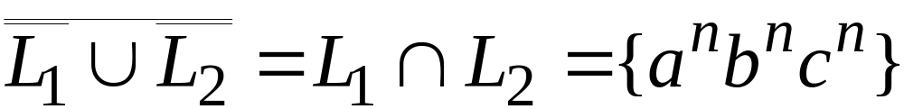
Example
Context-free:
Context-free:
Complement
NOT context-free

Slide 44
Intersection of
Context-free languages and
Regular Languages

Slide 45
The intersection of
a context-free language and
a regular language
is a context-free language
context free
regular
context-free

Slide 46


Machine
Machine
NPDA
for
DFA
for
context-free
regular
Construct a new NPDA machine
that accepts
simulates in parallel and

Slide 47
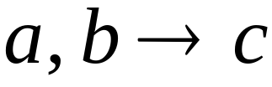


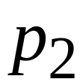
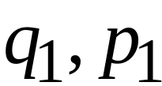

NPDA
DFA
transition
transition
NPDA
transition

Slide 48


NPDA
DFA
transition
NPDA
transition

Slide 49



NPDA
DFA
initial state
initial state
NPDA
Initial state

Slide 50

NPDA
DFA
final state
final states
NPDA
final states

Slide 51










Example:
context-free
NPDA

Slide 52




regular
DFA

Slide 53
Intersection?

Slide 54





context-free
Automaton for:
NPDA

Slide 55


In General:
simulates in parallel and
accepts string
if and only if
accepts string and
accepts string

Slide 56

Therefore:
is NPDA
is context-free
is context-free

Slide 57
Applications of
Regular Closure

Slide 58
The intersection of
a context-free language and
a regular language
is a context-free language
Regular Closure
context free
regular
context-free

Slide 59

An Application of Regular Closure
Prove that:
is context-free

Slide 60

We know:
is context-free

Slide 61


We also know:
is regular
is regular

Slide 62


context-free
regular
(regular closure)
context-free
is context-free

Slide 63

Another Application of Regular Closure
Prove that:
is not context-free

Slide 64
Proof?

Slide 65

If
is context-free
(regular closure)
Then
context-free
regular
context-free
Impossible!!!
Therefore, is not context free

Slide 66
Decidable Properties of
Context-Free Languages

Slide 67

Membership Question:
for context-free grammar
find if string

Slide 68
Membership Question:
for context-free grammar
find if string
Membership Algorithms:
Parsers
Exhaustive search parser
CYK parsing algorithm

Slide 69

Empty Language Question:
for context-free grammar
find if

Slide 70
Empty Language Question:
for context-free grammar
find if
Algorithm:
Remove useless variables
Check if start variable is useless

Slide 71

Infinite Language Question:
for context-free grammar
find if is infinite

Slide 72

Infinite Language Question:
for context-free grammar
find if is infinite
Algorithm:
1. Remove useless variables
2. Remove unit and productions
3. Create dependency graph for variables
4. If there is a loop in the dependency graph
then the language is infinite

Slide 73





Example:
Infinite language
Dependency graph

Slide 74


