Slide 1
Formal Languages
Context-Sensitive Languages

Slide 2

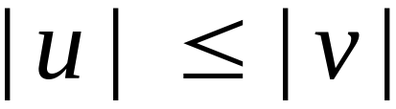
Context-Sensitive Grammars:
Productions
String of variables
and terminals
String of variables
and terminals
and:

Slide 3
Context sensitive grammars
Context-sensitive production: any production α → β satisfying |α| ≤ |β|.
Context-sensitive grammar: any generative grammar G = ⟨Σ, Γ, Π, σ⟩ such that every production in Π context-sensitive.
No empty productions.

Slide 4
Context-Sensitive Language
Language L context-sensitive if there exists context-sensitive grammar G such that either L = L(G) or L = L(G) ∪ {ε}.

Slide 5
Context-Free and Context-Sensitive Languages
Any context-free language context-sensitive despite fact that there exist context-free grammars that are not context-sensitive grammars.
A bit of engineering.

Slide 6

Language generated?

Slide 7

Language generated?

Slide 8

Generates {a^{i}b^{j}c^{i}d^{j}|i, j ≥ 1}

Slide 9

Language generated?

Slide 10
Generates {a^{i}b^{j}c^{k}|1 ≤ i ≤ j ≤ k}

Slide 11
Grammar for {a^{n}b^{j}a^{n}b^{k}a^{n}|1 ≤ j, k, n}

Slide 12
D->DB
D->B
X1A1->aX1
X1B->bX2
X2B->bX2
X2A2->aX3
X3A2->aX3
X3B->bX4
X4B->bX4
X4A3->aX5
X5A3->aX5
X5X6->aa
Grammar for {a^{n}b^{j}a^{n}b^{k}a^{n}|1 ≤ j, k, n}
S->X1YZA1TA2X6
T->A1TA2A3
T->A1A2
A3A2->A2A3
ZA1->A1Z
ZA2->A2Z
YA1->A1Y
A1YA2->A1CA2
A2ZA3->A2DA3
C->CB
C->B

Slide 13
Linear Bounded Automata (LBAs)
are the same as Turing Machines
with one difference:
The input string tape space
is the only tape space the machine is allowed to use

Slide 14







Linear Bounded Automaton (LBA)
Input string
Working space
on tape
Left-end
marker
Right-end
marker
All computation is done between end markers

Slide 15
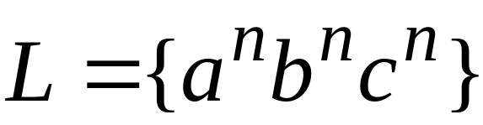
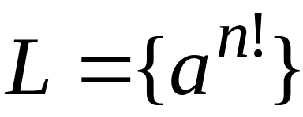
Example languages accepted by LBAs:
LBA’s have more power than NPDA’s
LBA’s have also less power
than Turing Machines

Slide 16
We define LBA’s as NonDeterministic
Open Problem:
Do NonDeterministic LBA’s
have the same power as
Deterministic LBA’s ?

Slide 17

Theorem:
A language is context sensitive
if and only if
is accepted by a Linear-Bounded automaton

Slide 18
The Chomsky Hierarchy

Slide 19
Unrestricted Grammars:
Productions
String of variables
and terminals
String of variables
and terminals

Slide 20
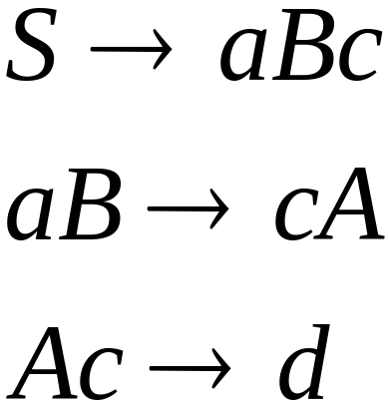
Example for an unrestricted grammar:

Slide 21
Why not context-sensitive?

Slide 22
Theorem:
A language is recursively enumerable
if and only if is generated by an
unrestricted grammar

Slide 23
The Chomsky Hierarchy
All formal languages
Recursively-enumerable
Recursive
Context-sensitive
Context-free
Regular

Slide 24
Formal Languages and Natural Language Processing

Slide 25
Relevance of Formal Languages
Regular languages
One of the key formalisms in NLP
(morphology, shallow parsing, text processing)
Context-free languages
Key formalism for parsing in NLP
Computability
What can be computed? What is an algorithm?
Efficiency
What can be computed efficiently?
Linguistics
What kind of formal language is natural language? Where is it in the Chomsky hierarchy?

Slide 26
Relevance of Formal Languages
Regular languages
One of the key formalisms in NLP
(morphology, shallow parsing, text processing)
Context-free languages
Key formalism for parsing in NLP
Computability
What can be computed? What is an algorithm?
Efficiency
What can be computed efficiently?
Linguistics
What kind of formal language is natural language? Where is it in the Chomsky hierarchy?
Most of
this
class

Slide 27
Relevance of Formal Languages
Regular languages
One of the key formalisms in NLP
(morphology, shallow parsing, text processing)
Context-free languages
Key formalism for parsing in NLP
Computability
What can be computed? What is an algorithm?
Efficiency
What can be computed efficiently?
Linguistics
What kind of formal language is natural language? Where is it in the Chomsky hierarchy?
Next
part

Slide 28
Context-free grammars
(may) have rules like
  NP → Det N
  PP → Prep NP
cannot have rules like
  NP PP → PP NP
  ADV anfangen → fangen ADV an
This restriction has implications for the processing resources and speed.

Slide 29
Issues
Why do computational linguists use formal grammars for describing natural languages?
Are natural languages context-free languages?

Slide 30
The goal of Natural Language Processing (NLP)
Given a natural language utterance (written or spoken):
Determine: who did what to whom, when, where, how, why (for what reasons, for what purpose)?
Towards this goal: Determine the syntactic structure of an utterance.

Slide 31
Steps to syntax analysis
For every word in the input string determine its word class.
Group all words into constituents.
Determine the linguistic functions (subject, object, etc.) of the constituents.
Determine the logical functions (agent, recipient, transfered-object, place, time …)

Slide 32
An example
A book was given to Mary by Peter.
det
noun
aux
verb
prep
name
prep
name

Slide 33
An example
A book was given to Mary by Peter.
det
noun
aux
verb
prep
name
prep
name
noun phrase
verb group
prep phrase
prep phrase

Slide 34
An example
A book was given to Mary by Peter.
det
noun
aux
verb
prep
name
prep
name
noun phrase
verb group
prep phrase
prep phrase
verb phrase

Slide 35
An example
A book was given to Mary by Peter.
det
noun
aux
verb
prep
name
prep
name
noun phrase
verb group
prep phrase
prep phrase
verb phrase
sentence

Slide 36
An example
A book was given to Mary by Peter.
Logical subject
Logical object
det
noun
aux
verb
prep
name
prep
name
noun phrase
verb group
prep phrase
prep phrase
verb phrase
passive sentence

Slide 37
Result
Agent (the giver): Peter
The object: a book
Recipient: Mary
Action: giving
When: in the past
Via inference
  Who has a book now? Mary

Slide 38
The context-free rules of a natural language grammar
Noun_Phrase → Determiner Noun
  a book
  the house
  some houses
  50 books
  Peter’s house

Slide 39
The context-free rules of a natural language grammar
Adjective_Phrase → Adjective
Adjective_Phrase → Adverb Adjective
  nice
  nicest
  very nice
  hardly finished

Slide 40
The context-free rules of a natural language grammar
Noun_Phrase → Det Adjective_Phrase Noun
  a nice book
  the old house
  some very old houses
  50 green books

Slide 41
The context-free rules of a natural language grammar
Prep_Phrase → Preposition Noun_Phrase
  with a nice book
  through the old house
  in some very old houses
  for 50 green books

Slide 42
The context-free rules of a natural language grammar
(may) include recursion (direct and indirect)
Examples
NP → NP PP # the bridge over the Nile
NP → NP S_{relative} # a student who likes this course
S_{relative} → NP VP # who likes this course
Notes:
Do TIGER-Search questions to determine the nesting level.
#s1:[cat="S"] >* #s2:[cat="S"] &
#s2 >* #s3:[cat="S"] &
#s3 >* #s4:[cat="S"] &
#s4 >* #s5:[cat="S"] &
#s5 >* #s6:[cat="S"] &
#s6 >* #s7:[cat="S"] &
#s7 >* #s8:[cat="S"] &
#s8 >* #s9:[cat="S"]

Slide 43
NP
S_{rel}
VP
NP
NP
NP
det noun rel-pron verb det noun
a student who likes this course

Slide 44
Formal Definition of a Context-free Grammar
A context-free grammar consists of
a set of non-terminal symbols N
set of terminals Σ
a set of productions A → α
    A ∈N, α-string ∈ (Σ∪N)*
a designated start symbol (from N)

Slide 45
Context-free grammars for natural language
A set of non-terminal symbols N
  word class symbols (N, V, Adj, Adv, P)
  linguistic constituent symbols (NP, VP, AdjP, AdvP, PP)
A set of terminals Σ
  all words of the English language
A set of productions A → α
  the grammar rules (e.g. NP → Det, AdjP, N)
A designated start symbol
  a symbol for the complete sentence

Slide 46
NLP: How many (non-)terminals?

Slide 47
How many …?
… non-terminals do we need?
  word class symbols (N, V, Adj, Adv, P)
    usually between 20 and 50
  linguistic constituent symbols (NP, VP, …)
    usually between 10 and 20
… terminals do we need?
  words of the English language?
    Different word stems (see, walk, give)
    > 50´000
    Different word forms (see, sees, saw, seen)
    > 100´000

Slide 48
How many …?
… grammar rules do we need?
  NP → Name # Mary, Peter
  NP → Det Noun # a book
  PP → Prep NP # to Mary
  VP → V NP PP # gave a book to Mary
  VP → V NP NP # gave Mary a book
Problem: This grammar will also accept:
  *Peter give Mary a books. # agreement problem
  *Peter sees Mary a book. # complement problem

Slide 49
Agreement: Why bother?
*Peter give Mary a books.
Consider:
  Peter threw the books into the garbage can that are old and grey.
  Peter threw the books into the garbage can that is old and grey.
Agreement can help us determine the intended meaning!

Slide 50
Agreement: First approach
  NP_{sg} → Name_{sg} # Mary, Peter
  NP_{sg} → Det_{sg} Noun_{sg} # a book
  NP_{pl} → Det_{pl} Noun_{pl} # the books
  PP → Prep NP_{sg} # to Mary
  PP → Prep NP_{pl} # for the books
  VP → V NP_{sg} NP_{sg} # gave Mary a book
  VP → V NP_{sg} NP_{pl} # gave Mary the books
  VP → V NP_{pl} NP_{sg} # gave the kids a book
  VP → V NP_{pl} NP_{pl} # gave the kids the books
Problem?

Slide 51
Agreement: First approach
  NP_{sg} → Name_{sg} # Mary, Peter
  NP_{sg} → Det_{sg} Noun_{sg} # a book
  NP_{pl} → Det_{pl} Noun_{pl} # the books
  PP → Prep NP_{sg} # to Mary
  PP → Prep NP_{pl} # for the books
  VP → V NP_{sg} NP_{sg} # gave Mary a book
  VP → V NP_{sg} NP_{pl} # gave Mary the books
  VP → V NP_{pl} NP_{sg} # gave the kids a book
  VP → V NP_{pl} NP_{pl} # gave the kids the books
Combinatorial explosion … too many rules

Slide 52
Agreement: Better approach
Variables ensure agreement via feature unification.
  NP[Num] → Name[Num]
    # Mary, Peter
  NP[Num] → Det[Num] Noun[Num]
    # a book, the books
  PP → Prep NP[X]
    # to Mary, for the books
  VP[Num] → V[Num] NP[X] NP[Y]
    # give Mary a book; gives Mary the books

Slide 53
Subcategorization
Verbs have preferences for the kinds of constituents they co-occur with.
For example:
  VP → Verb (disappear)
  VP → Verb NP (prefer a morning flight)
  VP → Verb NP PP (leave Boston in the morning)
  VP → Verb PP (leaving on Thursday)
But not: *I disappeared the cat.

Slide 54
Why is parsing hard?

Slide 55
from the Financial Times of Nov. 23. 2004 at http://news.ft.com/home/europe
McDonald’s CEO steps down to battle cancer
By Neil Buckley in New York
Published: November 23 2004 00:51
Last updated: November 23 2004 00:51
McDonald's said on Monday night Charlie Bell would step down as chief executive to devote his time to battling colorectal cancer, dealing another blow to the world's largest fast food company.
Mr Bell's resignation comes just seven months after James Cantalupo, its former chairman and chief executive, died from a heart attack.
McDonald's moved quickly to close the gap, appointing Jim Skinner, currently vice-chairman, to the chief executive's role.

Slide 56
from the Financial Times of Nov. 23. 2004 at http://news.ft.com/home/europe
McDonald’s CEO steps down to battle cancer
By Neil Buckley in New York
Published: November 23 2004 00:51
Last updated: November 23 2004 00:51
McDonald's said on Monday night Charlie Bell would step down as chief executive to devote his time to battling colorectal cancer, dealing another blow to the world's largest fast food company.
Mr Bell's resignation comes just seven months after James Cantalupo, its former chairman and chief executive, died from a heart attack.
McDonald's moved quickly to close the gap, appointing Jim Skinner, currently vice-chairman, to the chief executive's role.

Slide 57
Problems when parsing natural language sentences
Words that are (perhaps) not in the lexicon.
  Proper names
    James Cantalupo, McDonald's, InterContinental, GE
  Compounded words → need to be segmented
    kurskamrater, kurslitteratur, kursavsnitt, kursplaneundersökningarna, kursförluster
    valutakurs, snabbkurs, säljkurser aktiekurser, valutakursindex
  Foreign language expressions
    Don Kerr är Mellanösternspecialist på The International Institute for Strategic Studies i London , högt ansedd , oberoende thinktank .
Multiword expressions
  Idioms: to deal another blow
Metaphors
  to battle cancer

Slide 58
How can we obtain statistical preferences?
From a parsed and manually checked corpus (= collection of sentences)
Such a corpus is usually a database that contains the correct syntax tree with each sentence (therefore called a treebank).
Building a treebank is very time-consuming.

Slide 59
-> Statistical Methods (Sommersemester)

Slide 60
Can all the syntax of natural language be described with context-free rules?
Are there phenomena in natural language that require context-sensitive rules?

Slide 61
Limits of Context-free Grammars
It is not possible to write a context-free grammar
(or to design a Push-Down Automaton (PDA))
for the language L = {a^{n}b^{n}a^{n} | n > 0}
Why?
Intuitively: The memory component of a PDA works like a stack. One stack! So, it can only be used to count once.

Slide 62
Are natural languages context-free?
Received opinion: generally, yes
But … there is a famous paper about some constructions in Swiss German of the form
  w a^{n} b^{m} x c^{n} d^{m} y
  Jan säit, das mer (em Hans) (es huus) (hälfed) (aastriiche).
  Jan säit, das mer (d´chind)^{n} (em Hans)^{m} (es huus) (haend wele laa)^{n} (hälfe)^{m} (aastriiche).
but they are rather strange and rare.
The claim that they are not context-free relies on the assumption that n and m are unbounded.

Slide 63
Relevance of Formal Languages
Regular languages
One of the key formalisms in NLP
(morphology, shallow parsing, text processing)
Context-free languages
Key formalism for parsing in NLP
Computability
What can be computed? What is an algorithm?
Efficiency
What can be computed efficiently?
Linguistics
What kind of formal language is natural language? Where is it in the Chomsky hierarchy?
Next
part

Slide 64
Chomsky hierarchy:
Where does natural language fall?
Notes:
Do a regular grammar tree for this vs a reasonable tree.

Slide 65
The Chomsky Hierarchy
All formal languages
Recursively-enumerable
Recursive
Context-sensitive
Context-free
Regular

Slide 66
The notion of ”context”
We need ”context” to understand a natural language utterance!
This notion of ”context” is different from the notion of ”context” in the name context-free languages.

Slide 67
Is the set of sentences of a natural language finite?
Notes:
See example on next page. This one from http://www.mind.ilstu.edu/curriculum/language/weisler/tolwebrm/pages/19thelon.html

Slide 68
Where Does English Fall – The Finiteness Question
Is the set of English sentences finite?
Issues:
  Size of vocabulary
  Length of sentences
    I know that "1" isn't the largest number and I know that "2" isn't the largest number (...)
If the set of English sentences is finite, then a regular grammar has enough weak generative capacity.
Notes:
See example on next page. This one from http://www.mind.ilstu.edu/curriculum/language/weisler/tolwebrm/pages/19thelon.html

Slide 69
Chomsky hierarchy:
Where does natural language fall?
We need to refine the question:
The weak generative capacity of a grammar is the set of strings that the grammar generates.
The strong generative capacity of a grammar is the set of structures that the grammar generates.
Note that strong generative capacity mirrors linguistic and psychological reality much better than weak generative capacity does.
Notes:
Do a regular grammar tree for this vs a reasonable tree.

Slide 70
Is This English?
In the event that the Purchaser defaults in the payment of any instalment of purchase price, taxes, insurance, interest, or the annual charge described elsewhere herein, or shall default in the performance of any other obligations set forth in this Contract, the Seller may: at his option: (a) Declare immediately due and payable the entire unpaid balance of purchase price, with accrued interest, taxes, and annual charge, and demand full payment thereof, and enforce conveyance of the land by termination of the contract or according to the terms hereof, in which case the Purchaser shall also be liable to the Seller for reasonable attorney's fees for services rendered by any attorney on behalf of the Seller, or (b) sell said land and premises or any part thereof at public auction, in such manner, at such time and place, upon such terms and conditions, and upon such public notice as the Seller may deem best for the interest of all concerned, consisting of advertisement in a newspaper of general circulation in the county or city in which the security property is located at least once a week for Three (3) successive weeks or for such period as applicable law may require and, in case of default of any purchaser, to re-sell with such postponement of sale or resale and upon such public notice thereof as the Seller may determine, and upon compliance by the Purchaser with the terms of sale, and upon judicial approval as may be required by law, convey said land and premises in fee simple to and at the cost of the Purchaser, who shall not be liable to see to the application of the purchase money; and from the proceeds of the sale: First to pay all proper costs and charges, including but not limited to court costs, advertising expenses, auctioneer's allowance, the expenses, if any required to correct any irregularity in the title, premium for Seller's bond, auditor's fee, attorney's fee, and all other expenses of sale occurred in and about the protection and execution of this contract, and all moneys advanced for taxes, assessments, insurance, and with interest thereon as provided herein, and all taxes due upon said land and premises at time of sale, and to retain as compensation a commission of five percent (5%) on the amount of said sale or sales; SECOND, to pay the whole amount then remaining unpaid of the principal of said contract, and interest thereon to date of payment, whether the same shall be due or not, it being understood and agreed that upon such sale before maturity of the contract the balance thereof shall be immediately due and payable; THIRD, to pay liens of record against the security property according to their priority of lien and to the extent that funds remaining in the hands of the Seller are available; and LAST, to pay the remainder of said proceeds, if any, to the vendor, his heirs, personals representatives, successors or assigns upon the delivery and surrender to the vendee of possession of the land and premises, less costs and excess of obtaining possession.
Notes:
http://www.plainenglish.co.uk/ouch.html

Slide 71
Assume not finite
(Either because it really isn’t finite or because we care about strong generative capacity.)
English isn’t regular.
English can’t be characterized with a context-free grammar without sacrificing simplicity and elegance.
Some natural languages may not be context free at all.

Slide 72
Complexity of natural language
There have been many arguments about the complexity of natural language, but all of them have the following form:
  Find a particular construction type C (e.g. center embedding) in a natural language L (e.g. English)
  Assume that the construction type in question is theoretically unbounded: i.e., in theory speakers could go on producing ever longer instances of the construction.
  The fact that in real life there is a limit to the length of instances of C that people can process is held to be irrelevant.
    This hinges crucially on the competence-performance distinction.
Reduce C via a homomorphism to a formal expression of known complexity.
Argue thereby that L cannot be of lesser complexity than C.
Extrapolate from this one instance to natural language in general. I.e.: if there’s this one construction in this one language that has this complexity then the human language faculty must allow this in general.
Caveat: in order for this argument to be correct it is not sufficient in general to show that L contains C to draw conclusions about L from C.

Slide 73
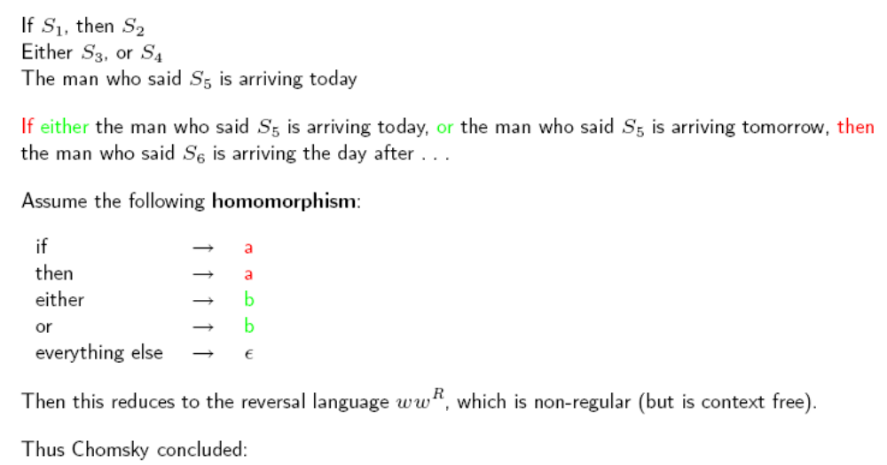
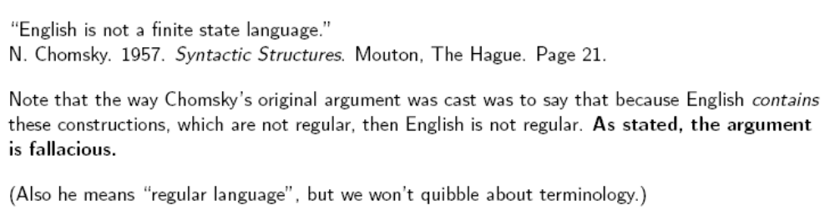
NL is not regular: Chomsky’s original argument

Slide 74
Problem with Chomsky’s argument?
Notes:
See example on next page. This one from http://www.mind.ilstu.edu/curriculum/language/weisler/tolwebrm/pages/19thelon.html

Slide 75
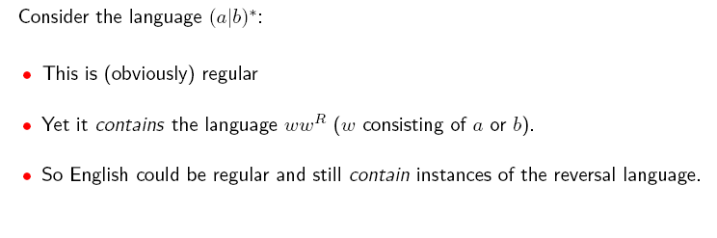
Why Chomsky’s argument is fallacious

Slide 76
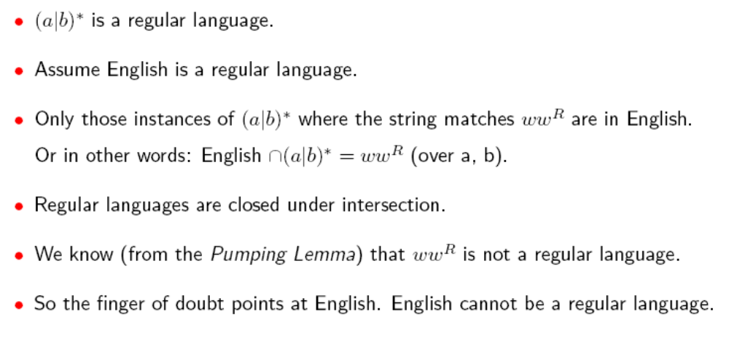
How to state the observation correctly

Slide 77
English isn’t regular – An example
Examples: The boy she saw yesterday was crying.
The boy she saw coming down the road was crying.
Grammar:
S → NP VP (not allowed)
So we have to write something like:
S → the X
X → boy Y
Y → she Z
Z → saw Q

Slide 78
English isn’t regular – The proof
If S₁ then S₂
Either S₃ or S₄
The man who said S₅ is arriving today.
If either the man who said either quit or stay is arriving today or the man who said S5 is arriving tomorrow, then the man who said S5 is arriving the day after tomorrow.
Let: if → a then → a
either → b or → b
others → ε
Then this sentence is of the form abbbba, which is an instance of x x^{R}.

Slide 79
English isn’t regular – Another proof
The cat the dog the rat the elephant admired bit chased likes tuna fish.
Form: (the noun)^{n} (transitive verb)^{n-1} likes tuna fish.

Slide 80
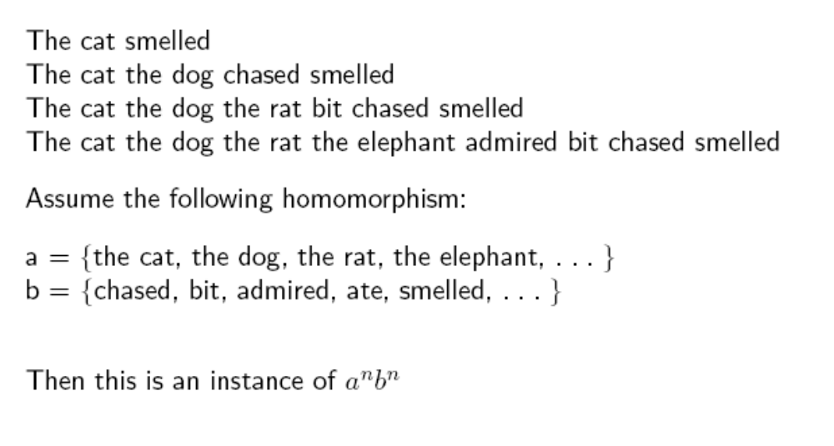
Similar point about center-embedding

Slide 81
Center embedding
English
a*b*
a^{n}b^{n}

Slide 82
Can we go higher on the hierarchy?
In morphology: reduplication in Bambara (Culy, 1985
In syntax: “cross-serial” dependencies in Swiss German (Shieber, 1985)

Slide 83
Swiss German is not context-free
The nested structures that we’ve just seen can easily be described with a context-free grammar. But what about sentences of the form ww:
x₁ x₂ x₃ x₄ x₅ …. y₁ y₂ y₃ y₄ y₅ … (we call these cross serial
dependencies)
In Swiss German:
Jan säit das mer em Hans es huus hälfed aastriiche.
Jan says that we Hans/DAT the house/ACC helped paint
Notes:
http://www.sfu.ca/~anoop/courses/CMPT-413-Spring-2003/tag.pdf p. 29 for nice version of proof.
We know that the nouns and verbs must fit like this because helped takes the dative and paint takes accusative

