Slide 1
Formal Languages
Simplifications of CFGs

Slide 2
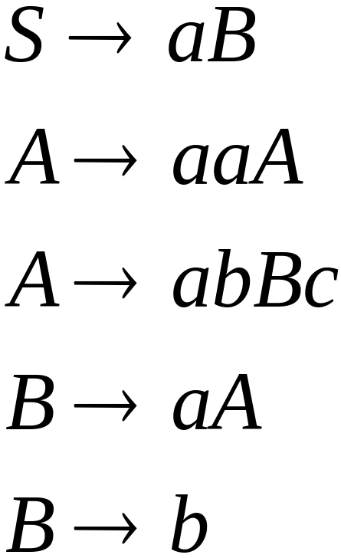
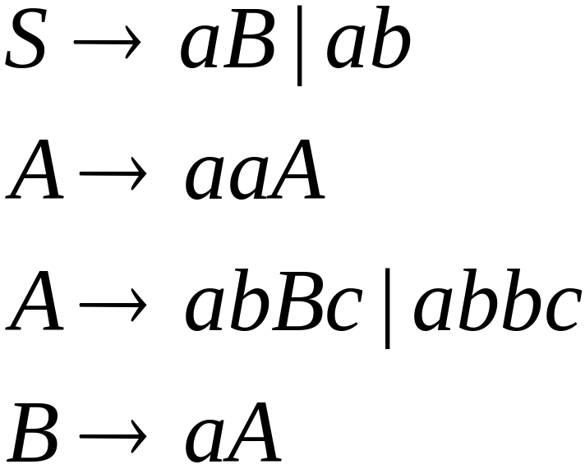

A Substitution Rule
Equivalent
grammar
Substitute

Slide 3

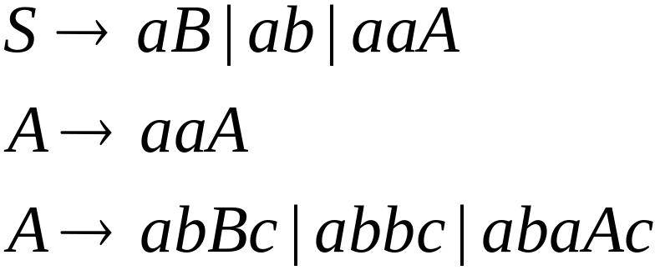
A Substitution Rule
Substitute
Equivalent
grammar

Slide 4
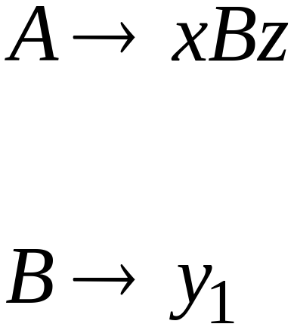
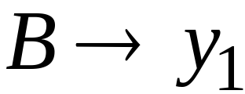
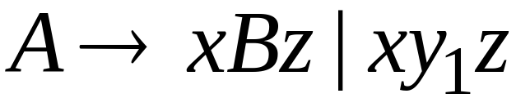
In general:
Substitute
equivalent
grammar

Slide 5
Language?

Slide 6
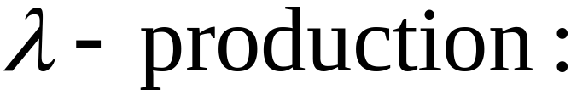


Nullable Variables
Nullable Variable:

Slide 7
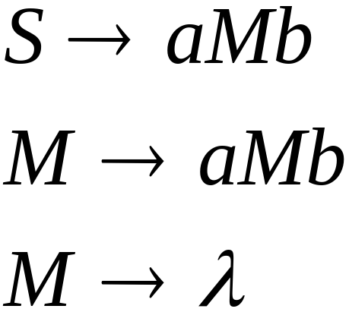
Removing Nullable Variables
Example Grammar:
Nullable variable

Slide 8
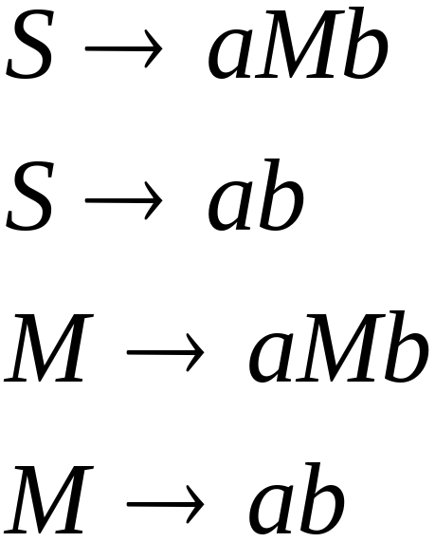

Final Grammar
Substitute

Slide 9

Unit-Productions
Unit Production:
(single variables on both sides)

Slide 10

Removing Unit Productions
Observation:
Is removed immediately

Slide 11
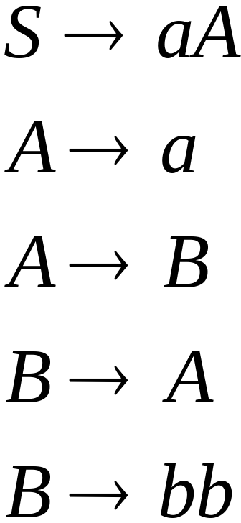
Example Grammar:

Slide 12
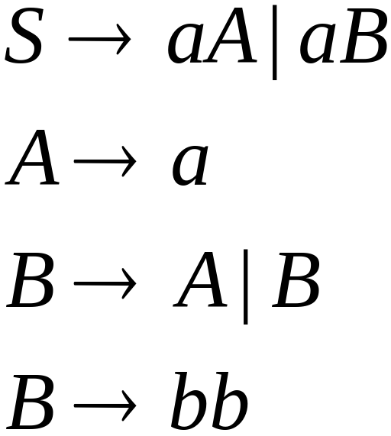

Substitute

Slide 13
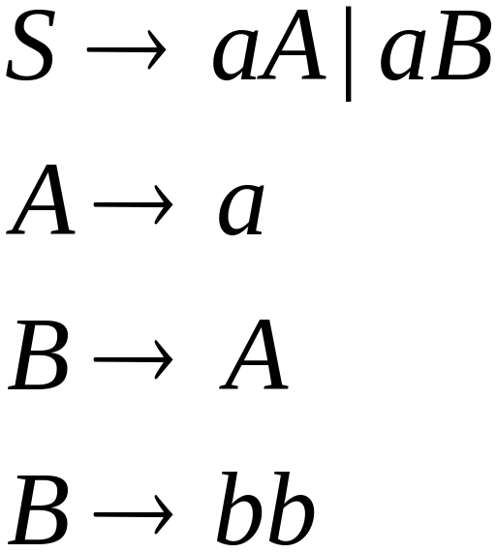

Remove

Slide 14
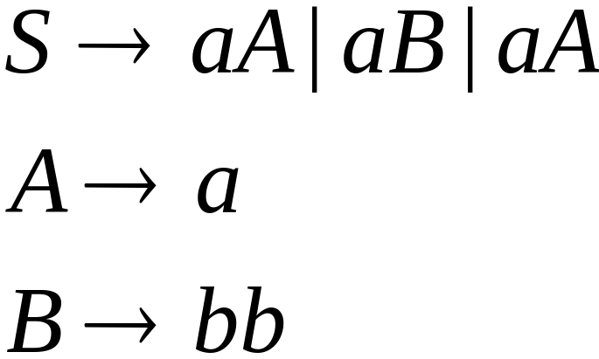

Substitute

Slide 15
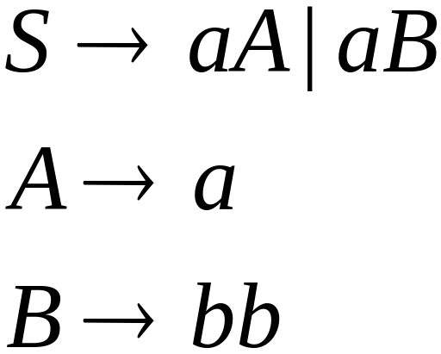
Remove repeated productions
Final grammar

Slide 16
Language?

Slide 17
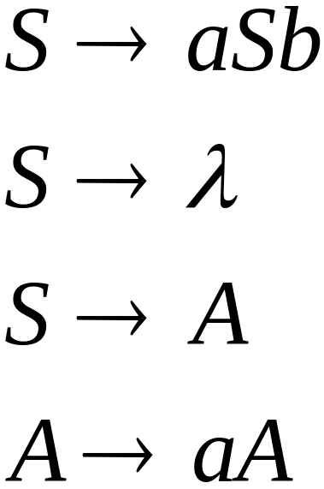
Useless Productions
Useless Production
Some derivations never terminate...

Slide 18
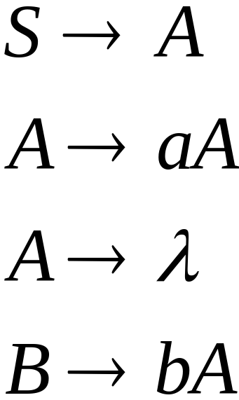
Another grammar:
Useless Production
Not reachable from S

Slide 19



In general:
contains only
terminals
if
then variable is useful
otherwise, variable is useless

Slide 20

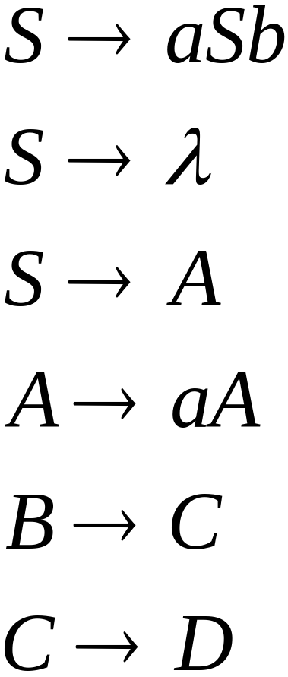
A production is useless
if any of its variables is useless
Productions
Variables
useless
useless
useless
useless
useless
useless
useless

Slide 21
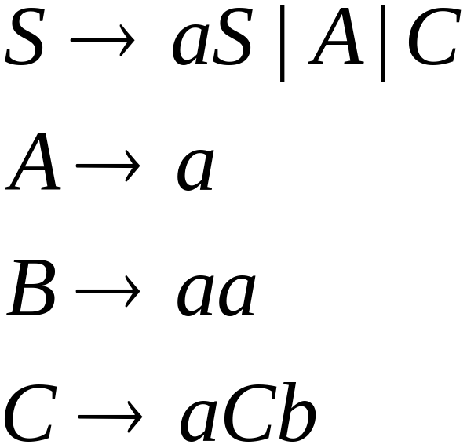
Removing Useless Productions
Example Grammar:

Slide 22
Remove useless productions

Slide 23
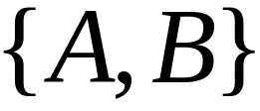

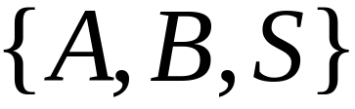
First:
find all variables that can produce
strings with only terminals
Round 1:
Round 2:

Slide 24
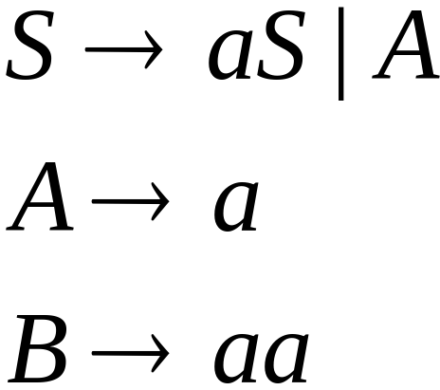
Keep only the variables
that produce terminal symbols:
(other variables are useless)
Remove useless productions

Slide 25




Second:
Find all variables
reachable from
Use a Dependency Graph
not
reachable

Slide 26
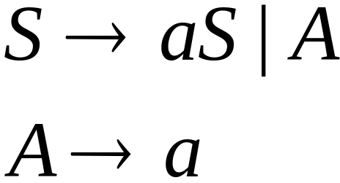
Keep only the variables
reachable from S
(the other variables are useless)
Final Grammar
Remove useless productions

Slide 27
Removing All
Step 1: Remove Nullable Variables
Step 2: Remove Unit-Productions
Step 3: Remove Useless Variables

Slide 28
Normal Forms for
Context-free Grammars

Slide 29


Chomsky Normal Form
Each production has form:
or
variable
variable
terminal

Slide 30
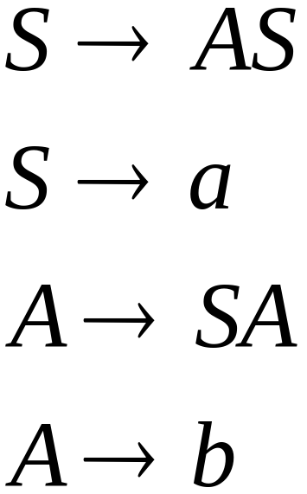
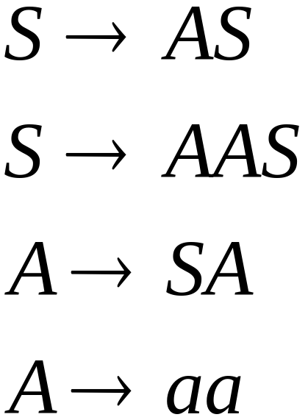
Examples:
Chomsky
Normal Form
Not Chomsky
Normal Form

Slide 31
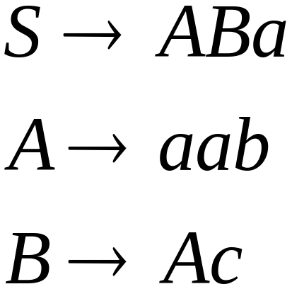
Conversion to Chomsky Normal Form
Example:
Not Chomsky
Normal Form

Slide 32
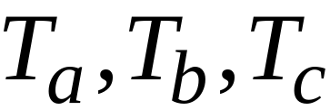
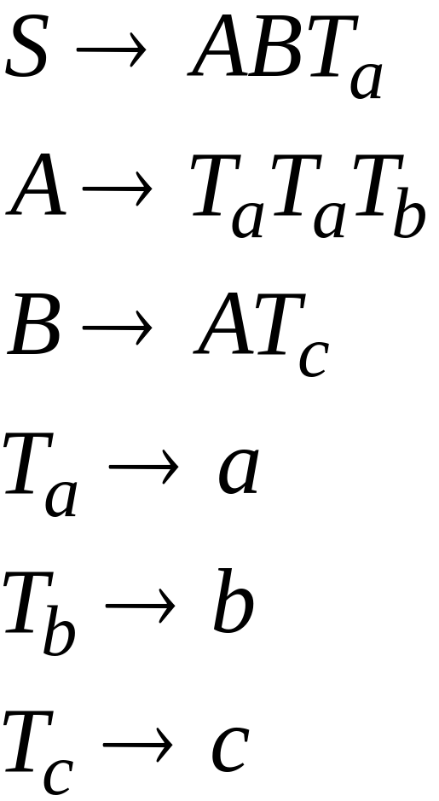
Introduce variables for terminals:

Slide 33

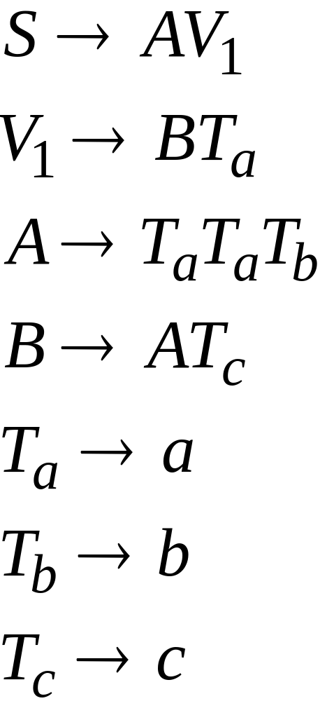
Introduce intermediate variable:

Slide 34
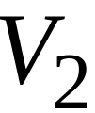
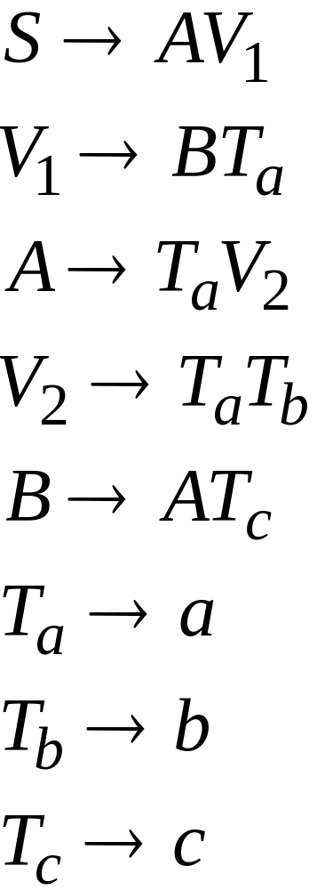
Introduce intermediate variable:

Slide 35
Final grammar in Chomsky Normal Form:
Initial grammar

Slide 36

In general:
From any context-free grammar
(which doesn’t produce )
not in Chomsky Normal Form
we can obtain:
An equivalent grammar
in Chomsky Normal Form

Slide 37
The Procedure
First remove:
    Nullable variables
    Unit productions

Slide 38

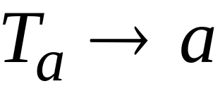

Then, for every symbol :
Add production
In productions: replace with
New variable:

Slide 39
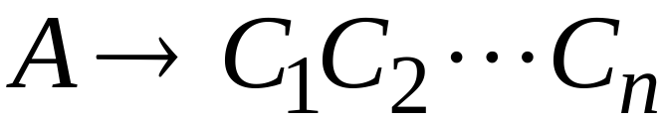
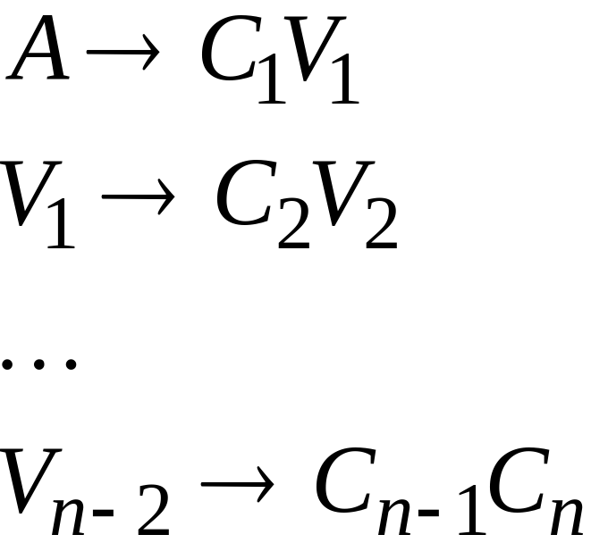
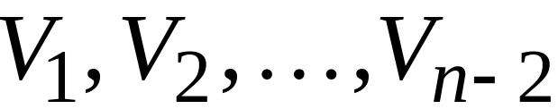
Replace any production
with
New intermediate variables:

Slide 40
Theorem:
For any context-free grammar
(which doesn’t produce )
there is an equivalent grammar
in Chomsky Normal Form

Slide 41
Observations
Chomsky normal forms are good
for parsing and proving theorems
It is very easy to find the Chomsky normal
form for any context-free grammar

Slide 42
exercise
Find CNF for this grammar:
S -> 0A0 | 1B1 | BB
A -> C
B -> S | A
C -> S | epsilon
(exercise 7.1.3, Hopcroft, Motwani, Ullman)

Slide 43
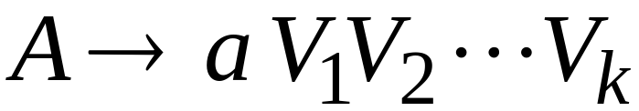

Greibach Normal Form
All productions have form:
terminal
variables

Slide 44
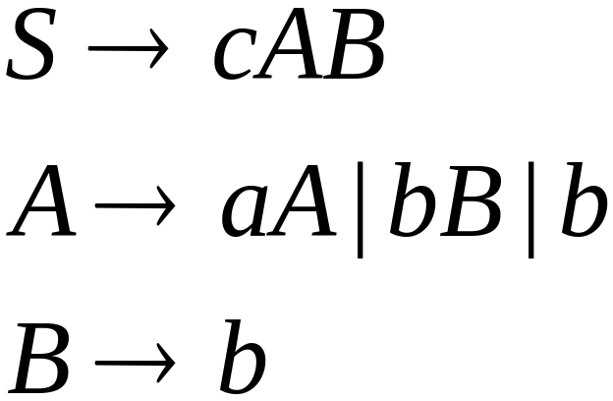
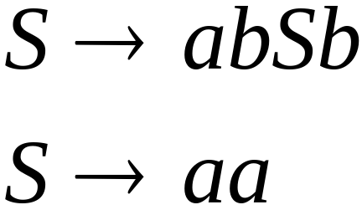
Examples:
Greibach
Normal Form
Not Greibach
Normal Form

Slide 45
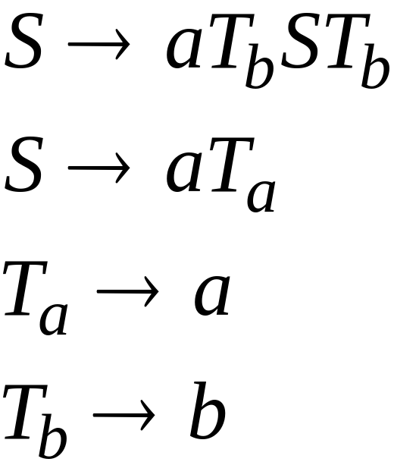
Conversion to Greibach Normal Form:
Greibach
Normal Form

Slide 46
Theorem:
For any context-free grammar
(which doesn’t produce )
there is an equivalent grammar
in Greibach Normal Form

Slide 47
Observations
Greibach normal forms are very good
for parsing
It is hard to find the Greibach normal
form of any context-free grammar

Slide 48
Try to compute Greibach Normal Form for grammar in CNF example

Slide 49
Compilers

Slide 50
Machine Code
Program
Add v,v,0
cmp v,5
jmplt ELSE
THEN:
add x, 12,v
ELSE:
WHILE:
cmp x,3
...
v = 5;
if (v>5)
x = 12 + v;
while (x !=3) {
x = x - 3;
v = 10;
}
......
Compiler

Slide 51
Compiler
Lexical
analyzer
parser
input
output
machine
code
program

Slide 52
A parser knows the grammar
of the programming language

Slide 53

Parser
PROGRAM STMT_LIST
STMT_LIST STMT; STMT_LIST | STMT;
STMT EXPR | IF_STMT | WHILE_STMT
| { STMT_LIST }
EXPR EXPR + EXPR | EXPR - EXPR | INT
IF_STMT if (EXPR) then STMT
| if (EXPR) then STMT else STMT
WHILE_STMT while (EXPR) do STMT

Slide 54
The parser finds the derivation
of a particular input
derivation
Parser
input
E => E + E
=> E + E * E
=> 10 + E*E
=> 10 + 2 * E
=> 10 + 2 * 5
E -> E + E
| E * E
| INT
10 + 2 * 5

Slide 55
derivation tree
derivation
E
E => E + E
=> E + E * E
=> 10 + E*E
=> 10 + 2 * E
=> 10 + 2 * 5
+
E
E
10
E
*
E
2
5

Slide 56
derivation tree
E
machine code
E
+
E
mult a, 2, 5
add b, 10, a
10
E
*
E
2
5

Slide 57
Parsing

Slide 58
Parser
input
string
grammar
derivation

Slide 59
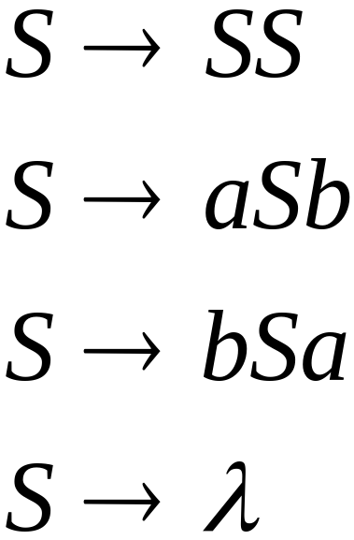

Example:
Parser
derivation
input
?

Slide 60
Parsing algorithm?

Slide 61
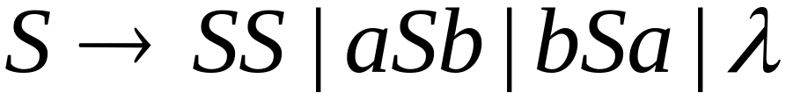
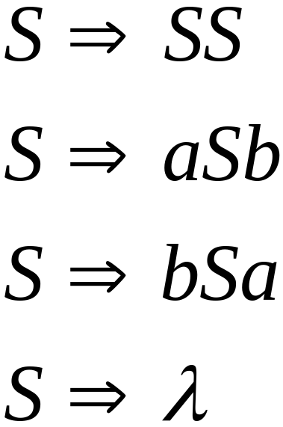
Exhaustive Search
Phase 1:
Find derivation of
All possible derivations of length 1

Slide 63
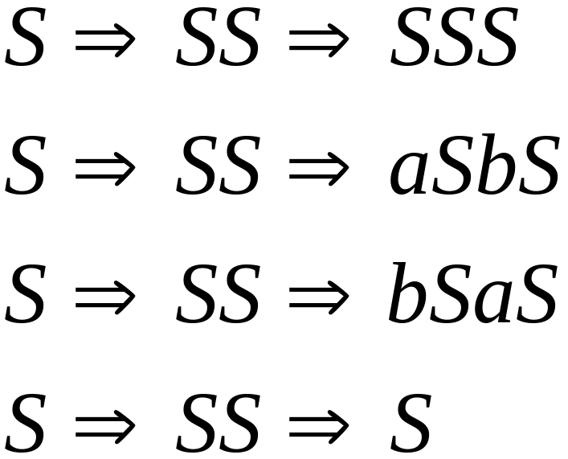
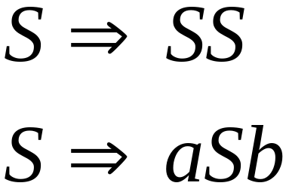
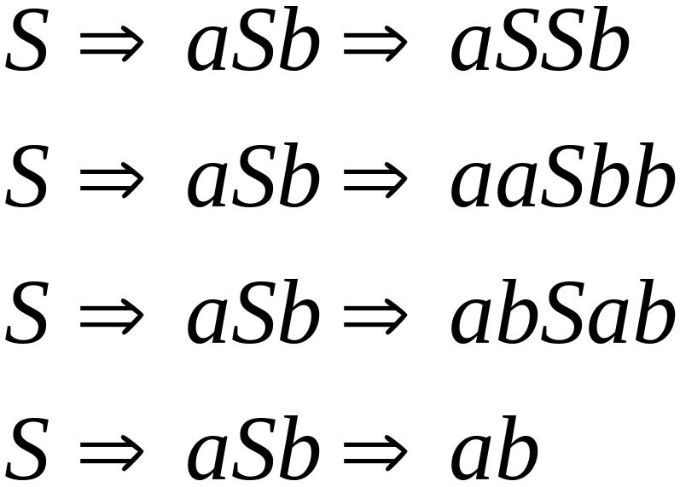
Phase 2
Phase 1
+ 2 more

Slide 64
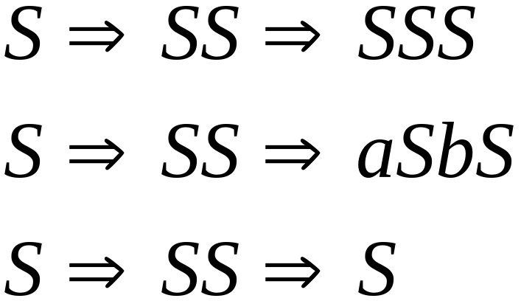
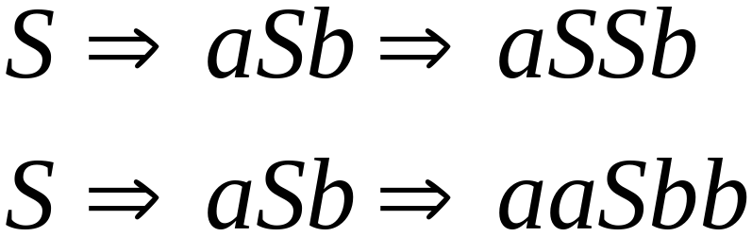
Phase 2
Phase 3

Slide 65
Final result of exhaustive search
(top-down parsing)
Parser
input
derivation

Slide 66
Is exhaustive search
a good parsing algorithm?

Slide 67
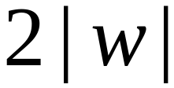

Time complexity of exhaustive search
Suppose there are no productions of the form
Number of phases for string :

Slide 68

For grammar with rules
Time for phase 1:
possible derivations

Slide 69
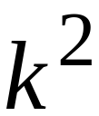
Time for phase 2:
possible derivations

Slide 70
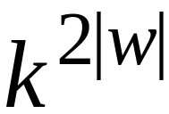
Time for phase :
possible derivations

Slide 71
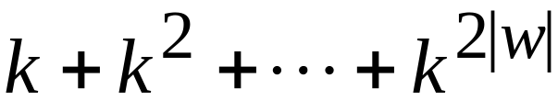
Total time needed for string :
phase 1
phase 2
phase 2|w|
Extremely bad!!!

Slide 72


There exist faster algorithms
for specialized grammars
S-grammar:
symbol
string
of variables
Pair
appears once

Slide 73

S-grammar example:
Each string has a unique derivation

Slide 74


For S-grammars:
In the exhaustive search parsing
there is only one choice in each phase
Time for a phase:
Total time for parsing string :

Slide 75

For general context-free grammars:
There exists a parsing algorithm
that parses a string
in time
(we will show this in the next class)

Slide 76
The CYK Parser

Slide 77

The CYK Membership Algorithm
Input:
Grammar in Chomsky Normal Form
String
Output:
find if

Slide 78


The Algorithm
Input example:
Grammar :
String :

Slide 79


Slide 80


Slide 81


Slide 82



Slide 83

Therefore:
Time Complexity:
Observation:
The CYK algorithm can be
easily converted to a parser
(bottom up parser)

Slide 84
The following slides are courtesy of Professor Papp, University of Debrecen.

Slide 85
1,7
1,1 7,7
a a b b a b a

Slide 86
Grammar
S→AB
S→CD
S→CB
S→SS
A→BC
A→a
B→SC
B→b
C→DD
C→b
D→BA
S
S B,C
S A,D
S D S,B C
B S
S A,S D S D
A A B,C B,C A B,C A
a a b b a b a

Slide 87
Grammar
S→AB
S→CD
S→CB
S→SS
A→BC
A→a
B→SC
B→b
C→DD
C→b
D→BA
S
S B,C
S A,D
S D S,B C
B S
S A,S D S D
A A B,C B,C A B,C A
a a b b a b a

Slide 88
Grammar
S→AB
S→CD
S→CB
S→SS
A→BC
A→a
B→SC
B→b
C→DD
C→b
D→BA
S
S B,C
S A,D
S D S,B C
B S
S A,S D S D
A A B,C B,C A B,C A
a a b b a b a

Slide 89
Grammar
S→AB
S→CD
S→CB
S→SS
A→BC
A→a
B→SC
B→b
C→DD
C→b
D→BA
S
S B,C
S A,D
S D S,B C
B S
S A,S D S D
A A B,C B,C A B,C A
a a b b a b a

Slide 90
Grammar
S→AB
S→CD
S→CB
S→SS
A→BC
A→a
B→SC
B→b
C→DD
C→b
D→BA
S
S B,C
S A,D
S D S,B C
B S
S A,S D S D
A A B,C B,C A B,C A
a a b b a b a

Slide 91
Grammar
S→AB
S→CD
S→CB
S→SS
A→BC
A→a
B→SC
B→b
C→DD
C→b
D→BA
S
S B,C
S A,D
S D S,B C
B S
S A,S D S D
A A B,C B,C A B,C A
a a b b a b a

Slide 92
Grammar
S→AB
S→CD
S→CB
S→SS
A→BC
A→a
B→SC
B→b
C→DD
C→b
D→BA
S
S B,C
S A,D
S D S,B C
B S
S A,S D S D
A A B,C B,C A B,C A
a a b b a b a

Slide 93
Grammar
S→AB
S→CD
S→CB
S→SS
A→BC
A→a
B→SC
B→b
C→DD
C→b
D→BA
S
S B,C
S A,D
S D S,B C
B S
S A,S D S D
A A B,C B,C A B,C A
a a b b a b a

Slide 94
Grammar
S→AB
S→CD
S→CB
S→SS
A→BC
A→a
B→SC
B→b
C→DD
C→b
D→BA
S
S B,C
S A,D
S D S,B C
B S
S A,S D S D
A A B,C B,C A B,C A
a a b b a b a

Slide 95
Grammar
S→AB
S→CD
S→CB
S→SS
A→BC
A→a
B→SC
B→b
C→DD
C→b
D→BA
S
S B,C
S A,D
S D S,B C
B S
S A,S D S D
A A B,C B,C A B,C A
a a b b a b a

Slide 96
Grammar
S→AB
S→CD
S→CB
S→SS
A→BC
A→a
B→SC
B→b
C→DD
C→b
D→BA
S
S B,C
S A,D
S D S,B C
B S
S A,S D S D
A A B,C B,C A B,C A
a a b b a b a

Slide 97
Word is in language
if S appears here
S
S B,C
S A,D
S D S,B C
B S
S A,S D S D
A A B,C B,C A B,C A
a a b b a b a

Slide 98
exercise
Parse “baaba” for this grammar
S -> AB | BC
A -> BA | a
B -> CC | b
C -> AB | a
(Hopcroft, Motwani, Ullman, p301)

