Slide 1
TRACKING MOBILE DEVICES USING PYTHON

Slide 2
TABLE OF CONTENTS
CHAPTER | TITLE | PAGENO:
 | ABSTRACT | 7
1. | INTRODUCTION | 8
 | • What is Python? | 9
 | • What is API key? | 10
 | • Usages of API keys | 11
 | • Working of API keys | 12
2. | SYSTEM ANALYSIS
 | • Proposed System | 14
3. | REQUIREMENTS | 15
4. | GEOCODER | 16
5. | SYSTEM MODULE
 | • Phonenumber | 17
 | • Folium | 18
6. | CODING | 20
7. | CONCLUSION | 32
8. | REFERENCE | 33
5

Slide 3
ABSTRACT
The system is proposed for predicting, tracking the mobile devices of a particular person using API keys which is received from the opensource online platform called “Geocoder”. This system exactly shows the carrier provider, longitude and latitude of the given Mobile Number. This mobile detection proposed work uses “Python” and also the modules “Folium” and “Phone numbers”.
This project is aimed at finding and locating the details of the given mobile number such as continent name of the mobile number, country name of the mobile number, currency used in the specified country of the mobile number, country’s time zone of the mobile number, latitude of the mobile number, longitude of the mobile number and using folium module and matplotlib it will create a separate html webpage. In the html webpage using latitude and longitude of the mobile number which is been retrieved using API keys is plotted in the map and given as the output.
Keywords: Mobile tracking, API Keys.
6

Slide 4
INTRODUCTION
This is a first article of a using multipart series on using python basic concepts to build a module to detect mobile tracking using API keys. API full form is Application Programming Interface Key. The API key often act as both a unique identifier and a secret token for authentication , and will generally have a set of access rights on API associated with it. It has no expiration so it may be used indefinitely, unless the project owner revokes or regenerates the key. Similarly in this article also we have created an API key to detect the accurate mobile location of a particular mobile number using Geocoder. Using this Geocoder will get the exact data which is required for us.
This mobile detection proposed work uses “Python” and also the modules “Folium” and “Phone numbers”. This project is aimed at finding and locating the details of the given mobile number such as continent name of the mobile number, country name of the mobile number , currency used in the specified country of the mobile number, country’s time zone of the mobile number, latitude of the mobile number, longitude of the mobile number and using folium module and matplotlib it will create a separate html webpage. In the html webpage using latitude and longitude of the mobile number which is been retrieved using API keys is plotted in the map and given as the output.
7

Slide 5
What is Python?
Python is a high-level, interpreted, interactive and object-oriented scripting language. Python is designed to be highly readable. It uses English keywords frequently whereas the other languages use punctuations. It has fewer syntactical constructions than other languages.
• Python is Interpreted: Python is processed at runtime by the interpreter. You do not need to compile your program before executing it. This is similar to PERL and PHP.
• Python is Interactive: You can actually sit at a Python prompt and interact with the interpreter directly to write your programs.
• Python is Object-Oriented: Python supports Object-Oriented style or technique of programming that encapsulates code within objects.
• Python is a Beginner’s Language: Python is a great language for the beginner level programmers and supports the development of a wide range of applications from simple text processing to WWW browsers to games.
8

Slide 6
What is API key?
An application programming interface (API) key is a code used to identify and authenticate an application or user. API keys are available through platforms, such as a white-labeled internal marketplace. They also act as a unique identifier and provide a secret token for authentication purposes.
APIs are interfaces that help build software and define how pieces of software interact with each other. They control requests made between programs, how those requests are made, and the data formats used. They are commonly used on Internet-of-Things (IoT) applications and websites to gather and process data or enable users to input information. For example, users can get a Google API key or YouTube API keys, which are accessible through an API key generator.
An API key is passed by an application, which then calls the API to identify the user, developer, or program attempting to access a website. It can help break development silos and will typically be accompanied by a set of access rights that belong to the API the key is associated with.
An API key has two parts: a public portion that Apple keeps, and a private key that you download. The private key enables you to sign tokens that authorize access to your data in App Store Connect and the Apple Developer website. Secure your private keys as you would other credentials, such as usernames and passwords
9

Slide 7
Usage of API key?
API keys are commonly used to control the utilization of the API’s interface and track how it is being used. This is often as a precaution to prevent abuse or malicious use. Common reasons why to use API keys include:
API Keys for Project Authorization
API keys are used in projects, providing authentication to identify users and the project itself. API keys provide project authorization through:
Project Identification
API keys can be used to identify a specific project or the application making the call to the API. While API keys are not as secure as the tokens that provide authentication, they help identify the project or application that makes the call. This ensures they can also be used to designate usage information to a specific project and reject unauthorized access requests.
Project Authorization
API keys are commonly used to check that the application making the call to the API has access to do so. Authorization will also check that the API being used in the project is enabled.
10

Slide 8
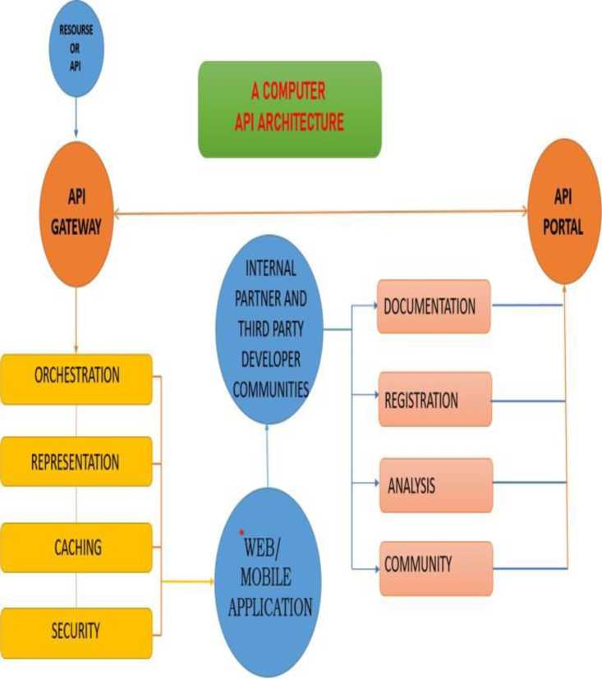
WORKING OF API key?
The key consists of code passed between an API and application services. The code calls programs from another application, and the key then identifies the end-user, the developer of the code, and the application making the API call. In this sense, the API key acts as an authentication token or a unique identifier.
11

Slide 9
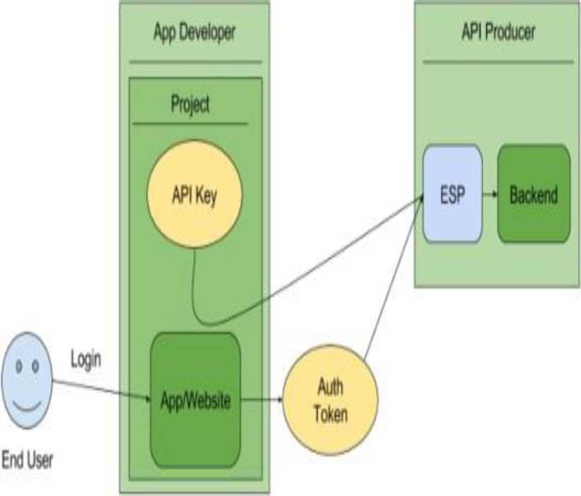
WORKING OF API key?
An API key has two parts: a public portion that Apple keeps, and a private key that you download. The private key enables you to sign tokens that authorize access to your data in App Store Connect and the Apple Developer website. Secure your private keys as you would other credentials, such as usernames and passwords
12

Slide 10
PROPOSED SYSTEM
• This project is basically designed to track the mobile devices and service provider of the given number.
• Firstly, import two modules phonenumbers(used for providing numerous features like basic information of a phonenumber, validation of a phone number etc) and folium(used for visualizing data that’s been manipulated in Python on an interactive leaflet map).
• Secondly, get the API key from the opensource web i.e., geocoder. This API key is used for retrieving the data from the opensource network.
• The retrieved information is parsed to the program and using description of the number function we can easily trace the country in which the number is located.
• Thirdly, by using folium module latitude and longitude is been tracked.
• Finally, the given latitude and longitude is parsed to html page and been located in the map which can been seen using chrome browser, fire fox browser or any other related internet browser.
13

Slide 11
REQUIREMENTS
Project requirements are conditions or tasks that must be completed to ensure the success or completion of the project. They provide a clear picture of the work that needs to be done. They're meant to align the project's resources with the objectives of the organization.
Project requirements are the general conditions and objectives necessary for implementing a project.
HARDWARE REQUIREMENTS | SOFTWARE REQIREMENTS
• Laptop/Desktop with Processor 2.8 GHz and above • RAM 512MB and above | • PYCHARM (latest version) • PYTHON 3.9 • GEOCODER • API KEY • HTML TEXT FILE • CHROME OR FIREFOX BROWSER
14

Slide 12
WHAT IS GEOCODING?
Geocoding is the process of transforming a description of a location—such as a pair of coordinates, an address, or a name of a place—to a location on the earth's surface. The user can geocode by entering one location description at a time or by providing many of them at once in a table. The resulting locations are output as geographic features with attributes, which can be used for mapping or spatial analysis.
It is used to quickly find various kinds of locations through geocoding. The types of locations that you can search for include points of interest or names from a gazetteer, like mountains, bridges, and stores; coordinates based on latitude and longitude or other reference systems, such as the Military Grid Reference System (MGRS) or the U.S. National Grid system; and addresses, which can come in a variety of styles and formats, including street intersections, house numbers with street names, and postal codes.
The system which is used for Geocoding is Geocoder which is used to give the output as geographic features with attributes, which can be used for mapping or spatial analysis.
15

Slide 13
PHONENUMBER MODULE
Phonenumbers is a Python module that comes with multiple features such as parsing phone numbers, etc. The Phonenumbers module of Python has multiple functions capable of performing various operations on a given phone number, like finding the region of the phone number, operator of the phone number, etc.
The user can use functions of the phonenumbers module in a Python program by importing this module into the program, and then they can use these functions to perform desired operations on given phone numbers.
The Phonenumbers module is very helpful for us in many ways, which include several following benefits:
• This module saves our lot of efforts
• This module saves our time for performing operations on phone numbers
• We can perform multiple operations at once on a given phone number using the phonenumbers module
• We can even perform operations on multiple phone numbers at once using this module
16

Slide 14
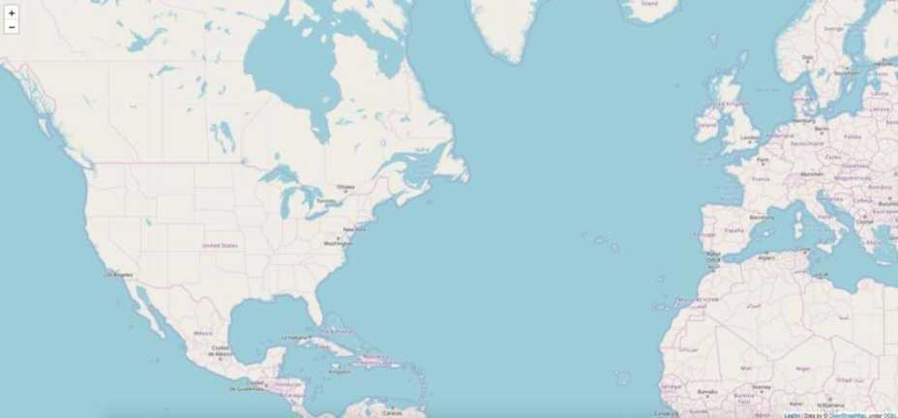
FOLIUM MODULE
• Folium is built on the data wrangling strengths of the Python ecosystem and the mapping strengths of the Leaflet.js (JavaScript) library.
• Simply, manipulate your data in Python, then visualize it on a leaflet map via Folium.
• Folium makes it easy to visualize data that’s been manipulated in Python, on an interactive Leaflet map.
• This library has a number of built-in tilesets from OpenStreetMap, Mapbox etc.
• The step to install folium module is:
pip install folium
Empty map for example
17

Slide 15
18

Slide 16
TRACKING IMPLEMENTATION
CODING SCREENSHOTS
(NUMBERLOCATION.PY)
(?l File Edit View Navigate Code Refactor Run Tools VCS Window Help pythonProject - numberlocation.py pythonProject r^, numberlocation.py
tjj rj numberlocation.py [fjp mylocation.html £ mynumber.py ^ 1 import phonenumbers
import folium
from mynumber import number from phonenumbers import geocoder
key = ¹c9d80cdl09a5429a9cab4ff153308199¹ sannumber = phonenumbers.parse(number)
yourlocation=qeocoder.description_for_number(sannumber_{r}"en") print("COUNTRY : \yourlocation) from phonenumbers import carrier service_provider=phonenumbers.parse(number)
print("SERVICE CARRIER PROVIDER : carrier.name_for_number(service_provider, "en"))
from opencage.geocoder import OpenCageGeocode geocoder = OpenCageGeocode(key)
query=str(yourlocation) results=geocoder.geocode(query) print(results)
lat = results[Q]['geometry’][¹lat¹]
Ing = results[0][¹ geometry']['Ing'] con=results[0]['components']['continent']
print("CONTINENT = \con) printOTATITUDE = \lat) print("LONGITUDE = \lng)
« 25 myMap = folium.Map( ition=[lat, Ing], ;oon_ T „=_9)
3
folium.Marker([lat, lng]_{A}i = yourlocation).add_to((myMap)) " myHap.save("mylocation.html")
19

Slide 17
CODING
(MYNUMBER.PY)
SCREENSHOTS
|?| File Edit View Navigate Code Refactor Run Jools VCS Window Help pythonProject - mynumber.py pythonProject mynumber.py
l £ numberlocation.py mylocation.html £ mynumber.py
£ 1 number="+919841510393"
* |
After typing the code in main file (‘numberlocation.py’) and importing the number from the another file(‘mynumber.py’) execute the main python file such that it automatically creates a html file named ‘mylocation.html’ and the location of the given mobile number can be located in the world map and the details of mobile number is displayed in output console.
20

Slide 18
HTML FILE
imberlocation.py ^ mylocation.html ^ mynumber.py <!DOCTYPE html>
<head>
<neta http-equiv="content-type" content="text/html; charset=UTF-8" />
<script>
L.NO.TOUCH = false;
L_DISABLE_3D = false;
</scnipt>
<style>html, body {width: 100%;height: 100%;margin: 0;padding: 0;}</style>
<style>#map {positionabsolute;top:0;bottom:0;right:0;left:0;}</style>
<script src="https://cdn.jsdelivr.net/npm/leafletgi.6.0/dist/leaflet.js"x/script>
<script src="https://code.jquery.com/jquery-1.12.4.min.js"x/script>
<script src="https://maxcdn.bootstrapcdn.com/bootstrap/3.2.0/js/bootstrap.min.js"></script>
<script src="https://cdnjs.cloudflare.eom/ajax/libs/Leaflet.awesome-markers/2.0.2/leaflet.awesome-markers.js"x/script> <link rel="stylesheet" href="https://cdn.jsdelivr.net/npm/leafletgi.6.0/dist/leaflet.css"/>
<link rel="stylesheet" href="https://maxcdn.bootstrapedn.com/bootstrap/3.2.0/css/bootstrap.min.css"/>
<script src="https://cdnjs.cloudflare.com/ajax/libs/Leaflet.awesome-markers/2.0.2/leaflet.awesome-markers.js"></script>
<link rel="stylesheet" href="https://cdn.jsdelivr.net/npm/leafletgi.6.0/dist/leaflet.css"/>
<link rel="stylesheet" href="https://maxcdn.bootstrapedn.com/bootstrap/3.2.0/css/bootstrap.min.css"/> f <link rel="stylesheet" href="https://maxcdn.bootstrapedn.com/^ootstrap/3.2.0/css/bootstrap-theme.min.css"/>
<link rel="stylesheet" href="https://maxcdn.bootstrapcdn.eom/font-awesome/4.6.3/css/font-awesome.min.css"/>
<link rel="stylesheet" href="https://cdnjs.cloudflare.com/ajax/libs/Leaflet.awesome-markers/2.0.2/leaflet.awesome-markers.css"/> dink rel="stylesheet" href="https://cdn.jsdelivr.net/gh/python-visualization/folium/folium/templates/leaflet.awesome.rotate.min.css"/>
cmeta name="viewport" content="width=device-width,
initial-scale=1.0, maximum-scale=1.0, user-scalable=no" />
<style>
#map_217e49abl65340e09b68d4dfc0alad94 { position: relative; width: 100.0%; height: 100.0%; left: 0.0%:
ocation.py ,fl mylocation.html mynumberpy
V3T TH'j_'lfll/jf_!i<ijrfeoot)Cir<i3o/DJogt)t)/zczyue3yo = L.tueLayeri,
"https://{s}.tile.openstreetmap.org/{z}/{x}/{y}.png",
{"attribution": "Data by \u0026copy; \u003ca href=\"http:y/openstreetniap.orq\"\u003eOpenStreetHap\u003c/a\u003e. under \u003ca href=\"http://w.^ ^ ^ ^ ).addTo(map_217e49obl65340e09b68d4d/c0alod94);
var marker_978eb7a8835c4dd3929ff4a031d££a45 = L.marker( [22.3511148, 78.6677428],
{>
).addTo(mop_217e49abl65340e09b68d4d/c0plad94);
var popup_ld6blb0b886a4d8597fc6880913a7110 = L.popup({"maxWidth": "100%"});
var html_62ffb6fd3b34468e8d0a53620e005fbb = |( <div id="html_62ffb6fd3b34468e8d0a53620e005fbb" style="width: 100.0%; height: 100.0%;">India</div>‘)[0]; popup_ld6blb0b886o4d8597/c6880913o7110.setContent(html_62//b6/d3b34468e8d0o53620e005/bb);
inarker_978eb7a8835c4dd3929ff4aB31dffa45. bindPopup (popup_ld6blbQb886a4d8597fc688Q913a711B)
21

Slide 19
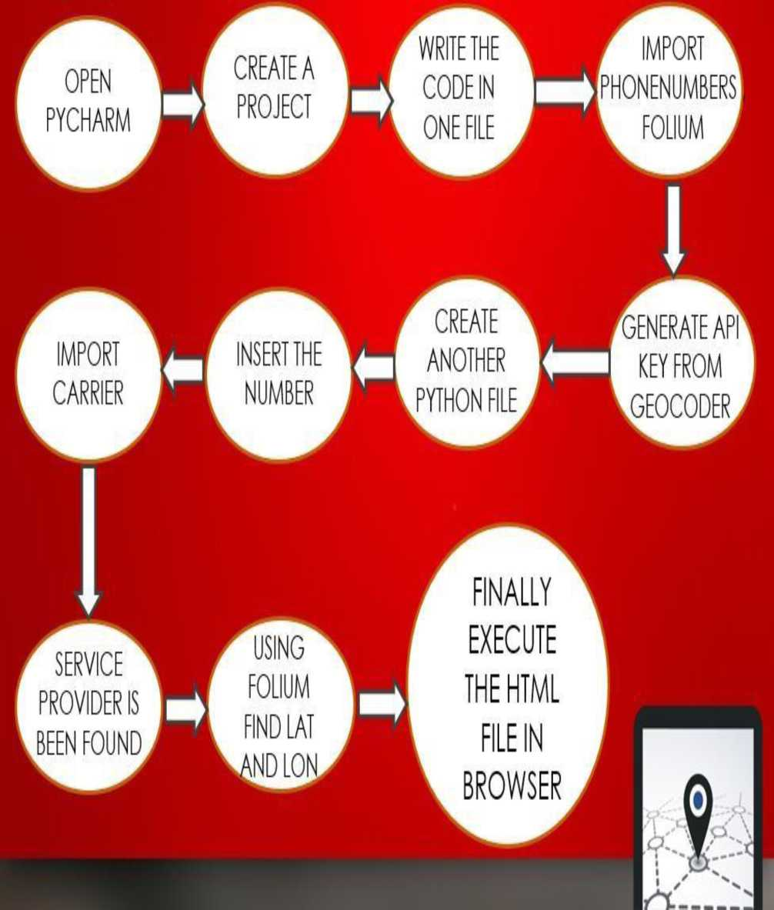
FLOWCHART FOR EXECUTION
OF PROJECT
22

Slide 20
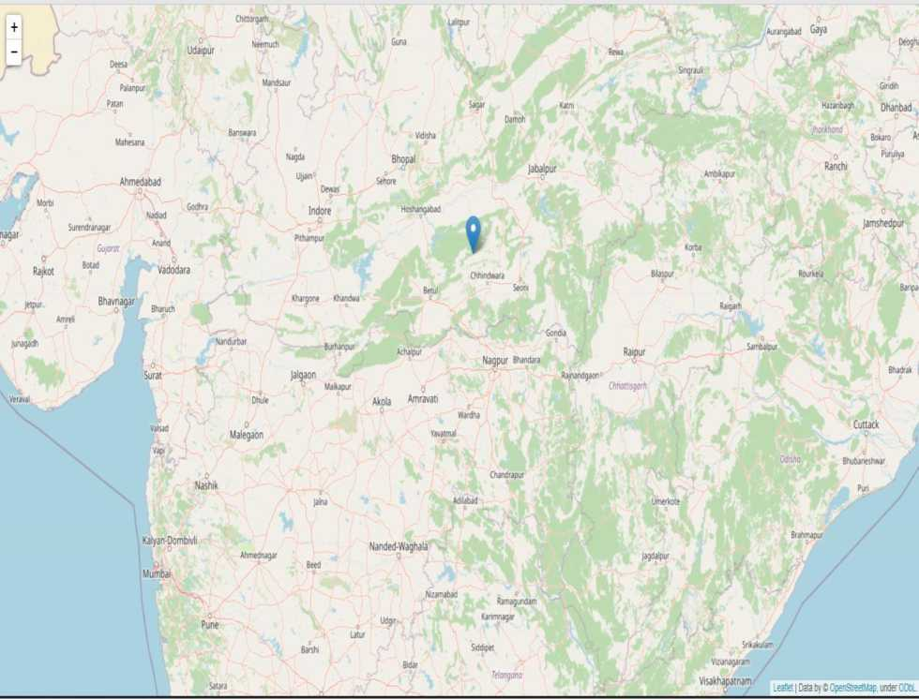
OUTPUT
COUNTRY : India
SERVICE CARRIER PROVIDER : Aircel CONTINENT = Asia LATITUDE = 22.3511148 LONGITUDE = 78.6677428
Process finished with exit code G
23

Slide 21
CONCLUSION
• Finally, this project shows the location of the given mobile number and it is plotted in the world map.
• This project can be widely used by some mobile application available in playstore and while using google maps this project is the basic level to it.
• But, this project shows the country, latitude and longitude of the mobile number but our next implementation is to track the state and city name of the mobile number in upcoming projects.
24

Slide 22
REFERENCE
[1] . "Google Earth Engine for geo-big data
applications: A meta-analysis and systematic review".By Haifa Tamiminiaa , Bahram Salehia,Masoud Mahdianparib,Lindi
Quackenbusha, Sarina Adelia, Brian Brisco.
[2] .“ Mobile SmartPhone as a Security and
Surveillance”—Milan Musikic,Dragan
Samardzija.
[3] .“Evaluation of Mobile Tracking System”-Hemalatha V adlamudi
25

