Slide 1
Toxic Comments Classifier
By Aditya Sridhar and Chandan Shankarappa

Slide 2
Introduction
Internet – open forum that allows open discussions and expression of opinions
Not all discussions occur smoothly
Certain disenfranchised individuals ruin it
Sometimes no motive behind their actions

Slide 3


Slide 4
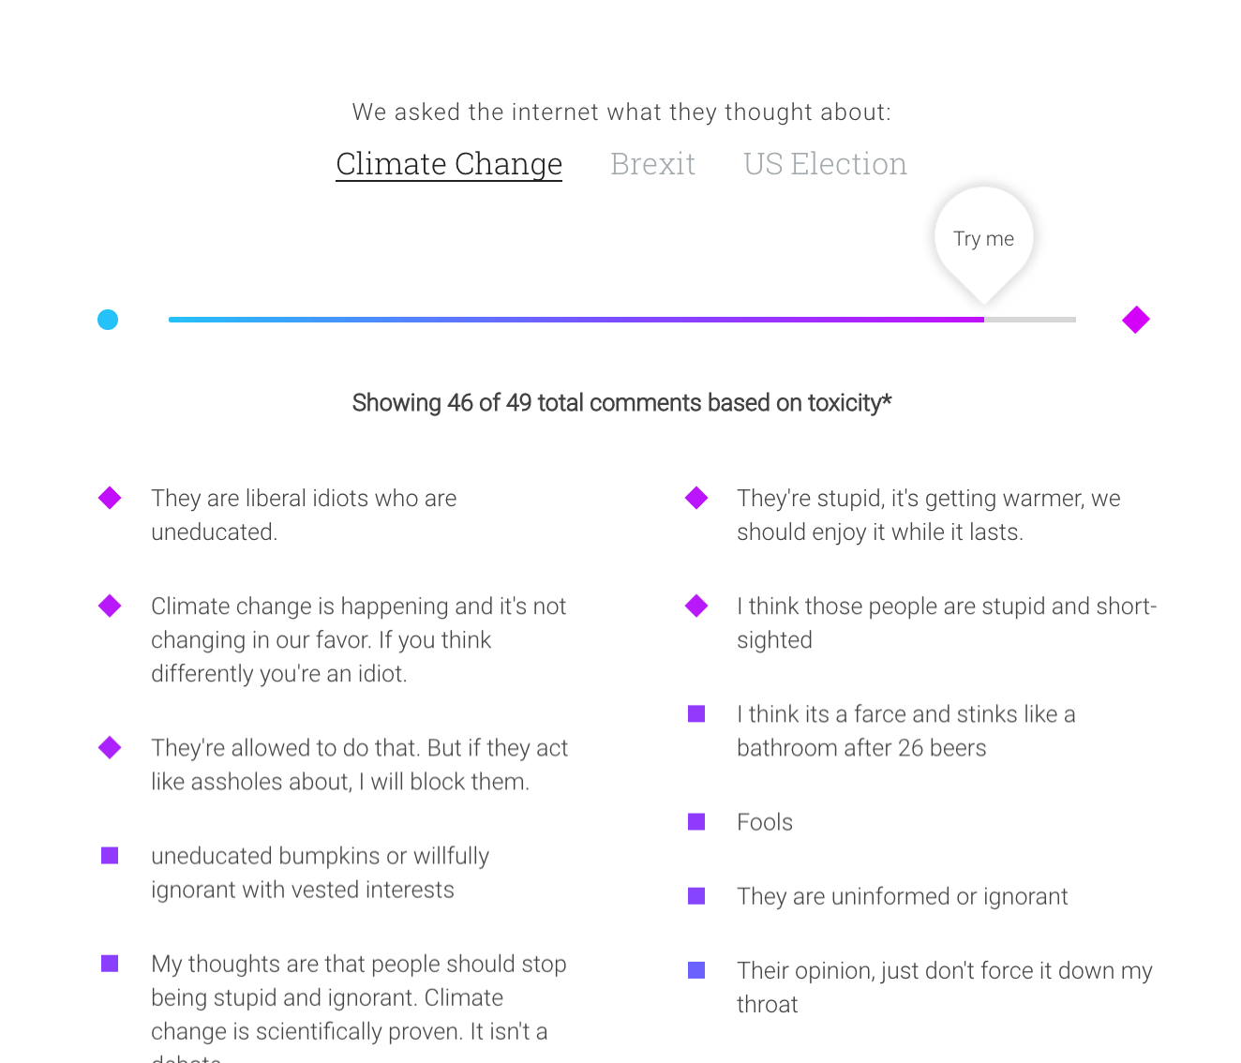
Example of Toxic Comments

Slide 5
Objective
Goal is to label each comment as one of - Toxic - Severely Toxic - Obscene - Threat - Insult - Identity Hate

Slide 6
Example of each type
Toxic – ‘Bye! Don't look, come or think of comming back! Tosser.’
Severely Toxic – inappropriate for class
Obscene – ‘A pair of jew-hating weiner nazi schmucks.’
Threat – ‘Hi! I am back again! Last warning! Stop undoing my edits or die!’
Insult – ‘People like you who revert good edits because you're too stupid to understand how to write well , and then revert other edits just because you've decided to bear a playground grudge, are the problem. Maybe one day you'll realise the damage you did to a noble project.’
Identity Hate – ‘He is also very ugly, and has a willy for a face.’

Slide 7
Data Pre Processing
Obtained data from Kaggle
A list of Wikipedia comments
Initially removed punctuations and upper cases
Retained them as they are important
Removed white spaces and time stamps

Slide 8
Methods/Models tried
Naïve Bayes bag of words approach
Linear SVM
Logistic Regression

Slide 9
Features Used
Number of punctuations (‘.’, ‘!’, ‘?’)
Number of upper case letters
Bag of words – unigram
Bigrams
TF-IDF vectorizer
Word to vectorizer

Slide 10
Experiments and Results
Punc and Caps – 88.34%
+ ngrams (using count vectorizer) – 89.05%
+ TF-IDF vectorizer – 89.59%
Punc, caps and TF-IDF including ngrams – 90.68%
min_df : 10 - 88.76%, 20 – 89.88%, 30 – 91.04%
+word2vec – 90.55%
min_df : 15 – 91.24%, 20 – 91.66%, 25 – 91.13%

