Slide 1
Toxic Comments Classifier
By Aditya Sridhar and Chandan Shankarappa

Slide 2
Introduction
Internet – open forum that allows open discussions and expression of opinions
Not all discussions occur smoothly
Certain disenfranchised individuals ruin it
Sometimes no motive behind their actions

Slide 3


Slide 4
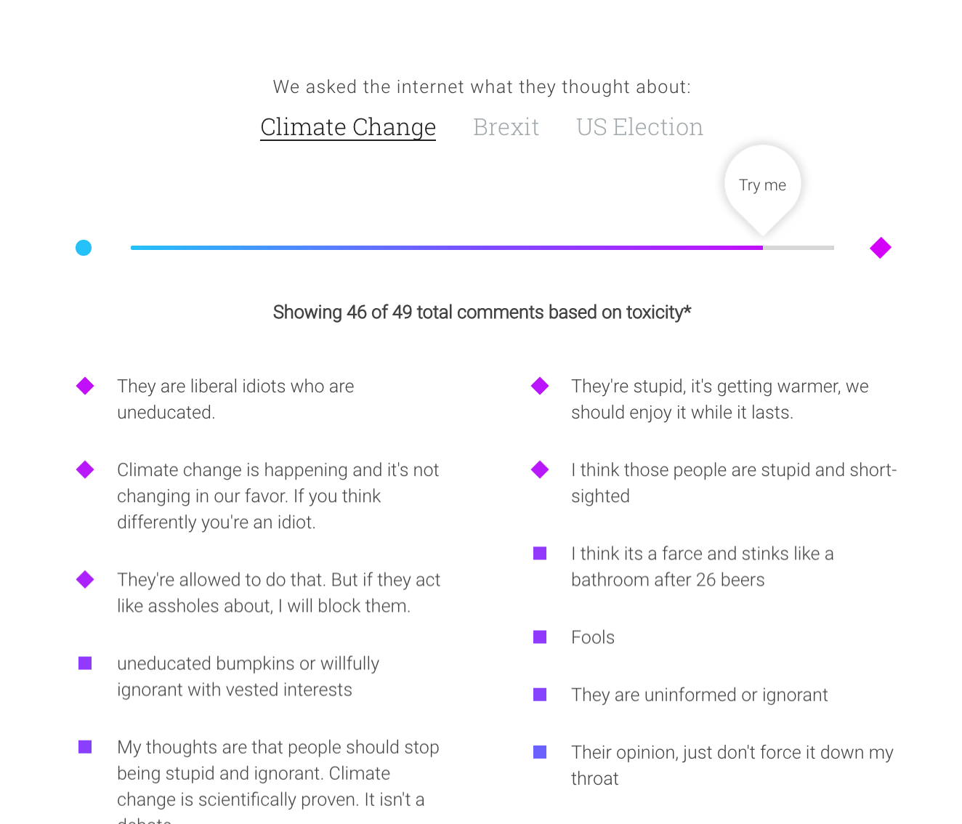
Example of Toxic Comments

Slide 5
Objective
Goal is to label each comment as one of - Toxic - Severely Toxic - Obscene - Threat - Insult - Identity Hate

Slide 6
Example of each type
Toxic – ‘Bye! Don't look, come or think of comming back! Tosser.’
Severely Toxic – inappropriate for class
Obscene – ‘A pair of jew-hating weiner nazi schmucks.’
Threat – ‘Hi! I am back again! Last warning! Stop undoing my edits or die!’
Insult – ‘People like you who revert good edits because you're too stupid to understand how to write well , and then revert other edits just because you've decided to bear a playground grudge, are the problem. Maybe one day you'll realise the damage you did to a noble project.’
Identity Hate – ‘He is also very ugly, and has a willy for a face.’

Slide 7
Data Pre Processing
Obtained data from Kaggle
A list of Wikipedia comments
Initially removed punctuations and upper cases
Retained them as they are important
Removed white spaces and time stamps

Slide 8
Distinction from other classification problems
Not a binary/multi-class classification!
Instead it is a multi-label classification
One Vs Rest approach, Adaptive algorithms, Label Powersets

Slide 9
Methods/Models tried
Multinomial Naïve Bayes bag of words approach
Linear SVM
Logistic Regression

Slide 10
Features Used
Number of punctuations (‘.’, ‘!’, ‘?’)
Number of upper case letters
Bag of words – unigram
Bigrams
TF-IDF vectorizer
Word2Vec (GloVe pre-trained vectors & training data)

Slide 11
Experiments and Results
Punc and Caps – 88.34%
+ ngrams (using count vectorizer) – 89.05%
+ TF-IDF vectorizer – 89.59%
Punc, caps and TF-IDF including ngrams – 90.68%
min_df : 10 - 88.76%, 20 – 89.88%, 30 – 91.04%
+word2vec – 90.55%
min_df : 15 – 91.24%, 20 – 91.66%, 25 – 91.13%

Slide 12
Evaluation of Multi-label classifiers
Cannot necessarily use same metrics as a binary/multi-class classifier
Accuracy metric – subset accuracy – strict metric
Hamming Loss, Jaccard Index, Average Precision/Recall for each label

Slide 13
Future Work
Focus has been on the NLP aspects, can consider more sophisticated ML models.
Can investigate use of better word embeddings like FastText and also try the larger Twitter GloVe corpus.
Examine correlation/ranking among the labels.

Slide 14
Questions & Feedback
We are Team 6, in case you want to vote for us!

