Slide 1
SMART CLAIM

Slide 2
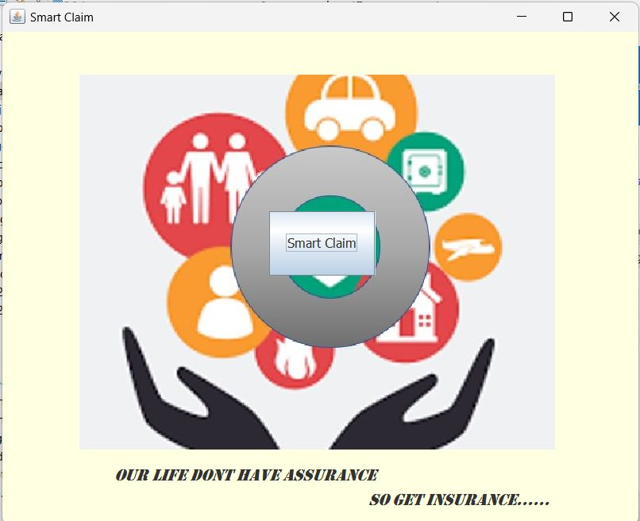

Slide 3
Done by
S.V.N Aditya - CH.EN.U4CSE20071
P.C.V.Satya Raman - CH.EN.U4CSE20049
Y. Nithin Reddy - CH.EN.U4CSE20046
P. Abhinai Raj - CH.EN.U4CSE20048

Slide 4
INTRODUCTION
Smart Claim - the instant insurance claiming software that revolutionizes the insurance industry.
In today's world, insurance is an essential aspect of our lives. Be it health, property, or vehicles, we all need insurance to protect ourselves from unforeseen events. However, the traditional insurance claiming process can be time-consuming and cumbersome, causing significant inconvenience to policyholders. This is where Smart Claim comes into the picture.
Smart Claim is an innovative insurance claiming software that streamlines the entire claiming process, from reporting a claim to receiving the settlement amount. With Smart Claim policyholders can file their claims instantly, and the software's advanced algorithms assess the claim's validity and settle the claim within minutes, eliminating the need for tedious paperwork and lengthy waiting periods.

Slide 5
MOTIVATION
The motivation behind developing the Smart Claim instant insurance claiming software is to address the challenges that policyholders face when filing insurance claims. The traditional claiming process involves a lot of paperwork, which can be time-consuming and stressful for policyholders. Additionally, the lengthy waiting period for claim settlement can cause financial difficulties, especially if the policyholder has suffered significant losses.
The Smart Claim software aims to simplify the insurance claiming process by leveraging the latest technologies, such as machine learning and artificial intelligence. By automating the process, policyholders can file their claims instantly, and the software's algorithms can assess the claim's validity and settle the claim within minutes. This means that policyholders can receive their settlement amount quickly, reducing the financial burden caused by the loss.

Slide 6
MAIN OBJECTIVE
The main objective of the Smart Claim instant insurance claiming the software is to provide policyholders with a hassle-free and efficient insurance claiming process. The traditional claiming process can be tedious and time-consuming, causing significant inconvenience to policyholders. With “Smart Claim" policyholders can file their claims instantly and receive their settlement amount within minutes, eliminating the need for lengthy waiting periods and tedious paperwork.
Another key objective of the Smart Claim software is to improve the operational efficiency of insurance companies. The software's machine learning algorithms can analyze vast amounts of data, enabling insurers to detect patterns of fraudulent behavior and prevent fraudulent claims. This can significantly reduce the risk of financial losses caused by fraudulent claims, enhancing the overall profitability of the insurance company.

Slide 7
PROPOSED WORK
Research and Analysis
Software Development
Testing and Validation
The first step is to conduct a comprehensive study of the current insurance claiming process and identify the pain points that policyholders and insurers face. Based on the research findings, the development team can define the software's requirements and specifications.
The next step is to develop the software based on the defined requirements and specifications. The development team can leverage the latest technologies, such as machine learning, artificial intelligence, and natural language processing, to build an efficient and user-friendly software.
Once the software is developed, it needs to be tested thoroughly to ensure that it meets the defined requirements and specifications. The testing team can perform functional, performance, and security testing to validate the software's reliability and robustness.

Slide 8
Deployment and Integration
Maintenance and Support
After the software is tested and validated, it can be deployed and integrated with the existing insurance system. The integration team can ensure that the software seamlessly integrates with the existing system and does not disrupt the operational processes.
Finally, the software needs to be maintained and supported to ensure that it continues to function optimally. The development team can provide regular updates and upgrades to the software, ensuring that it stays up-to-date with the latest technologies and trends.

Slide 9
ADMIN
The admin attribute refers to the role of the administrator of the software. The administrator is responsible for managing the software, including adding and removing users, managing policies, and monitoring claims. The admin can also access and analyze data to detect patterns of fraudulent behavior and take appropriate actions to prevent fraudulent claims. In addition, the admin can customize the software to meet the unique needs of the insurance company and ensure that it is compliant with regulatory requirements.

Slide 10
USER
The user attribute refers to the role of the policyholder who files an insurance claim using the software. The user can access the software through a web or mobile interface and file a claim instantly. The software's algorithms can assess the claim's validity and settle the claim within minutes, providing the user with a fast turnaround time for claim settlement. The user can also track the status of their claim and receive updates on the settlement process.

Slide 11
POLICE
The police attribute refers to the role of law enforcement agencies who can access the software to investigate insurance fraud cases. The software can provide the police with valuable data and insights into fraudulent behavior patterns, enabling them to identify and prosecute fraudsters. The police can also collaborate with the insurance company and share data to detect and prevent fraudulent claims.

