Slide 1


Slide 2


PROJECT ON
DATA SCIENCE
COVID-19 DATA ANALYSIS

Slide 3
INTRODUCTION
It feels surreal to imagine how the virus began to spread from one person that is patient zero to four million today. It was possible because of the transport system.
To be well prepared for any future pandemic we need to analysis the current covid19 situation, analysis of the data covid19 will help us to understand where we made mistakes and grow to prevent it.

Slide 4
BACKGROUND STUDY
To describe common python funtionality and features used for data science .
To query data frames structures for cleaning and processing.
To understand techniques such as lambdas and manipulating CSV files.

Slide 5

PROBLEMS STATEMENT
A model to predict the data of covid-19 analysis . Several factors affect the spread of covid-19 , we will try to analysis when covid out break is more .
As a result, it will help us to control the spread of covid-19 in affected area.

Slide 6
SOLUTION APPROACH
We will be going through some basic plots available in matplotlib and make it more aesthetically pleasing.
Here are the Visualizations we’ll be designing using matplotlib .
Simple Plot
Pie Chart
Initializing Dataset
Importing Dataset on Covid-19 India case time series
data = pd.read_csv('case_time_series.csv')

Slide 7
SOLUTION APPROACH
case_time_series.csv dataset has 7 column. We will be collecting Daily Confirmed Daily Recovered and Daily Deceased in variables as array.
Y = data.iloc[61:,1].values #Stores Daily Confirmed R = data.iloc[61:,3].values #Stores Daily Recovered D = data.iloc[61:,5].values #Stores Daily DeceasedX = data.iloc[61:,0] #Stores Date‘Y’ variable stores the ‘Daily Confirmed’ corona virus cases
‘R’ variable stores the ‘Daily Recovered’ corona virus cases
‘D’ variable stores the ‘Daily Deceased’ corona virus cases
And ‘X’ variable stores the ‘Date’ column

Slide 8
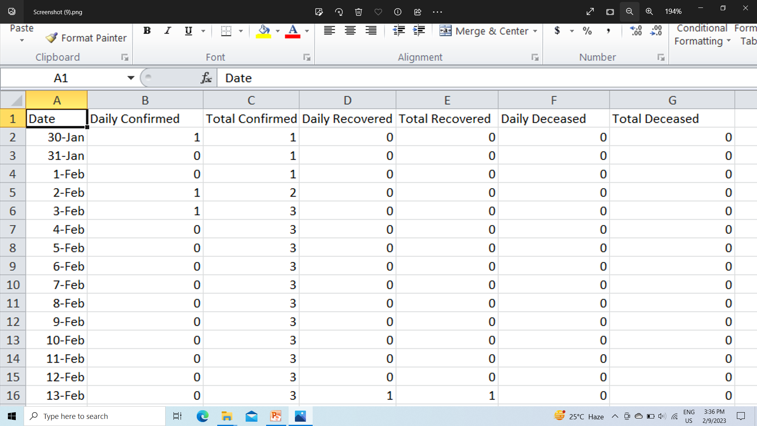
DATASET
The data we have used in this project was given by our instructor . The dataset consists of 106 rows and 7 columns with no null values. Column data consist of daily confirmed cases ,total confirmed cases ,daily recovered cases , daily decreasing case, total recovered cases .

Slide 9
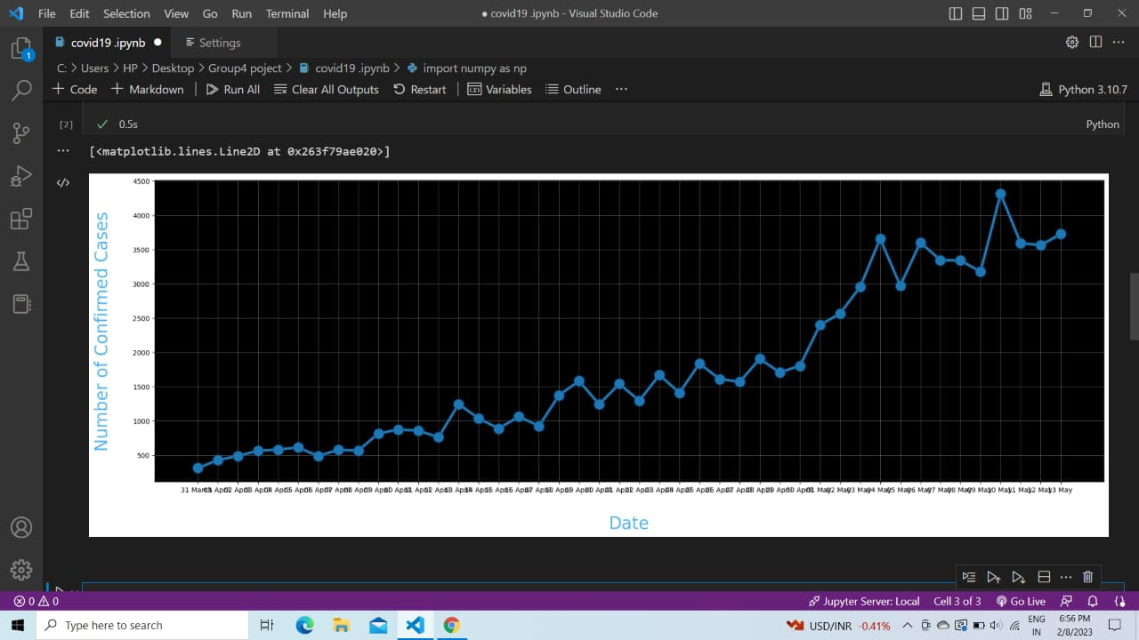
OBSERVATION
We get a Simple Plot on the execution of above code which looks like this where X-axis has Dates and Y-axis has Number of Confirmed cases.

Slide 10
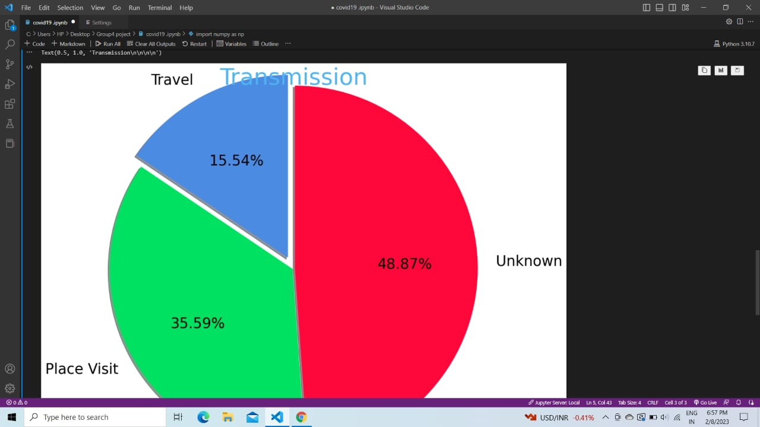
OBSERVATION
We’ll be plotting the Transmission Pie Chart to understand the how the virus is spreading based on Travel, Place Visit and Unknown reason.
slices = [62, 142, 195] activities = ['Travel', 'Place Visit', 'Unknown'] So we have created list slices based on which our Pie Chart will be divided and the corresponding activities are it’s valued.

Slide 11
CONCLUSION
At first ,there were many reasons why the
model didn’t work, it was showing many error than we analyse the code and debug
it.
we divided the work among our team member.
In this project , we have developed a python Machine Learning project to analyse the number of covid19 cases.

Slide 12
REFERENCE
Wikipedia
Kaggle
Books on Machine learning

Slide 13
THANK YOU

