Slide 1

INTERPERSONAL SKILLS
Notes:
PRESENTATION NOTES FOR
INTERPERSONAL SKILLS MODULE
Generic Skills Integration Project (GENSIP)
Student Counselling Service & Staff Development
University of Dublin, Trinity College
Tamara O’Connor
January 2003

Slide 2
Interpersonal skills
Necessary for relating and working with others
Effective communication skills – listening and expressing
Ability to give and receive feedback
Being able to work well in teams or groups
Notes:
We’ve spoken about listening now we are going to focus on non-verbal communication - the way people reinforce or replace spoken communication through the use of body language or voice.
A commonly accepted scenario is that communication between people is usually comprised of the words used (7%), the way words are used or stressed, e.g. tone, emotions (13%) and body language (80%).
Before showing this slide you could ask students to predict what proportion is verbal/non-verbal
Therefore it is very important to pay attention to non-verbal signals, both from a listening perspective as it will offer further clues about the other person’s internal situation beyond the words they use; but also the non-verbal signals we are giving out when expressing ourselves.
Try to give some specific examples.

Slide 3
Benefits
Personal relationships
Professional relationships
Employment related skill
Team or group work in college
Learn about other perspectives
Share work load
Notes:
Listening is a process that involves several steps.
Preparation would include arranging appropriate time to listen, free of distractions.
Paying attention to the speaker to demonstrate you are actively listening
Active listening involves our focused attention and we communicate this both verbally and non-verbally.

Slide 4
Aspects of Communication:
Listening & Expressing
Verbal & Non-Verbal
Notes:
Interpersonal skills are those necessary for relating and working with others – such as verbal and non-verbal communication, listening, giving and receiving feedback.
Howard Gardner described it as one of the multiple intelligences: interpersonal intelligence or the ability to be able to understand and work effectively with others.
Being able to understand and work with others in teams or groups is another important aspect of interpersonal skills. The focus is on facilitating teamwork, ensuring group effectiveness, decision making, running meetings and presenting work.

Slide 5
How does it feel….?
Notes:
Do the Exercise – Try not to listen.
How did you communicate to your partner that you were “not listening?”
Discuss how it felt to not be listened to/to try not to listen.
What do you think are the qualities of a good listener? (You could ask students to think of someone whom they feel always listens to them.

Slide 6
Communication Skills
Listening
Paying attention to the total content of someone’s verbal communication, without thinking of what you’re going to say next, what you need to do that afternoon, etc.
Notes:
Attending focuses on non-verbal behaviours to demonstrate you are actively listening to the speaker:
Facing speaker squarely,
Open posture,
Maintaining eye contact.
Nodding of the head
Smiles
Can you think of any other ways to communicate that you are attending to the other person?

Slide 7
Listening
Avoiding distractions
Attention giving
Active Listening
Notes:
We may listen for comprehension, as in a lecture where we are attending to ideas, facts or themes. Sometimes we practice evaluative listening when we need to make a judgement, as in the recent discussions on the Nice Treaty. At other times we listen empathically, when someone is trying to be understood and heard while many times we are just practicing appreciative listening, for pleasure (Hayes, 1991).
There is a difference between hearing and listening. Hearing is purely physical whereas listening involves not only hearing sounds but also responding, i.e. higher level and interpersonal. Selective listening requires concentration and attention. For example, in a lecture there are many sounds
In active listening the key is our intention - to understand someone, to learn something, to give help or comfort.
It also involves the ability to take in the whole message, accepting what is said without judging, understanding not only the words spoken but also the feelings that underlie the word.

Slide 8
Listening
Avoiding distractions
Reduce noise
Not thinking about what to say
Not thinking about other things
Notes:
Active listening shows you have understood the other person and acknowledged their feelings or concerns. You want to be able to show that you are following what the speaker is saying and you want to reflect thereby checking your understanding of the message and allowing the speaker to clarify his/her own thoughts.
Here are some strategies to enhance effective listening:
Not interrupting the speaker – give them space and time to say what they have to say. Stop talking – you can’t listen if you are talking!
Focusing – actively attend to the other person’s words, ideas, and feelings. Ask for more detail or ask them to expand on certain things.
Use paraphrasing - means providing a concise response to the listeners’ words to reflect that you have understood their message using own words (rewording). For example, ‘So what you’re saying is …’
Use summarising – formulate a brief statement containing key words and/or feelings that person has said. For example, ‘I think you’re trying to tell me …’
Use inquiry – to aid active listening by asking appropriate questions and using open-ended questions. An open question is one which leads the speaker into exploration and elaboration. A focused question calls for a “Yes”, or “no” or other specific response. It facilitates clarification. Most people tend to rely on closed or focused questions. Both essential to good communication.
Listen to how something is said – too often we concentrate on the content or what is being said whereas the emotions and reactions behind the content may be more important.
In summary, listening is a matter of concentration - the more attention paid the better the listening. Listening skills involve being receptive to others and being able to understand another person’s perspective.

Slide 9
Listening
Attending via
Body Language
Eye Contact
Nodding

Slide 10
Active Listening
By:
Not interrupting
Focusing
Paraphrasing
Summarising
Using open ended questions
Attending to speaker’s non-verbal
language
Notes:
There are several strategies for effectively expressing yourself and getting your message across to others.
Using “I” statements
For personal communication, especially in conflict or emotive situations, use of ‘I’ statements can be very effective. The strategy involves replacing ‘you’ messages with ‘I’ messages. You messages (e.g. “You are rude,” “You don’t like me anymore”) cause defensiveness and they demand a response. Replace the You with an I, trying to describe yourself. So “I feel upset” instead of “You are rude” or “I’m concerned we’re drifting apart”. ‘I’ messages do not involve judgement or blame.
When questions are not always questions
Avoid using questions that are not really questions. For example, “Doesn’t it upset you?” probably means “It upsets me” (Ellis, 1994, pp.245-246). If you want to find out what another person is thinking or feeling, it is better to use open-ended questions (what, why, how) rather than questions that require limited responses such as yes or no.
Barriers to sending messages
People often make excuses that inhibit good communication. These are often thoughts, concerns or attitudes we hold. For instance, perfectionism, fear of disapproval or rejection, hopelessness or low self-esteem (Burns, 1999) may stop someone from expressing them self. It is unlikely the concerns will go away unless they are addressed. A talk with an adviser, tutor or friend might help to solve a problem critical to academic or other success.
Use positive language and compliments.
Sometimes a message can mean the same thing, but it can be framed in a positive way or a negative way. Here’s a simple example: The stairs are slippery, so the teacher cautions the child not to trip on the way down. However, same scene but this time the teacher tells the child to be careful when going down. Same message, one expressed in a positive manner and one in a negative way, perhaps with resulting consequences.

Slide 11
Communication is:
Verbal
The words we use 7%
The tone we use 13%
Non-verbal
Body Language 80%
Notes:
Summary

Slide 12
Body Language
Gesturing
Facial expressions
Eye contact
Posture
Tone of voice
Notes:
1. Positive – Feedback should be given to help the individual. Provide positive information and points for improvement. Offer positive before negative.
2. Directly expressed, specific and relevant – Feedback should be specific and concentrate on particular incidents and observable behaviour; it is not about the individual as a person. It should relate to specific things that have actually happened – performance, behaviour, and outcomes.
3. Descriptive and not judgemental – Say what your reaction is but don’t pass judgement; your reactions, perceptions and opinions should be presented as such, not as facts. Describe what you have seen or heard and its impact on you, for example, “When you said . . . I felt that . . .” and “When I read that statement my reaction was . . .”
1. Sensitive – Take account of the other person’s feelings and reactions; vary your style according to the needs of the individual and the situation.

Slide 13
Communication Skills
Listening
Self-expression
Notes:
Receiving and Acting on Feedback:
Good feedback is meant to be of benefit. To use it constructively we need to:
∙ Be open and receptive
∙ Listen carefully to what is being said
∙ Consider the implications – examine the value of what has been said
∙ Be aware of immediate reactions – don’t react instantly
∙ Concentrate on the content – don’t ignore comments that don’t fit with
our ideas
∙ Question if we don’t understand – ask for clarification
∙ Ask for help/suggestions/ideas, “What if I did it this way?”
∙ Identify key issues that require change

Slide 14
Effective Expression
‘I’ Statements - ownership
Matching non-verbal & verbal
Questions
Overcome barriers
Positive language
Ask for feedback
Notes:
Welcome feedback on performance as a constructive way to help us develop and improve skills and performance. Feedback is based on the giver’s perception of our behaviour, and the impact it has on them.
We may not always agree with feedback we receive, but we should listen, clarify, evaluate and consider the alternatives.

Slide 15
Good communication involves:
Congruence between what we think, say and do
A willingness to listen
A level of openness
Respect for other person
Notes:
On a personal basis - we all interact with other people, it is worth reviewing and improving our interpersonal effectiveness.
In the helping professions good communication and interpersonal skills are crucial.
Furthermore, many surveys of employers and graduates indicate that employers want their employees to have good social skills. The ability to communicate well with others and the ability to work well in a team are valuable skills.
These skills are also important in business and management where modern organizations increasingly use teamwork which requires being able to communicate and collaborate with others.
They are also useful to develop in college where more cooperative learning is taking place, requiring interpersonal and small group skills.
These are skills that can be learnt thereby improving an individual’s performance, resilience and overall emotional literacy (Goleman, 1995).
Working in groups provides the opportunity to share ideas, hear other perspectives, to benefit from the experience and expertise of others and to receive help and support.

Slide 16
Communication Skills
What is Feedback?
Notes:
When preparing to listen, the first step is to avoid distractions. These can be external or in our heads.
Things that can get in the way of active listening (Brown, 1998)
∙ Distractions – noise/other things going on around us
∙ Thinking about how we are going to respond rather than concentrating on
what is being said
∙ Becoming impatient, especially when time is tight
∙ Guessing and assuming what people are going to say next
∙ Forming judgements/opinions about what people are saying
∙ Thinking about our own problems
∙ Getting ready to give our opinion and advice
What’s for lunch/dinner, what shopping have I got to get, etc.?

Slide 17

Giving Constructive Feedback
Positive
Specific
Non-judgmental
Sensitive
Notes:
The cornerstone of effective communication is the ability to listen and to accomplish this in an active manner. Often communication fails because people have not actually heard to the message or have only listened to part of it. As a result, they may have assumed or misinterpreted what was actually said. In the professional arena, good listening skills are necessary in order to communicate that you want to help.
Expressing refers to the ability to effectively say what we want to say.
Verbal refers to what we say with words
Non-verbal refers to all the other ways we communicate, via body language, tone etc. We’ll come back to this as it’s very important part of the communication process.
Now we are going to focus on listening.

Slide 18
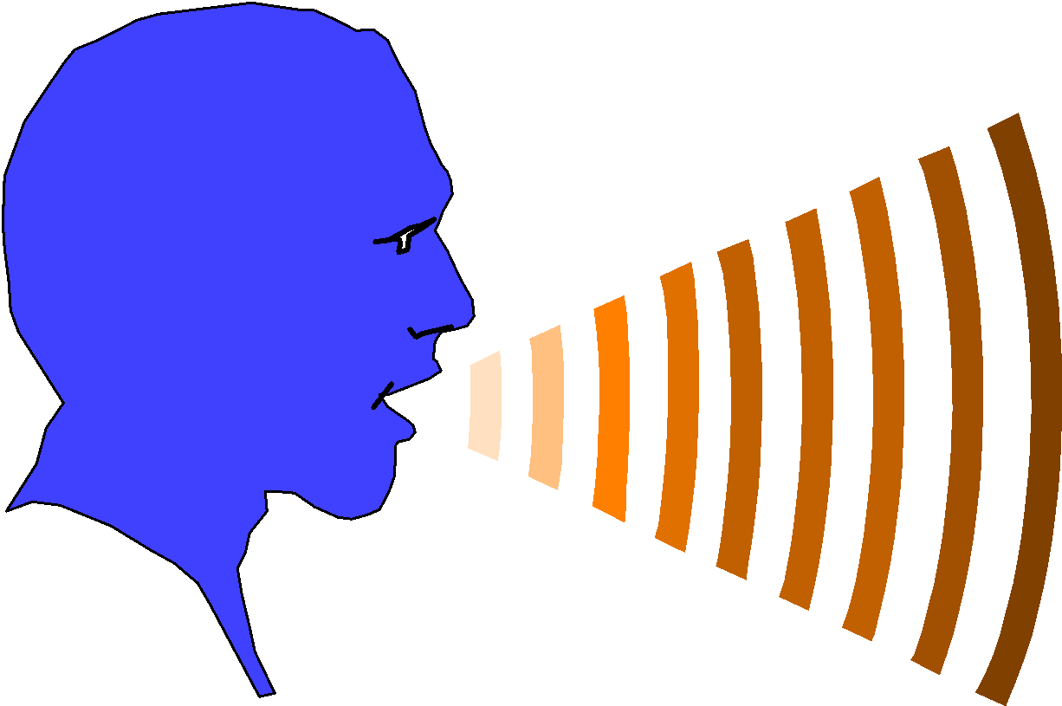
Giving Constructive Feedback
Encouraging
Actionable
Two-Way
Timely
Notes:
What is Feedback? In terms of two-way oral communication:
The ability to provide constructive feedback and to use feedback received in a positive way is an important element of effective communication.
Giving and receiving constructive feedback is useful in university for group learning environments and clinical placements; they are also essential skills for the workplace and life.
Feedback helps people to learn more about themselves. This may help to confirm the way they perform or function, or it may help them improve if the feedback suggests change is necessary. This will only happen if the feedback is constructive. Providing feedback to a peer or colleague is the ability to provide someone else with a critique about his or her work or performance.
Give examples of where this may occur on the course or in the profession.

Slide 19
Receiving Feedback
Be open & receptive
Listen to what is being said
Be aware of immediate reactions
Concentrate on content
Question if you don’t understand
Ask for help/suggestions/ideas
Notes:
Ask students try for examples before revealing the slide.
Gestures & Movements
o Head – nodding, shaking, tilted
o Arms – crossed, open
o Hands – in pockets, covering mouth
o Fingers – laced, pointing, playing with hair, tapping
o Legs & feet – crossed, tapping
Facial Expressions
o Whole face – smiling, frowning, surprise
o Eye Contact (very important)
o Eyebrows – raised, upturned
o Mouth – lips pursed, down-turned
Positioning & Orientation
o Where sitting or standing relative to others
Physical Contact
Posture/Stance
Feedback sounds – agreement, impatience, surprise, grunts
Tone
Students could model conversations, paying particular attention to body language.

Slide 20

Welcome feedback as a constructive way to help you develop and improve your skills and performance
Notes:
Listening is one part of the good communication loop;
The other part consists of the ability to send verbal messages constructively. Difficulties in expressing ourselves often arise when emotions become involved (which is frequent!). These difficulties may occur in a work situation, a professional relationship, personal interactions, educational exchanges, meetings or group settings – basically anytime people get together to communicate.
It is important that what we feel and/or think is congruent with what we say.

Slide 21

Working with Others
Notes:
1. Encouraging – Emphasise the positives as well as the negatives; give praise where it is due and be specific. If the information is negative, ensure the behaviour is under the control of the recipient, so they are able to change or improve.
2. Focus on behaviours – Concentrate on behaviour that the individual can change. Suggest alternative ways of behaving that allow them to consider how they might do things differently. Make sure the person has control over the behaviours.
3. Ensure understanding is two-way – Ask questions, check reactions, and ensure your comments have been received as you meant them. People cannot act on feedback if they don’t understand it.
4. Timely and in context – As soon as possible after the event. If you leave it too long, its usefulness will be lost.
5. Allow the recipient to accept or reject feedback – Give them time

Slide 22
Benefits of learning in groups
Experience, skills or knowledge of others
Support, encouragement, responsibility
Share work
Increase understanding
Differing perspectives
Others?
Notes:
Cooperative learning can lead to better results for students. It provides opportunities that are not always available to the individual learner. Some of the benefits are:
∙ Other members of the group may have knowledge, skills, abilities or experience which may help enrich a task or solve a difficulty
∙ A sense of responsibility to fellow students can provide good motivation; also sense of support and encouragement
∙ More complex problems can be solved by breaking them down into separate tasks for group members – for example, a reading list could be shared out and group members make their notes available to others
∙ Discussing a subject with others can often help understanding
∙ Opportunity to share ideas and differing perspectives thereby broadening student’s perspective
Learning in groups also develops necessary teamwork skills often required in professional work. This includes work done in groups and teams such as interpersonal, oral communication skills, self-appraisal as well as specific skills related to the task, i.e. time management or decision-making. “These personal and transferable skills are what employers say they want from graduates, and in some work areas, they can be more important than subject knowledge” (Jackson, 1999, p.2).

Slide 23
What is a group?
A group is a collection of individuals who come together for a particular reason or with a common aim.
Notes:
“Whenever people gather together in an organisation to engage in mutual consideration of work problems, a group has formed and a meeting is taking place” (Turner, 1983, p. 97).
Membership in groups is inevitable. People gather all the time to consider a mutual problem, to come together for a particular reason or with a common aim (Maskill & Race, 1996).
There are various types of groups, depending on the purpose, context, pattern of communication and functions. Basically, there are informal groups and formal groups.
In higher education, you will encounter formal groups in the format of small lectures, classes, seminars, tutorials, discussions, problem-based, projects, labs, and clubs or societies.
Examples of informal groups.

Slide 24
What is a group?
Task elements
Goals, Resources, Skills, Decisions
Process elements
Roles, Communication, Dynamics, Conflict Resolution
Notes:
Groups usually entail task and process elements.
The task element is to define the goal, to mobilise resources and skills and to make decisions to accomplish the task.
Process skills involve understanding the roles played by individuals in groups, to improve the communication between members in order to achieve best results, to understand dynamics of group and to handle conflict that may arise.

Slide 25
What is group dynamics?
Group dynamics examines the way people behave in groups and attempts to understand the factors that make a group more effective.
Notes:
Group dynamics is the term used to describe the way people behave in groups. It relates to the interactions and relationships.
Group dynamics affects the quality of communication, decision-making, interaction, cooperation, negotiation and trust. Establishing shared ways of operating and shared responsibilities is part of the process.
Understanding group dynamics helps people make a group more effective. Too much attention to tasks and not enough to process can inhibit effectiveness.
You may want to talk about roles and functions. Give or get students to give examples of how dynamics affects groups.

Slide 26
To be effective groups need to:
Achieve a task
Build and maintain the group
Develop / help individuals
Notes:
For groups to be effective they need to achieve a task, to build and maintain the group, and to develop individuals. This involves good communication as well as members taking responsibility for their own behaviour, observing ground rules, and confronting problems openly and constructively. Effective groups need to be ‘nurtured’.
If these three elements are looked after, all the benefits of working in groups will be achieved.

Slide 27
Effective groups:
Clear, relevant goals
Open communication
Cooperation
Members responsible for own behaviour
Processes for decisions established
Problems confronted openly
Conflict resolved constructively
Notes:
Go over importance of identifying goals and examples from discipline or course. It helps to define exactly what the task is, for example ask questions like:
What are we supposed to learn? What skills to develop?
What are we supposed to produce?
What criteria will be used to assess it?
What are the deadlines? Guidelines?
What do we want from the group project?
Establishing ground rules helps with communication, cooperation, decision making and responsibility.
Monitor progress.
Good communication includes being able to communicate feelings to other members of the group (e.g. if someone is not doing their work). It is usually better to speak directly to other people rather than about them.
Decision-making can be a difficult area for a group as it involves power issues and offers potential conflict. Decisions by consensus allows all members to be involved in the process; however, it also takes more time. All members need to express their opinions and then agreement reached usually by compromise.
Conflicts can arise for a variety of reasons and it is important to deal with these before they fester. Sometimes students seem to think they have to be friends with group members; it is important for them to realise this isn’t necessary in order for the task to be achieved.
Conflicts also provide positive outcomes. It is how conflicts are managed which determine if the outcome is positive or negative. Remember that controversy can be productive – it can lead to creativity! Go over suggestions.

Slide 28
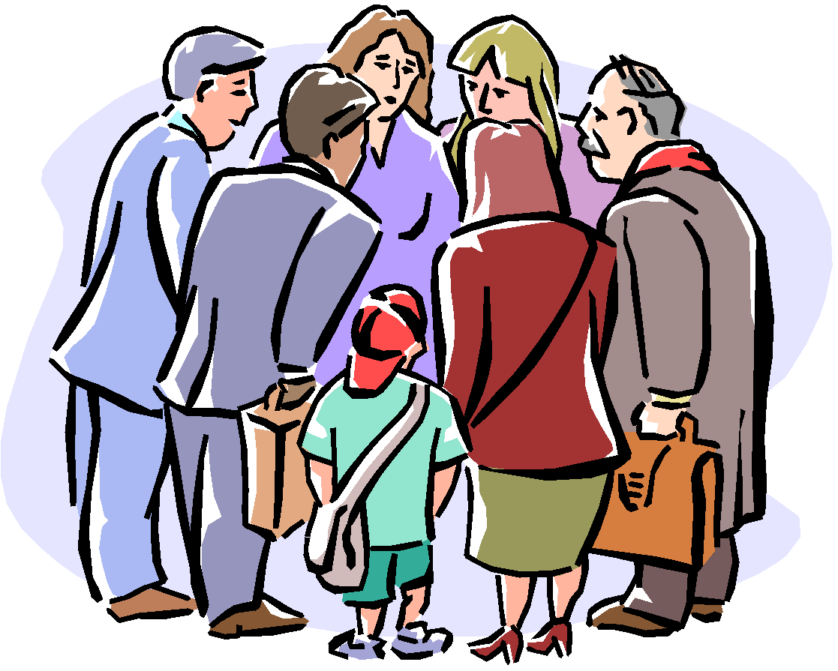
Groups need to be “nurtured”
What does this mean?
Notes:
Have students discuss guidelines described in handouts – this may be done in pairs or as a larger group – and their relevance and importance in their experience.

Slide 29

Giving presentations
Aim/purpose & context
Planning & preparation
Delivery
Overcoming nerves
Notes:
Usually work with others involves some form of presentation that may even be assessed.
Giving presentations is a key employment related skill that needs to be learned. This section provides information on helping you to become more confident speakers. Effective speaking is a skill that can be taught and practised.
First it is necessary to identify the purpose for the presentation.
Once the purpose or aim has been established, a good presentation can be divided into two components: 1) Planning/ preparation and 2) Delivery.
For many making a presentation or giving a talk is a daunting prospect. This may be a result of limited experience or a fear of being the centre of attention or a worry that they may not give a perfect performance. So we’ll be addressing how to overcome nerves.

Slide 30
Giving presentations
Purpose & Context:
To inform, train, persuade, entertain, sell or demonstrate?
Who is the audience?
How much time do you have?
Where is the venue?
Formal or informal?
Notes:
The purpose may be to inform, to discuss, to demonstrate or to persuade. Presentations can vary in length and formality. Furthermore they may take a narrative, analytical or persuasive form. Try to give your students a clear idea about these aspects of their presentation, including the type of assessment and criteria if applicable.

Slide 31
Giving presentations
Planning & Preparation:
Relevance to aim and audience!
Gather material relevant to message
Key points only!
Notes:
Knowing the audience for the presentation is a critical factor to success. The more known about the audience the more accurately the required information can be delivered. Two questions should be asked. First, who is the audience? Then, what do they want to hear? Is the audience fellow students, lecturers, professionals, others? Will they be familiar with the material to be presented? The answers to these questions will affect the language and complexity of information used. The key is to seek balance between giving clear explanations and avoiding ‘talking down’ to people.
It is a good idea to consult several types of sources (e.g. newspapers, journals, periodicals, government publications, Internet, reference books, etc.) for a higher quality presentation.
The key is to find a balance between too much information and poor preparation. The latter may be due to a lack of or inaccurate information. The presentation should be clear, accurate and analytical. Remember it must be relevant to the audience. Good knowledge of the subject provides confidence for getting up and delivering the presentation.

Slide 32
Giving presentations
Planning & Preparation:
Structure the material
Intro = catch attention
Middle = logical, chunks
End = summarise main points
Beginning
Middle
End
Notes:
The introduction must catch the audience’s attention; especially important are the first 5 minutes. Some useful techniques for achieving this include:
An overview of the presentation outlining the issues and objectives
∙ A statistic or shocking fact
∙ A quotation
∙ A question
∙ A humorous incident
∙ A headline
The middle or main portion of the presentation is where the argument or explanation is provided. This should consist of key points. A useful way to determine the best structure is to summarise notes gathered and focus on key points. Write them on cards or as a mind map (diagram) and then decide what order to present them in – should the most important go first or last, or should it be chronological? The ‘rule of three’ is a useful device. This involves building up a presentation across three points with the thrust on the last point (Aziz, 2000, p. 36).
The closing or conclusion summarises the main points. It is useful to include a concluding statement, perhaps related to the objectives stated in the introduction.

Slide 33

Giving presentations
Planning & Preparation:
Use of notes
Use of visual aids – KISS!
Rehearse
Notes:
It is a good idea to use speakers’ notes. One ways is to put everything down on note cards. Each card should contain one of the key ideas, followed by reminder words or examples. Notes help the speaker to remember information and to control nerves; however, they should not be read as a script.
Advise students of some useful tips for preparing visual aids:
∙ Use the KISS principle – Keep It Simple, Stupid!
∙ Avoid too much text on slides or overheads - No more than five lines per slide, no more than five words per line.
∙ Eliminate inefficient words such as a, an, the...
∙ Use visual symbols, such as ↑ for increase. Imagery is powerful.
∙ Use colour.
∙ Use headings and bullet points.
∙ If using PowerPoint (or other graphics packages) to generate slides or visual aids, use a minimum 24-point font.
∙ Make sure to have a hard copy standby.
∙ If using more advanced technology ensure the equipment is available and know how to use it.
It is important to rehearse a presentation as it provides useful information and helps to contain nerves. Rehearsing will give an indication of the length of the presentation, and provides the opportunity to reduce or increase the content.

Slide 34
Giving presentations
Delivery:
Check room, time, equipment
Awareness of self – voice, body language, confidence
Dealing with questions
Notes:
Arrive early to check the room and to check any equipment. Make sure you have a watch or can see a clock to keep to the timetable.
Use the first few moments to settle in, ask the audience if they can hear you, stating who you are.
Think positive and be aware of self as deliver presentation so can adjust accordingly.
Handling questions. If you are asked questions at the end but are not sure of the answer, say so. You are not expected to know everything. You can mention that you will attempt to find out for them or ask the audience if they know.

Slide 35
Giving presentations
Tips for delivering presentations:
Be aware of verbal language
Be aware of non-verbal language
Eye contact
Hands/gestures
Posture
Face audience
Clothes
Notes:
The main reason many people shy away from speaking in public is fear – the fear of going blank or of forgetting what you had planned to say, the fear of sounding stupid or of boring the audience to death. For some people, it is the deep fear that they are being judged – not just what they are saying.
There is a big difference between being nervous before speaking and feeling terrified. A certain amount of anxiety and tension before addressing a group is natural and even energising. The key to success is to focus on the positive implications of giving a presentation rather than on the negative ones.

Slide 36
Giving presentations
Reasons for feeling nervous:
Lack of experience
Lack of preparation
Lack of enthusiasm
Negative self-talk
Notes:
Advance preparation. Initial organisation of the material and your knowledge on the subject matter is important. The more you know about the subject to be presented, the more confident you will feel.
Rehearse the presentation! This may help to reduce feelings of nervousness and increase feelings of control.
Use relaxation techniques (like deep breath or three minute). These will help you to settle down and get control. Try taking several deep breaths, tensing and relaxing muscles and visualise a pleasant scene.
Keep positive thoughts in your head, don’t let the negative ones or the fears get control.
Anticipate potential problems. Ask yourself what is the worst that could happen and try to prepare for each potential disaster. For example:
∙ Handouts in case the OHP stops working
∙ Having your notes close to hand in case you suddenly forget what you are talking about
∙ A list of potentially awkward questions from the audience
∙ A glass of water in case your mouth goes dry
∙ Rehearse positive responses to potential problems

Slide 37

Giving presentations
Overcoming nerves:
Be over-prepared
Rehearse/practice
Use relaxation techniques
Think positive
Allow for all eventualities
Avoid stressors
Notes:
Be aware of verbal language.
∙ Pay attention to voice. Talk louder than normal and try to vary the pitch of your voice. Speak slowly enough for the audience to capture the meaning of what you are saying. Avoid a monotonous tone.
∙ Word choice. Long words are harder to understand than short words. Eliminate words or phrases that may be inappropriate, insulting or stereotyping. Avoid the overuse of similar words.
Be aware of non-verbal language.
∙ Keep eye contact. This helps to engage the audience and encourages their attention. Try to look at all members, however if you are nervous a useful tactic is to pick only one or two and imagine you are only addressing them, rather than a roomful of people.
∙ Use hands in a variety of gestures. Do not fidget with notes, play with clothes, etc. Use your hands to describe and reinforce your verbal message. Avoid pointing at the audience.
∙ Be aware of posture. Stand straight, with chest up and shoulders relaxed. A little movement is helpful so long as you do so with clear purpose. This allows your voice to project. Anchor yourself spreading feet apart (1.5 feet). This ensures you stand still and forces shoulders back and reduces anxiety.
∙ Face the audience. Bear in mind that your facial expression should reinforce your message. Smile from time to time. The warmth that you will emit can affect the listeners’ level of interest or motivation. Avoid turning your back to the audience and looking at the screen.
∙ Clothes. Do not wear clothes that distract attention from what you are saying. Dress comfortably and appropriately.

