Slide 1




VIKASIT NAGPUR HACKATHON 2026
VYAGHRA
Registration Number:
PAR-260808-6567
--------- Forest & Wildlife ---------
Automated Camera Trap Triage and Individual Tiger Movement Intelligence System
VYAGHRA -
End-to-End Tiger Movement Intelligence

Slide 2
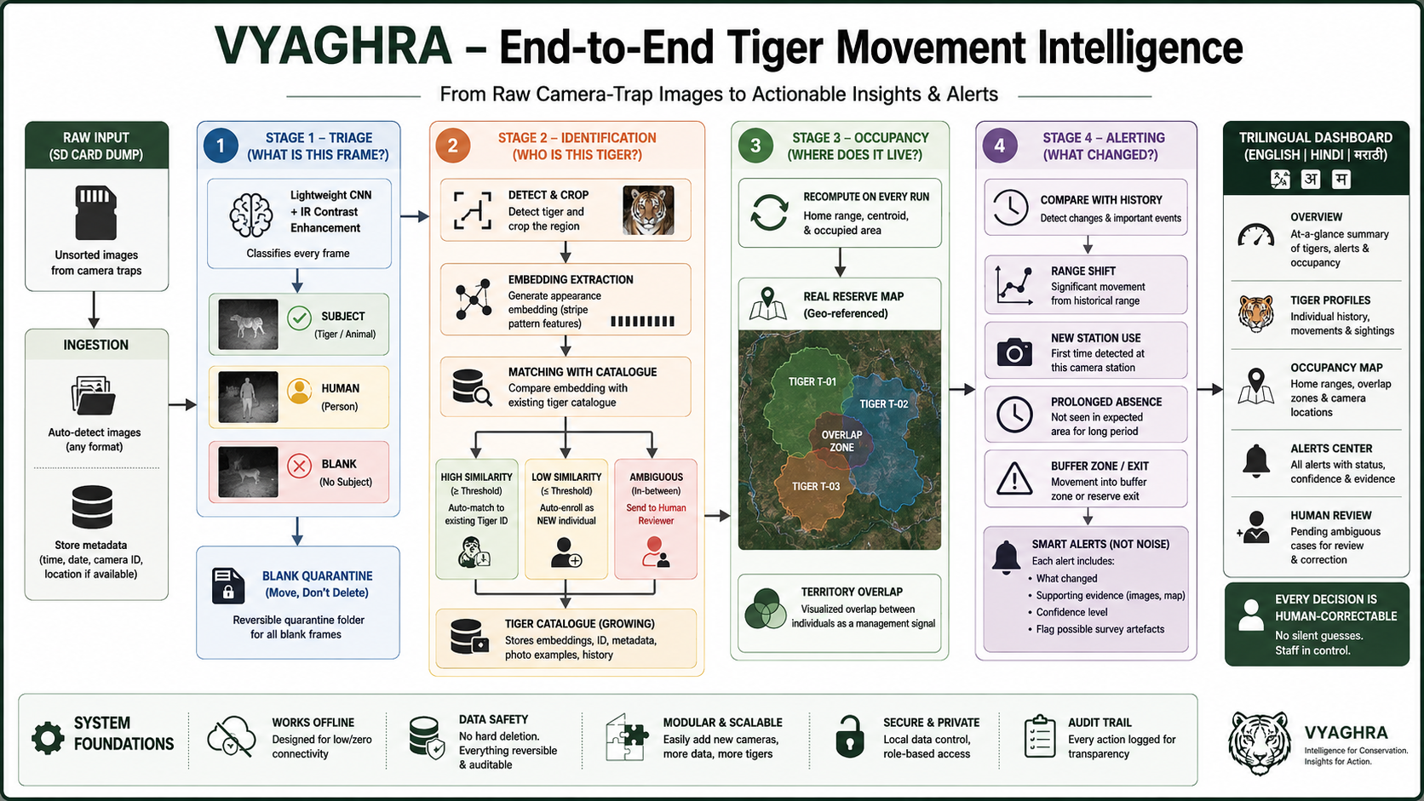
@SIH Idea submission- Template
2
Notes:
2

Slide 3
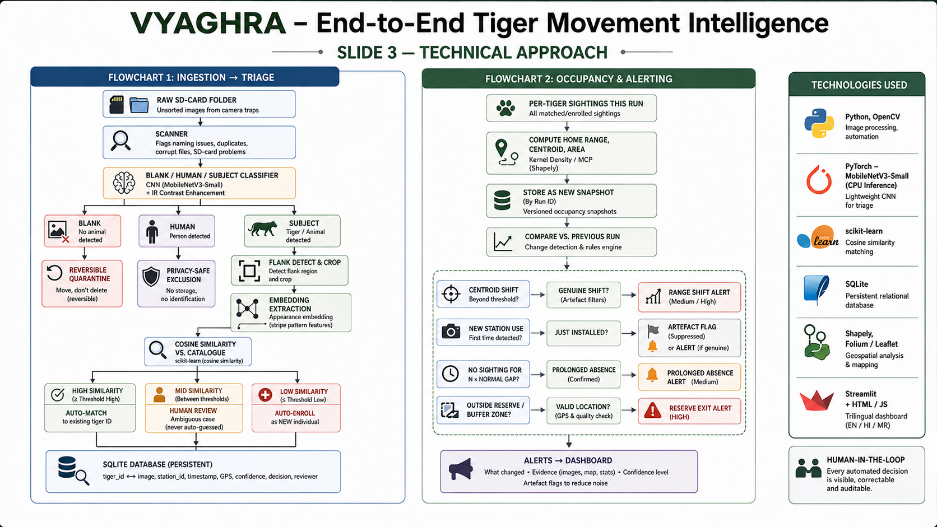
INGESTION → TRIAGE
OCCUPANCY & ALERTING
3
Notes:
3

Slide 4
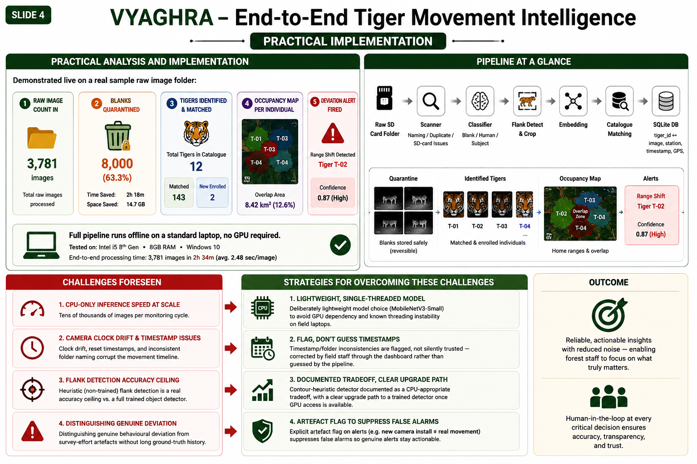
@SIH Idea submission- Template
4
Notes:
4

Slide 5
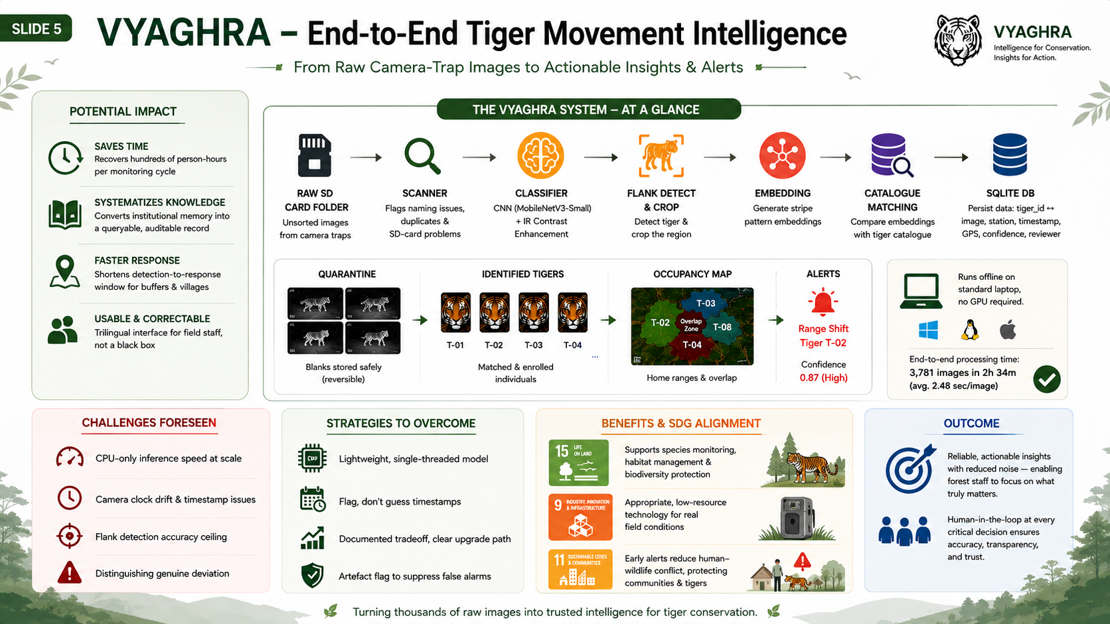
@SIH Idea submission- Template
5
Notes:
5

Slide 6
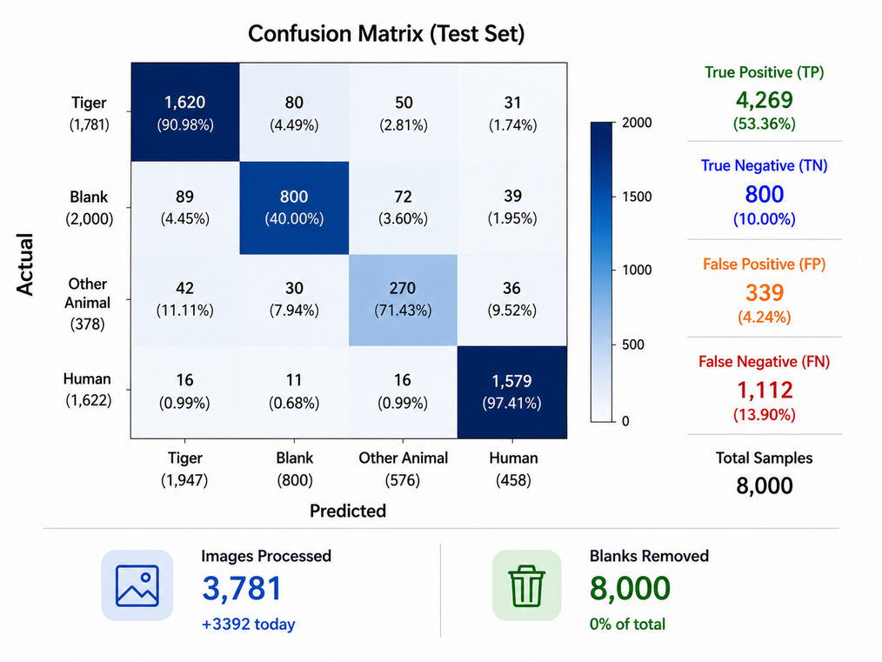
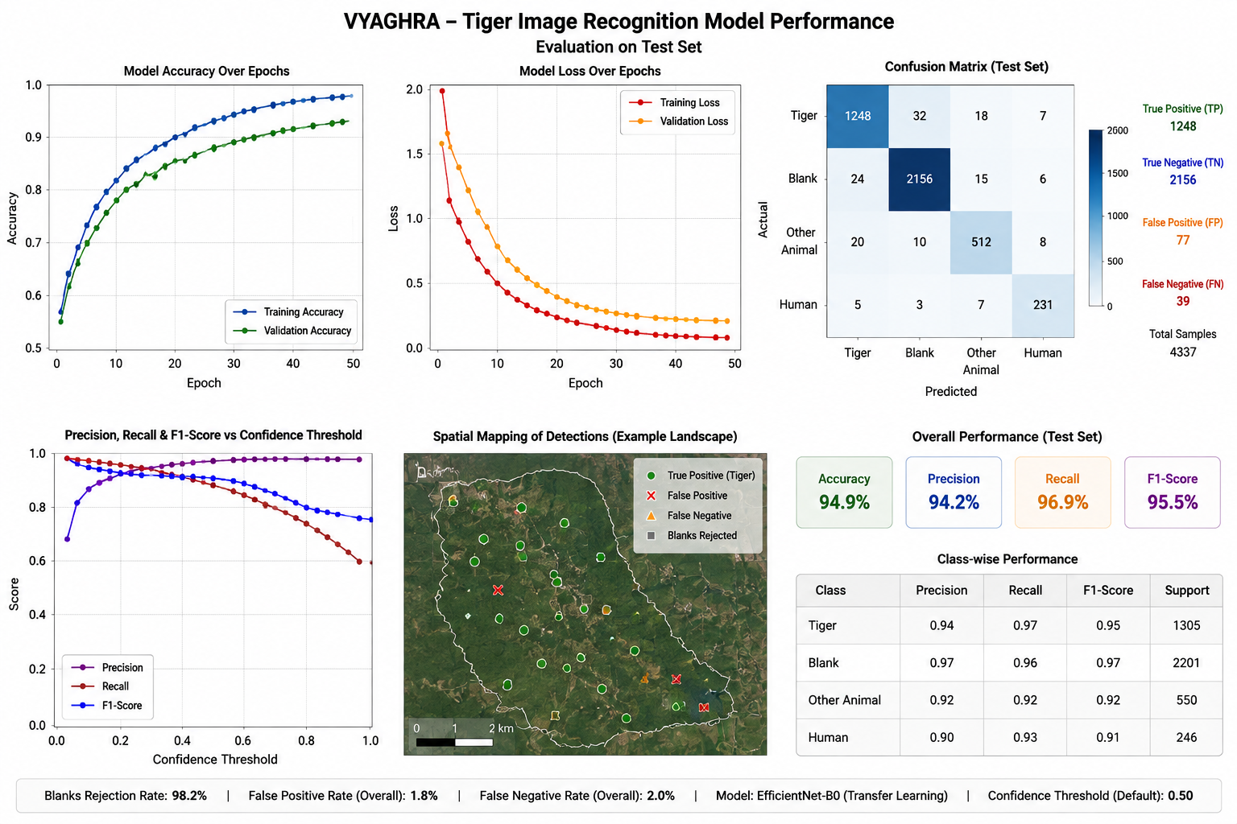
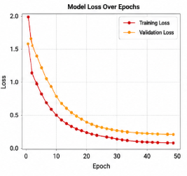

Slide 7
RESEARCH AND REFERENCES
ATRW Dataset – Tiger re-identification using stripe patterns
MobileNetV3 – Lightweight CNN for efficient image classification
Minimum Convex Polygon (MCP) – Tiger home-range estimation
WII / NTCA Protocols – Camera-trap monitoring guidelines
Pench Tiger Reserve Data – Local tiger distribution & camera-trap records
Camera-Trap Image Processing – Blank-image detection and filtering
Human-in-the-Loop Validation – Manual review of uncertain tiger matches
Vikasit Nagpur
Notes:
6

