Slide 1
















Introduction to
Wireless LAN
ADITYA THAKUR 122 B

Slide 2



What is WLAN?
A wireless local area network (WLAN) is a group of colocated computers or other devices that form a network based on radio transmissions rather than wired connections.
A Wi-Fi network is a type of WLAN

Slide 3
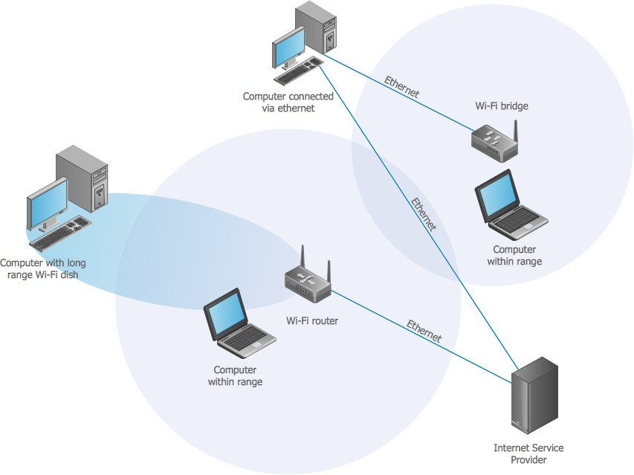

Slide 4
Benefits of WLAN....
Extended reach: WLANs enable computing to happen anywhere, even when carrying high data loads and advanced web applications.
Device flexibility: A WLAN supports use of a wide range of devices, such as computers, phones, tablets, gaming systems, and IoT devices.
Easier installation and management: A WLAN requires less physical equipment than a wired network, which saves money, reduces installation time.
Scalability: Easily scalable. Adding users is as simple as assigning login credentials.
Network management: Nearly all management of a WLAN can be handled virtually.

Slide 5
Drawback of WLAN....
Slower bandwidth: Wireless LANs offer slower speeds than wired connections.
Security risk: Wireless LANs are vulnerable to unauthorized access. Limited capacity: Wireless networks can't handle many connections. Higher cost: Wireless setups are more expensive than wired ones.
Health concerns: Wireless devices emit potentially harmful RF radiation.

Slide 6
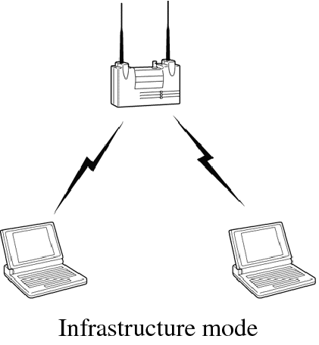
How is a WLAN created?
A WLAN can be configured in one of two ways:
Infrastructure
A home or office Wi-Fi network is an example of a WLAN set up in infrastructure mode. The endpoints are all connected and communicate with each other through a base station, which may also provide internet access.
A basic infrastructure WLAN can be set up with just a few parts: a wireless router, which acts as the base station, and endpoints, which can be computers, mobile devices, printers, and other devices

Slide 7
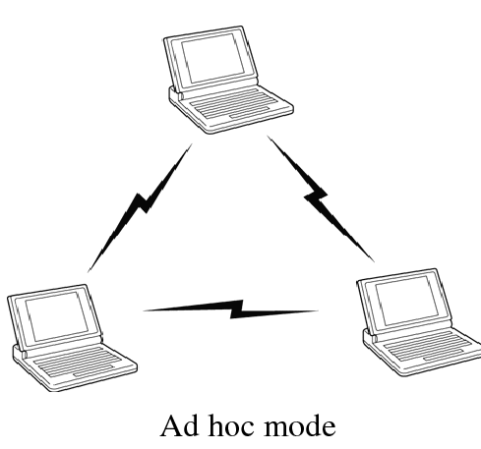
Ad hoc
In this setup, a WLAN connects endpoints such as computer workstations and mobile devices without the use of a base station. Use of Wi-Fi Direct technology is common for an ad hoc wireless network. An ad hoc WLAN is easy to set up and can provide basic peer-to-peer (P2P) communication.
An ad hoc WLAN requires only two or more endpoints with built-in radio transmission, such as computers or mobile devices. After adjusting network settings for ad hoc mode, one user initiates the network and becomes visible to the others.

Slide 8
THANKYOU

