Slide 1
Lecture 7: Classification
CS 550: Machine Learning
Dr. Gagan Raj Gupta

Slide 2
Multiple Supervised Learning Formulations …
Consider building an ML module for an e-mail client
Some tasks that we may want this module to perform
Predicting whether an email of spam or normal: Binary Classification
Predicting which of the many folders the email should be sent to: Multi-class Classification
Predicting all the relevant tags for an email: Tagging or Multi-label Classification
Predicting what’s the spam-score of an email: Regression
Predicting which email(s) should be shown at the top: Ranking
Predicting which emails are work/study-related emails: One-class Classification ?
These predictive modeling tasks can be formulated as supervised learning problems
Let’s look at some basic classification algorithms and evaluation metrics

Slide 3

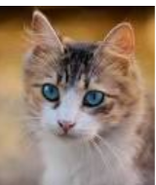


Learning by Examples
The idea also applies to multi-class classification: Use one image per class, and predict label based on the distances of the test image from all such images
Consider a binary classification problem – cat vs dog
Assume training data with just 2 images – one and one
Given a new test image (cat/dog), how do we predict its label?
A simple idea: Predict using its distance from each of the 2 training images
d( , ) < d( , ) ? Predict cat else dog
Test
image
Test
image
Wait. Is it ML? Seems to be like just a simple “rule”. Where is the “learning” part in this?
Some possibilities: Use a feature learning/selection algorithm to extract features, and use a Mahalanobis distance where you learn the W matrix (instead of using a predefined W), using “distance metric learning” techniques
Excellent question! Glad you asked!
Even this simple model can be learned. For example, for the feature extraction/selection part and/or for the distance computation part

Slide 4

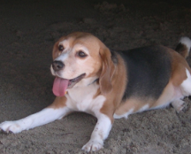

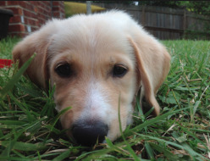
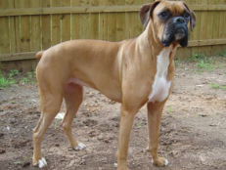

Capturing Variations by using more Training Data
Just one input per class may not sufficiently capture variations in a class
A natural improvement can be by using more inputs per class
We will consider two approaches to do this
Learning with Prototypes (LwP)
K-Nearest Neighbors (KNN)
Both LwP and KNN will use multiple inputs per class but in different ways
“cat”
“dog”
“cat”
“dog”
“cat”
“dog”

Slide 5
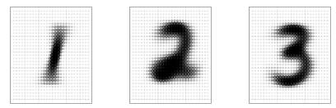
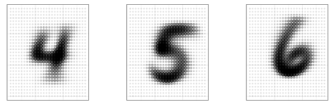

Learning with Prototypes (LwP)
Basic idea: Represent each class by a “prototype” vector
Class Prototype: The “mean” or “average” of inputs from that class
Predict label of each test input based on its distances from the class prototypes
Predicted label will be the class that is the closest to the test input
How we compute distances can have an effect on the accuracy of this model (may need to try Euclidean, weight Euclidean, Mahalanobis, or something else)
Averages (prototypes) of each of the handwritten digits 1-9
Pic from: https://www.reddit.com/r/dataisbeautiful/comments/3wgbv9/average_handwritten_digit_oc/

Slide 6





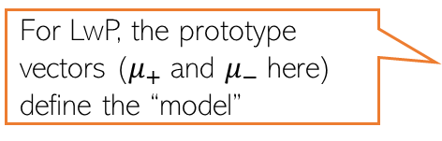
Learning with Prototypes (LwP): An Illustration
Suppose the task is binary classification (two classes assumed pos and neg)
Training data: $N$ labelled examples ${\{\left(x_{n},y_{n}\right)\}}_{n=1}^{N}$,${ x}_{n}∈ℝ^{D}$, ${ y}_{n} ∈\{−1,+1\}$
Assume $N_{+}$ example from positive class, $N_{−}$ examples from negative class
Assume green is positive and red is negative
$$μ_{−}= \frac{1}{N_{−}}\sum_{y_{n}=−1}{x_{n}}$$
$$μ_{+}= \frac{1}{N_{+}}\sum_{y_{n}=+1}{x_{n}}$$
$$μ_{−}$$
$$μ_{+}$$
LwP straightforwardly generalizes to more than 2 classes as well (multi-class classification) – K prototypes for K classes
For LwP, the prototype vectors ($μ_{+}$and $μ_{−}$here) define the “model”
Test example
Test example

Slide 7



LwP: The Prediction Rule, Mathematically
What does the prediction rule for LwP look like mathematically?
Assume we are using Euclidean distances here
$${\left|\left|μ_{−}−x\right|\right|}^{2}={\left|\left|μ_{−}\right|\right|}^{2}+{\left|\left|x\right|\right|}^{2}−2\left\langle μ_{−},x\right\rangle$$
$$μ_{−}$$
$$μ_{+}$$
$${\left|\left|μ_{+}−x\right|\right|}^{2}={\left|\left|μ_{+}\right|\right|}^{2}+{\left|\left|x\right|\right|}^{2}−2\left\langle μ_{+},x\right\rangle$$
Test example $x$
Prediction Rule: Predict label as +1 if $f\left(x\right)={\left|\left|μ_{−}−x\right|\right|}^{2}$ $−$ ${\left|\left|μ_{+}−x\right|\right|}^{2}>0$ otherwise -1

Slide 8

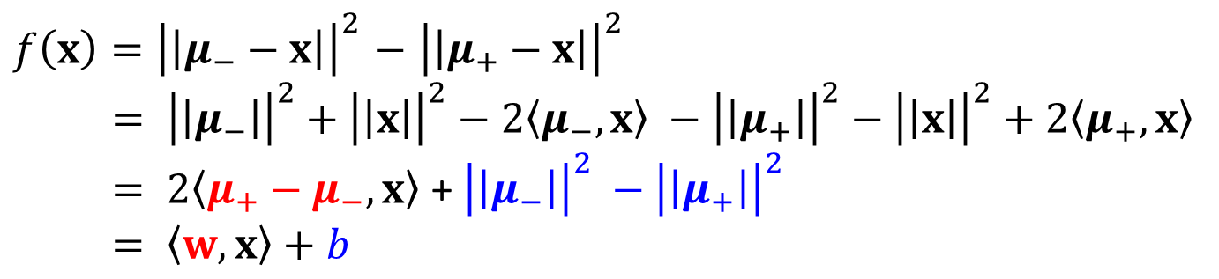
LwP: The Prediction Rule, Mathematically
Let’s expand the prediction rule expression a bit more
Thus LwP with Euclidean distance is equivalent to a linear model with
Weight vector $w=$2($μ_{+}−μ_{−})$
Bias term $b={\left|\left|μ_{−}\right|\right|}^{2} −{\left|\left|μ_{+}\right|\right|}^{2}$
Prediction rule therefore is: Predict +1 if $\left\langle w,x\right\rangle +b$ > 0, else predict -1
$f\left(x\right)={\left|\left|μ_{−}−x\right|\right|}^{2}$ $−$ ${\left|\left|μ_{+}−x\right|\right|}^{2}$
$= {\left|\left|μ_{−}\right|\right|}^{2}+{\left|\left|x\right|\right|}^{2}−2\left\langle μ_{−},x\right\rangle −{\left|\left|μ_{+}\right|\right|}^{2}−{\left|\left|x\right|\right|}^{2}+2\left\langle μ_{+},x\right\rangle$
$= 2\left\langle μ_{+}−μ_{−},x\right\rangle$ + ${\left|\left|μ_{−}\right|\right|}^{2} −{\left|\left|μ_{+}\right|\right|}^{2}$
$= \left\langle w,x\right\rangle +b$
Will look at linear models more formally and in more detail later

Slide 9



LwP: Some Failure Cases
Here is a case where LwP with Euclidean distance may not work well
In general, if classes are not equisized and spherical, LwP with Euclidean distance will usually not work well (but improvements possible; will discuss later)
Can use feature scaling or use Mahalanobis distance to handle such cases (will discuss this in the next lecture)
$$μ_{−}$$
$$μ_{+}$$
Test example $x$

Slide 10
LwP: Some Key Aspects
Very simple, interpretable, and lightweight model
Just requires computing and storing the class prototype vectors
Works with any number of classes (thus for multi-class classification as well)
Can be generalized in various ways to improve it further, e.g.,
Modeling each class by a probability distribution rather than just a prototype vector
Using distances other than the standard Euclidean distance (e.g., Mahalanobis)
With a learned distance function, can work very well even with very few examples from each class (used in some “few-shot learning” models nowadays – if interested, please refer to “Prototypical Networks for Few-shot Learning”)
How well LwP works depends crucially on the way we compute distances

Slide 11
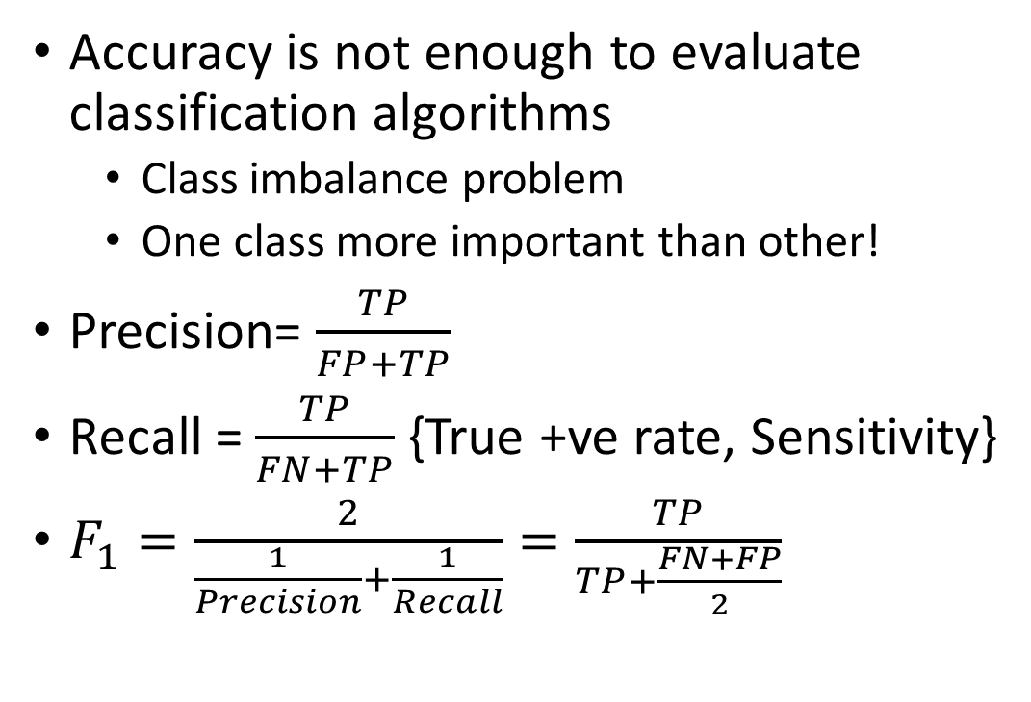
Confusion Matrix
Accuracy is not enough to evaluate classification algorithms
Class imbalance problem
One class more important than other!
Precision= $\frac{TP}{FP+TP}$
Recall = $\frac{TP}{FN+TP}$ {True +ve rate, Sensitivity}
$F_{1}=\frac{2}{\frac{1}{Precision}+\frac{1}{Recall}}=\frac{TP}{TP+\frac{FN+FP}{2}}$
Discuss:
Safe Video for Kids
Surveillance

Slide 12
Precision/Recall Tradeoff
Why is this not smooth?

Slide 13
Precision vs Recall Curve

Slide 14
ROC Curve
True +ve rate = Recall = $\frac{TP}{TP+FN}$ {Sensitivity}
False +ve Rate = $1−\frac{TN}{FP+TN}=\frac{FP}{FP+TN}$ {Specificity}
We want to choose that classifier that maximizes the area under the curve
Precision-Recall curve preferred when the +ve class is rare
OR when you want to reduce the false +ves.

Slide 15
Which classifier is better?

Slide 16
Multiclass Classification (MNIST digits)
Confusion Matrix
Relative Errors
Looking at this plot, it seems that your efforts should be spent on reducing the false 8s.
More training data for digits that look like 8s (but are not) so the classifier can learn to distinguish them from real 8s.
Engineer new features to help classifier—E.g. Count the # of closed loops (e.g., 8 has two, 6 has one, 5 has none).
Preprocess the images (e.g., using Scikit-Image, Pillow, or OpenCV) to make some patterns stand out more, such as closed loops.

Slide 17
Learning with Prototypes (LwP)
$$μ_{−}= \frac{1}{N_{−}}\sum_{y_{n}=−1}{x_{n}}$$
$$μ_{+}= \frac{1}{N_{+}}\sum_{y_{n}=+1}{x_{n}}$$
$$μ_{−}$$
$$μ_{+}$$
$$w$$
$$w=μ_{+} −μ_{−}$$
Prediction rule for LwP (for binary classification with Euclidean distance)
If Euclidean distance used
$f\left(x\right)= 2\left\langle μ_{+}−μ_{−},x\right\rangle$ + ${\left|\left|μ_{−}\right|\right|}^{2} −{\left|\left|μ_{+}\right|\right|}^{2}= \left\langle w,x\right\rangle +b$
For LwP, the prototype vectors (or their difference) define the “model”. $μ_{+}$and $μ_{−}$ (or just $w$ in the Euclidean distance case) are the model parameters.
Decision boundary
(perpendicular bisector of line joining the class prototype vectors)
($f\left(x\right)$> 0 then predict +1 otherwise -1)
Exercise: Show that for the bin. classfn case
$$f\left(x\right)=\sum_{n=1}^{N}{α_{n}\left\langle x_{n},x\right\rangle +b}$$
Note: Even though$f\left(x\right)$ can be expressed in this form, if N > D, this may be more expensive to compute (O(N) time)as compared to $\left\langle w,x\right\rangle +b$ (O(D) time).
Can throw away training data after computing the prototypes and just need to keep the model parameters for the test time in such “parametric” models
So the “score” of a test point $x$ is a weighted sum of its similarities with each of the N training inputs. Many supervised learning models have $f\left(x\right)$ in this form as we will see later
However the form $f\left(x\right)=\sum_{n=1}^{N}{α_{n}\left\langle x_{n},x\right\rangle +b}$is still very useful as we will see later when we discuss kernel methods

Slide 18
Improving LwP when classes are complex-shaped
Using weighted Euclidean or Mahalanobis distance can sometimes help
Note: Mahalanobis distance also has the effect of rotating the axes which helps
$$μ_{+}$$
$$d_{w}\left(a,b\right)=\sqrt{\sum_{i=1}^{D}{{w_{i}\left(a_{i}−b_{i}\right)}^{2}}}$$
$$μ_{−}$$
Use a smaller $w_{i}$ for the horizontal axis feature in this example
A good W will help bring points from same class closer and move different classes apart
W will be a 2x2 symmetric matrix in this case (chosen by us or learned)
$$μ_{−}$$
$$d_{w}\left(a,b\right)=\sqrt{{\left(a−b\right)}^{⊤}W\left(a−b\right)}$$
$$μ_{+}$$
$$μ_{+}$$
$$μ_{−}$$

Slide 19
Improving LwP when classes are complex-shaped
Even with weighted Euclidean or Mahalanobis dist, LwP still a linear classifier ☹
Exercise: Prove the above fact. You may use the following hint
Mahalanobis dist can be written as $d_{w}\left(a,b\right)=\sqrt{{\left(a−b\right)}^{⊤}W\left(a−b\right)}$
$W$ is a symmetric matrix and thus can be written as $AA⊤$ for any matrix $A$
Showing for Mahalabonis is enough. Weighted Euclidean is a special case with diag $W$
LwP can be extended to learn nonlinear decision boundaries if we use nonlinear distances/similarities(more on this when we talk about kernels)
Note: Modeling each class by not just a mean by a probability distribution can also help in learning nonlinear decision boundaries. More on this when we discuss probabilistic models for classification

Slide 20
LwP as a subroutine in other ML models
For data-clustering (unsupervised learning), K-means clustering is a popular algo
K-means also computes means/centres/prototypes of groups of unlabeled points
Harder than LwP since labels are unknown. But we can do the following
Guess the label of each point, compute means using guess labels
Refine labels using these means (assign each point to the current closest mean)
Repeat until means don’t change anymore
Many other models also use LwP as a subroutine
Will see K-means in detail later

Slide 21
Supervised Learning using Nearest Neighbors

Slide 22

Nearest Neighbors
Another supervised learning technique based on computing distances
Very simple idea. Simply do the following at test time
Compute distance of of the test point from all the training points
Sort the distances to find the “nearest” input(s) in training data
Predict the label using majority or avg label of these inputs
Can use Euclidean or other dist (e.g., Mahalanobis). Choice imp just like LwP
Unlike LwP which does prototype based comparison, nearest neighbors method looks at the labels of individual training inputs to make prediction
Applicable to both classifn as well as regression (LwP only works for classifn)
Wait. Did you say distance from ALL the training points? That’s gonna be sooooo expensive! ☹
Yes, but let’s not worry about that at the moment. There are ways to speed up this step

Slide 23
Nearest Neighbors for Classification

Slide 24
Nearest Neighbor (or “One” Nearest Neighbor)
Decision boundary
Interesting. Even with Euclidean distances, it can learn nonlinear decision boundaries?
Indeed. And that’s possible since it is a “local” method (looks at a local neighborhood of the test point to make prediction)
Nearest neighbour approach induces a Voronoi tessellation/partition of the input space (all test points falling in a cell will get the label of the training input in that cell)
Test point
Test point

Slide 25
K Nearest Neighbors (KNN)
In many cases, it helps to look at not one but $K$ > 1 nearest neighbors
Essentially, taking more votes helps!
Also leads to smoother decision boundaries (less chances of overfitting on training data)
$K$ = 1
Test input
$K$ = 3
How to pick the “right” K value?
K is this model’s “hyperparameter”. One way to choose it is using “cross-validation” (will see shortly)
Also, K should ideally be an odd number to avoid ties

Slide 26
$ε$-Ball Nearest Neighbors ($ε$-NN)
Rather than looking at a fixed number $K$ of neighbors, can look inside a ball of a given radius $ε$, around the test input
So changing $ε$ may change the prediction. How to pick the “right” $ε$ value?
Test input
Just like K, $ε$ is also a “hyperparameter”. One way to choose it is using “cross-validation” (will see shortly)

Slide 27
Distance-weighted KNN and $ε$-NN
The standard KNN and 𝜖-NN treat all nearest neighbors equally (all vote equally)
An improvement: When voting, give more importance to closer training inputs
$K$ = 3
Test input
$$\frac{1}{3}$$
+
$$\frac{1}{3}$$
+
$$\frac{1}{3}$$
=
In weighted approach, a single red training input is being given 3 times more importance than the other two green inputs since it is sort of “three times” closer to the test input than the other two green inputs
Unweighted KNN prediction:
$$\frac{3}{5}$$
+
$$\frac{1}{5}$$
+
$$\frac{1}{5}$$
=
Weighted KNN prediction:
$ε$-NN can also be made weighted likewise

Slide 28
KNN/$ε$-NN for Other Supervised Learning Problems
Can apply KNN/𝜖-NN for other supervised learning problems as well, such as
Multi-class classification
Regression
Tagging/multi-label learning
For multi-class, simply used the same majority rule like in binary classfn case
Just a simple difference that now we have more than 2 classes
For regression, simply compute the average of the outputs of nearest neighbors
For multi-label learning, each output is a binary vector (presence/absence of tag)
Just compute the average of the binary vectors
Result won’t be a binary vector but we can report the best tags based on magnitudes
We can also try the weighted versions for such problems, just like we did in the case of binary classification

Slide 29
KNN Prediction Rule: The Mathematical Form
Let’s denote the set of K nearest neighbors of an input $x$ by $N_{K}\left(x\right)$
The unweighted KNN prediction $y$ for a test input $x$ can be written as
This form makes direct sense of regression and for cases where the each output is a vector (e.g., multi-class classification where each output is a discrete value which can be represented as a one-hot vector, or tagging/multi-label classification where each output is a binary vector)
For binary classification, assuming labels as +1/-1, we predict $sign(\frac{1}{K} \sum_{i∈N_{K}(x)}{y_{i}}$)
Assuming discrete labels with 5 possible values, the one-hot representation will be a all zeros vector of size 5, except a single 1 denoting the value of the discrete label, e.g., if label = 3 then one-hot vector = [0,0,1,0,0]
$$y= \frac{1}{K} \sum_{i∈N_{K}(x)}{y_{i}}$$

Slide 30
Nearest Neighbors: Some Comments
An old, classic but still very widely used algorithm
Can sometimes give deep neural networks a run for their money ☺
Can work very well in practical with the right distance function
Comes with very nice theoretical guarantees
Also called a memory-based or instance-based or non-parametric method
No “model” is learned here (unlike LwP). Prediction step uses all the training data
Requires lots of storage (need to keep all the training data at test time)
Prediction step can be slow at test time
For each test point, need to compute its distance from all the training points
Clever data-structures or data-summarization techniques can provide speed-ups

Slide 31
Decision Trees
A Decision Tree (DT) defines a hierarchy of rules to make a prediction
Root and internal nodes test rules. Leaf nodes make predictions
Decision Tree (DT) learning is about learning such a tree from labeled data
Root Node
Body
temp.
Warm
Cold
Non-mammal
An Internal Node
A Leaf Node
Gives
birth
Yes
No
Mammal
Non-mammal

Slide 32
Decision Trees for Supervised Learning
The basic idea is very simple
Recursively partition the training data into homogeneous regions
Within each group, fit a simple supervised learner (e.g., predict the majority label)
What do you mean by “homogeneous” regions?
Even though the rule within each group is simple, we are able to learn a fairly sophisticated model overall (note in this example, each rule is a simple horizontal/vertical classifier but the overall decision boundary is rather sophisticated)
A homogeneous region will have all (or a majority of) training inputs with the same/similar outputs

Slide 33





Decision Trees for Classification
5
NO
YES
Test input
$$x_{1}>3.5 ?$$
4
NO
YES
NO
YES
3
$$x_{2}>2 ?$$
$$x_{2}>3 ?$$
Feature 2 ($x_{2})$
2
Predict Red
Predict Green
Predict Green
Predict Red
1
1
2
3
4
5
6
Feature 1 ($x_{1})$
Remember: Root node contains all training inputs
Each leaf node receives a subset of training inputs
DT is very efficient at test time: To predict the label of a test point, nearest neighbors will require computing distances from 48 training inputs. DT predicts the label by doing just 2 feature-value comparisons! Way more fast!!!

Slide 34
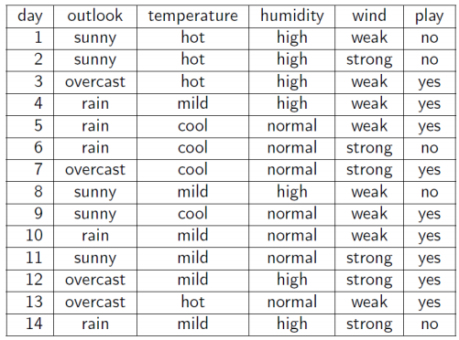
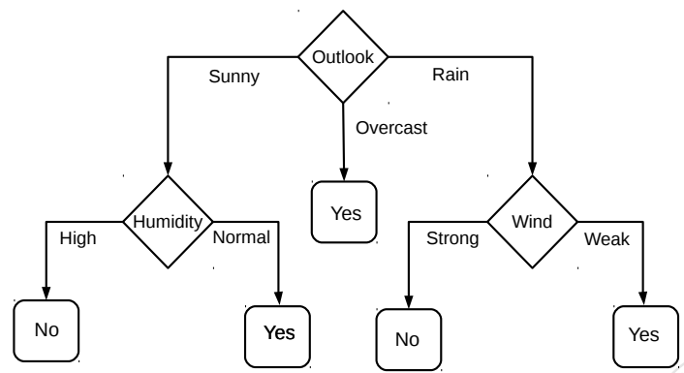
Decision Trees for Classification: Another Example
Deciding whether to play or not to play Tennis on a Saturday
Each input (Saturday) has 4 categorical features: Outlook, Temp., Humidity, Wind
A binary classification problem (play vs no-play)
Below Left: Training data, Below Right: A decision tree constructed using this data
Example credit: Tom Mitchell

Slide 35
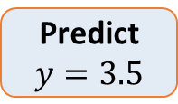


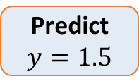

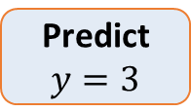

Decision Trees for Regression
Can use any regression model but would like a simple one, so let’s use a constant prediction based regression model
Another simple option can be to predict the average output of the training inputs in this region
4
3
2
1
NO
YES
$$x>4 ?$$
$$y$$
NO
YES
Predict $y=3.5$
$$x_{2}>3 ?$$
Predict $y=3$
Predict $y=1.5$
1 2 3 4 5
$$x$$
To predict the output for a test point, nearest neighbors will require computing distances from 15 training inputs. DT predicts the label by doing just at most feature-value comparisons! Way more fast!!!

Slide 36
Decision Trees: Some Considerations
Usually, cross-validation can be used to decide size/shape
What should be the size/shape of the DT?
Number of internal and leaf nodes
Branching factor of internal nodes
Depth of the tree
Split criterion at internal nodes
Use another classifier?
Or maybe by doing a simpler test?
What to do at the leaf node? Some options:
Make a constant prediction for each test input reaching there
Use a nearest neighbor based prediction using training inputs at that leaf node
Train and predict using some other sophisticated supervised learner on that node
Usually, constant prediction at leaf nodes used since it will be very fast

Slide 37
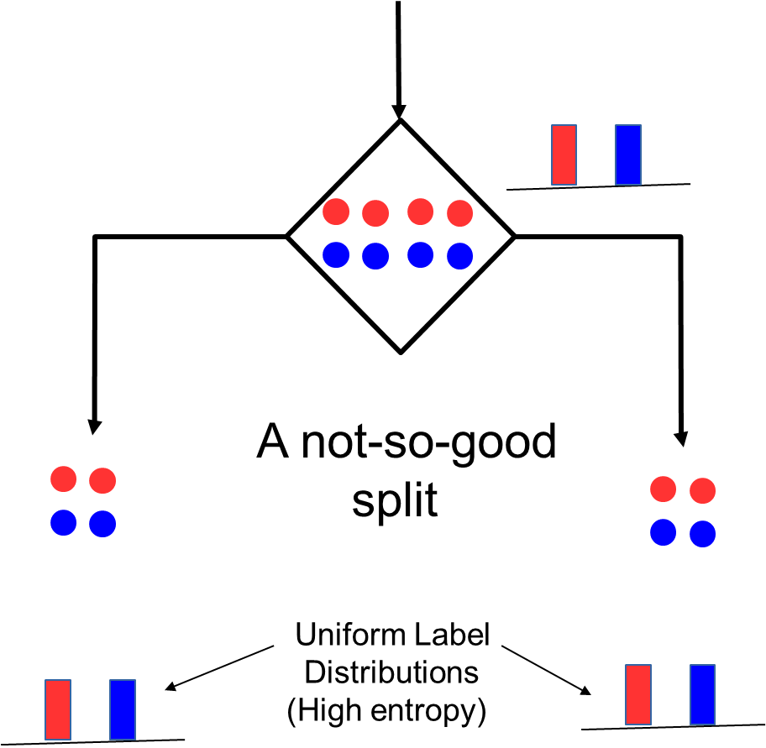
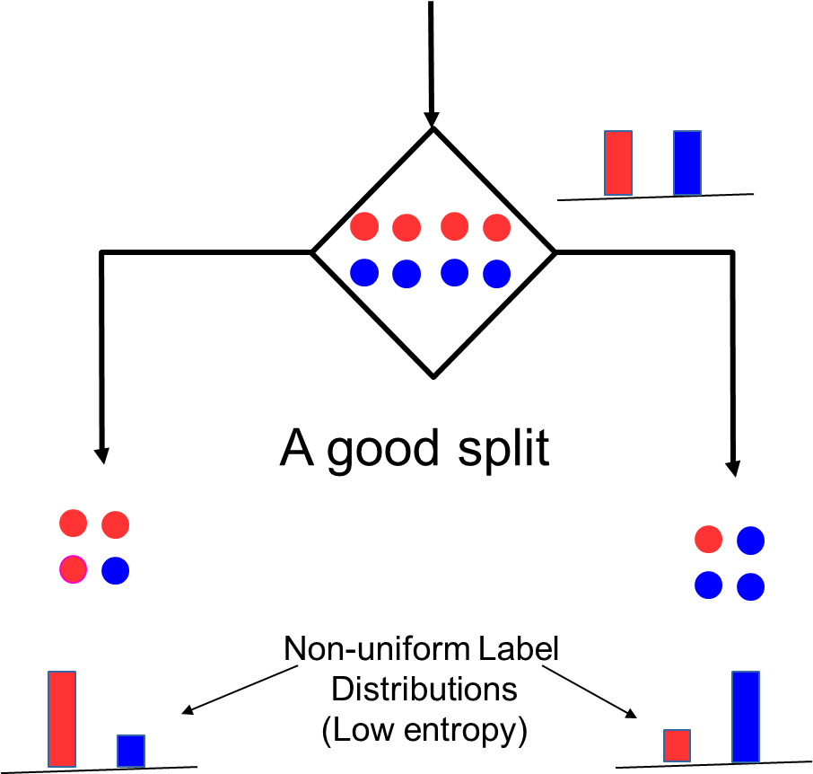
How to Split at Internal Nodes?
37
Recall that each internal node receives a subset of all the training inputs
Regardless of the criterion, the split should result in as “pure” groups as possible
A pure group means that the majority of the inputs have the same label/output
For classification problems (discrete outputs), entropy is a measure of purity
Low entropy ⇒ high purity (less uniform label distribution)
Splits that give the largest reduction (before split vs after split) in entropy are preferred (this reduction is also known as “information gain”)

Slide 38
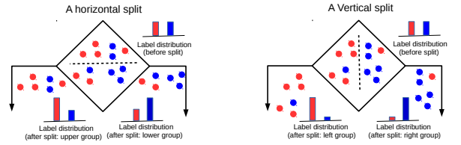
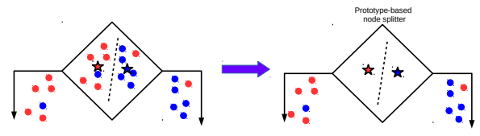
Techniques to Split at Internal Nodes?
38
Each internal node decides which outgoing branch an input should be sent to
This decision/split can be done using various ways, e.g.,
Testing the value of a single feature at a time (such internal node called “Decision Stump”)
Learning a classifier (e.g., LwP or some more sophisticated classifier)
With this approach, all features and all possible values of each feature need to be evaluated in selecting the feature to be tested at each internal node
(can be slow but can be made faster using some tricks)
DT methods based on testing a single feature at each internal node are faster and more popular (e.g., ID3, C4.5 algos)
DT methods based on learning and using a separate classifier at each internal node are less common. But this approach can be very powerful and are sometimes used in some advanced DT methods

Slide 39
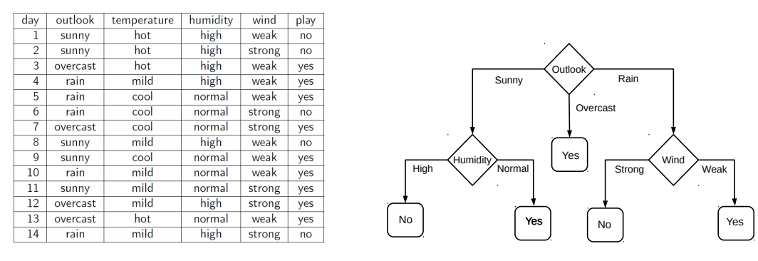
Decision Tree Construction: An Example
39
Let’s consider the playing Tennis example
Assume each internal node will test the value of one of the features
Question: Why does it make more sense to test the feature “outlook” first?
Answer: Of all the 4 features, it’s the most informative
It has the highest information gain as the root node

Slide 40


Constructing Decision Trees
Given some training data, what’s the “optimal” DT?
5
How to decide which rules to test for and in what order?
NO
YES
$$x_{1}>3.5 ?$$
4
NO
YES
NO
YES
How to assess informativeness of a rule?
3
$$x_{2}>2 ?$$
$$x_{2}>3 ?$$
Feature 2 ($x_{2})$
2
Predict Red
Predict Green
Predict Green
Predict Red
1
In general, constructing DT is an intractable problem (NP-hard)
1
2
3
4
5
6
Feature 1 ($x_{1})$
The rules are organized in the DT such that most informative rules are tested first
Often we can use some “greedy” heuristics to construct a “good” DT
Hmm.. So DTs are like the “20 questions” game (ask the most useful questions first)
To do so, we use the training data to figure out which rules should be tested at each node
Informativeness of a rule is of related to the extent of the purity of the split arising due to that rule. More informative rules yield more pure splits
The same rules will be applied on the test inputs to route them along the tree until they reach some leaf node where the prediction is made

Slide 41
Decision Tree Construction: An Example
41
Let’s consider the playing Tennis example
Assume each internal node will test the value of one of the features
Question: Why does it make more sense to test the feature “outlook” first?
Answer: Of all the 4 features, it’s the most informative
It has the highest information gain as the root node

Slide 42
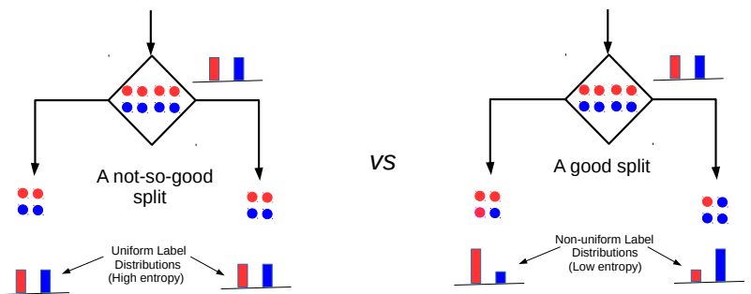


Entropy and Information Gain
42
Assume a set of labelled inputs $S$ from C classes, $p_{c}$ as fraction of class c inputs
Entropy of the set $S$ is defined as $H(S)=−\sum_{c∈C}{p_{c} log p_{c}}$
Suppose a rule splits $S$ into two smaller disjoint sets $S_{1}$ and $S_{2}$
Reduction in entropy after the split is called information gain
Uniform sets (all classes roughly equally present) have high entropy; skewed sets low
$IG=H\left(S\right)− \frac{\left|S_{1}\right|}{\left|S\right|}H\left(S_{1}\right)$ $− \frac{\left|S_{2}\right|}{\left|S\right|}H\left(S_{2}\right)$
This split has a low IG
(in fact zero IG)
This split has higher IG

Slide 43
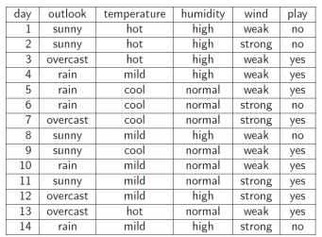
Entropy and Information Gain
43
Let’s use IG based criterion to construct a DT for the Tennis example
At root node, let’s compute IG of each of the 4 features
Consider feature “wind”. Root contains all examples S = [9+,5-]
S_{weak} = [6+, 2−] ⇒ H(S_{weak} ) = 0.811
S_{strong} = [3+, 3−] ⇒ H(S_{strong}) = 1
Likewise, at root: IG(S, outlook) = 0.246, IG(S, humidity) = 0.151, IG(S,temp) = 0.029
Thus we choose “outlook” feature to be tested at the root node
Now how to grow the DT, i.e., what to do at the next level? Which feature to test next?
Rule: Iterate - for each child node, select the feature with the highest IG
$$\text{H}\text{(}\text{S} \text{) =}\text{ −(9/14) }\text{log}\text{2}\text{(9/14) − (5/14) }\text{lo}\text{g}\text{2}\text{(5/14) = 0.94}$$
$IG(S,wind)=H\left(S\right)− \frac{\left|S_{weak}\right|}{\left|S\right|}H\left(S_{weak}\right)$ $− \frac{\left|S_{strong}\right|}{\left|S\right|}H\left(S_{strong}\right)$ = 0.94 − 8/14 ∗ 0.811 − 6/14 ∗ 1 = 0.048

Slide 44
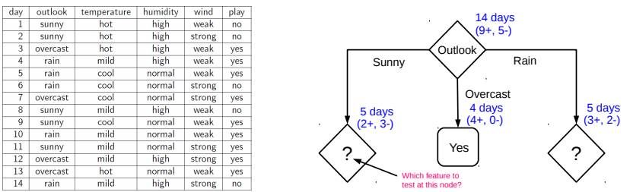
Growing the tree
44
Proceeding as before, for level 2, left node, we can verify that
IG(S,temp) = 0.570, IG(S, humidity) = 0.970, IG(S, wind) = 0.019
Thus humidity chosen as the feature to be tested at level 2, left node
No need to expand the middle node (already “pure” - all “yes” training examples ☺)
Can also verify that wind has the largest IG for the right node
Note: If a feature has already been tested along a path earlier, we don’t consider it again

Slide 45
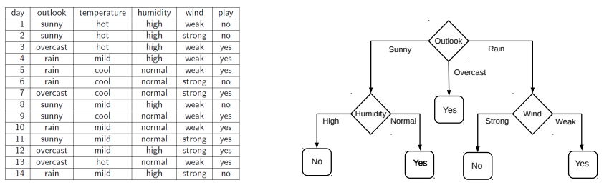
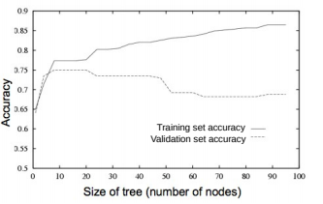
When to stop growing the tree?
45
Stop expanding a node further (i.e., make it a leaf node) when
It consist of all training examples having the same label (the node becomes “pure”)
We run out of features to test along the path to that node
The DT starts to overfit (can be checked by monitoring
the validation set accuracy)
Important: No need to obsess too much for purity
It is okay to have a leaf node that is not fully pure, e.g., this
At test inputs that reach an impure leaf, can predict probability of belonging to each class (in above example, p(red) = 3/8, p(green) = 5/8), or simply predict the majority label
To help prevent the tree from growing too much!
OR

Slide 46
Avoiding Overfitting in DTs
46
Desired: a DT that is not too big in size, yet fits the training data reasonably
Note: An example of a very simple DT is “decision-stump”
A decision-stump only tests the value of a single feature (or a simple rule)
Not very powerful in itself but often used in large ensembles of decision stumps
Mainly two approaches to prune a complex DT
Prune while building the tree (stopping early)
Prune after building the tree (post-pruning)
Criteria for judging which nodes could potentially be pruned
Use a validation set (separate from the training set)
Prune each possible node that doesn’t hurt the accuracy on the validation set
Greedily remove the node that improves the validation accuracy the most
Stop when the validation set accuracy starts worsening
Use model complexity control, such as Minimum Description Length (will see later)
Either can be done using a validation set

Slide 47
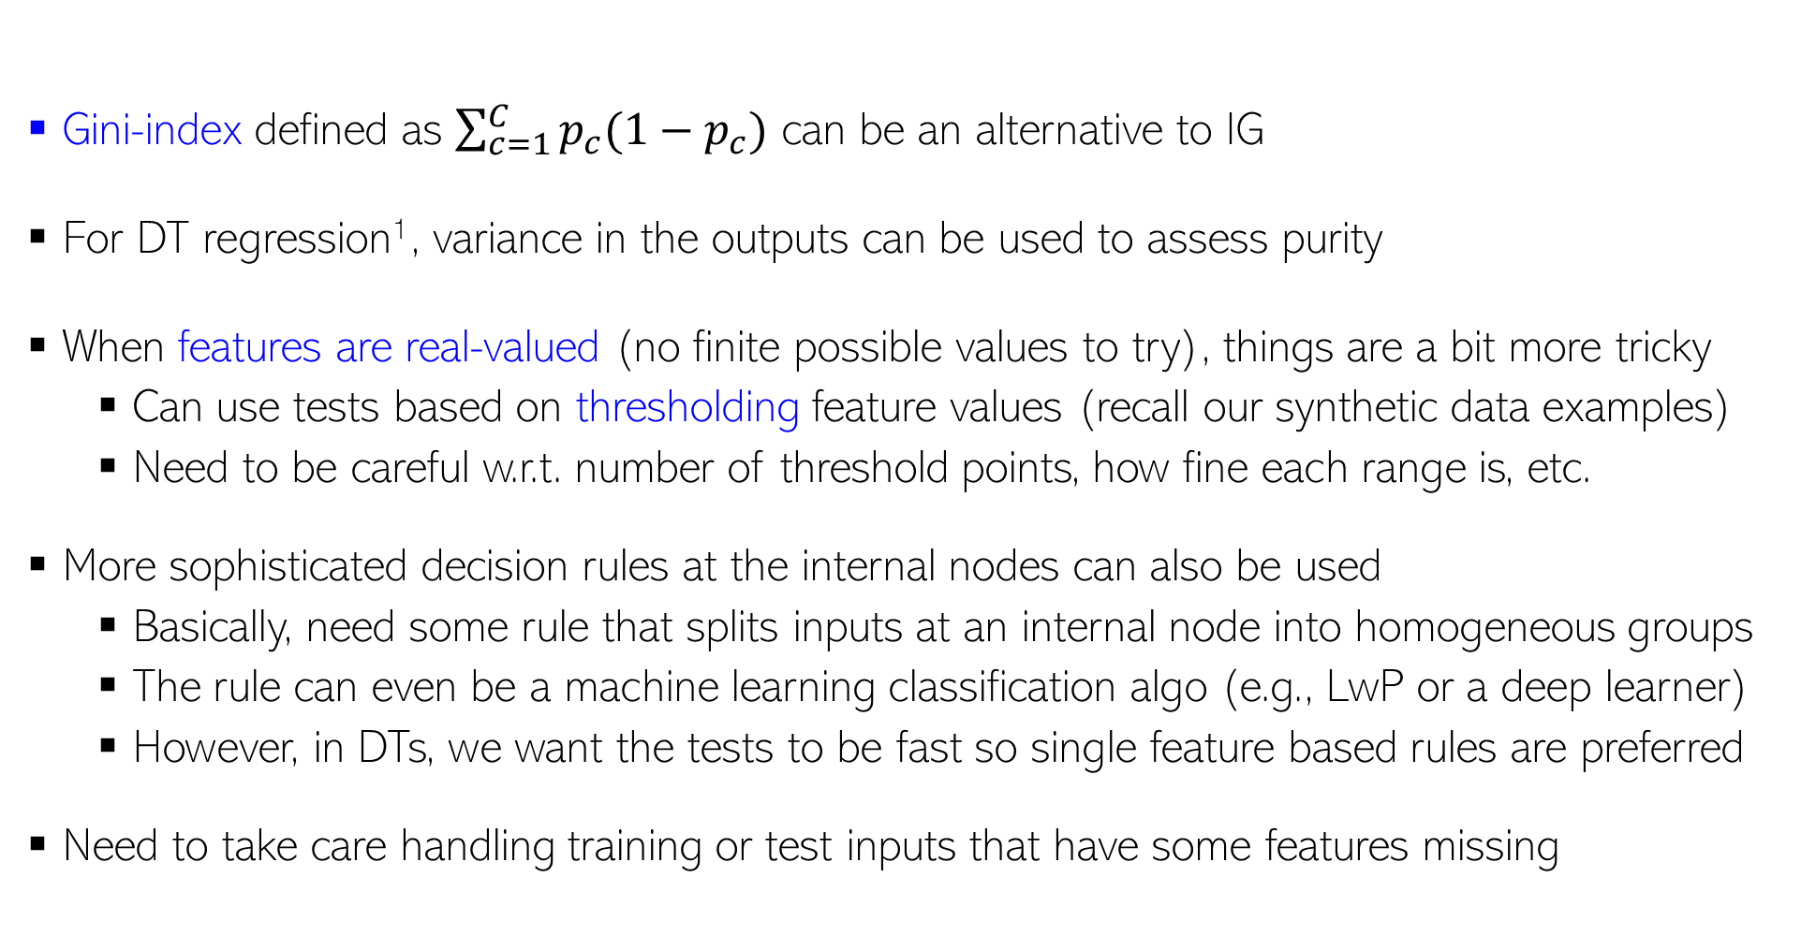
Decision Trees: Some Comments
For regression, outputs are real-valued and we don’t have a “set” of classes, so quantities like entropy/IG/gini etc. are undefined
47
Gini-index defined as $\sum_{c=1}^{C}{p_{c}(1−p_{c})}$ can be an alternative to IG
For DT regression¹, variance in the outputs can be used to assess purity
When features are real-valued (no finite possible values to try), things are a bit more tricky
Can use tests based on thresholding feature values (recall our synthetic data examples)
Need to be careful w.r.t. number of threshold points, how fine each range is, etc.
More sophisticated decision rules at the internal nodes can also be used
Basically, need some rule that splits inputs at an internal node into homogeneous groups
The rule can even be a machine learning classification algo (e.g., LwP or a deep learner)
However, in DTs, we want the tests to be fast so single feature based rules are preferred
Need to take care handling training or test inputs that have some features missing
An illustration on the next slide
¹Breiman, Leo; Friedman, J. H.; Olshen, R. A.; Stone, C. J. (1984). Classification and regression trees

Slide 48
An Illustration: DT with Real-Valued Features
48
Test example
“Best” (purest possible) Horizontal Split
“Best”(purest possible) Vertical Split
Up Down
Left Right
Between the best horizontal vs best vertical split, the vertical split is better (more pure), hence we use this rule for the internal node
This illustration’s credit: Purushottam Kar

Slide 49
Decision Trees: A Summary
49
.. thus helping us learn complex rule as a combination of several simpler rules
Some key strengths:
Simple and easy to interpret
Nice example of “divide and conquer”
paradigm in machine learning
Easily handle different types of
features (real, categorical, etc.)
Very fast at test time
Multiple DTs can be combined
via ensemble methods: more powerful
(e.g., Decision Forests; will see later)
Used in several real-world ML applications, e.g., recommender systems, gaming (Kinect)
Some key weaknesses:
Learning optimal DT is (NP-hard) intractable. Existing algos mostly greedy heuristics
Can sometimes become very complex unless some pruning is applied
5
NO
YES
$$x_{1}>3.5 ?$$
4
NO
YES
NO
YES
3
$$x_{2}>2 ?$$
$$x_{2}>3 ?$$
Feature 2 ($x_{2})$
2
Predict Red
Predict Green
Predict Green
Predict Red
1
1
2
3
4
5
6
Human-body pose estimation
Feature 1 ($x_{1})$

