Slide 1

CO2 Emissions

Slide 2
Objective
The goal is to model CO2 emissions as a function of car engine features using machine learning in Python to predict emissions accurately. We'll leverage visualization tools like Matplotlib and Seaborn to create plots, heatmaps, and charts, revealing key patterns and insights for sustainable vehicle design and policy.

Slide 3
Dataset Details
This dataset has the 12 following variables(with their description):
make, car brand under study.
model - the specific model of the car.
vehicle_class - car body type of the car.
engine_size - size of the car engine, in Liters.
cylinders - number of cylinders.
transmission - "A" for`Automatic', "AM" for ``Automated manual', "AS" for 'Automatic with select shift', "AV" for 'Continuously variable', "M" for 'Manual'.
fuel_type - "X" for 'Regular gasoline', "Z" for 'Premium gasoline', "D" for 'Diesel', "E" for 'Ethanol (E85)', "N" for 'Natural gas'.
fuel_consumption_city - City fuel consumption ratings, in liters per 100 kilometers.
fuel_consumption_hwy - Highway fuel consumption ratings, in liters per 100 kilometers.
fuel_consumption_comb(l/100km) - the combined fuel consumption rating (55% city, 45% highway), in L/100 km.
fuel_consumption_comb(mpg) - the combined fuel consumption rating (55% city, 45% highway), in miles per gallon (mpg).
co2_emissions - the tailpipe emissions of carbon dioxide for combined city and highway driving, in grams per kilometer.

Slide 4

Exploratory Data Analysis
The number of variables (columns) is 12, and the number of instances (rows) is 7385.
Variables | Mean | Standard Deviation | Median | Mode
engine_size | 3.16 | 1.35 | 3.0 | 2.0
cylinders | 5.62 | 1.83 | 6.0 | 4.0
fuel_consumption_city | 12.56 | 3.50 | 12.1 | 11.9
fuel_consumption_hwy | 9.04 | 2.22 | 8.7 | 7.8
fuel_consumption_comb(l/100km) | 10.98 | 2.89 | 10.6 | 9.4
fuel_consumption_comb(mpg) | 27.48 | 7.23 | 27.0 | 25.0
co2_emissions | 250.58 | 58.51 | 246.0 | 221 / 246

Slide 5
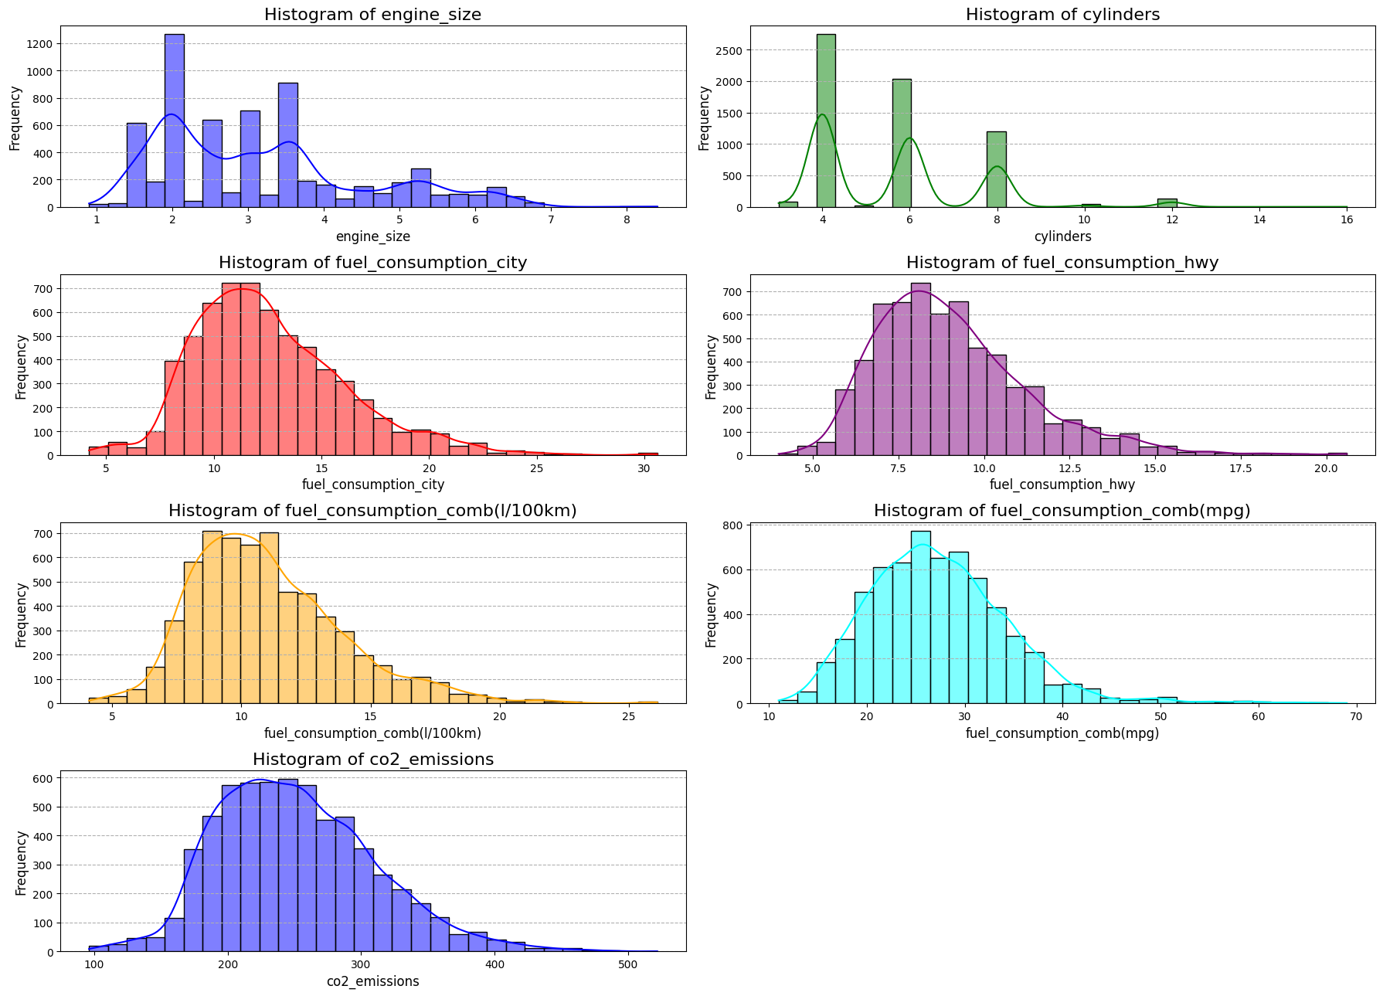

Slide 6
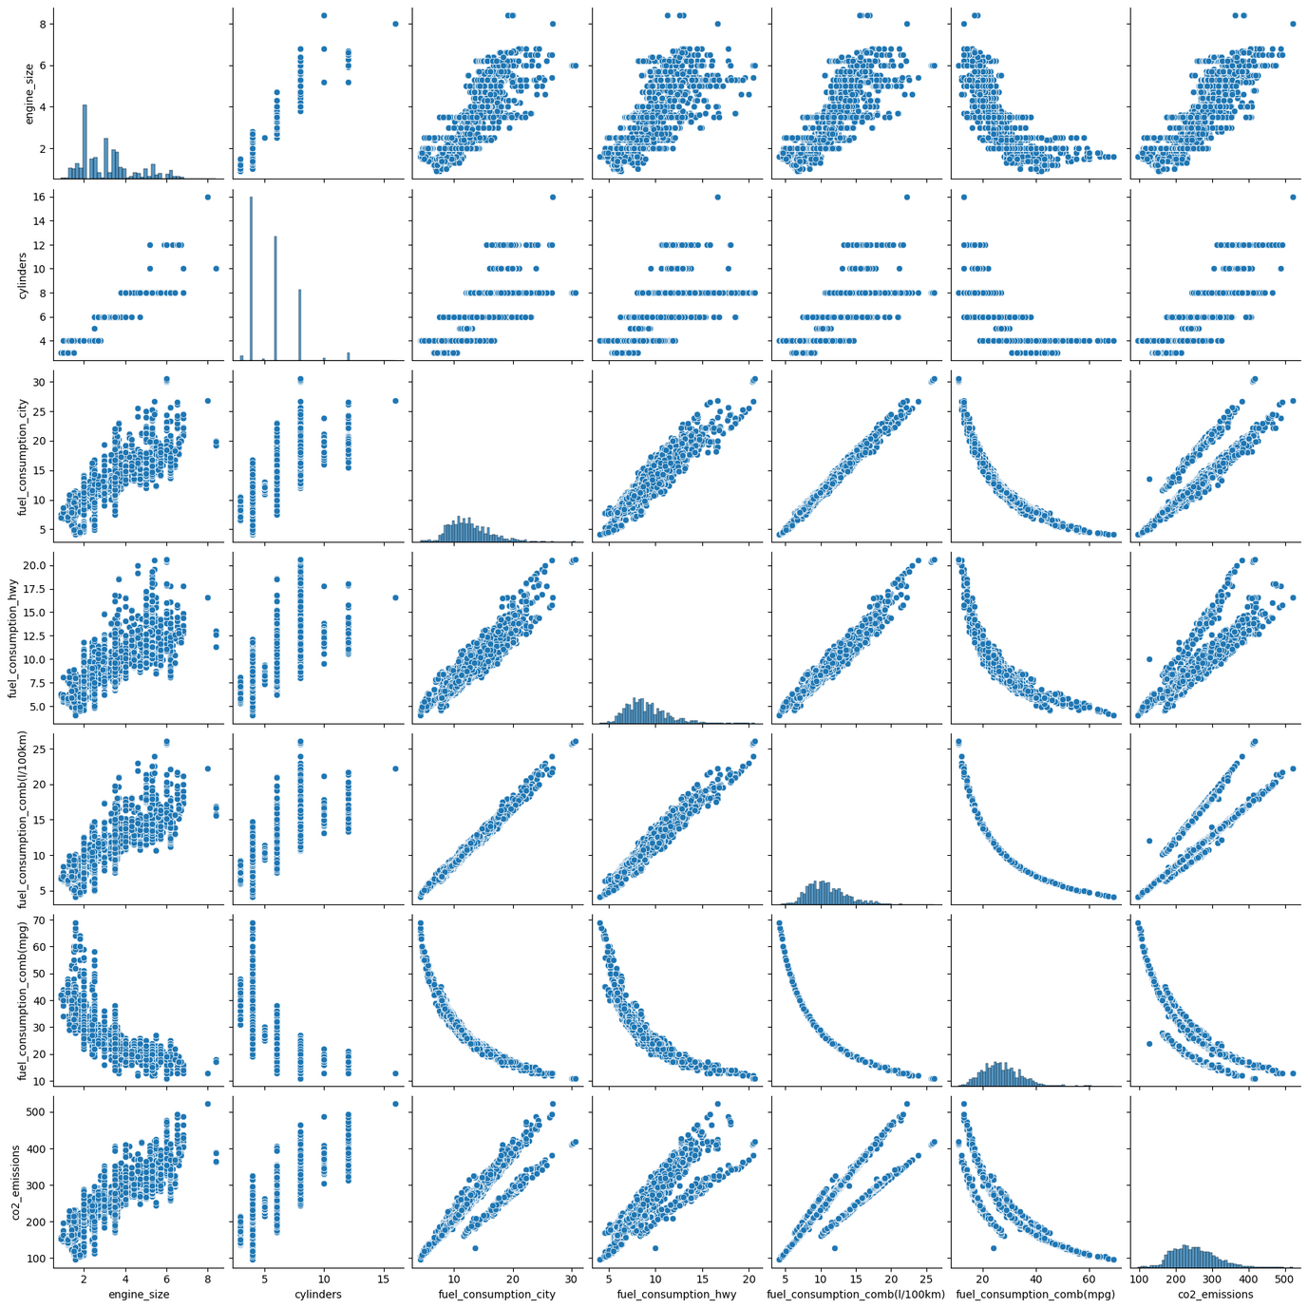

Slide 7
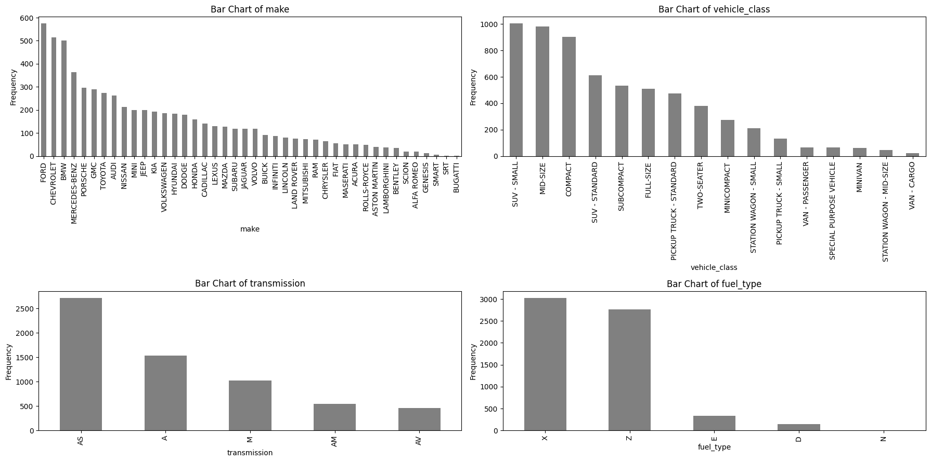

Slide 8
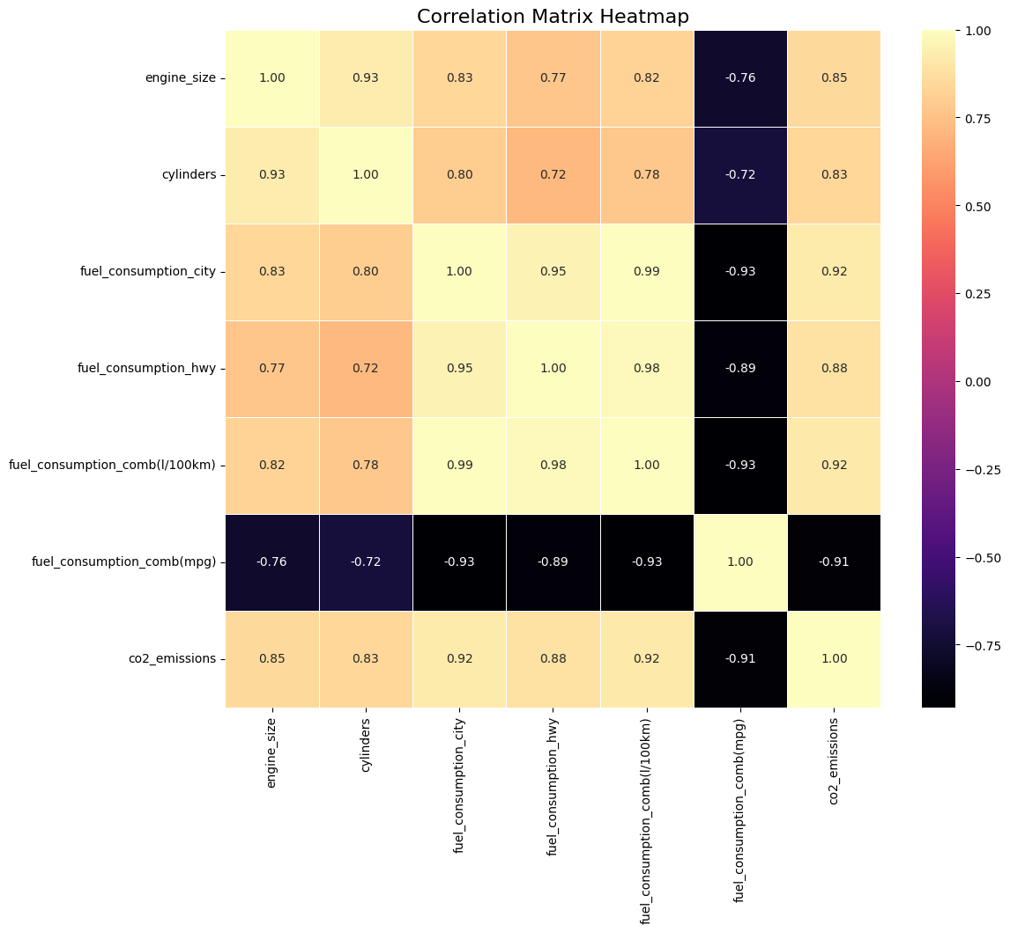

Slide 9
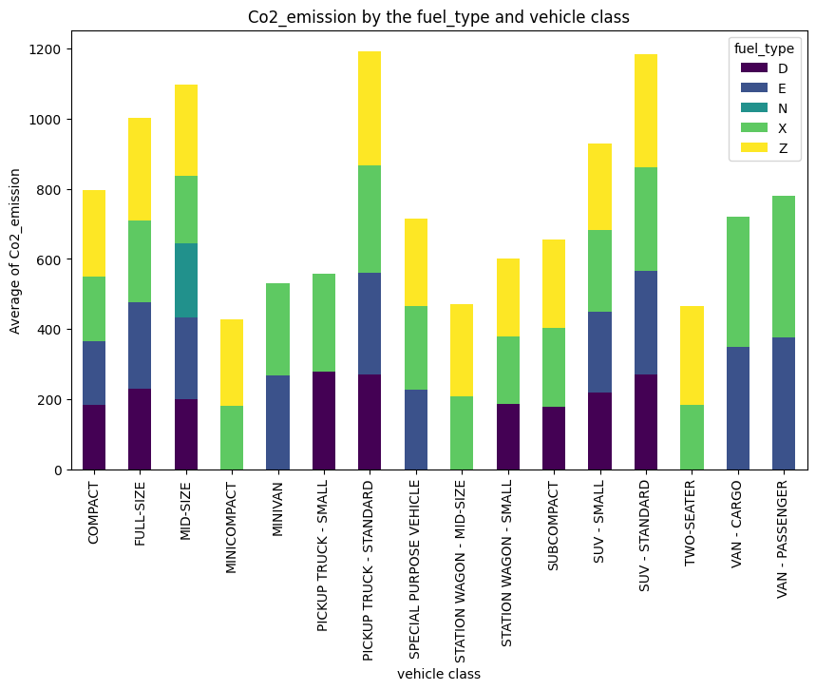

Slide 10
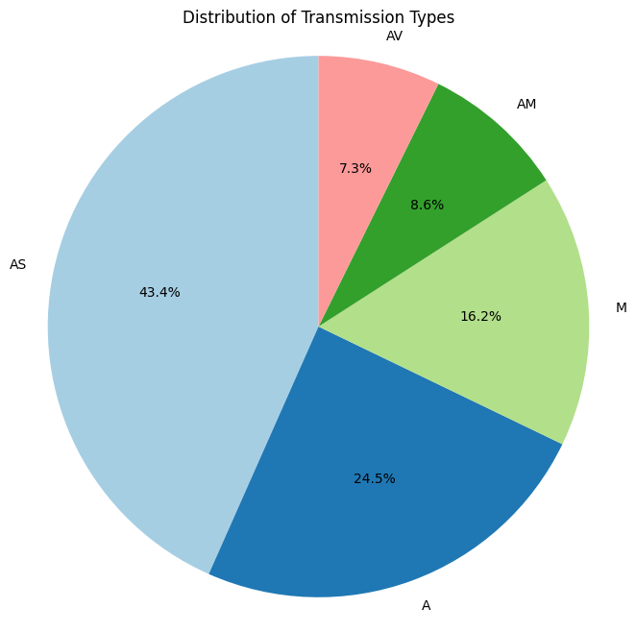
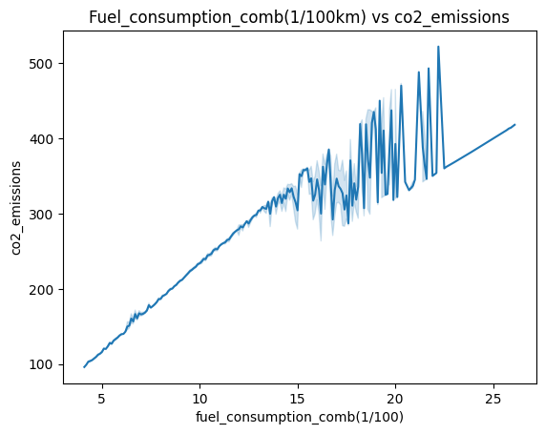

Slide 11
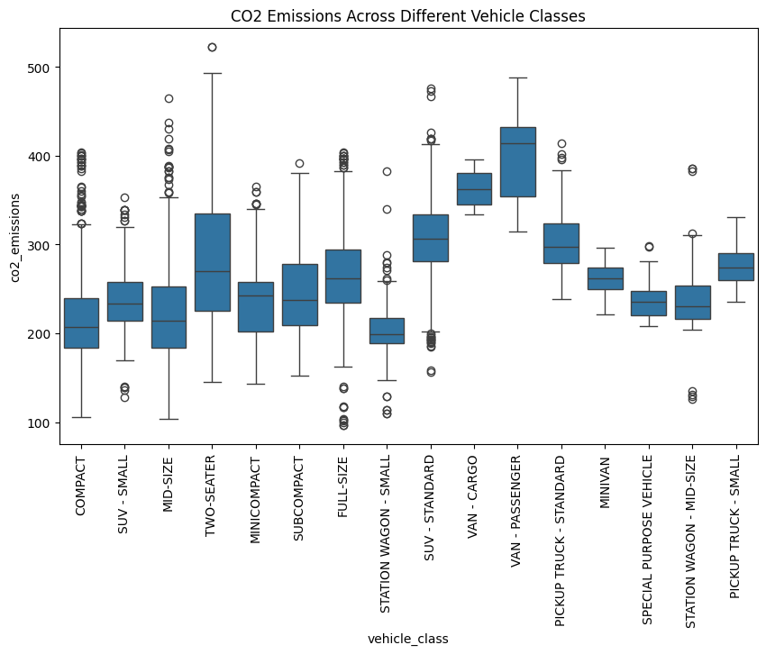

Slide 12
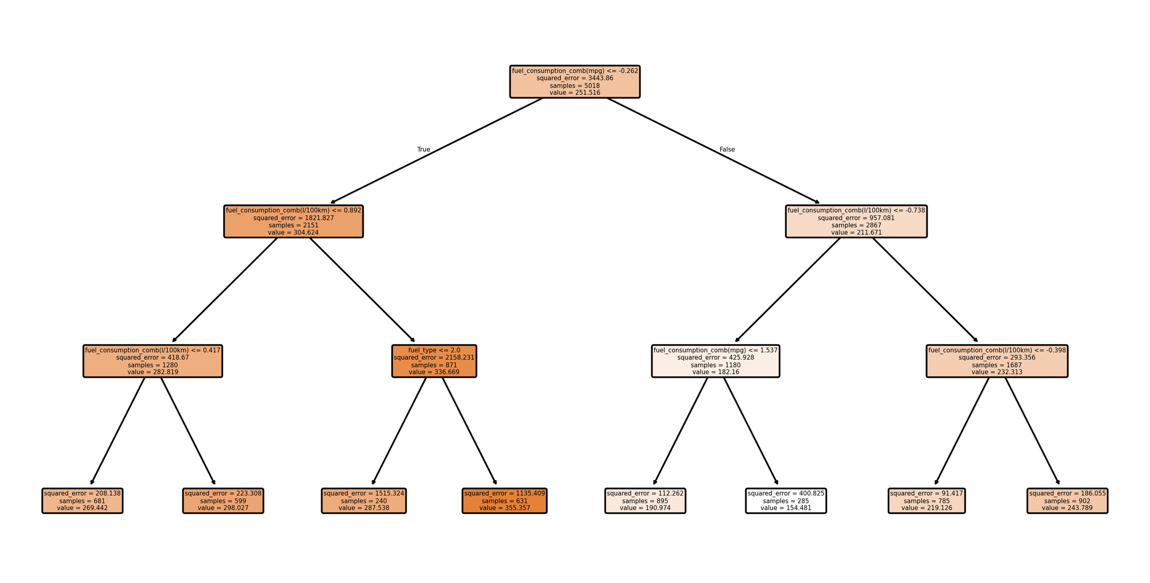

precision recall f1-score support
0 0.91 0.97 0.94 686
1 0.96 0.89 0.93 569
accuracy 0.93 1255
macro avg 0.94 0.93 0.93 1255
weighted avg 0.94 0.93 0.93 1255
Accuracy (Decision Tree Regression): 0.934661

Slide 13
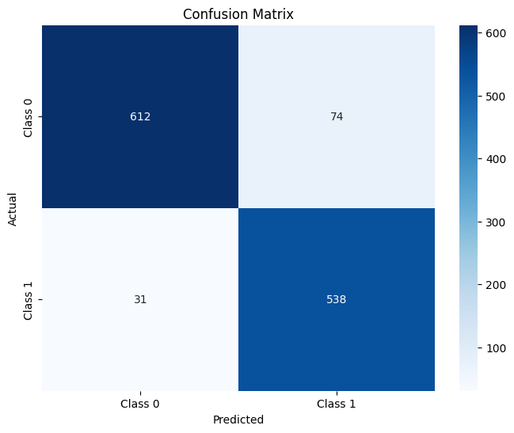
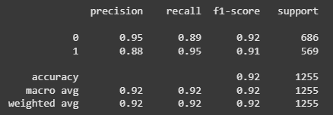

Classification Report for
Linear Regression

Slide 14
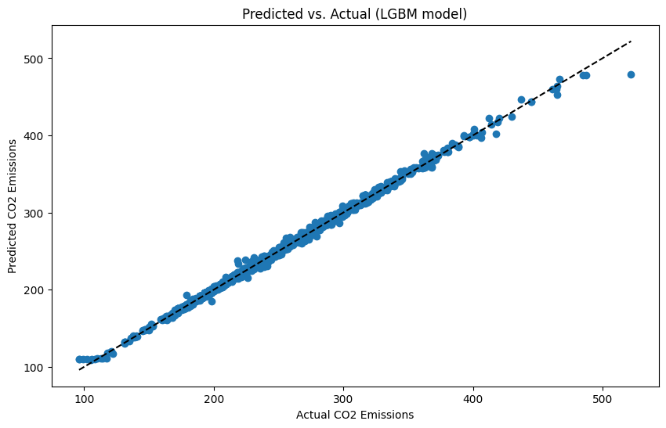
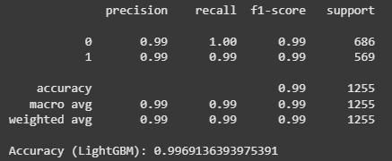

Classification Report for
LGBM Model

Slide 15
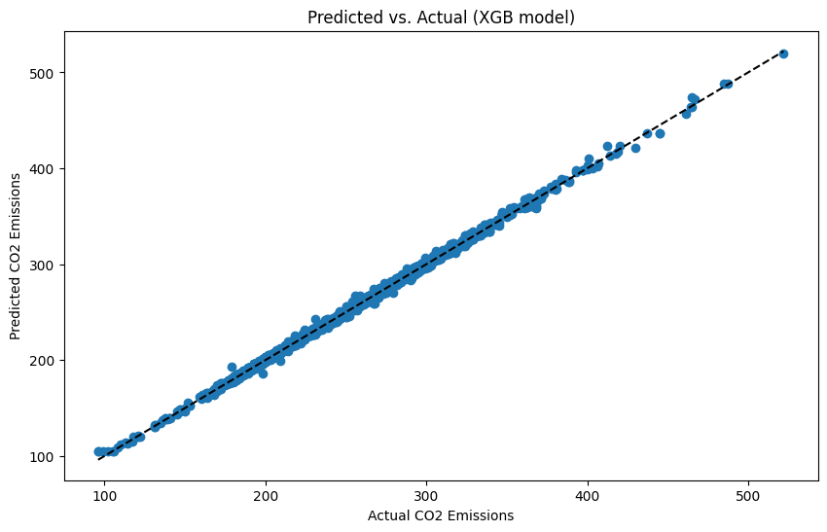
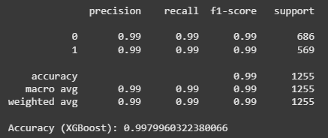

Classification Report for
XGBoost Model

Slide 16
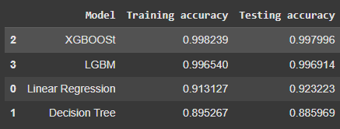
Give Pros and Cons for each model. tell why we chose XGBoost as our final Model.

Slide 17
Screenshot of the APP Page.

Slide 18
Challenges
By implementing a

Slide 19
Conclusion
By implementing a

Slide 20
Thank you

