Slide 1
Credit score prediction
-Aditya Unal

Slide 2
ABOUT THE PROJECT
The Project is divided into two parts :
Create a dataset with parameters that will effect the credit score
Run classification model to predict if the user’s credit Score will decrease in the next 3 months.

Slide 3
Creating dataset
First Approach :
To select some very strong/strong impact parameters
Make profiles based on them.
Fill columns based on different profiles on the values range of these impact paramters.
Add outliers here only.
Problems :
Creating such low-level logic to create data it might lead to overfitting.
Too many combinations.
Final Approach :
To select some very strong impact parameters to map some labels for ground truths. Keep other parameter values such that they will not effect the impact score. Created 5000 values using this.
Consider appropriate distributions for each parameter and randomly select from them. Created 15000 values from this.
Created 5000 outliers(Above top 75% quartile or below bottom 25% quartile)
Added noise at the end. The label is not changed even though the impact score is change to simulate realism.

Slide 4
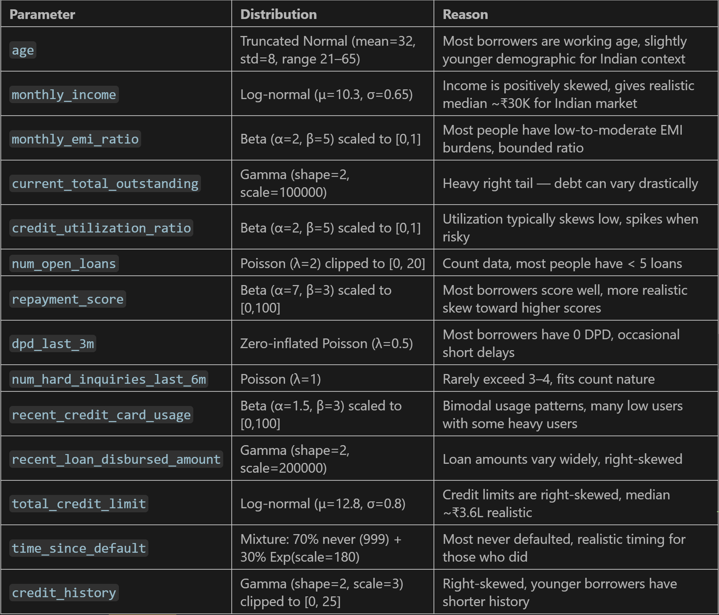
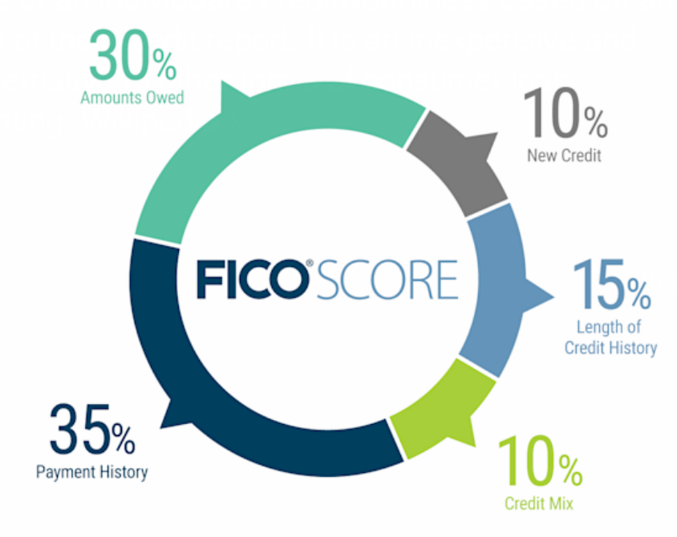
Parameters
The weightage of each parameter
has been decided by me and are
inspired by ho FICO scores are
calculated.

Slide 5
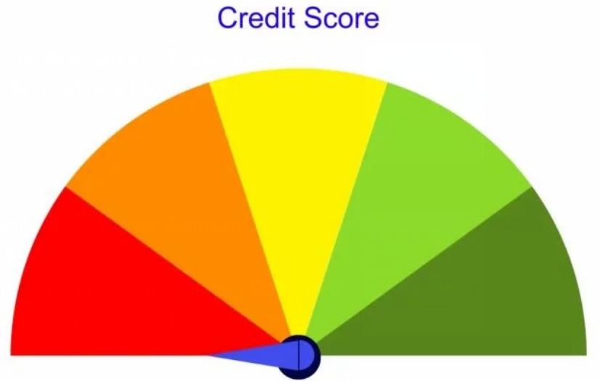
Classification
Classifying into three classes :
Likely Increase
Likely Decrease
Stable

Slide 6

Thank you
Aditya Unal
9557504015
Unal.aditya10@gmail.com
https://github.com/AdityaUnal/CreditStore

