Slide 1

ENPM662 Project 2
Laparoscopic Surgical Robot having 6 DOF Manipulator and 2 DOF Surgical Instrument
Member 1: Aditya Varadaraj (117054859)
Member 2: Saurabh Palande (118133959)

Slide 2
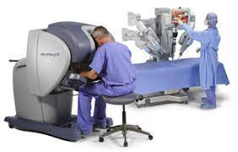
Introduction
In the past few years, a very significant development has been observed in the field of industrial manipulators.
Increased flexibility, versatility, dexterity, precision and accuracy of industrial manipulators --> use in intricate medical procedures.
We propose to apply our knowledge of robot modelling to one such application of industrial manipulator used in laparoscopic surgery.

Slide 3
Motivation
Advantages of Robotic Laparoscopic surgery: -
Minimally Invasive Surgery - Smaller Scars are required.
Less recovery/healing time.
The patient feels less pain while the scars heal.
Less internal scarring.
Robots can reach conventionally inaccessible areas with high dexterity and precision.

Slide 4
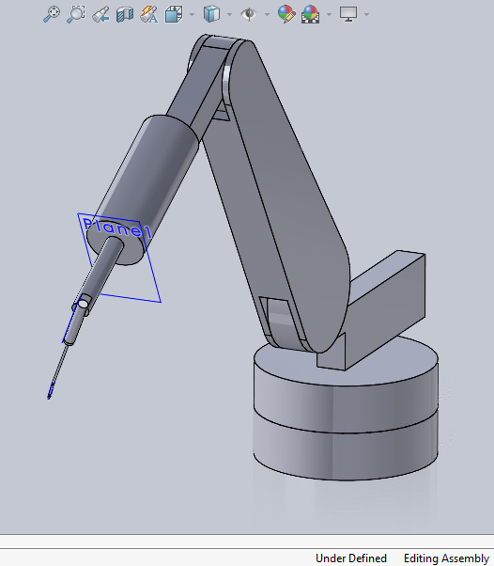
Process followed
Designing of CAD Model in SOLIDWORKS.
Forward and Inverse Kinematics (Manually)
Exporting and modifying URDF for joint limits, transmission, etc.
Using MoveIt to teleop the manipulator.
Validation of Forward and Inverse Kinematics.
Programming the robot to move in a desired volume inside the laceration cut by using a Python script.
Final Report and Presentation

Slide 5
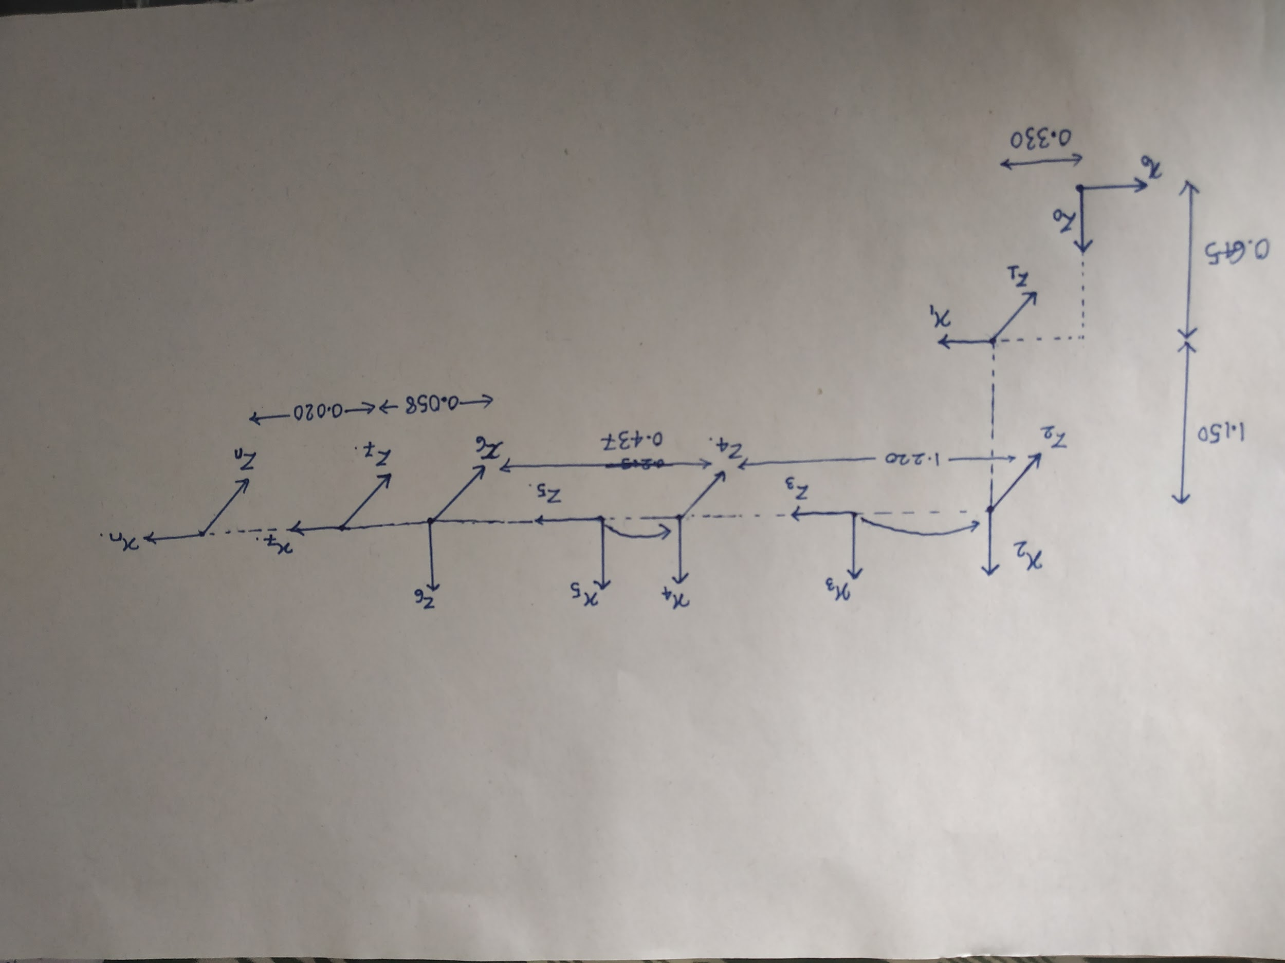
Calculations
Link_i | a_i (m) | Alpha_i (degrees) | d_i (m) | Theta_i (degrees)
0 ->1 | 0.330 | 90 | 0.645 | 180+theta_1
1 ->2 | 1.15 | 0 | 0 | 90 + theta_2
2 ->3 | 0 | 90 | 0 | theta_3
3 ->4 | 0 | -90 | 1.22 | theta_4
4 ->5 | 0 | 90 | 0 | theta_5
5 ->6 | 0 | 90 | 0.437 | 90 + theta_6
6 ->7 | 0.058 | 90 | 0 | 90 + theta_7
7 ->n | 0.02 | 0 | 0 | theta_8
Forward Kinematics : -
X_dot = J*theta_dot
Inverse Kinematics: -
theta_dot = J_inv * X_dot

Slide 6
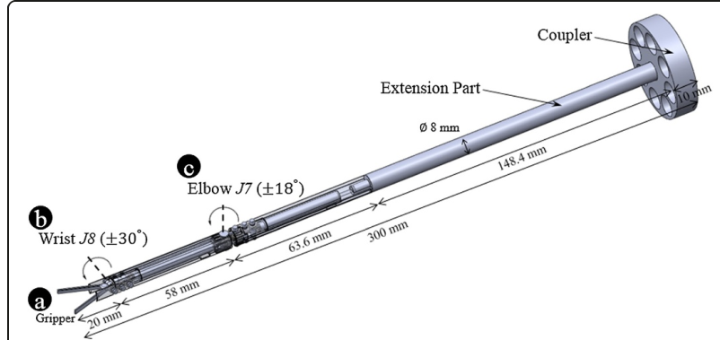
Surgical Instrument

Slide 7
Problems faced: -
Robot was falling in gazebo due to gravity. We added controllers and tried to tune the pid and joint effort values but tuning it for 8 joints was difficult so we used MoveIt instead of Gazebo.
Model configuration in MoveIt was different than the home position used for calculation of DH parameters so we had to account for this joint angle errors.
Moveit is showing the trajectory of the joint between end effector and the previous link so the path shown in Results section might be an approximation of the path followed by the tip of the actual end - effector.
Since multiple solutions might exist for the inverse kinematics problem, the joint motion shown in Moveit might not be the one which is expected in surgery.

Slide 8
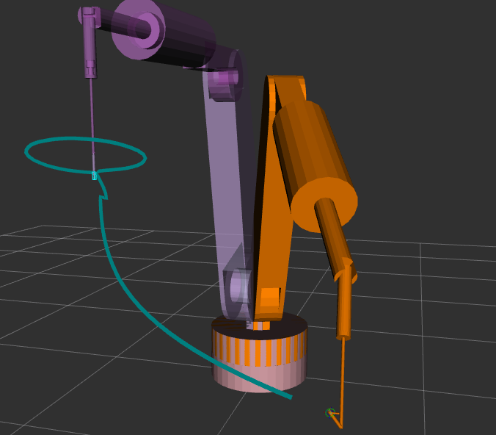
Results: -
We tried to show the manipulator going to its home position from an arbitrary location and then simulate the circular path inside the laceration cut by calculating joint angles using our inverse kinematics code and publishing the joint angles by MoveIt.
Simulation video: - Link

Slide 9
Conclusion: -
Only kinematics is not enough to simulate the exact motion of the tip of the surgical instrument. Dynamics, Constraints in the workspace should also be taken into account.
We used a basic PID controller for this project but in such applications where precision is of utmost importance advanced controllers are used.
Since the robot has 8 DOF, there are multiple joint angle configurations which can give the same position of the tip of the end effector (surgical instrument).

Slide 10
References
C. Lee et al., “Pneumatic-type surgical robot end-effector for laparoscopic surgical-operation-by-wire,” Biomed. Eng. Online, vol. 13, no. 1, 2014.
Kuka KR 120 2700 - 2 datasheet

