Slide 1

ENPM667 Project 1: Holistic Adaptive Multi-model control of 4WID Autonomous Vehicle
Aditya Varadaraj (117054859), Saurabh Palande (118133959)

Slide 2
Introduction
An autonomous vehicle, or a driverless vehicle, is one that is able to operate itself and perform necessary functions without any human intervention, through ability to sense its surroundings.
Path following is one of the key aspects of autonomous driving
Heirarchical controllers are better in most driving conditions but fail in extreme conditions.
Hence, holistic controllers are used in such extreme situations

Slide 3
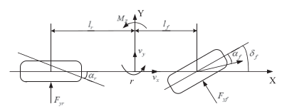
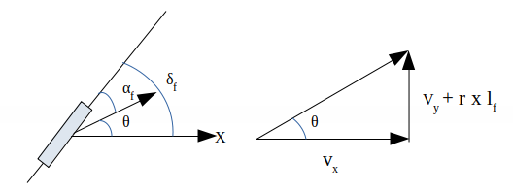
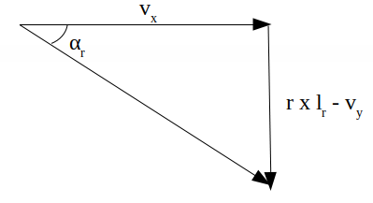
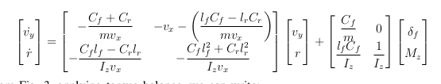
System Modelling and State Space

Slide 4
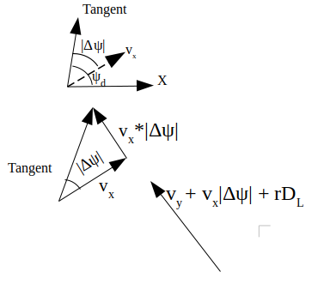
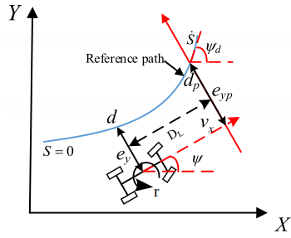
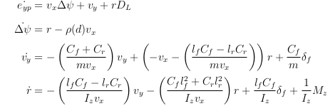

Slide 5
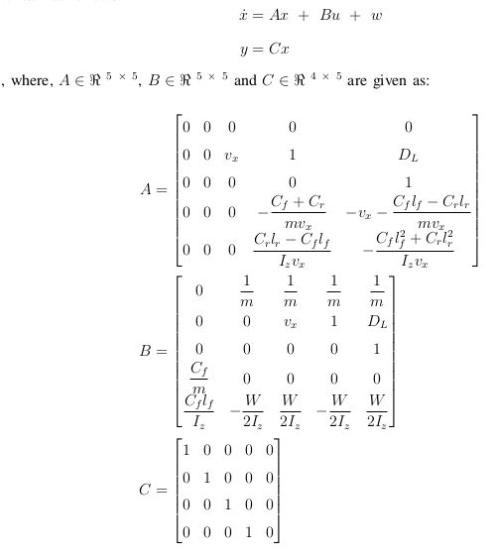
x = [e_x e_yp ∆ψ v_y r]^{T}
u = [δ_f F_xlf F_xrf F_xlr F_xrr ]^{T}
w = [−a_xd v_x ρ(d) 0 0 0]^{T}
y = [e_x e_yp ∆ψ v_y ]^{T}

Slide 6
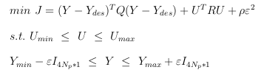
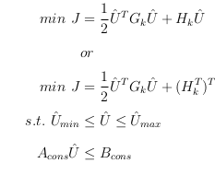
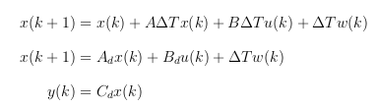
Q and R matrices and hence Gk, Hk matrices use an adaptive mechanism for some of the weights

Slide 7
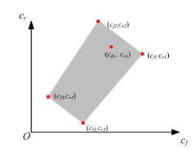
Convex Multi-Model Scheme
A Convex Polytope based multi-model scheme is used to account for variations in cornering stiffness.

Slide 8
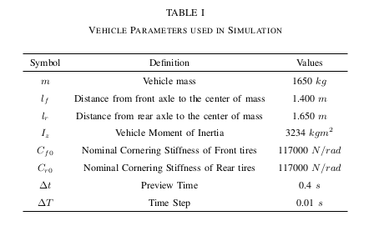
Vehicle Simulation Parameters

Slide 9
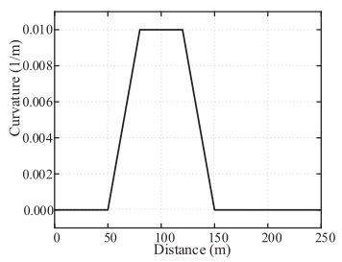
Curvature of Path: J-turn
This is the curvature of the path that the vehicle has to follow.

Slide 10
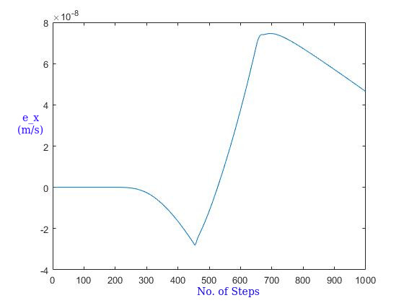
Results

Slide 11
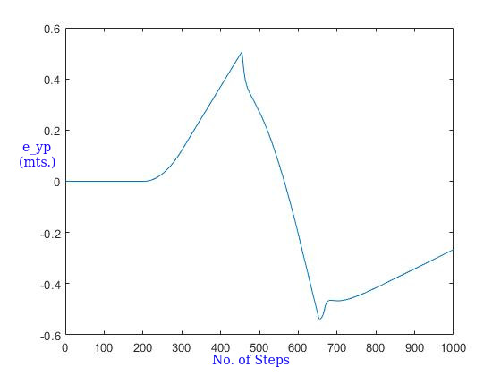

Slide 12
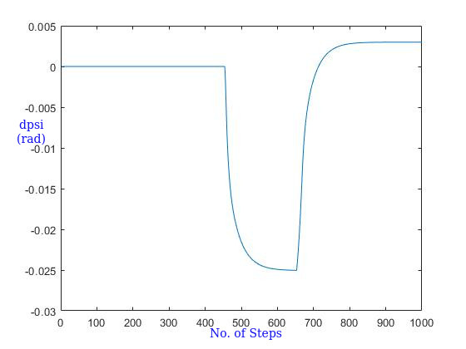

Slide 13
