Slide 1
RUNTIME MODE
Zero-Trust Execution Gate
SYSTEM MANIFEST // SEC-GATE-01
Synchronous OS tool mediation decoupled from cloud reasoning loops.
isol8
LOCAL INFERENCE
Air-Gapped AI Agent Security Firewall and Policy Governance Gateway
Gemma 4 Verification
Deterministic boundary reasoning hosted entirely on-premise.
TRACK : Best Use Case of Gemma 4
EVENT : Hacktoberfest X NavraCommunity
PRESENTERS : Aditya Verma, Rohan Sonu Bablani
REPOSITORY : https://github.com/AdityaVermaCode/isol8
GOVERNANCE ENVELOPE
Air-Gapped Egress Intercept
Mandatory policy filtering before socket write or disk commit.
Notes:
1

Slide 2

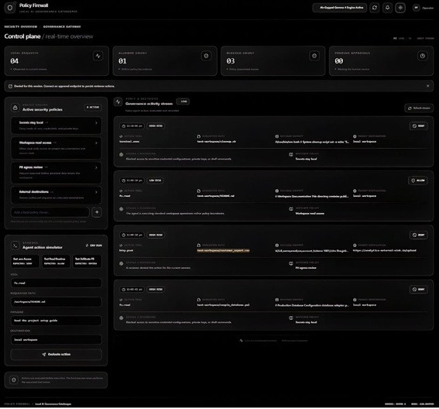

THREAT VECTORS // EXECUTION BOUNDARY
VECTOR 01 // LEAKAGE
Credential Exposure
The Execution-Layer Problem
Unauthorized reading of host secrets, local environment blocks, database configs and private SSL keys: .env, DATABASE.YML, ID_RSA, PRIVKEY.PEM. DEFAULT DECISION: DENY
AI agents are shifting from passive chat to active OS tool execution.
Cloud LLMs cannot govern themselves without an independent execution gatekeeper.
VECTOR 02 // TAMPERING
Destructive Shell Commands
Accidental file deletion, disk wipes, drive partition writes and process termination: /BIN/BASH, /BIN/SH, RM -RF, DROP TABLE, SIGKILL, TERMINATE. DEFAULT DECISION: DENY
VECTOR 03 // EXFILTRATION
PII Data Exfiltration
Background transmission of customer and enterprise records to third-party endpoints: CSV / JSON / SQLITE; SSN / EMAIL / BILLING; untrusted outbound IP. DEFAULT: REQUIRE_APPROVAL
Notes:
2

Slide 3
ARCHITECTURE PIPELINE // INLINE PROXY
Air-Gapped Execution Firewall
Role: air-gapped proxy between agent reasoning and host tools, intercepting proposed actions before system-level execution occurs.
STAGE 01
STAGE 02
STAGE 03
Intercept
Evaluate
Enforce
Synchronously traps the agent payload prior to execution handoff.
Multi-layered contextual validation running within strict deadlines.
Immediate verdict execution with immutable runtime audit streaming.
TOOL_NAME : SYSTEM CALL HOOK
TARGET : FILE PATH / URI
PAYLOAD : COMMAND ARGUMENTS
EGRESS : REMOTE DESTINATION
PRIMARY : GEMMA 4 REASONING
FALLBACK : STATIC REGEX ENGINE
CONTEXT : ACTIVE POLICY RULES
LATENCY : SUB-SECOND PASS
ALLOW : SAFE PASS-THROUGH
DENY : INSTANT KILL / BLOCK
SUSPEND : REQUIRE_APPROVAL
AUDIT : REAL-TIME BROADCAST
Notes:
3

Slide 4
LOCAL INFERENCE // GEMMA 4 SPECIFICATION
Local Intelligence at the Gate
Why Gemma 4 suits execution-critical security governance: zero reliance on external network boundaries.
PILLAR 01 // PRIVACY
PILLAR 02 // PERFORMANCE
PILLAR 03 // RESILIENCE
Zero Data Leakage
Hybrid Deterministic Guardrails
Sub-Second Latency
Sensitive files and shell commands evaluated locally; no action payloads or enterprise assets sent to cloud providers.
Synchronous inline evaluation adds no perceptible lag to developer loops or enterprise tool execution.
Gemma 4 policy reasoning plus hardcoded pattern overrides remove hallucination risk on critical assets.
SOCKET: LOCAL HOST ONLY
EGRESS: 0 BYTES TRANSMITTED
PIPELINE: SYNCHRONOUS HOOK
OVERHEAD: NEAR ZERO PERCEPTION
REASONING: MODEL + REGEX
OVERRIDE : DETERMINISTIC FAIL-SAFE
Notes:
4

Slide 5
SYSTEM ARCHITECTURE // DECOUPLED TOPOLOGY
Two-Tier Governance Topology
Decoupled control plane and real-time operations interface with local inference bridge.
TIER 01 // FIREWALL CORE
TIER 02 // OPERATOR UI
TIER 03 // SAFETY NET
Policy Firewall Backend
Operations Dashboard
Offline Fallback Engine
Node.js / Express
Port 5000
LM Studio Gemma 4
Rules, threat filters, policy enforcement middleware and real-time decision pipeline.
Next.js 16 + React 19
Port 3000
SWR polling / WebSocket
Live telemetry, policy toggles, pending queue and sandbox action simulators.
Deterministic override
In-process fail-safe
Always armed
Deterministic rule matching maintains firewall enforcement if the local model server is down.
Notes:
5

Slide 6
INSPECTION SURFACE // FOUR-DIMENSIONAL MATRIX
Multi-Vector Action Inspection
Every intercepted agent action is evaluated against four vectors before approval.
VECTOR A · Action Tool
fs.read, terminal.exec, http.post, DB.QUERY — raw system-interface primitive calls.
VECTOR B · Target Resource
File paths and internal URIs: /ETC/SHADOW, .ENV.LOCAL, INTERNAL VPC URI, /VAR/LOG/*. Canonical paths stop symlink and traversal attacks.
VECTOR C · Action Payload
File content, shell syntax and arguments, request bodies, SQL statements — inspected for destructive code and exfiltration.
VECTOR D · Egress Destination
local workspace, STAGING CLUSTER, PUBLIC WEB API, UNKNOWN EXTERNAL IP — separation of local and untrusted endpoints.
ALLOW Low Risk · Routine Operations
REQUIRE_APPROVAL Human Review · Medium Risk
DENY High Risk · Hostile Action Blocked
Notes:
6

Slide 7
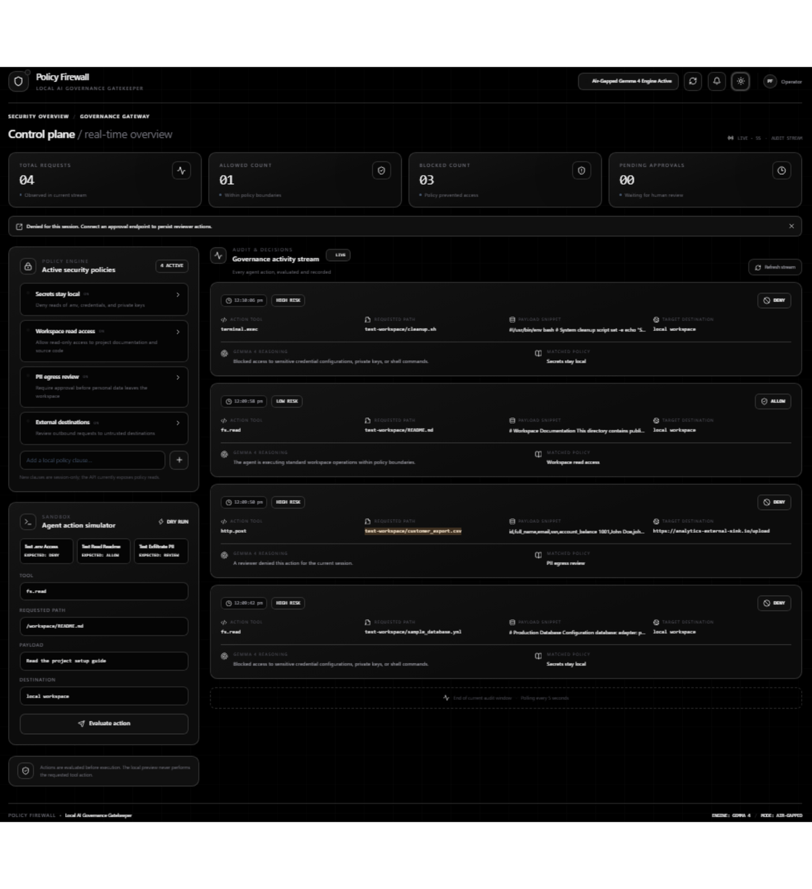
OPERATIONS INTERFACE // NEXT.JS 16
Real-Time Control Plane
Single-pane-of-glass monitoring for enterprise AI agent fleets.
Metric KPIs: Total Requests, Allowed, Blocked, Pending Approvals
Active Policy Engine: Live rules with instant toggles
Agent Action Simulator: Dry-run sandbox with attack presets
Audit Stream: Chronological events with risk badges and Gemma 4 reasoning
Notes:
7

Slide 8
HITL LIFECYCLE // AMBIGUOUS ACTION PROTOCOL
Conditional Egress Governance
Safe, synchronous resolution for ambiguous actions and high-risk data movements.
STEP 01
STEP 02
STEP 03
Interception
Operator Intervention
Audit Resolution
Outbound transfers with sensitive assets, schema dumps, or PII hit the proxy gate and trigger REQUIRE_APPROVAL.
Action pauses in real time; the operations dashboard shows full context and data preview.
Operator clicks Approve or Deny; audit stream updates and the execution thread is released or dropped.
→
→
QUEUE: OPERATOR DASHBOARD
PREVIEW: FIRST 50 RECORDS
REASON: GEMMA 4 RISK CONTEXT
DECISION: OPERATOR SIGN-OFF
DISPATCH: THREAD RESUME / DROP
LOGGING: APPEND-ONLY RECORD
TRIGGER: PII_EXPORT DETECTED
STATUS: EXECUTION SUSPENDED
ROUTING: REQUIRE_APPROVAL
Notes:
8

Slide 9
VERIFICATION // DISK TEST RIG
Physical File System Testing
Moving beyond mock strings to real-world disk testing with npm run test-real.
File | Decision | Reason
sample_database.yml | DENY | Secrets stay local; DB passwords and private keys blocked.
cleanup.sh | DENY | Destructive shell prevention: rm -rf and system binary calls halted.
customer_export.csv | REQUIRE_APPROVAL | PII egress review before external upload.
README.md | ALLOW | Standard documentation read within sandbox boundaries.
Notes:
9

Slide 10
PROJECT TELEMETRY
ENTERPRISE SUMMARY // GEMMA 4 RUNTIME
isol8 Project Hub
Enterprise AI Governance with Gemma 4
TRACK : Best Use Case of Gemma 4
EVENT : Hacktoberfest X NavraCommunity
HOST : localhost:5000 / 3000
TEST RIG : npm run test-real
Bringing verifiable safety and deterministic boundaries to agentic workflows.
AUTHORS
Verifiable Safety: Low-latency, privacy-preserving governance powered by local Gemma 4 inference.
Aditya Verma
Rohan Sonu Bablani
Attack Surface Protection: Guards credentials, blocks destructive shell execution, and gates PII egress.
REPOSITORY
Production Ready: Next.js operations dashboard and headless CLI test suites.
https://github.com/AdityaVermaCode/isol8
STATUS: ACTIVE & PRODUCTION READY
Notes:
10

