Slide 1
Building Customer Loyalty After the First Purchase
Aditya Vijay | Ang Wei Lin | Emily Pham Vinh Tan | Saelin Lee | Shwe Tin Aung | Zhengfeng Toh

Slide 2
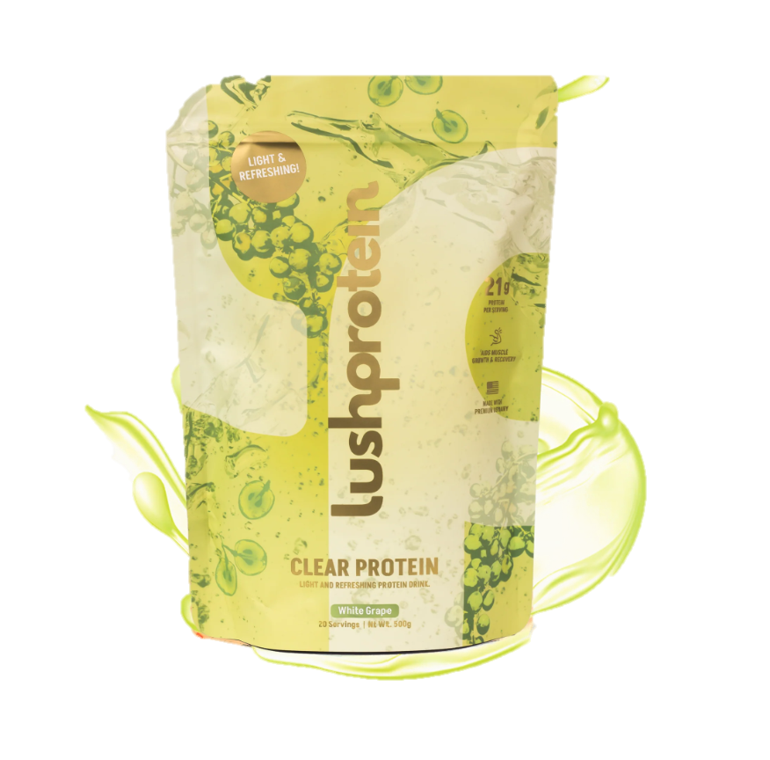
Project Overview
Core Problem
75%
churn rate
Key Metric
60 days
window for 2nd purchase

Slide 3
Business at a Glance
# of unique customers
Total orders
Repeat Rate
13,780
27,350
32.4%
60-day retention
Median days to 2nd order
Subscriber LTV uplift
18.1%
49 days
+166%
vs non-subscribers
Nearly 8 in 10 first-time buyers never return within 60 days - the window when product biology begins delivering results and when almost all loyalty decisions are made.
The overall 32.4% repeat rate includes late returners; the 60-day rate of 18.1% is the operationally critical number.

Slide 4
Deep discounting destroys cohort quality
-52%
+8%
-55%
# of Unique Customers
1,696 | 3,815 | 2,299 | 1,399 | 2,621 | 4,107
From 2021 to 2025, number of unique customers increased by 8% but revenue per customers reduced by 55%
The business is acquiring more customers at lower quality – paying more to earn less and compounding the damage through weaker repeat buyers.
The business has more customers than ever but earns less than it did 4 years ago
*% Discounted of Gross Revenue = Discount Given ÷ (Price: Total + Discount Given)
Notes:
-52% Revenue in 2025 vs 2021 peak, despite 8% more unique customers in 2025
Revenue per customer: 2021 vs 2025, a 55% collapse in customer value

Slide 5
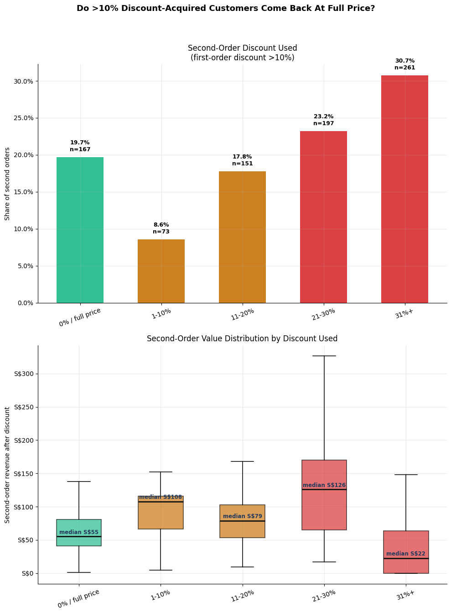
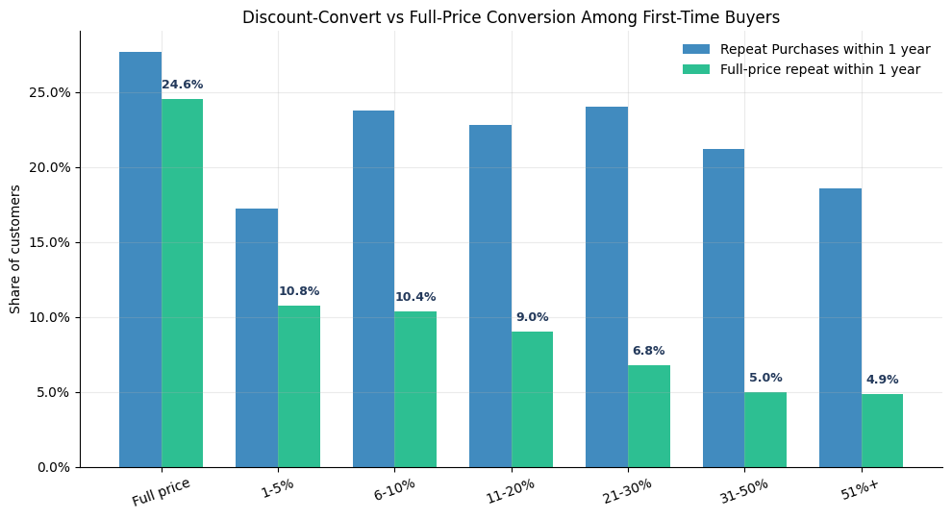
Deep discount destroys loyalty?
Generally, people who received higher discounts are less likely to become full-price repeat purchases
However, we do see that for second-order purchases, having a moderate discount (< 30% off) generated better revenue than full-price converts
Promotional campaign that uses deep discounts (>30% off) is acquiring cohorts that are materially less loyal and less profitable over time. The brand is spending margin to attract weaker customers.
Notes:
"Any discount hurts loyalty. Deep discounts destroy it."
Full-price first-time buyers repeat at 36.4% with an average LTV of S$274. Any discounted first order drops the repeat rate to ~22–26% — a floor that barely moves regardless of how deep the discount goes.
The heaviest cohort (51%+ off) has a repeat rate of 21.9% and LTV of just S$92 — a −40% repeat rate drop and −66% LTV collapse vs full price.
The brand is not just discounting existing demand — it is systematically recruiting a lower-quality customer base. 1,619 first-time buyers (12.1% of all acquisitions) came in at 31%+ off. Every one of them is worth roughly one-third of a full-price customer over their lifetime.

Slide 6
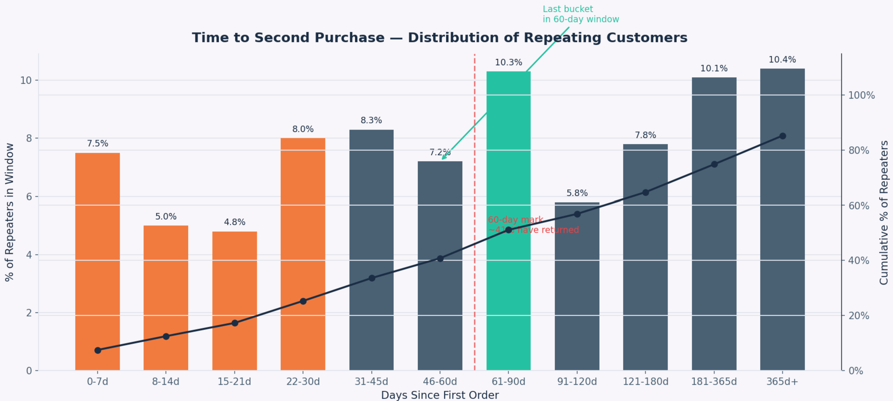
Time to second purchase
41% of customers who ever come back do so within 60 days.
The 61–90 day window is the largest single repurchase bucket within the first year.
51% of all repeat buyers return within 90 days.
Notes:
This chart looks at all 4,461 customers who ever made a second purchase and asks: when did they come back?
The orange bars on the left — Days 0 to 30 — show the customers who came back quickly. These are highly engaged buyers who repurchased almost immediately, maybe they ran out of protein, or they bought a gift and came back for themselves.
Then you see a dip in Days 31–60, before a big spike. The 61–90 day window is actually the single largest repurchase bucket — more customers return here than in any other 30-day window. That makes sense for a protein supplement: if you buy a month's supply, you run out in about 4–6 weeks, and then you need to reorder.
The key takeaway is this: 41% of customers who will ever come back do so within 60 days. Half do so within 90 days. After that, the numbers drop off. So the first 3 months after a first purchase are by far the most critical window for LushProtein to act.
"This chart looks only at customers who came back for a second purchase — and asks: how long did it take them?
Each bar is a time window. The height tells you what percentage of all repeat buyers came back in that window.
A few things stand out. First, 41% of repeat buyers come back within the first 60 days — that's the orange bars on the left. So nearly half of all returning customers return fast, within two months.
Second, the single biggest window is 61 to 90 days — 10.3%. That makes intuitive sense for a protein supplement. You buy a month's supply, you finish it in 4 to 6 weeks, and then you reorder. That's the natural repurchase cycle.
Third, 51% return within 90 days. So more than half of all repeat buyers come back within 3 months.
The implication is clear: if you want to win a customer back, the first 90 days are your window. After that, the bars shrink and the opportunity fades. This sets up the next question — what exactly happens to customers who don't come back in that window?"

Slide 7
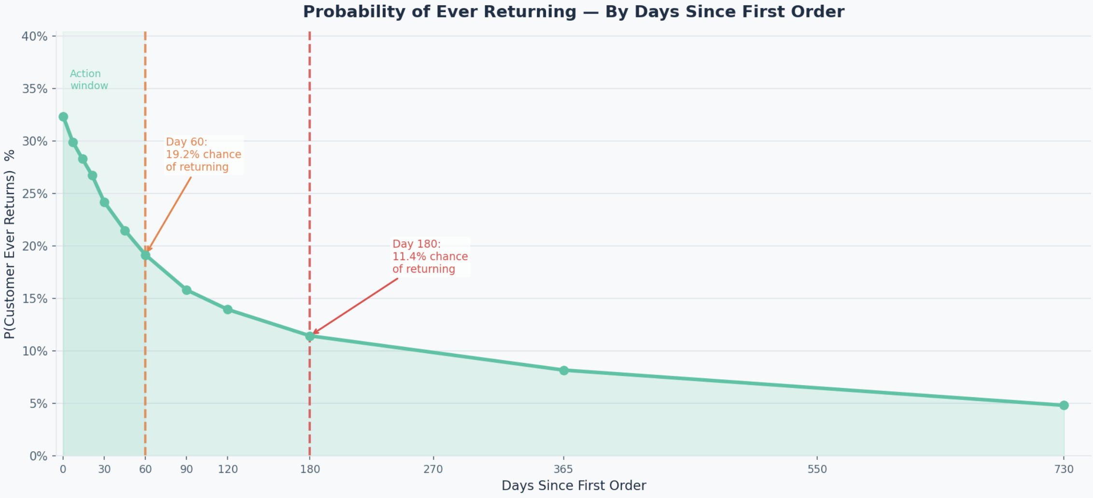
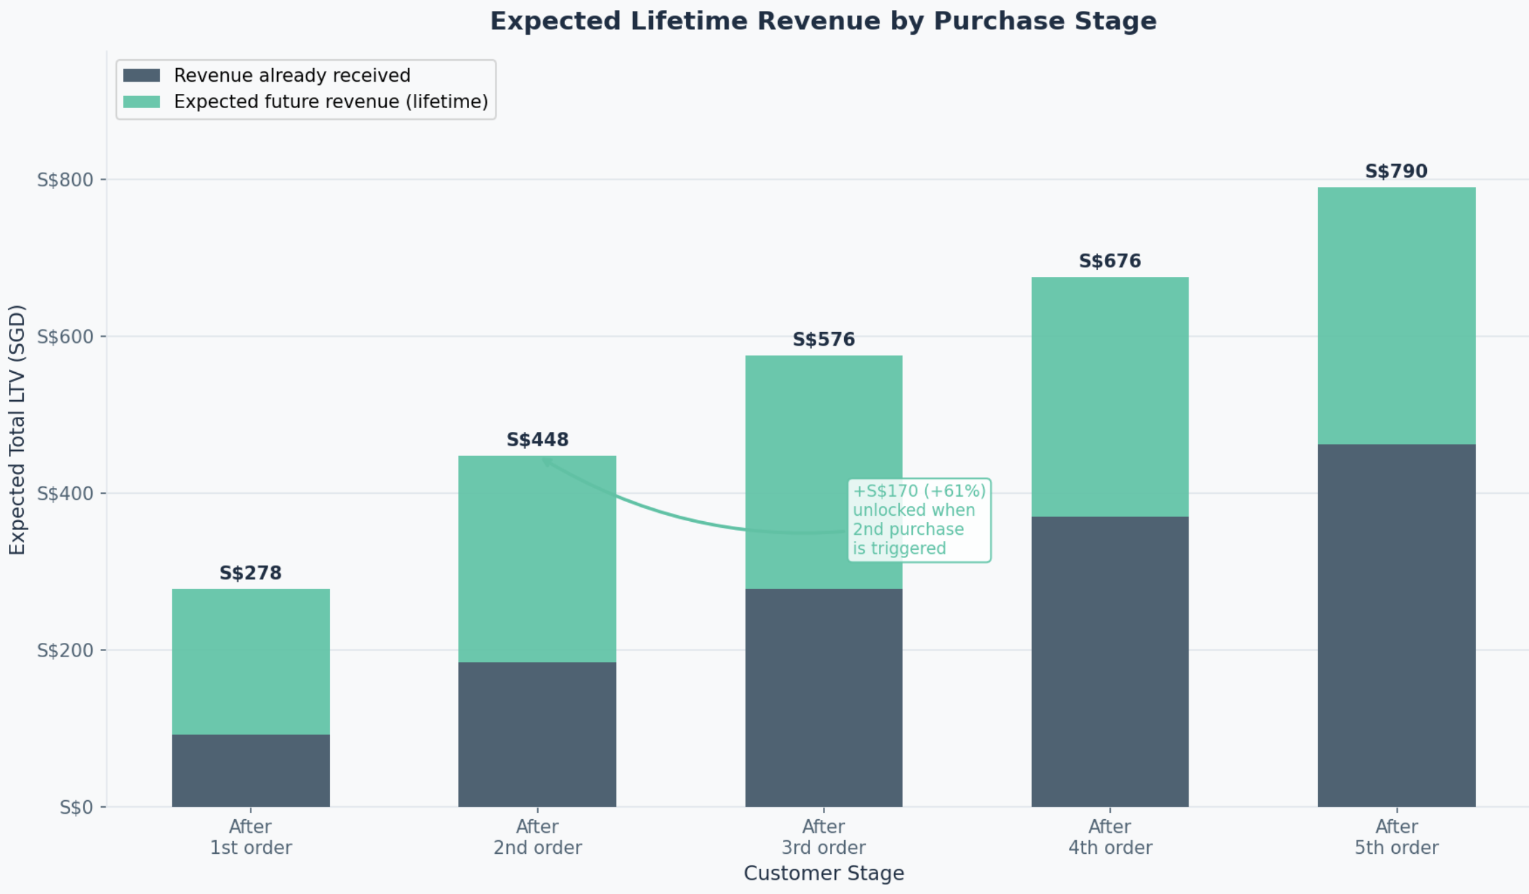
What happens after the first order?
Survival Curve – P(Ever Return) Declines each day
Value Unlocked per Purchase Stage
19.2% chance of return left by Day 60
11.4% chance of return left by Day 180
+61% LTV unlocked by 2nd purchase
Every day without a 2nd purchase is a permanent loss. By Day 60, the window is already half-closed - but triggering that return unlocks 61% more lifetime value.
Notes:
Left Chart — Survival Curve
What it shows: For a customer who has NOT yet returned, what is the probability they ever will — as days pass?
Source: Built from 03_time_to_second_purchase.csv (bucket percentages) + 05_channel_quality.csv (overall repeat rate)
Where 32.4% comes from (top of the curve): From 05_channel_quality.csv: total repeaters across all channels ÷ total customers = 4,459 ÷ 13,780 = 32.4%.
This is the starting point — the moment someone places their first order, there is a 32.4% chance they will ever buy again.
Where 19.2% comes from (Day 60): By Day 60, 40.8% of all repeat buyers have already come back (from the first 6 buckets in Slide 1). So 40.8% of the "returners" have been used up. The remaining probability = 32.4% × (1 − 40.8%) = 32.4% × 59.2% = 19.2%. Every day that passes without a 2nd purchase, the probability ticks down.
Where 11.4% comes from (Day 180): By Day 180, the first 9 buckets account for 64.7% of all repeat buyers. Remaining probability = 32.4% × (1 − 64.7%) = 32.4% × 35.3% = 11.4%.
The "Action window" shading (0–60 days): Just a visual highlight showing the zone where intervention has the highest impact — while the probability is still high.
Right Chart — LTV Staircase
What it shows: If a customer is currently at stage X (just made their Nth purchase), what is their total expected lifetime value — combining what's already been received and what's statistically expected in the future?
Source: 07_lens1_decomposition.csv (AOV = S$92) + 09_lens3_inter_purchase_time.csv (conversion rates)
Where S$278 comes from ("After 1st order"):
Already received: S$92 (1 order)
Expected future: using the full conversion chain starting at 1→2 (52.8%), the expected future orders = 2.02. So 2.02 × S$92 = S$186
Total: S$92 + S$186 = S$278
Where S$448 comes from ("After 2nd order"):
Already received: S$92 × 2 = S$184
Expected future: now the chain starts at 2→3 (67.3%), which is a higher conversion rate. Expected future orders = 2.85. So 2.85 × S$92 = S$263
Total: S$184 + S$263 = S$448 (note: slight rounding difference gives S$447 technically, shown as S$448)
Where +S$170 and +61% come from: S$448 − S$278 = S$170 more expected lifetime value the moment the 2nd purchase is triggered. S$170 ÷ S$278 = 61% increase.
This is the core insight: triggering a 2nd purchase doesn't just give you S$92 today — it unlocks S$170 in total statistical lifetime value because that customer now converts at much higher rates for every future purchase.
S$576, S$676, S$790 follow the same logic — each stage starts the future chain at a higher conversion rate, so expected LTV keeps growing.
"The previous slide told us when customers come back. These two charts tell us what it costs us when they don't — and what we gain when they do.
The left chart is a survival curve. It starts at 32% — that's the overall chance any first-time buyer ever returns, measured across all 13,780 customers in our data. But that probability isn't fixed. It declines every single day that passes without a second order.
By Day 60, it's already down to 19.2%. By Day 180 — just six months after the first order — it's only 11.4%. That's a two-thirds drop. And crucially, it barely moves after that. So after six months, a customer is essentially gone.
The right chart shows why this matters in dollar terms. A customer who has just made their first purchase is worth S$278 in expected lifetime value — that's the S$92 already spent plus the statistical value of all future orders they're likely to place.
But the moment they make a second purchase, that jumps to S$448. That's an increase of S$170, or 61%. Why such a big jump? Because customers who buy twice are dramatically more likely to buy a third time — 67% of them do. And 75% of those go on to a fourth. The loyalty pattern compounds.
So the question isn't just 'can we get customers to come back?' It's 'can we get them back before Day 60, while we still have a 19% chance of winning them — and unlock 61% more value in the process?'
That's exactly what the next slide quantifies."
Note:
32.4% of ALL customers will ever return.
So out of everyone who ever bought from LushProtein, 32.4% eventually come back. That is the whole returner pool.
By Day 60, 40% of THAT 32.4% have already come back.
So 60% of the 32.4% are still "out there" — they haven't returned yet.
60% of 32.4% = 19.2%
So What Does 19.2% Actually Mean?
"If I pick any random customer who hasn't returned by Day 60, there is a 19.2% chance they will ever come back."
Compare that to Day 0 when it was 32.4%. You've already lost nearly half your chances, just by letting 60 days pass.

Slide 8
The retention opportunity
At-risk Pool
Target
Revenue per Customer
~ 4,100
15% hit rate
S$356
2024 – 2025 first timers who did not make 2nd order
Target to hit 15% of customers to come back
Each customer who comes back is worth S$356 is LTV – Chain of future orders
Potential Business Value: S$ 219,000
By converting 15% of ~4,100 at-risk first-timers through a post-purchase program
Notes:
Core idea: "If LushProtein ran a programme to bring back customers who bought once and never returned... how much money could that be worth?"
4.1k comes from 03_cohort_retention_heatmap.csv
2024 cohort had 1,392 customers who never returned, 2025 had 2,752. 2024 before is too old. Not realistic to win back. 2026 is too fresh. Should not be counted as "lost" yet. Target: The current rates (14–17%): From - 03_cohort_retention_heatmap.csv.
2024 cohort: 338 / 2,015 customers came back within 60 days = 16.8%
2025 cohort: 519 / 3,524 came back within 60 days = 14.7%
So only 15 out of 100 customers will respond to the program (Assumption based on history)
Revenue per Customer:
$92 for first purchase (in 07_lens1_decomposition.csv). 2nd purchase is 92 again. But once 2nd purchase is in, how many more orders can we statistically expect? Using the table in 09_lens3_inter_purchase_time.csv, we can expect 2.85 orders. From there, we do first order + 92x2.85 = S$356~
Script:
"We have about 4,100 customers from 2024 and 2025 who bought once and never came back. That's the pool we're targeting.
A post-purchase programme, emails at Day 7, 30 and 45, with a loyalty incentive — should conservatively convert 15% of them. That's based on real data: we're currently getting 14–17% without any programme, and our best years hit 22%.
Each customer who comes back is worth S$356 in lifetime value, not just the S$92 order, but the chain of future orders that follows, because customers who buy twice convert at 67–80% for every subsequent purchase.
615 customers times S$356 equals roughly S$219,000. That's the opportunity sitting in our customer base right now."

Slide 9
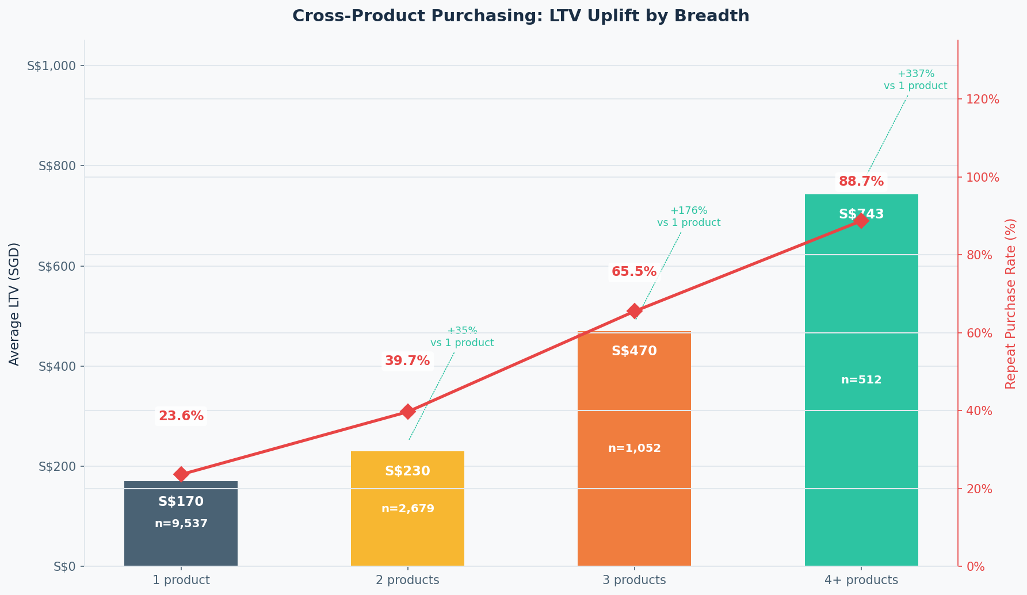
The cross-sell opportunity
Moving a customer from 1 to 3 product categories:
Raises repeat rate from 23.6% → 65.5% (+178%)
Raises avg LTV from S$170 → S$470 (+176%)
Notes:
So far we've talked about when customers come back.
Now I want to talk about how broadly they buy - because the number of product categories a customer engages with is one of the strongest predictors of loyalty in our data.
One category: 23.6% repeat rate, S$170 LTV. Two categories: 39.7% repeat. Three: 65.5% repeat, S$470 LTV. Four or more: 89% repeat, S$743 LTV. Moving a customer from one category to three roughly triples both repeat rate and LTV.
This points to two levers - cross-sell and a product recommender. Single-category customers are our highest-churn segment, and broadening their basket is where the LTV math points. We'd recommend prioritizing this as a workstream and running a controlled test to confirm the lift.

Slide 10
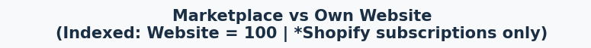
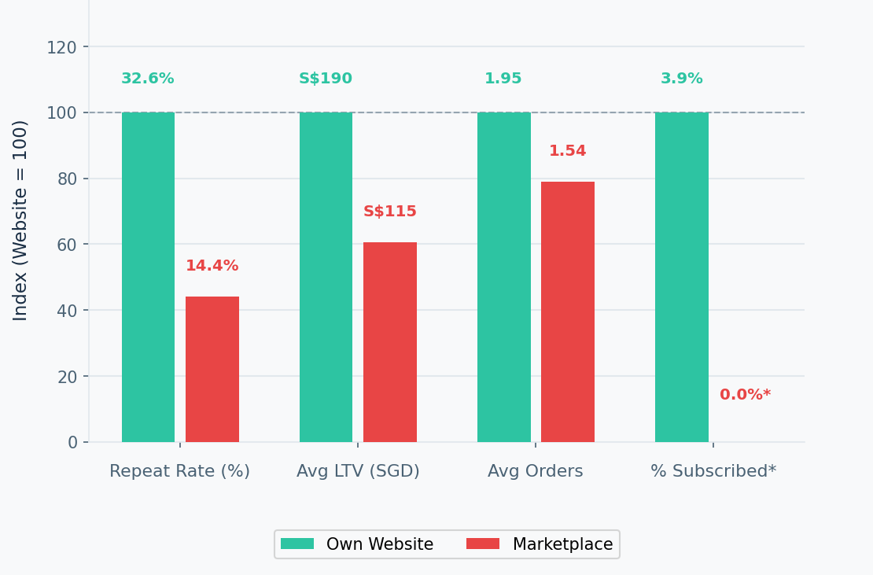
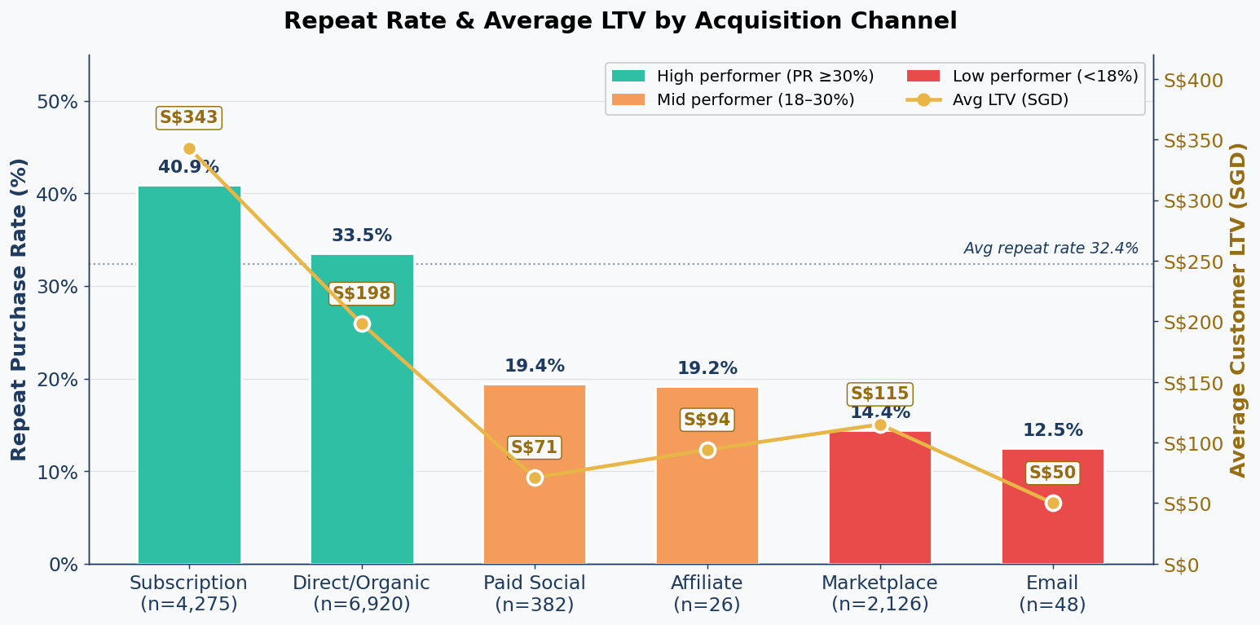
Not all customers are equal
S$83
Total Addressable LTV gap: S$176,458
We have healthy customer groups – Subscription and Direct/Organic.
Customers via Marketplace take 15% out of total customers, but they underperform on every metric we can measure.
Direct/Organic vs Marketplace: repeat rate(x2.3 gap), Avg LTV(x1.7 gap), Avg Orders(x1.3 gap), 0 subscriptions via Marketplace*
*Due to the nature of platform, we cannot track the subscription rate
Notes:
We've been treating our customer base as one business. The data says it's not — channel quality varies wildly, and one channel is dragging the whole average down.
Subscription and Direct/Organic are our healthy customer groups - 40.9% and 33.5% repeat rates, both above our 32.4% average. Below the line: Paid Social, Affiliate, Email, and Marketplace. Unfortunately, Marketplace is the biggest of those underperformers as they have 15% of our customer base, 14.4% repeat rate, S$115 LTV against S$198 on our own website.
But here's what makes it strategic: marketplace customers are locked out of subscription — 0% subscribed, because the platform doesn't support it. So we're paying marketplace fees to acquire customers who are structurally weaker and cannot access our highest-LTV behavior. Total addressable LTV gap: S$176,000.
Our channel recommendation is a three-step shift.
One: cap paid promotion spend on Shopee and Lazada. Keep listings live, but stop spending acquisition budget on a S$115-LTV channel when our website produces S$198 - a 72% gap per dollar.
Two: redirect that budget to brand-keyword retargeting - intercept high-intent searchers on Google and Meta before they return to the marketplace.
Three: keep one or two hero SKUs exclusive to our own website. Make the full range a reason to come to us directly. We'd pilot with a single SKU first to confirm migration before scaling.

Slide 11
Next Steps
Opportunity
Action Plan
Potential Business Value
Marketing
Reduce structural discounting
Rebuild full-price demand
Effective discounting strategy
KSGD 528
Customer retention
Post-purchase email flow (Day 7/30/45)
Win-back campaign at Day 55 before cliff
60% repeat 2nd purchase in 60 days
KSGD 219
Cross-sell
Sole-buyers to cross-cat buyers
KSGD 200
Cross-sell strategy
Product recommender
Channel
Redirect budget to brand-keyword retargeting
Cap paid promotion spend on Marketplace
Marketplace strangers to loyal subscribers
KSGD 176
Notes:
Discounting strategy: In 2025, assuming revenue per order recovered partially to $150, net revenue in 2025 would increase by S$528K (>50%)

Slide 12
Thank you
Questions?

