Slide 1


DXR CLV Progress Report
DXR CLV Team Sep 2024

Slide 2

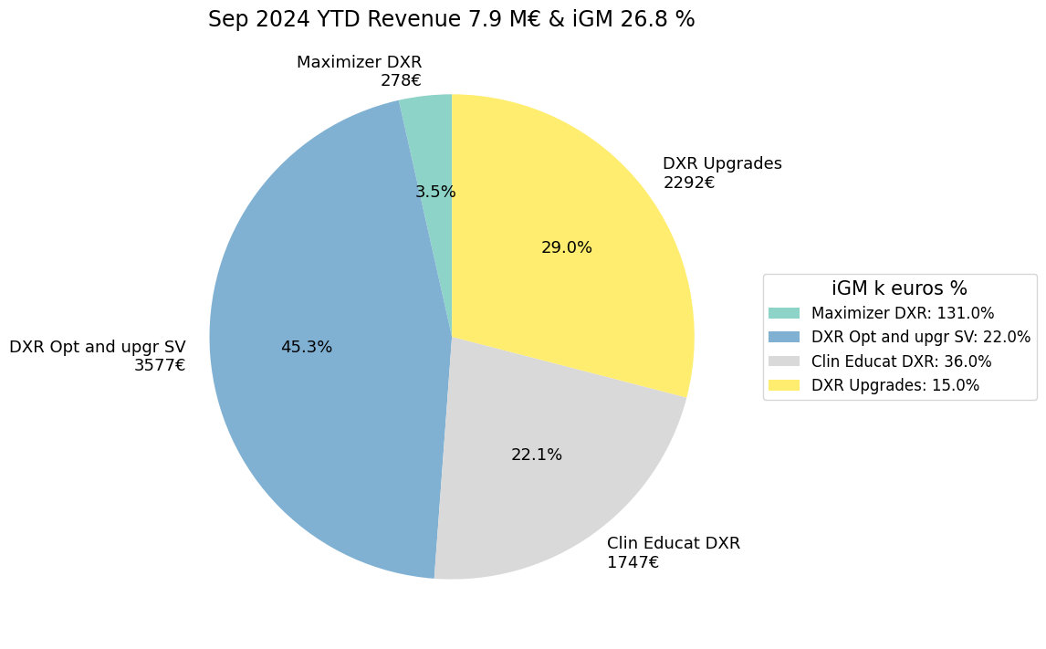
DXR CLV Business Updates & Plan for 2024
DXR CLV sales -> strong YoY growth ~ 18% over last 3 years.
Year | AOP | Actual | AOP Growth | Actual Growth Vs LY | Growth Vs AOP | iGM AOP (%) | iGM Actual (%)
2020 | 7,054 |  |  | 4% | 6%
2021 | 6,904 | 7,348 |  |  | 6% | 56% | 31%
2022 | 8,629 | 10,001 | 25% | 36% | 16% | 56% | 31%
2023 | 10,234 | 11,194 | 19% | 12% | 9% | 56% | 31%
2024 | 11,923 |  | 17% |  |  | 28% | 26.8%
Releasing DiDi 2, 3 & ED5 Win 10 by Q1 2025
Released this month CLV tool CLUE (AI based) for DXR along with other modalities
Released 3D Camera & Auto Collimation Upgrade in Q2 2024
Releasing Comfort Track to Comfort Position by Q3 2024
CLV Roadmap for next 3 years, need QXP from regions

Slide 3
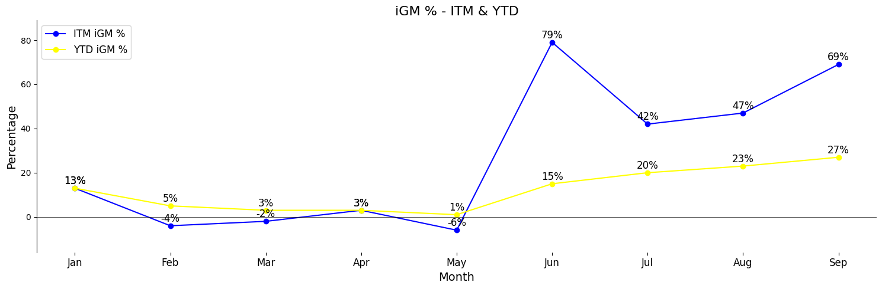
CLV iGM % - ITM & YTD (AOP, 24 CLV iGM : 27%, Actual YTD : 27%)
Significant iGM Improvement in last 2 months from YTD 20% to 27%
CLV YTD iGM was negative till May . After June started improving (AOP Target 27%)
Still NAR, YTD iGM @ 9%, need support from NAR to deep dive on reasons for lower CLV iGM%

Slide 4
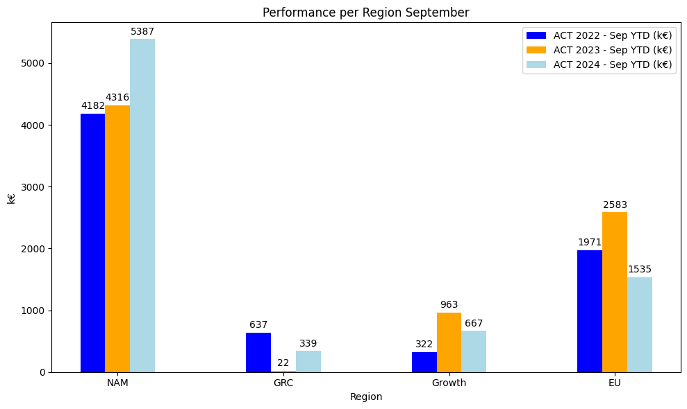
Performance per Region Sep YTD
68 % of YTD CLV sales is from NAR, however iGM% is still a concern
NAR iGM Increased from -14% May YTD to 17% Sep YTD
Region | Market | ACT 2022 - Sep YTD | ACT 2023 - Sep YTD | ACT 2024 - Sep YTD (k€)
NAR | NAM | 4182 | 4316 | 5387
GRC | GRC | 637 | 22 | 339
Growth | APA | 175 | 242 | 286
EU | CEE | 37 | 41 | 41
Growth | RCA | 0 | 13 | 0
EU | BNL | 511 | 233 | 178
EU | DAC | 708 | 805 | 604
EU | FRA | 146 | 224 | 258
EU | IBE | 21 | 11 | 46
EU | IIG | 69 | 728 | 153
EU | NOR | 254 | 188 | 39
EU | UKI | 225 | 353 | 216
Growth | ISC | 0 | 222 | 0
Growth | JPN | 82 | 123 | 22
Growth | LAT | -7 | 206 | 186
Growth | META | 72 | 157 | 173
Total | Total | 7112 | 7884 | 7928

Slide 5
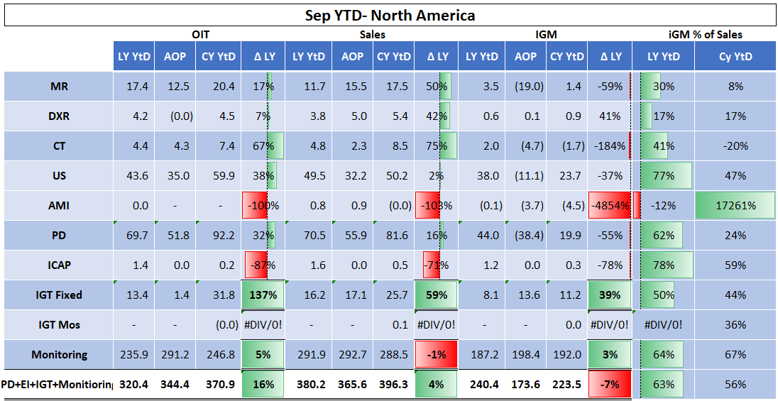
CLV Sep 2024 YTD- North America
All DI modalities facing headwind @ NAR for CLV iGM%

Slide 6
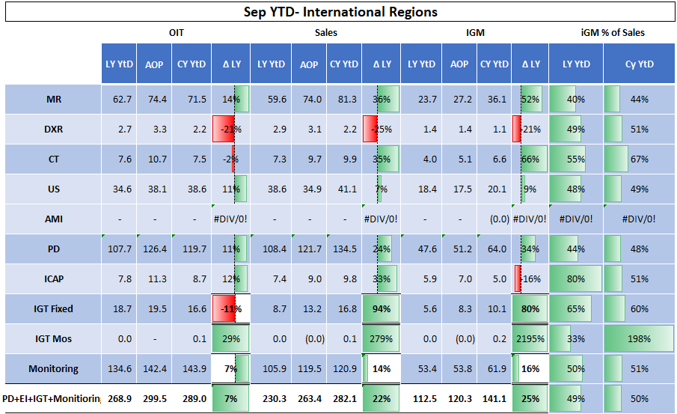
CLV Sep 2024 YTD- International Markets
Only DXR Sales performance is poor in International Markets Vs other modalities

Slide 7
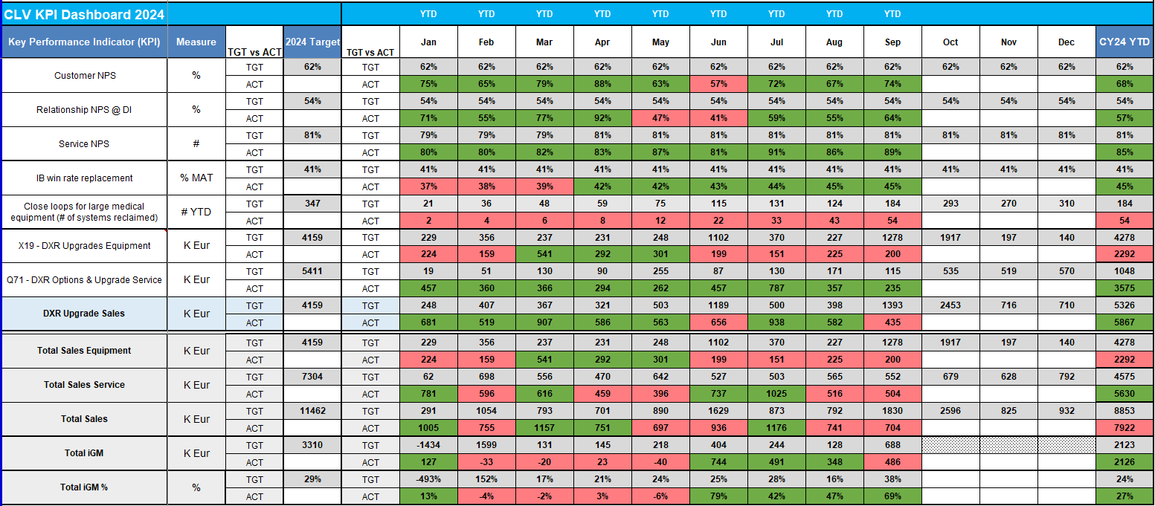
CLV Performance Dashboard 2024 - Sep YTD
Total September YTD Sales exceeding AOP by 4%, Customer NPS back to Green, Growing IB Win Rate

Slide 8
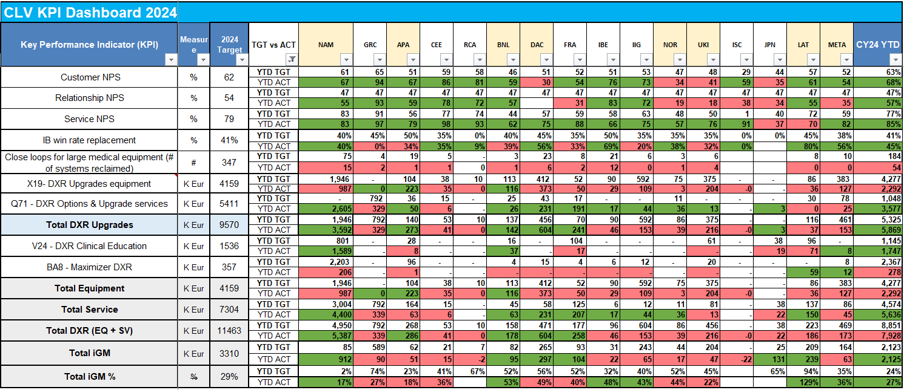
CLV Market Performance Dashboard 2024 - Sep YTD
70 % of YTD CLV sales is from NAR

