Slide 1


DXR CLV Progress Report
DXR CLV Team Aug 2024

Slide 2

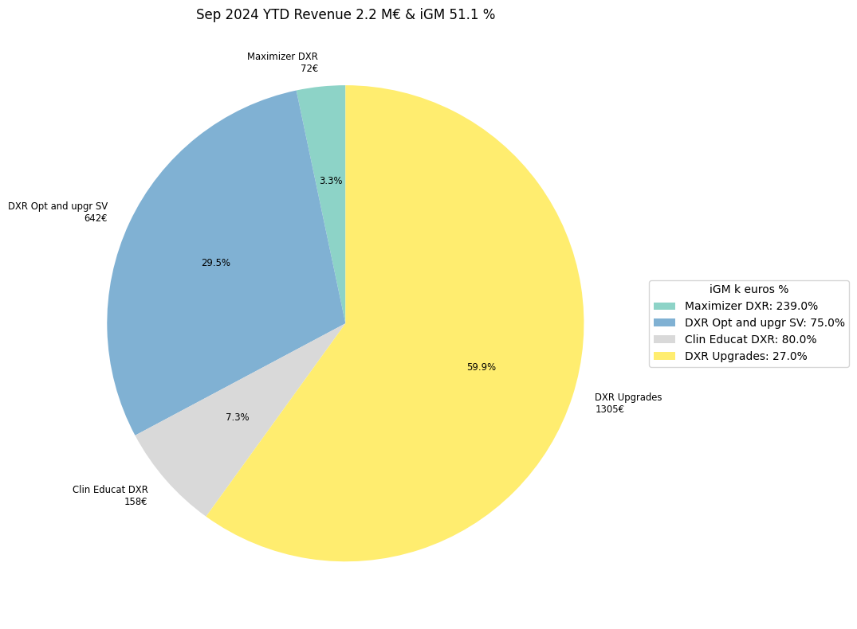
DXR CLV Business Updates & Plan for 2024
DXR CLV sales -> strong YoY growth ~ 18% over last 3 years.
Year | AOP | Actual | AOP Growth | Actual Growth Vs LY | Growth Vs AOP | iGM AOP (%) | iGM Actual (%)
2020 | 7,054 |  |  | 4% | 6%
2021 | 6,904 | 7,348 |  |  | 6% | 56% | 31%
2022 | 8,629 | 10,001 | 25% | 36% | 16% | 56% | 31%
2023 | 10,234 | 11,194 | 19% | 12% | 9% | 56% | 31%
2024 | 11,923 |  | 17% |  |  | 28% | 51.1%
Releasing DiDi 2, 3 & ED5 Win 10 by Q1 2025
Released this month CLV tool CLUE (AI based) for DXR along with other modalities
Released 3D Camera & Auto Collimation Upgrade in Q2 2024
Releasing Comfort Track to Comfort Position by Q3 2024
CLV Roadmap for next 3 years, need QXP from regions

Slide 3
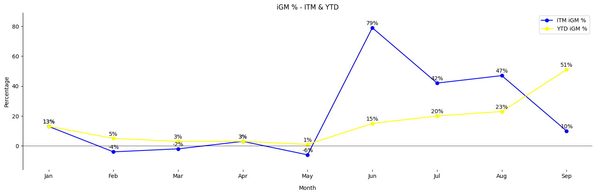
CLV iGM % - ITM & YTD (AOP, 24 CLV iGM : 28%, Actual YTD : 51%)
Significant iGM Improvement in last 2 months from YTD 20% to 51%
CLV YTD iGM was negative till May . After June started improving (AOP Target 28%)
Still NAR, YTD iGM @ 9%, need support from NAR to deep dive on reasons for lower CLV iGM%

Slide 4
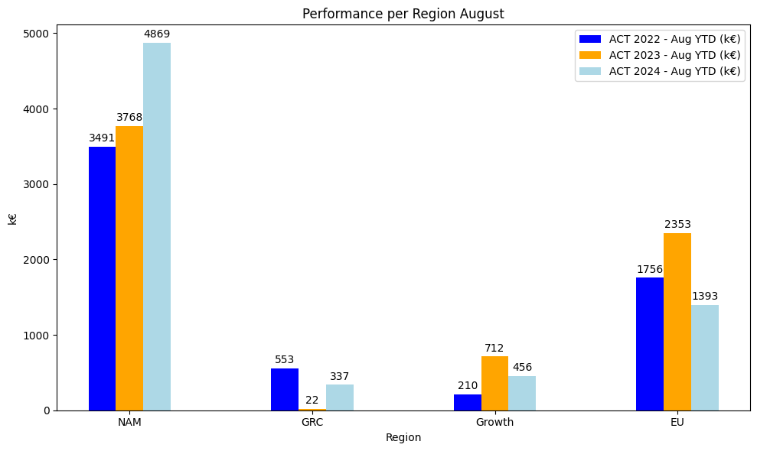
Performance per Region Aug YTD
70 % of YTD CLV sales is from NAR, however iGM% is still a concern
NAR iGM Increased from -14% May YTD to 9% Jul YTD
Region | Market | ACT 2022 - Aug YTD | ACT 2023 - Aug YTD | ACT 2024 - Aug YTD (k€)
NAR | NAM | 3491 | 3768 | 4869
GRC | GRC | 553 | 22 | 337
Growth | APA | 165 | 202 | 270
EU | CEE | 31 | 41 | 40
Growth | RCA | 0 | 13 | 0
EU | BNL | 480 | 217 | 168
EU | DAC | 608 | 669 | 537
EU | FRA | 126 | 177 | 242
EU | IBE | 17 | 11 | 37
EU | IIG | 59 | 708 | 146
EU | NOR | 218 | 182 | 35
EU | UKI | 217 | 348 | 188
Growth | ISC | 0 | 222 | 0
Growth | JPN | 70 | 113 | 16
Growth | LAT | -25 | 162 | 170
nan | META | 89 | 83 | 167
Total | Total | 6099 | 6938 | 7222

Slide 5
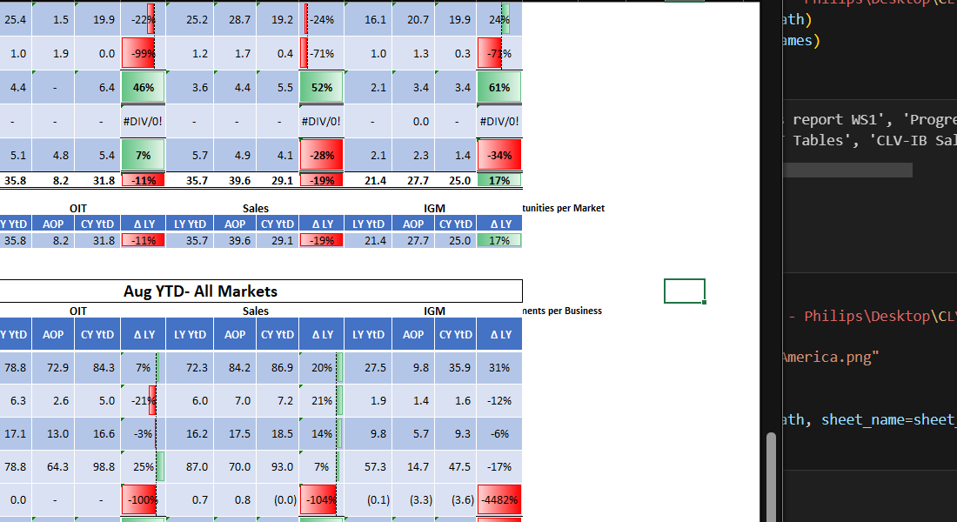
CLV Jul 2024 YTD- North America
All DI modalities facing headwind @ NAR for CLV iGM%

Slide 6
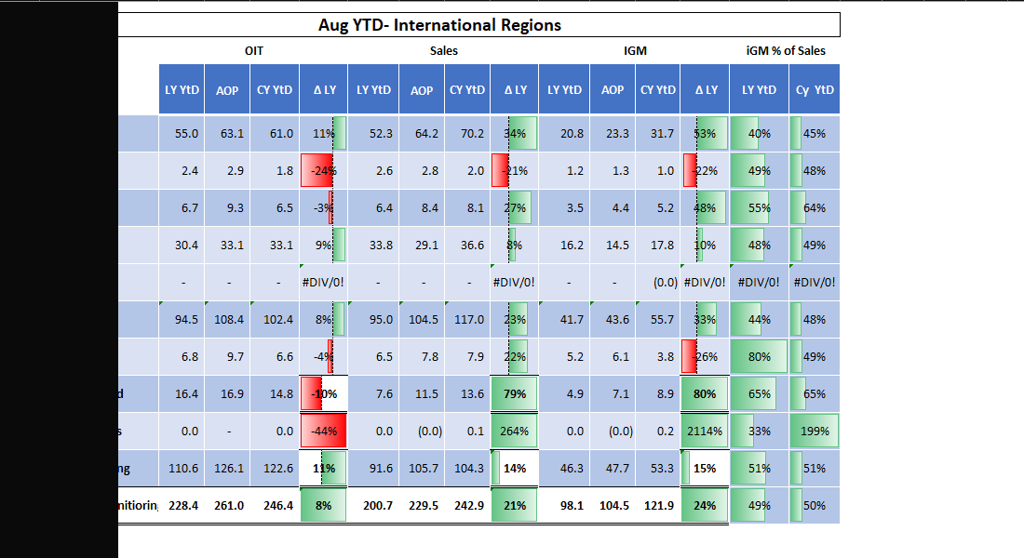
CLV Aug 2024 YTD- International Markets
Only DXR Sales performance is poor in International Markets Vs other modalities

Slide 7
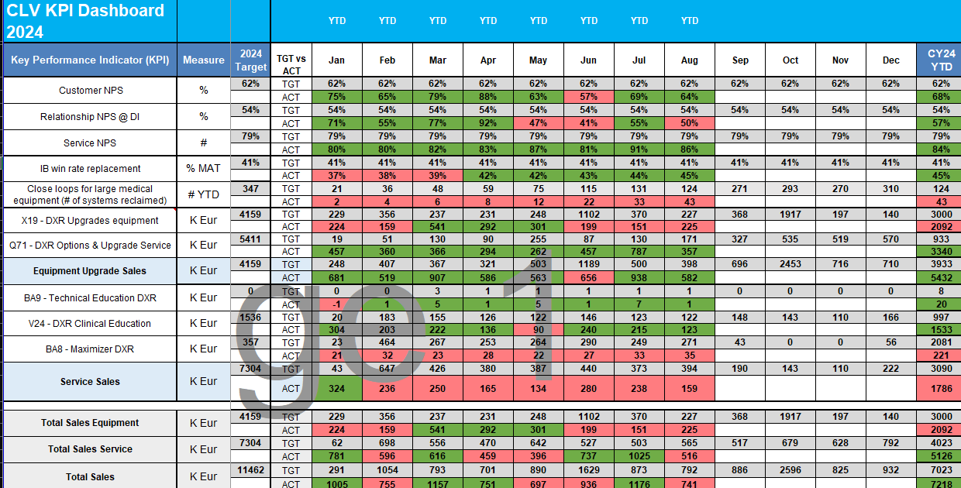
CLV Performance Dashboard 2024 - Aug YTD
Total August YTD Sales exceeding AOP by 4%, Customer NPS back to Green, Growing IB Win Rate

Slide 8
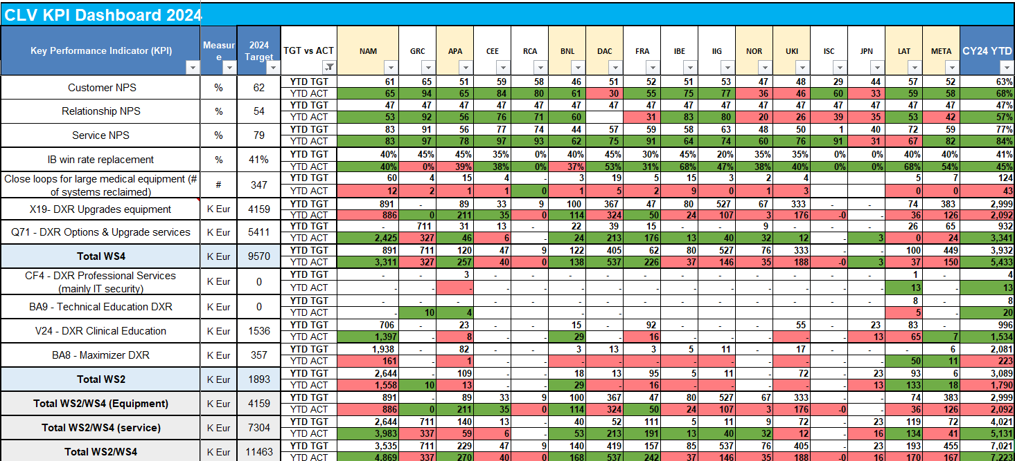
CLV Market Performance Dashboard 2024 - Aug YTD
70 % of YTD CLV sales is from NAR

